Slide 1
Universities as Impact Investors: Strategies, Allies, Choices
Edward T. Jackson, Carleton University
Meeting on Investing in Change for a Better Tomorrow, Responsible Investment Committee, University of Toronto, Hart House, January 15, 2013

Slide 2
Investments intended to create positive impact beyond financial return
Provide capital
Transactions currently tend to be private debt or equity investments
We expect more publicly traded investment opportunities will emerge as the market matures
Expect financial returns
The investment should be expected to return at least nominal principal
Donations are excluded
Market-rate or market-beating returns are within scope
Businesses designed with intent
The business (fund manager of company) into which the investment is made should be designed with intent to make a positive impact
This differentiates impact investments from investments that have unintentional positive social or environmental consequences
… to generate positive social and/or environmental benefit
Positive social and/or environmental impact should be part of the stated business strategy and should be measured as part of the success of the investment
Source: JP Morgan, Rockefeller Foundation and GIIN, 2010

Slide 3
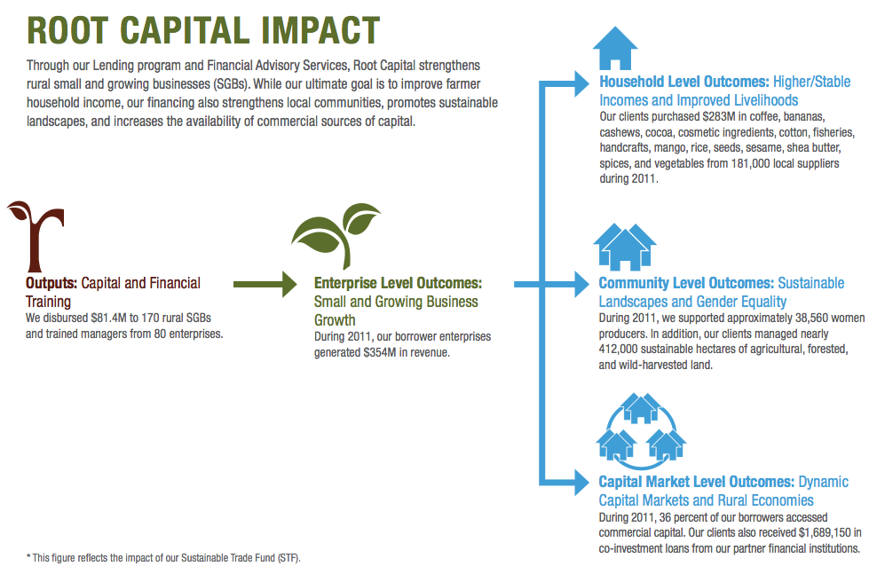
Source: Root Capital, 2011

Slide 4
Impact Investing: Mapping Returns
Source: adapted from Monitor Institute 2009, via Rockefeller Foundation , 2011
High
i
Traditional
Investments
Financial
First
Market
Related
Impact
Investments
Impact
First
SRI
(“Do No Harm”)
Financial
Returns
Low Impact
and
Low Financial Returns
Philanthropy
Subsidized Investments
Below
Market
Grants
Low
High
Social Returns

Slide 5
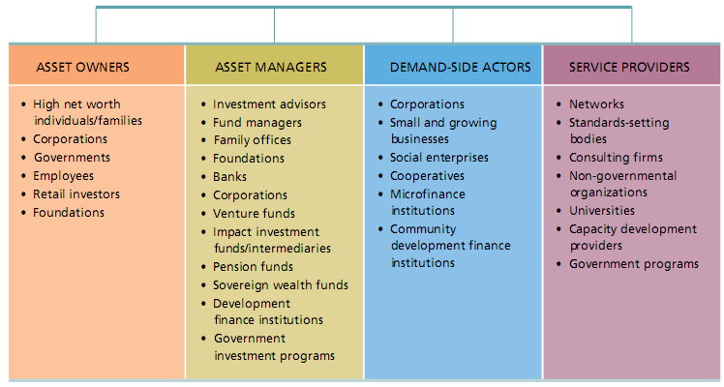
Actors in the Impact Investing Industry

Slide 6
Accelerating Impact: Achievements, Challenges and What’s Next in Building the Impact Investing Industry
http://www.rockefellerfoundation.org/news/publications/accelerating-impact-achievements

Slide 7
Universities as Impact Investors: Why?
Income inequality is growing
Poverty, homelessness, unemployment are “wicked” problems that require the efforts of all institutions
Enterprises and facilities for marginalized groups are undercapitalized
Universities should contribute to the regions in which they are based
Strengthens the case for public funding of PSE

Slide 8
Universities as Impact Investors: How?
Creating mechanisms and partnerships that help to:
Mobilize capital to scale social enterprises (eg. renovation, maintenance, food, courier, printing)
Mobilize capital to expand social infrastructure (affordable housing, women’s shelters, hospices, seniors’ facilities, day care centres, non-profit offices)

Slide 9
Strategies
Operating funds: to investments in individual projects enterprise or real estate
Operating funds: through a joint investment vehicle (eg. targeted investment fund or syndication) in enterprise or real estate
Pension funds: through joint or syndicated instruments (eg. model of Concert Properties) in real estate
Endowment funds: through program-related loans or guarantees in real estate

Slide 10
Allies
Other impact investors (eg. RBC, T-D, MARS II Centre, Social Capital Partners, Alterna Credit Union)
Canada Mortgage and Housing Corporation
Other federal agencies: Business Development Bank of Canada, FedDev Ontario
Provincial agencies: Employment Ontario, Jobs Fund, etc.
Municipal agencies: Toronto Community Housing, others
Foundations: Ontario Trillium Foundation, Toronto Community Foundation

Slide 11
Choices
Informed by its broader institutional strategy, intention must drive the decision of a university to become an impact investor. Trade-offs must be made, regulations respected and risks managed. But it is possible. And the benefits not only to the community, but to the university itself, will be very significant.

Slide 12
Learn More
Global Impact investing Network thegiin.org
MaRS Centre for Impact Investing impactinvesting.marsdd.com
Purpose Capital purposecap.com

Slide 13
Contact Information
Edward Jackson
Carleton University
Edward_jackson@carleton.ca

