Slide 1
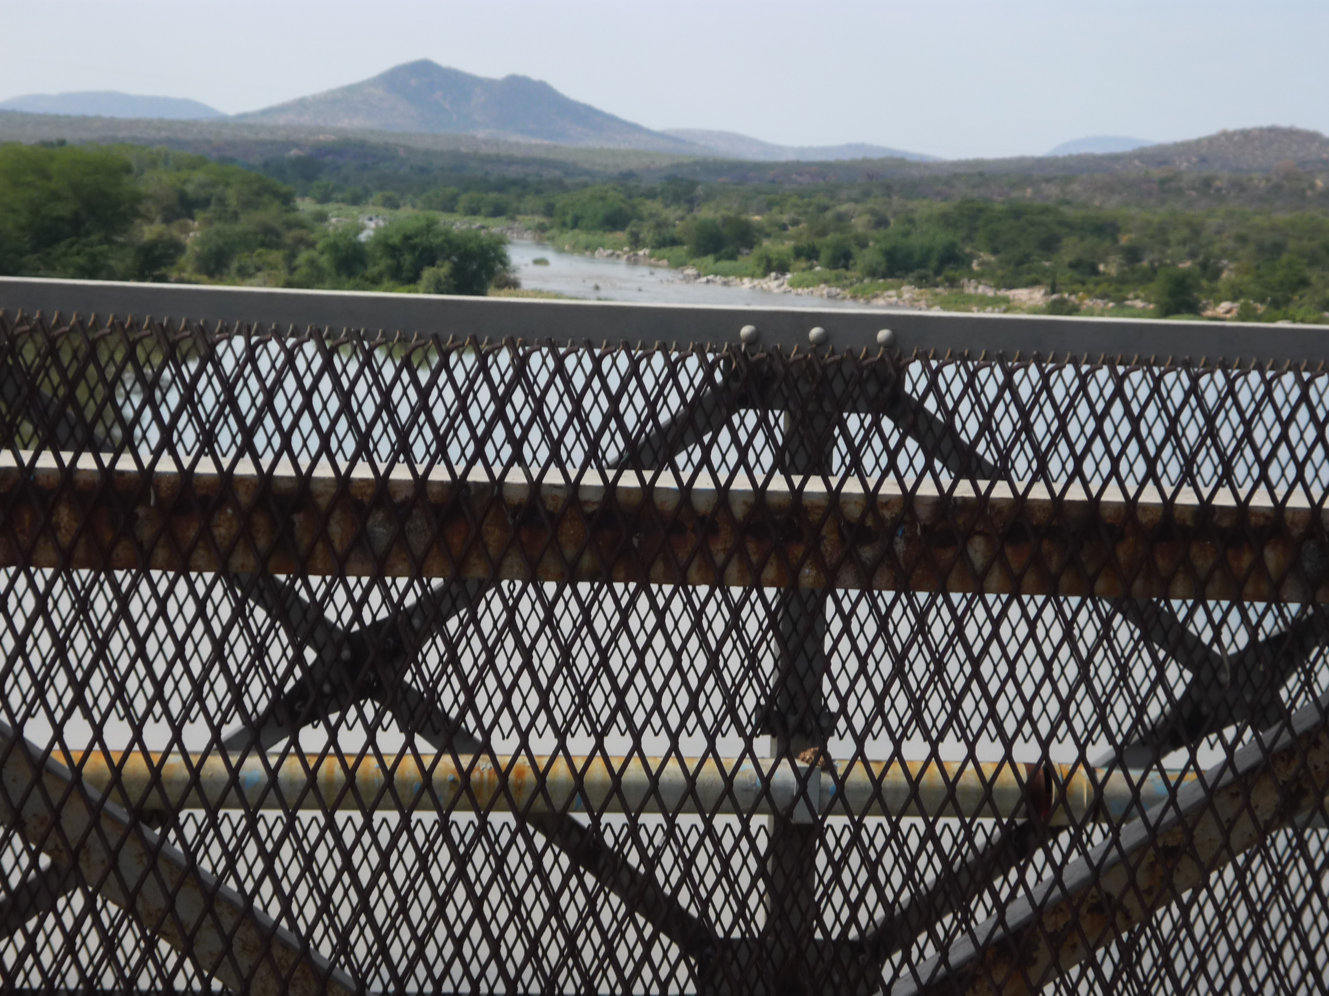
AFRI 3100/5100
African Studies Abroad:
Migration Lives and Livelihoods in
SOUTH AFRICA
Blair Rutherford,
Sociology/Anthropology & African Studies

Slide 2
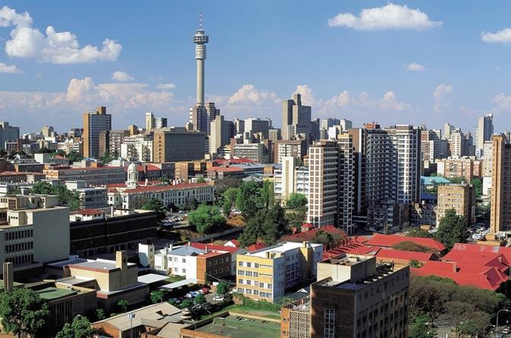
Outline
South Africa – context
Preliminary course outline
Course requirements
Logistics and Budget
Application Process
Past experience
Questions

Slide 3

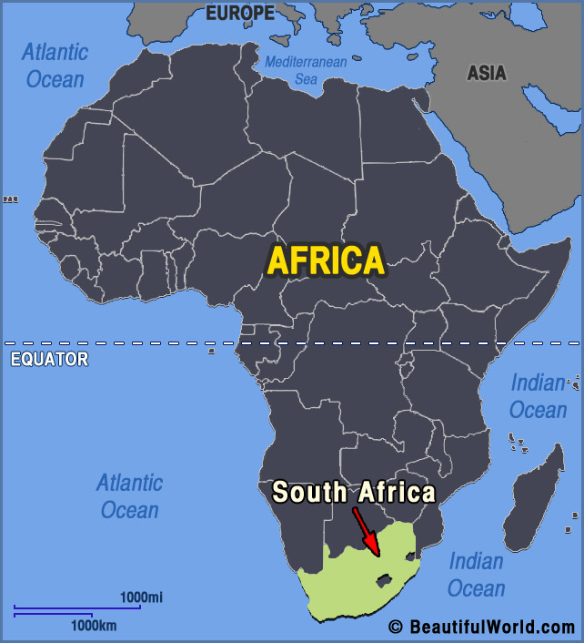
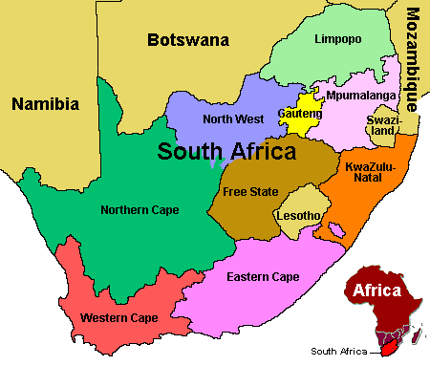
South Africa - Context

Slide 4
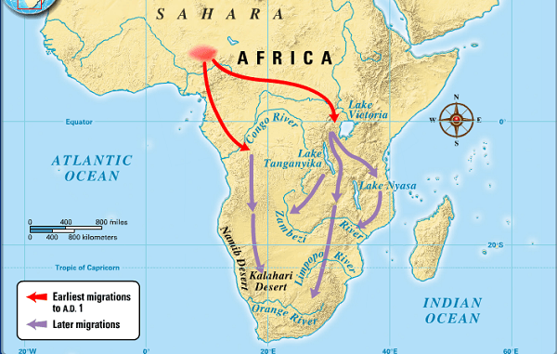
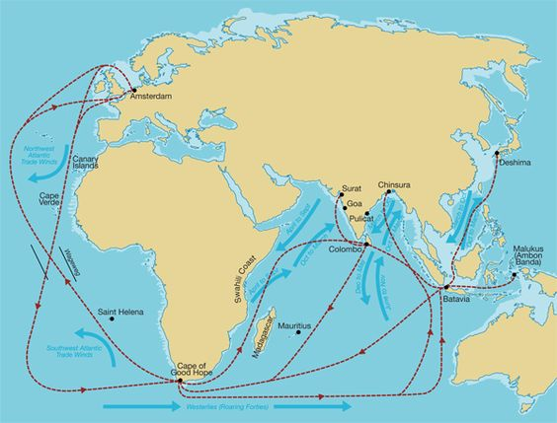
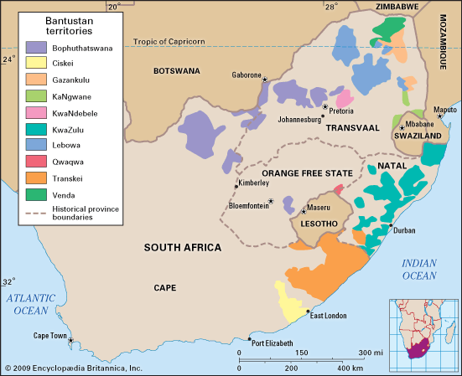
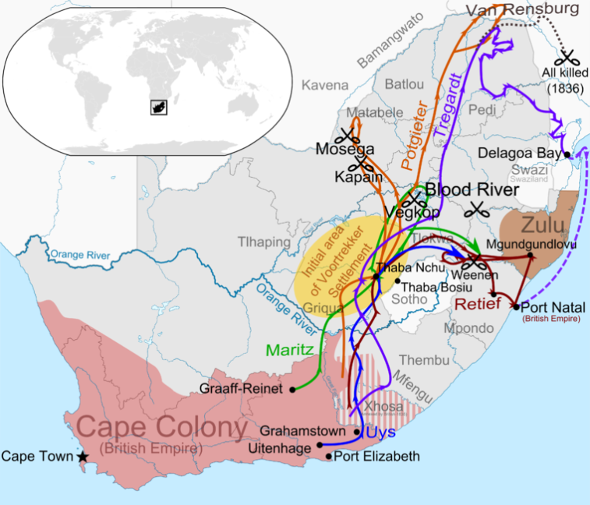
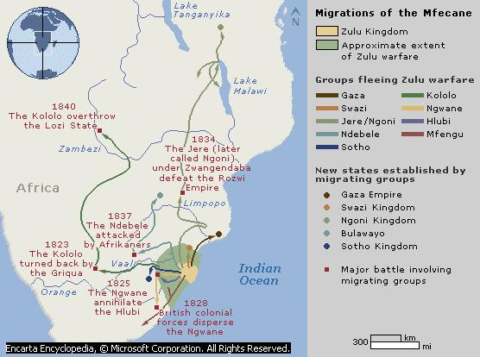
Migrations: histories, ethnogenisis, politics

Slide 5
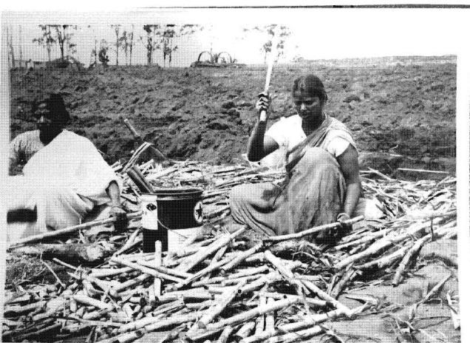
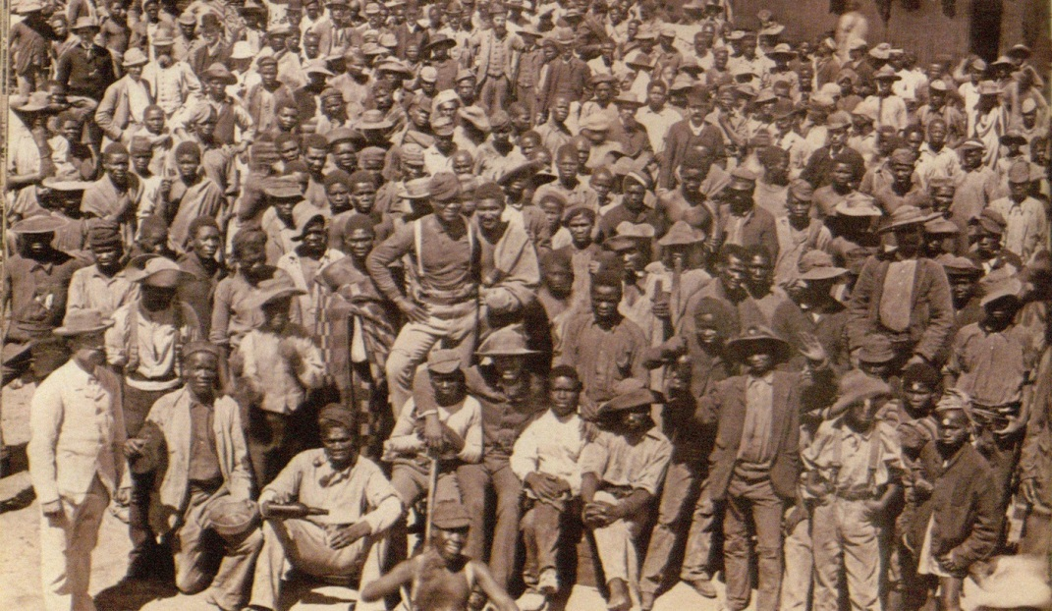
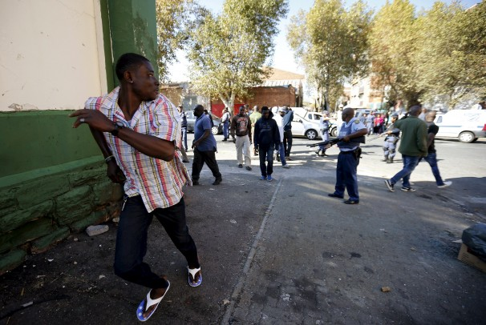
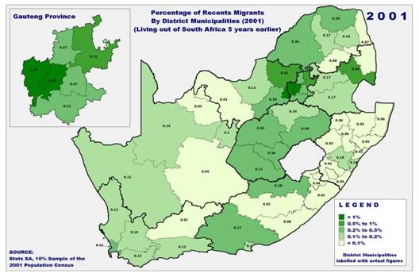


Slide 6
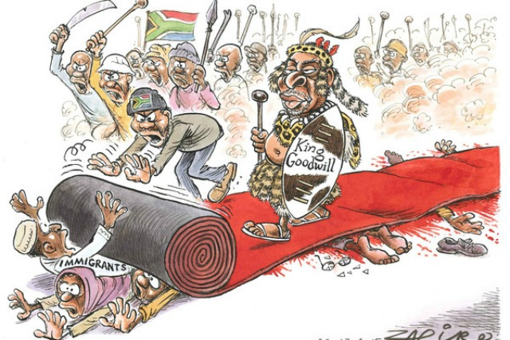


Slide 7
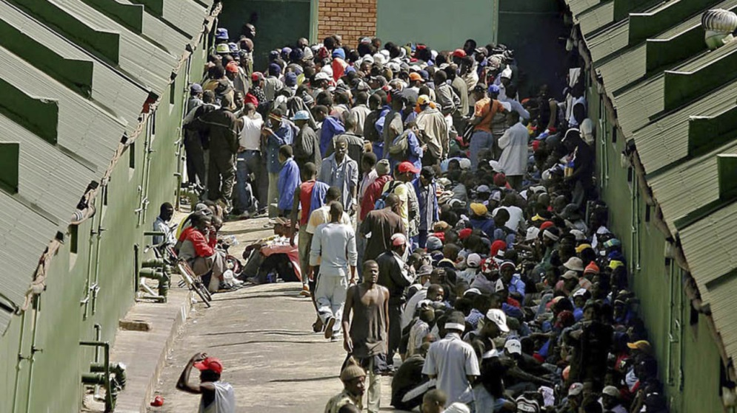

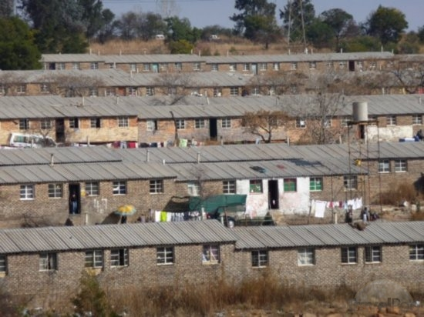
Course Outline – Key Themes
Gendered migration histories of the gold mines
Migrant livelihoods
Politics of belonging
Diasporas & the “rainbow
nation”
Immigration and refugee policies and laws

Slide 8
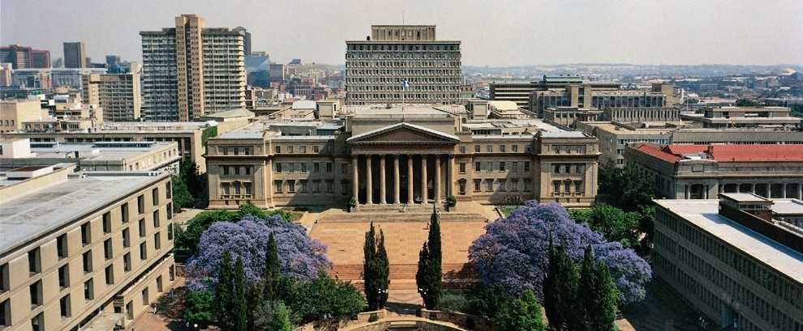
Course components
Course readings will be available on cuLearn
Coordinated with the African Centre for Migration & Society, University of the Witwatersrand, and
its
MA
class
Assignments will be a mixture of reflection pieces
and group assignment with Wits students
AFRI 5100 requirements are different than 3100’s

Slide 9
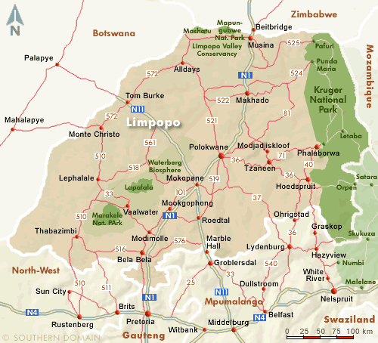
Experiential Learning
Guest lectures by South African (-based) scholars, policy-makers, activists, artists, NGO officials, and community-based representatives
Site visits/tours of important current and historical areas of migration &
& migrants (workplaces,
neighbourhoods, meeting
centres, borders, etc.)
Planned trips to
Bushbuckridge and
Musina near Mozambique
and Zimbabwe
Possible placement course

Slide 10
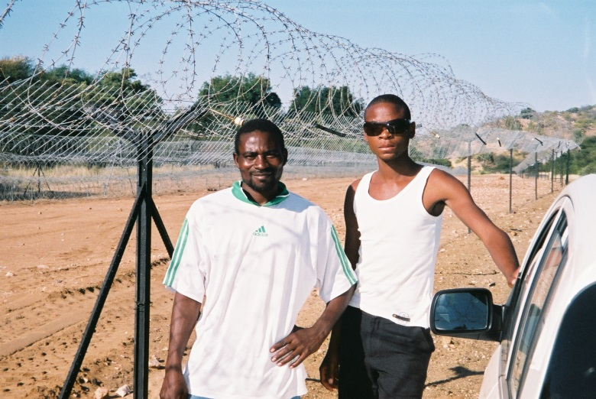
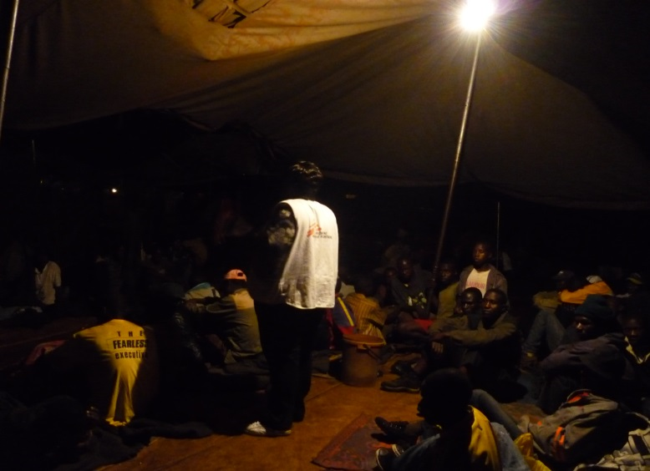
Logistics & Budget
Course dates: Monday May 8th to Friday May 26th
Aim to arrive no later than May 7th and depart any time from May 27th – students arrange own flights
Normally, lecture/visit in am,
free pm & weekends
Weather should be dry & sunny:
cool-temperate in Jo’burg
(10-23⁰ C. day,
3-11⁰ C. at night) and warmer
in the north
Safety concerns

Slide 11
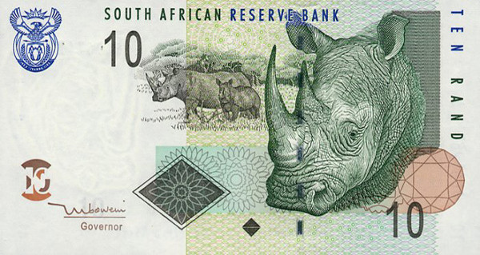


Budget ideas
Carleton will cover in-country ground transport and most/all accommodation for Carleton students;
shared rooms: near Wits; Wits rural facility in Bushbuckridge; lodge in/near Musina
Students responsible for (estimated figures):
-air travel ($1100-1800)
-tuition ($700)
-food ($25/day)
-vaccination (depends)
-no visa fee for Canadian citizens
-Park fee in, e.g., Mapungubwe ($20)
ATMs are widely available (but bank fees)

Slide 12

Application Process
Application form available on IAS site - http://carleton.ca/africanstudies/ias-study-abroad-course/
Minimum of 3rd Year standing or permission of instructor
Application deadline: 31 October 2016

Slide 13

Past Experience
Aileen Fry, Malawi, May 2016

Slide 14
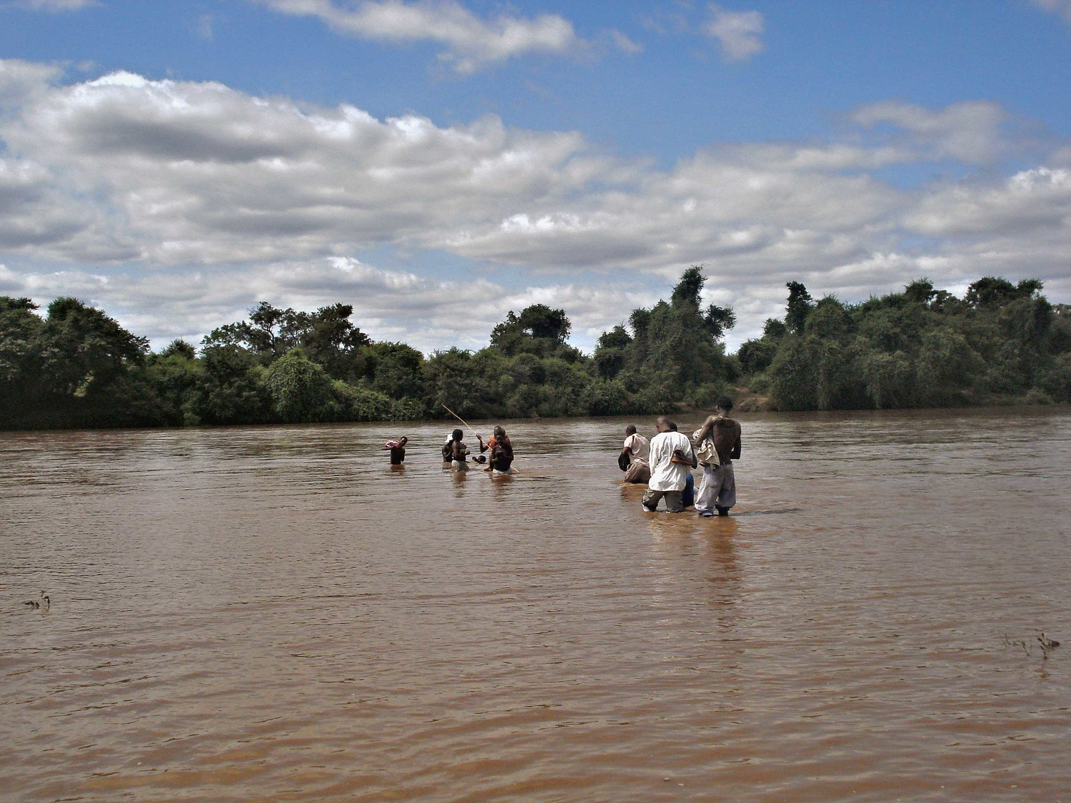
Thank you
Ngiyabonga
Ndi a livhuha
Ke a leboga
Enkosi
Dankie
Ngiyathokoza
Ke a leboha
Ndza khensa
Tatenda
Mahadsanid
Asante

