Slide 1
The Global Refugee Crisis: Responses From the EU and Canada
Krystyna Wojnarowicz
MA Candidate, Political Science
Dec. 3rd 2015

Slide 2
Today’s Plan
Types of Migrants
Contextualize the crisis
International Norms
EU Law
Refugee Crisis
Member State Differences
Canada’s Response and Responsibility Sharing

Slide 3
Types of Migrants
Migrant
Economic Migrant
Refugee (Convention or Mandate)
“someone who is unable or unwilling to return to their country of origin owing to well-founded fear of being persecuted for reasons of race, religion, nationality, membership of a particular social group, or political opinion (UNHCR)
Asylum Seeker
Internally Displaced Person (IDP)
Stateless Person
Notes:
A Convention refugee is “someone who is unable or unwilling to return to their country of origin owing to well-founded fear od being persecutied for reasons of race, religions, nationality, membership of a particular social group, or political opinion.
A Convention Refugee is given status by a state-Europe and North America-usually given permanent residence or subsidiary protection that has to be renewed every couple of years.
A Mandate Refugee is given status by the UNHCR-usually have to stay in a refugee camp, denied certain rights to work etc.
Stateless Person does is not considered the citizen of any state -no citizenship-Palestinians or or those who were never registered.
The definition of refugees was intended to exclude internally displaced persons, economic migrants, victims of natural disasters, or persons fleeing violent conflict but not subject to discriminatory persecution.1

Slide 4
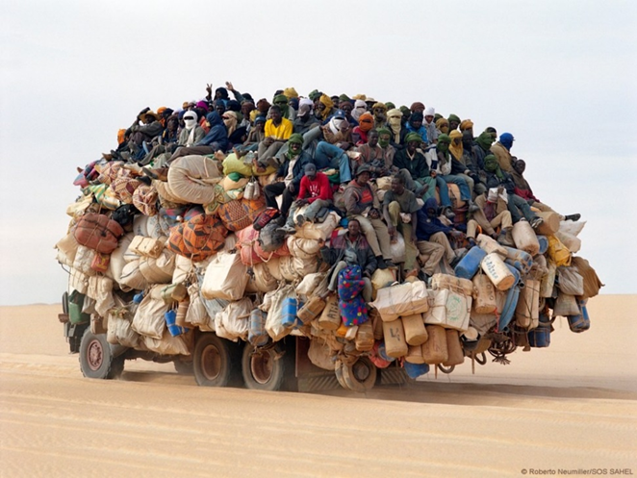
Displacement Worldwide
2014: 59.5 million persons of concern
Including refugees, internally displaced persons (IDPs),
stateless, and those in “refugee like” situations.
19.5 million refugees
14.1 million under UNHCR’s mandate
5.1 million Palestinian refugees-UNRWA
38.2 million IDPS
1.8 million asylum seekers
Notes:
Source: http://www.unhcr.org/556725e69.html

Slide 5
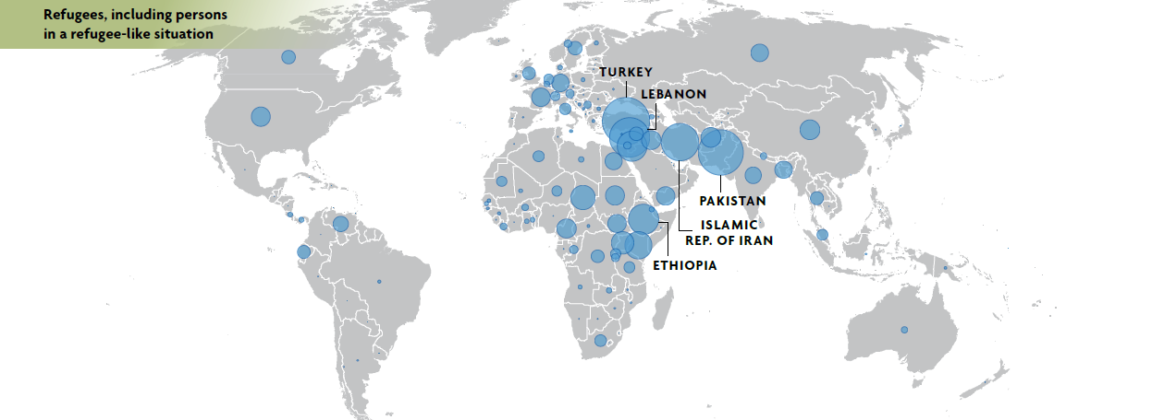
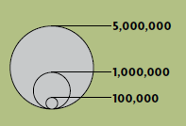
Notes:
May 2015
Emergency Situations
Mali
IDPs in Mali: 128, 866
Refugees from Mali: 147, 685
Democratic Republic of Congo (DRC)
IDPs in DRC: 2, 611, 558
Refugees from DRC: 493, 500
Central African Republic (CAR)
IDPs in CAR: 437, 395
Refugees from CAR: 424, 707
South Sudan
IDPs in South Sudan: 1, 440, 000
Refugees from South Sudan: 622, 133

Slide 6
1951 Refugee Convention (Geneva Convention)
First comprehensive international instrument on refugees
It contains the universal definition of refugee and the principle of non-refoulement
It lists rights and obligations :
It requires States to co-operate with UNHCR
Suspension of penalties for illegal entry
Minimum standard of treatment, e.g. education, PHC
Facilitation of access to legal counsel
Notes:
After WW2
1951 Refugee Convention:
Prepared between 1947 and 1950
Major achievement in international refugee law since it:
defined “refugee”
Embodied the principle of non-refoulement-'no Contracting State shall expel or return (refouler) a refugee in any manner whatsoever to the frontiers of territories where his life or freedom would be threatened on account of his race, religion, nationality, membership of a particular social group or political opinion.
Set the minimum standard of treatment for refugees
Provided for juridical status, gainful employment and welfare
Provided for identity and travel documents, naturalization, etc.

Slide 7
1967 Protocol to the Refugee Convention
Addressed two limitation to the Convention:
1951 dateline, which limited the benefits of the Convention to persons who became refugees prior to 1 January 1951
Geographical limitation, to the Continent of Europe

Slide 8
Who is responsible for the protection of refugees?
Primarily it is the responsibility of States to provide national protection and to conduct eligibility procedures.
When States do not meet this responsibility, the Statute of UNHCR contains mechanisms for ensuring protection of refugees.
“The United Nations High Commissioner for Refugees, acting under the authority of the General Assembly, shall assume the function of providing international protection, under the auspices of the United Nations, to refugees who fall within the scope of the present Statute and of seeking permanent solutions for the problem of refugees by assisting governments and, subject to the approval of the governments concerned, private organizations to facilitate the voluntary repatriation of such refugees, or their assimilation within new national communities.” Chapter 1, General Provisions
Notes:
Chapter 1 General Provisions:
The United Nations High Commissioner for Refugees, acting under the authority of the General Assembly, shall assume the function of providing international protection, under the auspices of the United Nations, to refugees who fall within the scope of the present Statute and of seeking permanent solutions for the problem of refugees by assisting governments and, subject to the approval of the governments concerned, private organizations to facilitate the voluntary repatriation of such refugees, or their assimilation within new national communities.
http://www.unhcr.org/cgi-bin/texis/vtx/search?page=search&docid=3ae69ee64&query=UNHCR%20Statute

Slide 9
Common European Asylum System (CEAS)
Developed in 1999 to harmonize common minimum standards for asylum and reception.
Asylum Procedures Directive
Reception Conditions Directive
Qualification Directive
EURODAC
European Refugee Fund
Notes:
-Implementation of Directives is a slow and incomplete endeavour. Directives are something that MS must achieve a result without dictating the means of achieving that result.
Receptuon: Minimum standards of reception (housing, food, pocket money or vouchers) There are a lot of contradicitons within is, Article 7 states that Asylum seekers shall have freedom of movement within the territory of the host MS for Article 7b states that MS can decide on the residence of the applicant for reasons of public interest.
Article 8 states that detention should be used as a last resort, but most asylum-seekers in Italy are in these quasi detention centrs.
EURODAC and sharing of biometrics (fingerprints and photographs) will allow law enforcement access to the EU database of the fingerprints of asylum seekers under strictly limited circumstances in order to prevent, detect or investigate the most serious crimes, such as murder, and terrorism.
Africa: The OAU Convention Governing the Specific Aspects of Refugee Problems in Africa, adopted in 1969 Latin America: Cartagena Declaration 1984

Slide 10
Schengen Area
Established 1995
Designed to help facilitates free travel of EU citizens (accompanies Eurozone and free trade of goods, services and capital)
Privilege not for refugees and migrants
Notes:
Established in

Slide 11
Dublin Regulations (1997)
What is it?
In Practice
Ensures that one MS is responsible for an asylum procedure.
The first country an asylum-seekers enters is responsible for their RSD procedure.
Prevents “asylum shopping”
Causes delays in applications
Excessive use of detention
Separates families
Limited opportunities to appeal transfers
Impedes integration
Denies refugee agency
Pressure on external borders
Notes:
Over the past few years there has been a significant amount of Court litigation whereby asylum seekers challenged transfers to other Member States under the Dublin system, both for protection concerns and due to inadequate reception conditions, at the national level and at the European level.
-2. When there is a significant risk of absconding, Member States may detain the person concerned in order to secure transfer procedures in accordance with this Regulation, on the basis of an individual assessment and only in so far as detention is proportional and other less coercive alternative measures cannot be applied effectively.
http://eur-lex.europa.eu/LexUriServ/LexUriServ.do?uri=OJ:L:2013:180:0031:0059:EN:PDF

Slide 12
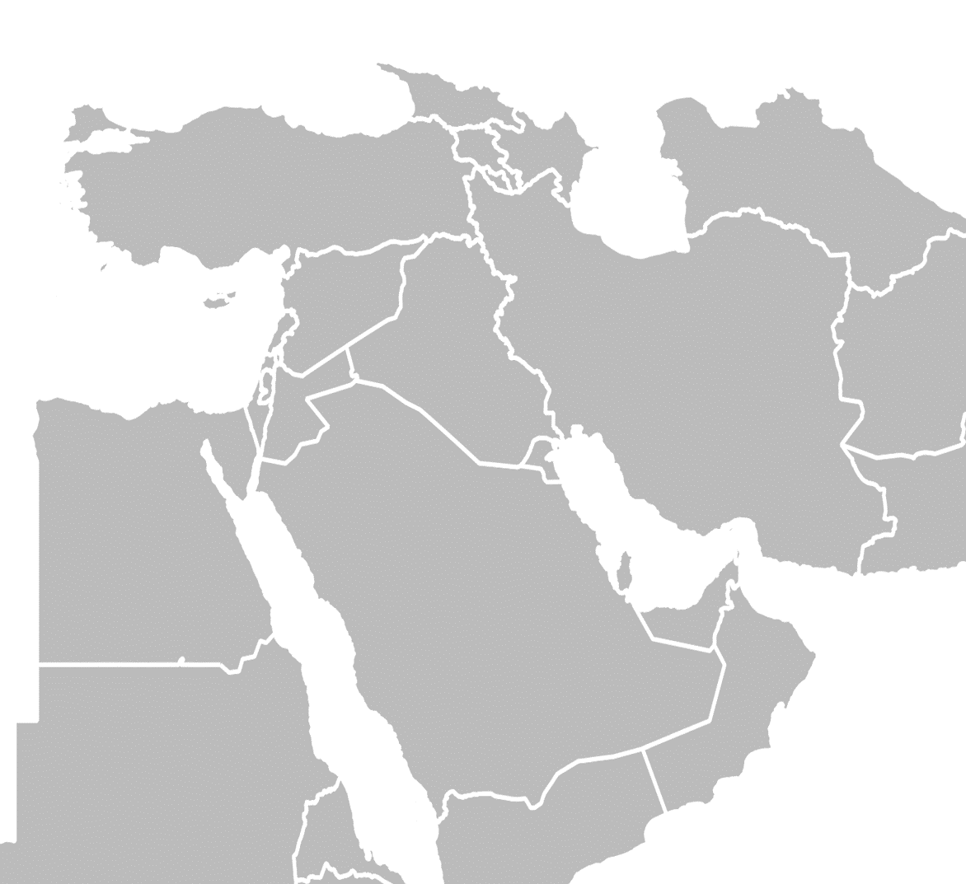
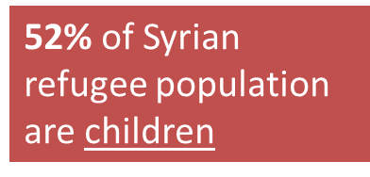
Syria
Turkey
2,181,293
Lebanon
1,075,637
Iraq
244,765
The war in Syria entered into its 5th year in 2015.
Jordan
633,644
Egypt
127,681
4,289,792 million refugees
7.6 million IDPs
Notes:
http://data.unhcr.org/syrianrefugees/regional.php
Turkey ratified the 1951 Refugee Convention, but with a geographical limitation that only recognizes as refugees people fleeing Europe. However, under customary international refugee law and international human rights law, Turkey must respect the principle of nonrefoulement, which prohibits countries from returning anyone to a place where they face a real risk of persecution, torture, or inhuman and degrading treatment or punishment. Nonrefoulement also prohibits rejection of asylum seekers at borders that would expose them to such threats.

Slide 13
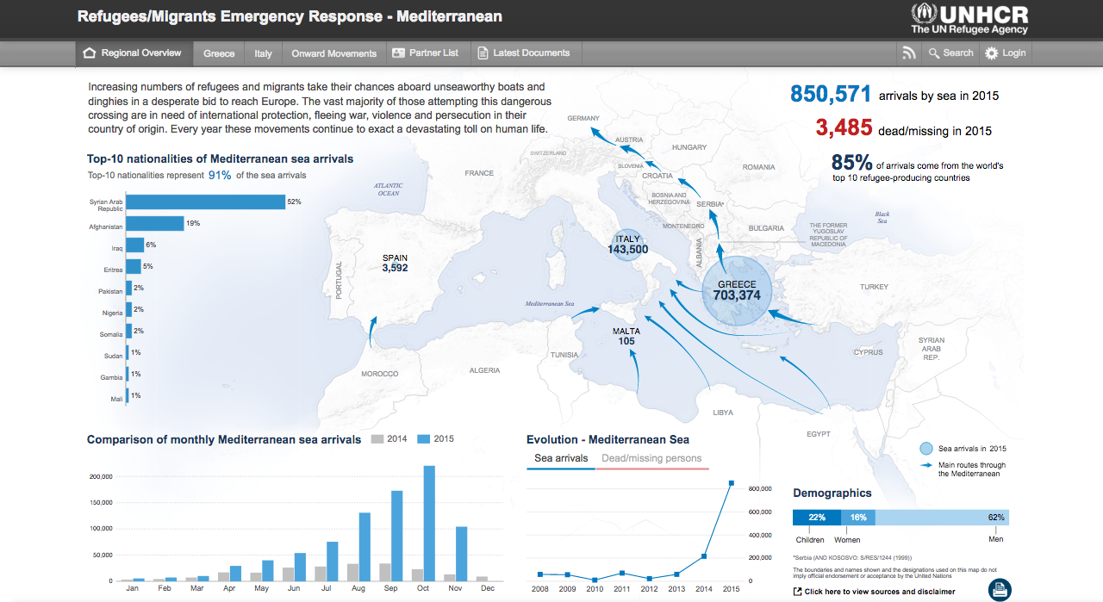

Slide 14
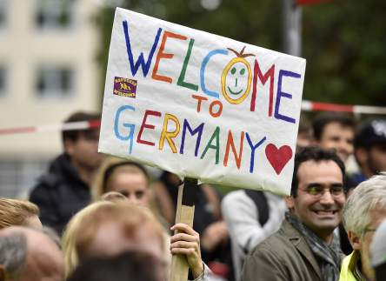
Germany Welcoming Refugees
800,000 to 1 million refugees
Suspended Dublin Regulation for Syrian refugees
History: Germany wants to be seen as progressive and not excluding or oppressing minorities.
Family Reunification
Generous reception and welfare benefits
Jobs

Slide 15
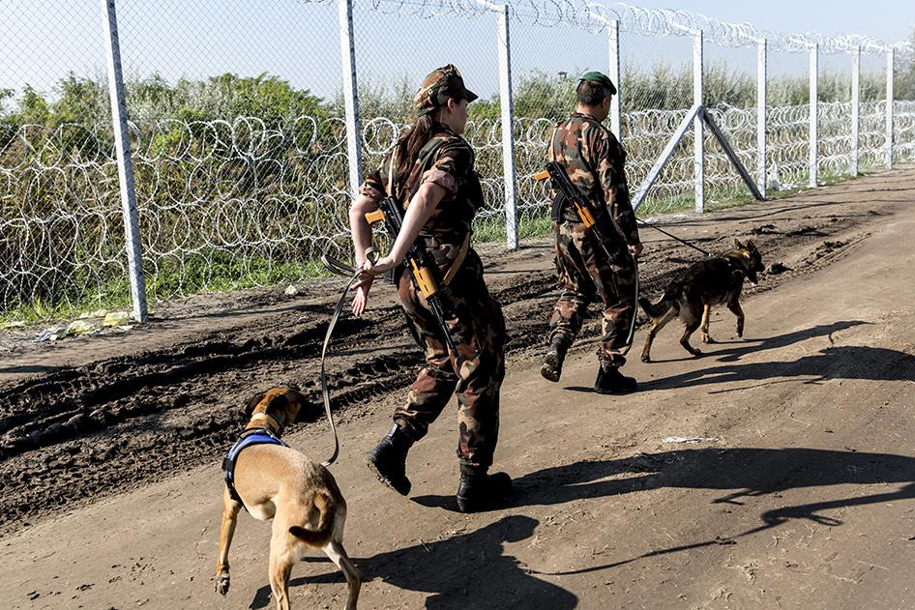
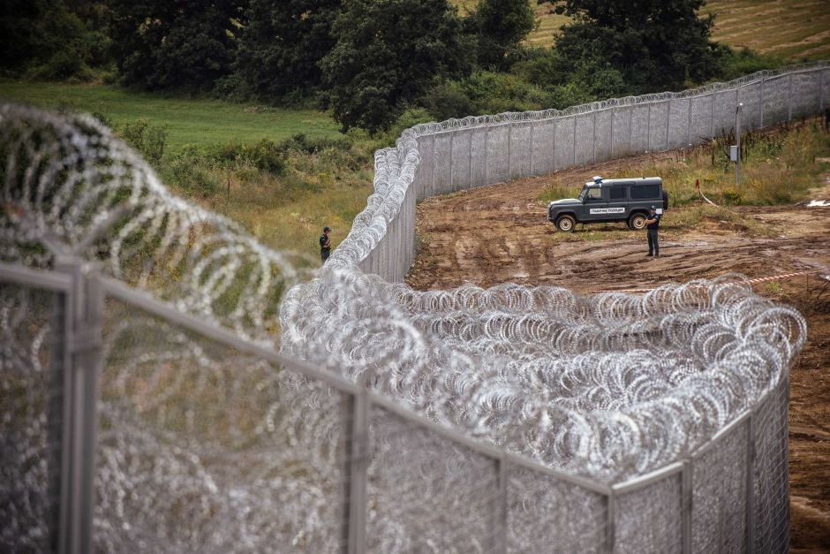
Hungary-Fences and Barriers
Hungary signed the Convention and Protocol in March 1989.
De facto closure of border with Serbia since Sep 15 2015
Criminalizing irregular entry from Serbia
Asylum detention
Deportation to Serbia
As of Nov. 10th 700 refugees sentenced to expulsion for crossing fence
Notes:
Right wing government. Victor Orban PM “Those arriving have been raised in another relgiions and represent a radically different culture. Most of them are not Christians, but Muslims” “This is an improtant question because Europe and European identity if rooted in Christinity”

Slide 16
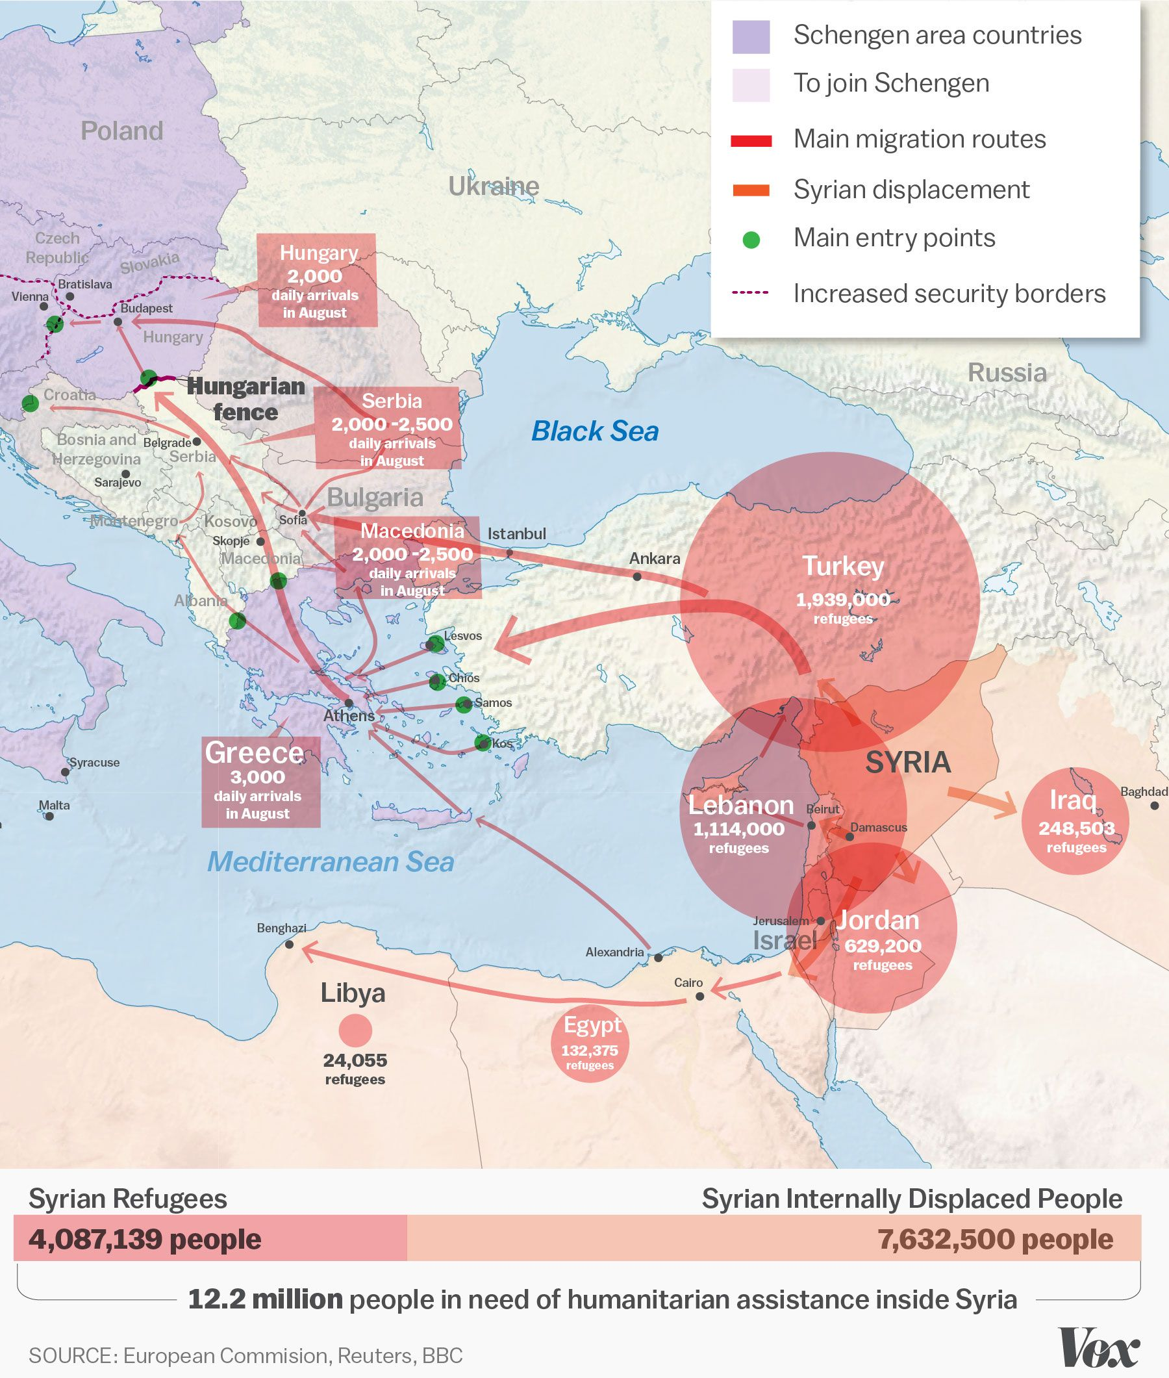

Slide 17
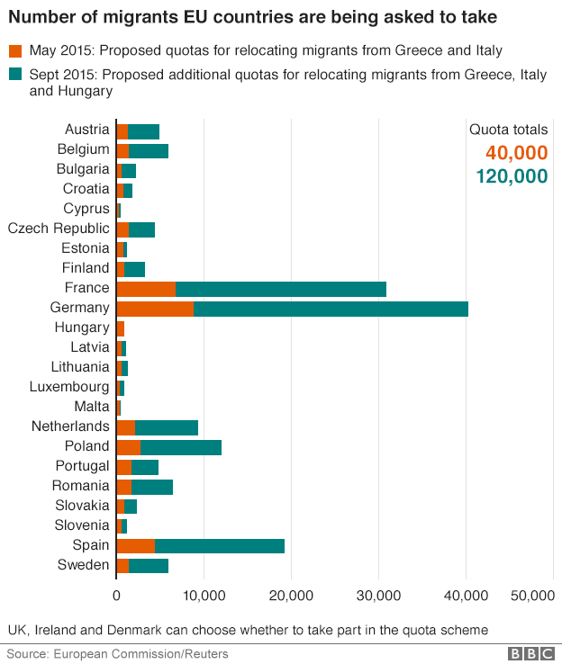
EU Mandatory Refugee Quota Plan
Notes:
He said that under the plan Hungary would need to take in 2,000 people seeking refuge in two years, but because of rules that allow families to be reunited, the number could rise, he said according to Origo news portal.
The plan is to relocate120,000 asylum seekers from Italy and Greece across the EU to help share the burden of the EU states where most migrants and refugees first arrive to the continent.
-Hunagry, Czech and Slovakia voted against obligatory mechanisms.

Slide 18
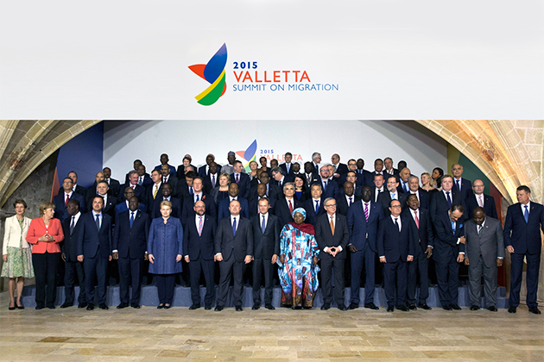
Valetta Summit 11th-12th November
Migration a shared responsibility of countries of origin, transit and destination.
Political declaration and an action plan designed to:
address the root causes of irregular migration and forced displacement
enhance cooperation on legal migration and mobility
reinforce the protection of migrants and asylum seekers
prevent and fight irregular migration, migrant smuggling and trafficking in human beings
work more closely to improve cooperation on return, readmission and reintegration
Emergency Trust Fund for Africa
Notes:
-Builds on existing cooperation between the EU and Africa, partiuclarly on regional policy dialogues
The EU Emergency Trust Fund for stability and addressing root causes of irregular migration and displaced persons in Africa was also formally launched at the occasion of the Valletta summit. Development aid, job opportunities, food and nutrities etc.
-Horn of Africa, North Africa and Sahel Region and Lake Chad.

Slide 19
Notes:
http://www.consilium.europa.eu/en/meetings/international-summit/2015/11/11-12/
The EU Emergency Trust Fund for stability and addressing root causes of irregular migration and displaced persons in Africa was also formally launched at the occasion of the Valletta summit. Development aid, job opportunities, food and nutrities etc.
-Horn of Africa, North Africa and Sahel Region and Lake Chad.

Slide 20
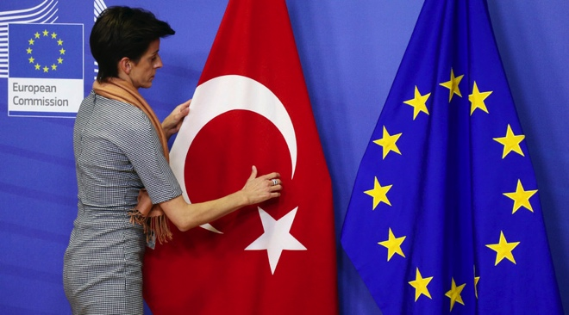
EU Heads of State Meeting with Turkey
Turkey not a signatory to the Protocol
Temporary Protection
Joint Action Plan to stem movement of irregular migration-preventing travel to Turkey and to the EU
Incentives:
An initial 3 billion EUR
Easing of visa restrictions for Turks
Renewed talks on Turkish accession to EU
Turkey has been in accession talks since October 2005
Notes:
Essentially Eu and Turkey made a deal that Turks get easier access but Syrians will be prevented from moving through Greece-a bribe
Quick fix response with uncertain outcomes for refugees.
Increase smuggling
http://www.consilium.europa.eu/en/press/press-releases/2015/11/29-eu-turkey-meeting-statement/
-Containing refugees in Turkey will hardly lead to the regions stability.
-Returns of irregular migrants to COO

Slide 21
Canada and Refugee Resettlement: Responsibility Sharing
Notes:
Resettlement: the selection and transfer of refugees from a State in which they have sought protection to a third State which has agreed to admit them – as refugees – with permanent residence status.

Slide 22
Resettlement Categories
Legal and/or physical protection needs
Survivors of violence and/or torture
Medical needs
Women and girls at risk
Family reunification
Children and adolescents at risk
Lack of foreseeable alternative durable solutions
Notes:
To have their case submitted to a resettlement country, refugees must meet the requirements for submission under one or more of the resettlement submission categories.
Legal and/or Physical Protection Needs of the refugee in the country of refuge (this includes a threat of refoulement);
Survivors of Violence and/or Torture, where repatriation or the conditions of asylum could result in further traumatization and/or heightened risk; or where appropriate treatment is not available;
Medical Needs, in particular life-saving treatment that is unavailable in the country of refuge;
Women and Girls at Risk, who have protection problems particular to their gender;
Family Reunification, when resettlement is the only means to reunite refugee family members who, owing to refugee flight or displacement, are separated by borders or entire continents;
Children and Adolescents at Risk, where a best interests determination supports resettlement;
Lack of Foreseeable Alternative Durable Solutions, which generally is relevant only when other solutions are not feasible in the foreseeable future, when resettlement can be used strategically, and/or when it can open possibilities for comprehensive solutions.
(Note: For more information on these categories, see the presentation “UNHCR Resettlement Submission Categories”.)
Canada is also really good at accepting refugees who are sexual minorities-particularly trans-refugees.

Slide 23
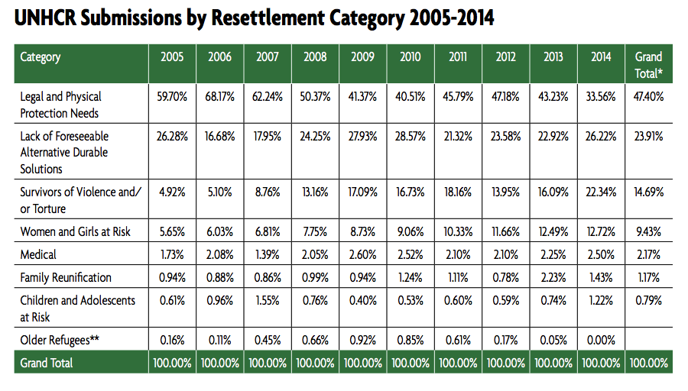

Slide 24
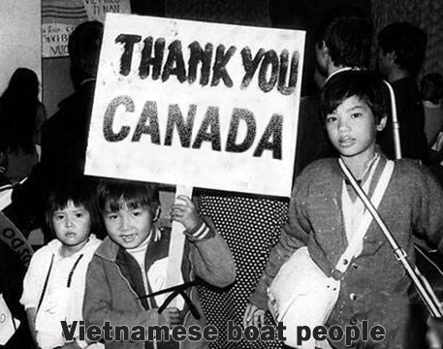
Canada and Resettlement
Canada is second largest resettlement country in terms of referrals made by UNHCR (USA is the first).
Indochinese refugees
People of Canada awarded Nansen Medal in 1986 for their role in PSR and GSR.
Politicization of Resettlement under Harper
Commitment to resettling 25,000 Syrian refugees by the end of the year.
Notes:
-Fear of an infiltration of communism.
As the Vietnam War came to a chaotic end in the late 1970’s, hundreds of thousands refugees fled the new Communist regime, embarking on risky journeys in overcrowded boats in search of sanctuary. Thousands perished, and those who survived overcame starvation, bad weather, and piracy, only to end up stranded in refugee camps in Thailand, Malaysia, Indonesia and Hong Kong.
Between 1975 and 1978, Canada welcomed 7708 refugees from Vietnam and Cambodia and between 1978 and 1994 an additional 136, 951 Indochinese refugees were calling Canada their home. In collaboration with the government and the general public, Canada resettled over 202,178 Vietnamese, Laotian, and Cambodian refugees between 1975 and 1997.
-Refugees613, RefugeesWelcome, Catholic Centre for Immigrants always looking for volunteers!

Slide 25
Thank you:)
Ambassadors of Rationality in our Communities!!!
What we can do to help:
Refugees613
Catholic Centre for Immigrants
RefugeesWelcome
SAH’s and Private Sponsorship
Contact
Krystynawojnarowicz@cmail.carleton.ca
Notes:
We are all Ambassadors of Rationality in out communities. Engage in difficult discussions and debates. You as teachers have the power to bring up these conversation in safe spaces in the classroom where students can ask these difficult questions and you can begin to start to break down stereotypical and ill informed beliefs. There are a lot of tenacious individuals who stand firm to their convictions and it’s these types of indiviualls who need to be confronted.

