Slide 1
EU Trade Policy EU-Canada relations

Slide 2
http://www.youtube.com/watch?v=IiOC5XG2I5Y

Slide 3
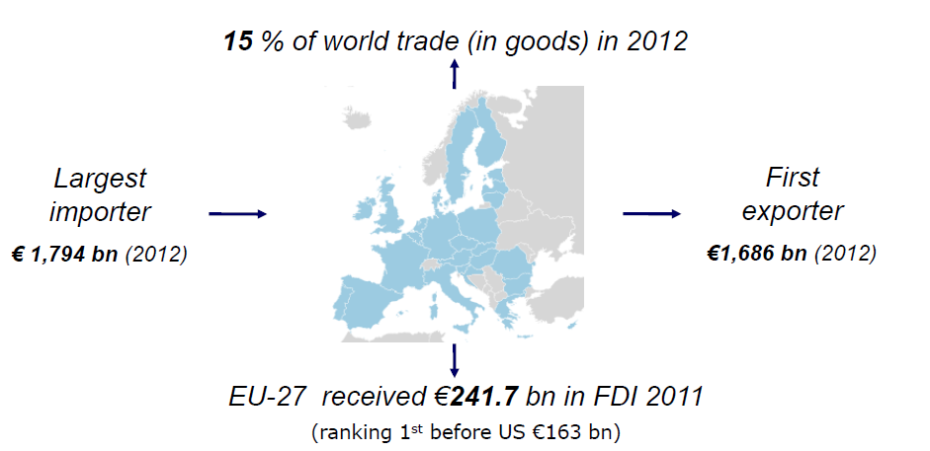
The EU – a major trading power
European Commission, 2013

Slide 4
The EU – a major trading power
% of global exports, goods, 2012
% of global exports, services, 2012
EU
15%
EU
25%
United States
11%
Others
42%
Others
55%
Japan
5%
United States
18%
China
14%
India
5%
China
6%
Japan
4%
Europa, 2013

Slide 5
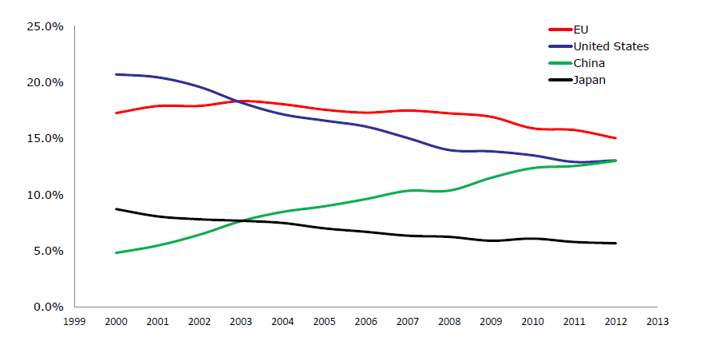
Share of EU27 (excluding intra-EU trade), USA, Japan and China in world trade in goods (%)
Source: European Commission (2013)

Slide 6
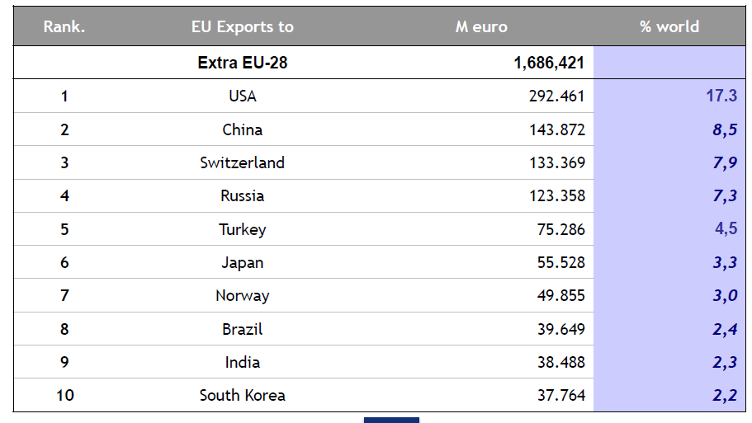
Ten major EU export partners (2012)
European Commission, 2013

Slide 7
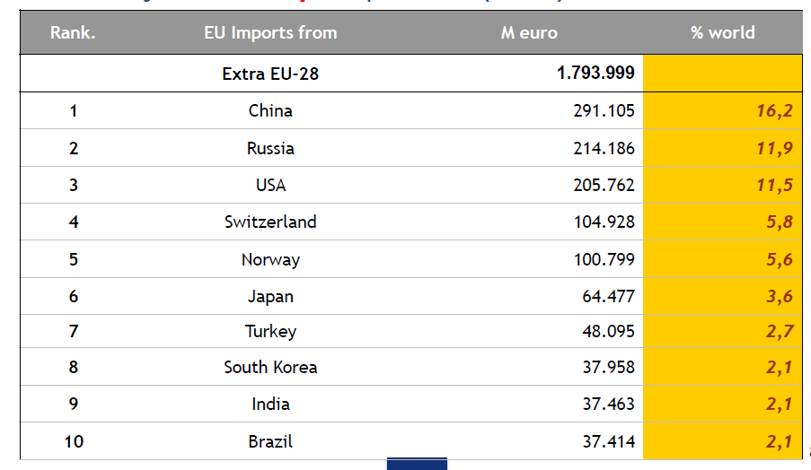
Ten major import partners (2012)
European Commission, 2013

Slide 8
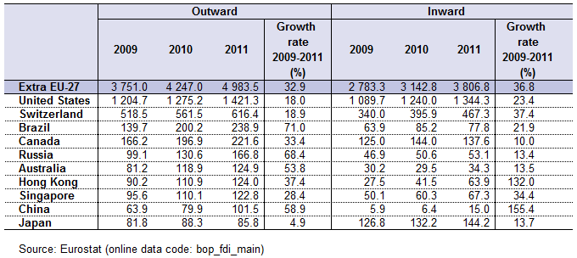
Major investment partners (2011)
European Commission, 2013

Slide 9
EU trade policy: History
Treaty of Rome (1957): “an ever closer union among the peoples of Europe.”
The first common policy.
Progressive elimination of internal tariffs by 1969- Formation of a free trade area (FTA) for the EEC with the gradual elimination of tariffs, quotas and other barriers to trade among members.
Creation of a uniform tariff schedule applicable to the imports from the rest of the world: formation of a custom union.
Single European Act (1986): four freedoms of movement: goods, services, capital and people.

Slide 10
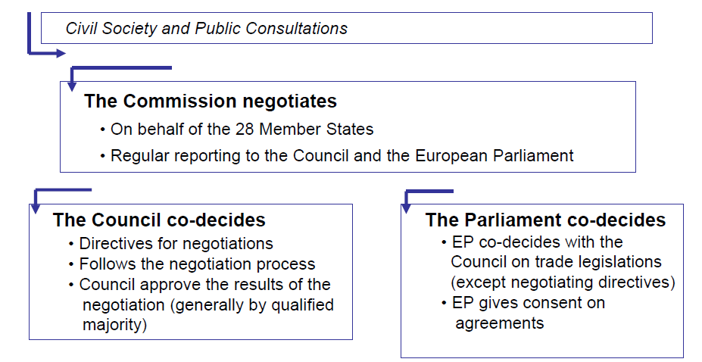
EU trade policy: Institutional framework
European Commission, 2013

Slide 11
New EU trade policy
Global Europe Strategy, 2006:
“an integrated approach to trade policy, linking the internal and external aspects of the EU’s competitiveness” (EC);
Increased market access (tariffs, NTBs);
New generation of trade agreements.
Europe 2020, 2010:
Completion of current negotiating agenda;
Deepen trade relations with other strategic partners;
Help European businesses access global markets;
Create opportunities for investors;
More assertive approach to enforcement;
Share the benefits of the global economy.

Slide 12
Why a new trade policy?
Globalisation;
Loss of competitiveness;
Shift in global powers;
Economic crisis.

Slide 13
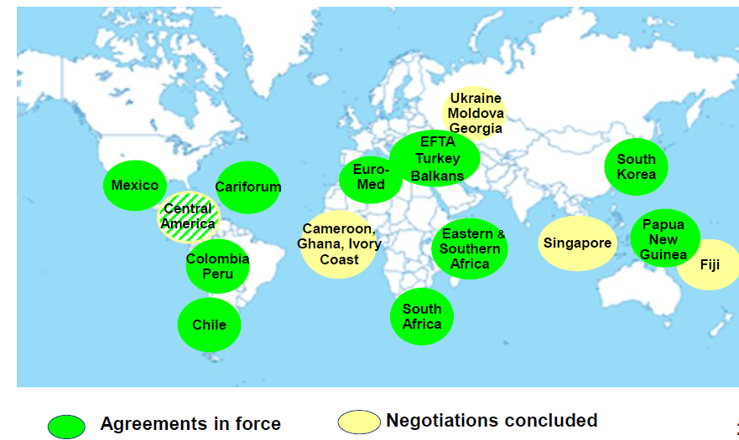
Bilateral agreements
European Commission, 2013

Slide 14
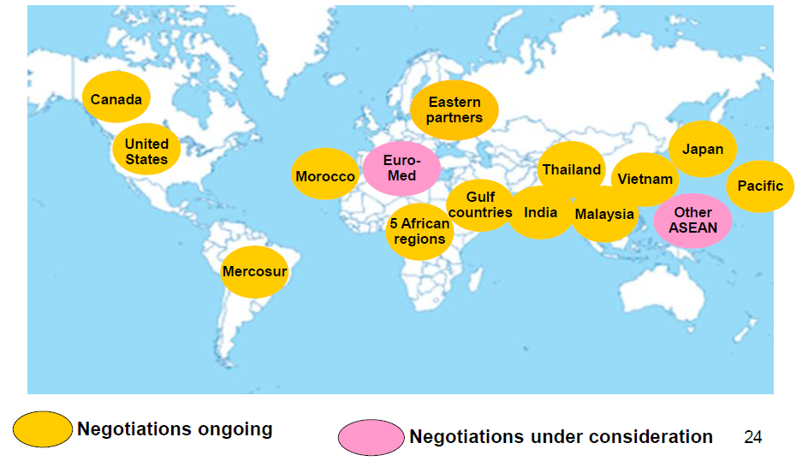
Bilateral agreements
European Commission, 2013

Slide 15
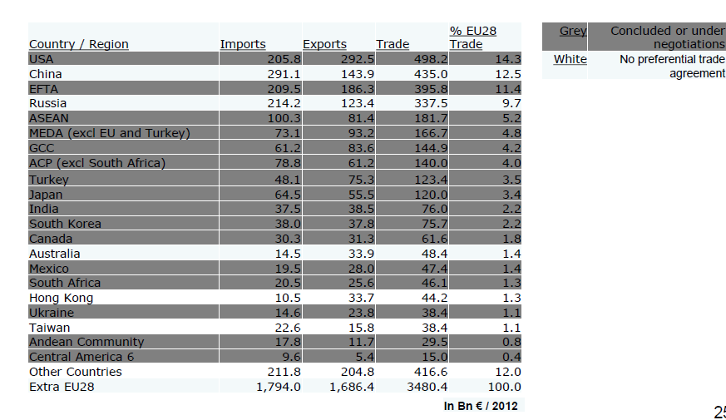
FTA partners and trade in goods
European Commission, 2013

Slide 16
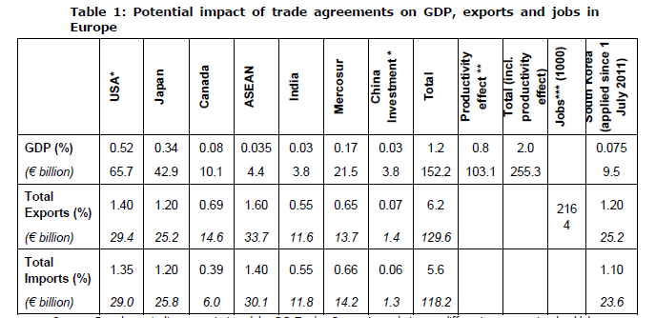
Source: European Commission (July 2012)

Slide 17
Canada’s trade policy
Run by the Federal Government
Canada’s Global Commerce Strategy (2007); Action Plan (2012):
Pro-trade (since 2006):
9 free trade agreements in force: Panama, Jordan, Colombia, Peru, Honduras, European Free Trade Association (Norway, Switzerland, Iceland, Lichtenstein).
1 free trade agreement signed: South Korea (2014)
1 deep economic and trade agreement concluded: EU;
11 free trade agreements under negotiations: including Japan and India; Trans-Pacific Partnership (TPP): Australia, Brunei, Chile, Canada, Japan, Malaysia, Mexico, New Zealand, Peru, Singapore, the United States, and Vietnam.

Slide 18
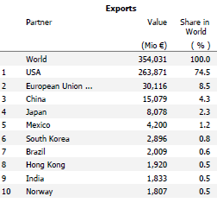
Canada’s top export destinations (goods) 2012
EU, DG Trade 2013
Notes:
Us share decreased from 87% to 74% between 2002 and 2011

Slide 19
Canada’s top export commodities (2010)
 | $ millions | %
Exports | 404,834 | 100.0
Agricultural and fishing products | 36,938 | 9.1
Forestry products | 21,851 | 5.4
Energy products | 90,886 | 22.5
Industrial goods and materials | 96,489 | 23.8
Machinery and equipment | 76,095 | 18.8
Automotive products | 56,783 | 14.0
Other consumer goods | 16,428 | 4.1
Other | 9,364 | 2.3

Slide 20
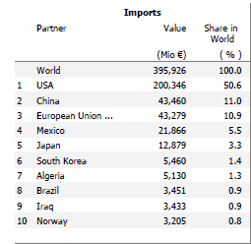
Canada’s top import sources (goods) 2012
EU, DG Trade, 2013

Slide 21
EU - Canada Relations
1976:
Bilateral Framework Agreement for Commercial and Economic Cooperation: Joint Cooperation Committee
Bilateral agreements for various trade issues, sectoral agreements and bilateral “consultations” or “dialogues” for various sectors:
1997: cooperation between customs administrators;
1998: Mutual Recognition Agreement (MRA):
good manufacturing practices for pharmaceuticals and mandatory conformity procedures in the following sectors: medical devices, tele-communications, terminal equipment, information technology equipment and radio transmitters, electrical safety, electromagnetic compatibility and recreational craft.
1999: competition agreement (cooperation between Competition Bureau Canada and the European Commission);
1999: Veterinary Agreement;
2003: Wine and Spirits Agreement;
2009: Civil Aviation Safety Agreement;
2009: Comprehensive Air Services Agreement;
2005: negotiations on a Trade and Investment Enhancement Agreement (TIEA):
Regulatory cooperation, gov. procurement, financial services, IPR
Notes:
Joint Cooperation Committee: a form of regulatory cooperation.
The absence of mutual recognition agreements in many sectors means that industries must often comply with two different regulatory systems. Enhancing mutual recognition could cut the costs of regulatory compliance. For example, if mutual recognition were extended to conformity assessment of regulated products, producers would need only to have the product tested in the country of origin prior to export.
All these initiatives mainly recognize equivalence of some product standards or product conformity assessment procedures. Regulatory cooperation is limited to joint committees with consultative functions that meet at the request of one party.
in April 2005, Canada and the EU agreed to recognize the equivalence of their respective domestic food safety measures for pork and animal health measures for bovine semen. This agreement—negotiated under the 1999 Canada–EU Veterinary Agreement—is intended to improve the ability of Canadian companies to become eligible to export pork to the EU.
TIEA: efforts toward a stronger regulatory cooperation, but held back by the EU’s desire to include the Canadian provinces in any agreement as various barriers to market access to public procurement and regulatory cooperation were at the provincial level. The EU suspended TIEA in May 2006.
The TIEA framework provides for the development of a voluntary mechanism for regulatory cooperation, noting scope for coordination between the EU’s Better Regulation Package and Canada’s Smart Regulation Initiative. This mechanism resulted in the December 2004 adoption of the Framework for Regulatory Cooperation, which aims to facilitate exchanges between regulators trying to reduce bilateral barriers to trade.
Currently,
officials are identifying initial projects to pursue under
the Framework.

Slide 22
EU – Canada relations
September 26, 2014 – Canada-EU Summit in Ottawa:
Conclusion of negotiations for Canada-EU Comprehensive Economic and Trade Agreement (CETA)
Conclusion of negotiations for Canada-EU Strategic Partnership Agreement
Notes:
strategic direction for stronger future relations and collaboration between Canada and EU member states at the bilateral and multilateral levels.
The SPA touches on a number of mutual priority areas, including energy, security, innovation, sustainable development and the promotion of human rights.

Slide 23
EU – Canada relations
2013:
Canada – the 12th most important trading partner for the EU (1.7% of EU external trade in goods)
EU – the 2nd most important trading partner for Canada (9.8% of Canada external trade in goods)
Important trading partners in services
EU is Canada’s fourth largest source and destination of investment (2011)

Slide 24
Comprehensive Economic and Trade Agreement (CETA)
October 2008: Joint Study, Assessing the Costs and Benefits of a Closer EU-Canada Economic Partnership:
EU GDP increase by 0.08%;
Canada GDP increase by 0.77% ($12 billion benefit);
May 2009: Launch of CETA negotiations;
September 2014: end of CETA negotiations.

Slide 25
Comprehensive Economic and Trade Agreement (CETA): Scope
Trade in goods: non-agricultural and agricultural
Regulatory measures: sanitary and phytosanitary issues; technical barriers to trade
Customs procedures and rules of origin
Cross-border trade in services, including mutual recognition of professional qualifications
Investment

Slide 26
Comprehensive Economic and Trade Agreement (CETA): Scope
Central and sub-central government procurement
Regulatory cooperation (laws and procedures)
Intellectual property
Temporary movement of business persons
Competition policy and related matters (monopolies and state enterprises)
Institutional arrangements and dispute settlement
Sustainable development

Slide 27
Comprehensive Economic and Trade Agreement (CETA): Achievements
Tariffs:
Industrial goods:
99.3% (EU); 99.6% (Canada) at 0% at entry into force;
Autos: rule of origin: 50% limit on non-originating materials for 7 years
100,000 vehicles: 70% transaction value or 80% net cost for non-originating materials;
Cumulation provision in case of EU-US FTA.
Agricultural goods:
93.6% (EU); 92% (Canada) at 0% at entry into force;
EU meat markets:
Beef and veal market: 50,000 tonnes duty-free in-quota hormone-free; 11,500 tonnes duty-free in-quota of high-quality beef;
Bison: 3,000 tonnes duty-free in-quota;
Pork: 81,011 tonnes duty-free in-quota;
Canada supply-managed products:
Poultry and eggs excluded;
Cheese: 16,800 tonnes (16,000 tonnes new market access plus 800 tonnes from current WTO quota for new member states); 1,700 tonnes for industrial-use cheese.

Slide 28
Comprehensive Economic and Trade Agreement (CETA): Achievements
Services and investment:
Health care, public education, cultural and other social services excluded;
Labour mobility:
Process of recognizing foreign qualifications streamlined;
Minimize barriers to temporary entry;
Investment:
Investor-state dispute settlement:
Clear investor protection standards such as rules followed by arbitration tribunals;
Clear rules on the conduct of procedures in arbitration tribunals;
Transparent process.
“A breach of the fair and equitable treatment obligation can only arise when there is:
Denial of justice in criminal, civil or administrative proceedings;
A fundamental breach of due process, including a fundamental breach of transparency, in judicial and administrative proceedings.
Manifest arbitrariness;
Targeted discrimination on manifestly wrongful grounds, such as gender, race or religious belief;
Abusive treatment of investors, such as coercion, duress and harassment.”

Slide 29
Comprehensive Economic and Trade Agreement (CETA): Achievements
Government procurement:
Established thresholds;
Negative list.
Intellectual property:
Pharmaceutical:
Additional protection for pharmaceutical products never more than 2 years;
Canadian generics able to be exported during the additional protection period.
Geographical Indicators (GIs):
Various ways of addressing 179 terms covering foods and beer:
Keep the validity of existing Canadian trademarks;
Ability to use specified English and French language terms commonly employed in Canada;
Limited GI rights on: Asiago, Feta, Fontina, Gorgonzola and Munster (future users accompany them by expressions such as “kind”, “type”, “style”, “imitation”;
Ability to use components of multi-terms.
State-to-state dispute settlement.

Slide 30
Comprehensive Economic and Trade Agreement (CETA): Achievements
Regulatory cooperation activities on a voluntary basis;
“recognizing the right of each Party to determine their desired level of health, safety, environment, and consumer”;
Explain why no initiation or withdrawal from cooperation;
Ongoing bilateral discussions on regulatory governance;
Sharing information, consult, sharing proposed regulations that might have an impact on the other party at an early stage;
Regulatory Cooperation Forum:
Setting for discussion, assist individual regulators, review initiatives, encourage bilateral cooperation;
Outside bodies to conduct assessments on product standards:
Parties have to accept decisions.

Slide 31
Comprehensive Economic and Trade Agreement (CETA): Achievements
Cooperation in motor vehicles regulations:
International standards: on a voluntary basis;
Cooperation in biotechnology:
Shared objectives:
Exchanging information on policies, regulations and risk assessment processes; promoting science-based approval process; low level presence of GMOs; minimize adverse trade impacts of regulatory practices.
CETA results in substantial progress by establishing various institutional channels through which sector-specific NTBs can be addressed over time;
Elimination of small regulatory differences, double testing, inspection procedures (conformity assessment).

Slide 32
Thank you! Questions? Crina Viju: crina.viju@carleton.ca

