Slide 1
Catalonia: the difficult path towards independence
Sebastian D. Baglioni
Carleton University
March 11, 2015

Slide 2
Outline
Background and Context
Catalan Political Parties
Spanish Political Parties
Sociological Factors and Independence
The “Referendum for Independence” and the Spanish Constitutional Court
The “Process of Citizen Participation”
Results
Political Responsibilities and Alternatives

Slide 3
Background and Context
The Spanish Constitution: the system of Autonomous Regions
Catalonia:
self-government and shared government
autonomy and asymmetry
L’Estatut de Catalunya 2006
Identity and Symbols
Clarification and Separation of Powers
Funding
The Spanish Constitutional Court

Slide 4
Catalan Nationalist Political Parties
Convergencia i Unio – Unio Democratica de Catalunya (CiU), centre-right – 30.7%
Nationalism and autonomism
Pro-independence
Esquerra Republicana de Catalunya (ERC), left – 13.7%
Pro-independence
Iniciative per Catalunya Verds (ICV), green-left – 9.9%*
Catalan nationalism, federalism
Esquerra Unida i Alternativa (EUiA), left – 9,9%*
Pro-independence
* In coalition

Slide 5
Spanish Political Parties
Partido Popular (PP) – conservatives
Spanish Nationalism
Autonomy
Partido Socialista Obrero Español (PSOE) – socialist
Federalism – asymmetric federalism
“Plural Spain”

Slide 6
Sociological factors and independence

Slide 7
Sociological Factors and Independence
Source: Survey about the current political situation in Catalonia 2014
Centre d'Estudis d'Opinio - Generalitat de Catalunya

Slide 8
Sociological Factors and Independence
Source: Survey about the current political situation in Catalonia 2014
Centre d'Estudis d'Opinio - Generalitat de Catalunya

Slide 9
The “Referendum for Independence” and the Spanish Constitutional Court
Political Disputes and Constitutional Arguments
Illegal status and political inaction
Blur line between democracy and legality
From a democratically binding referendum to a non-binding illegal consultation process

Slide 10
The “Process of Citizen Participation”
Two questions:
Do you want Catalonia to become a State? (Yes/No);
If the answer is in the affirmative:
Do you want this State to be independent? (Yes/No).

Slide 11
The “Process of Citizen Participation”
Non-binding consultation
Administration of the Process
Transparency
Legal Accusations

Slide 12
Results
Referendum Results (Definitive)
 | Percentage | Absolute Number
YES-YES | 80.91 | 1.897.274
YES-NO | 10.02 | 234.848
YES-Blank | 0.97 | 22.755
NO | 4.49 | 105.345
Blank | 0.56 | 13.201
Others | 3.05 | 72.032
Source: Generalitat de Catalunya (gencat.cat)

Slide 13
Results - Turnout
Parliament Election 2010
58%
Parliament Election 2010
68%
Process of Citizen Participation
35% - 37% - 41%
No census, no registration

Slide 14
Results
Will for independence by vote intention to the Catalan Parliament
 | YES (44.5%) | NO (45.2%)
PP | 0 | 100
CiU | 81.2 | 11
Esquerra | 90.5 | 5.3
PSC | 11.3 | 86.8
ICV | 27.9 | 60.5
Ciutadans | 0 | 98.4
CUP | 85.4 | 4.2
Podemos | 15.7 | 80.4
Source: Survey about the current political situation in Catalonia 2014 (December) - Centre d'Estudis d'Opinio - Generalitat de Catalunya

Slide 15
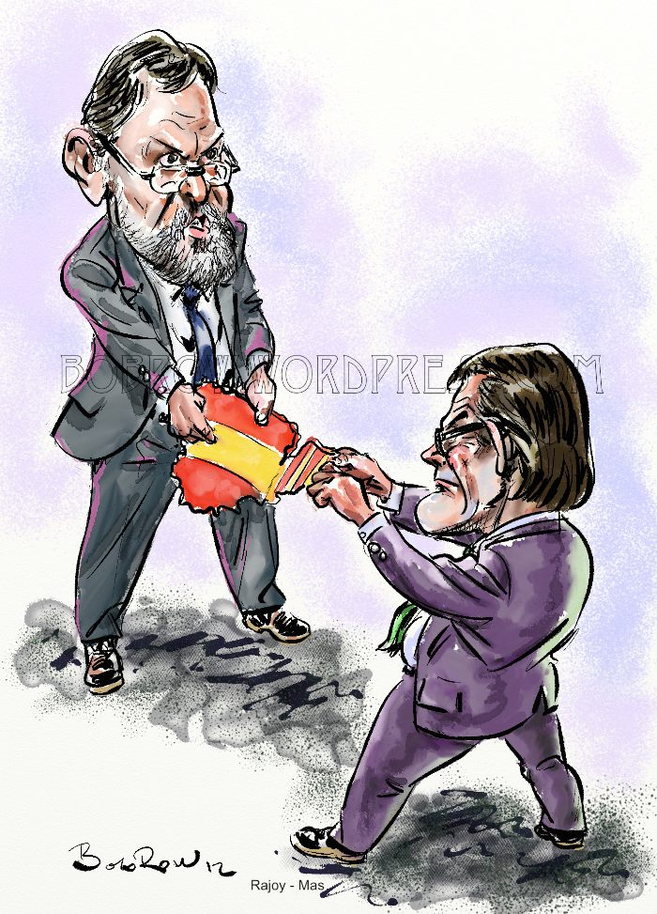
Political Responsibilities and Alternatives
Plebiscitarian Elections
Judicial Activism
Political Gridlock

Slide 16
Political Responsibilities and Alternatives
Building political dialogue
Harmonizing democracy and legality
Constitutional reform ?
Reform of Title VIII
Federalism (asymmetry)

