Slide 1
Climate Change and Renewable Energy Policy in the EU and Canada
Ottawa, October 1st 2015
Comparing EU Climate and Renewables Governance 2008 and 2014
Dr. Christian Hey
German Advisory Council on the Environment, Berlin

Slide 2
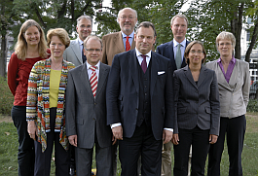
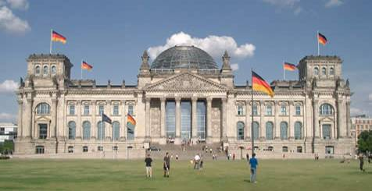
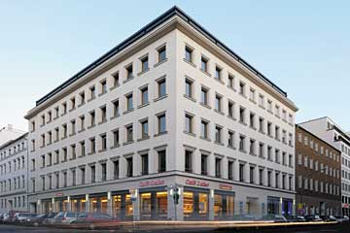
German Advisory Council on the Environment
Main Characteristics
Interdisciplinary, scientific and independent
7 University Professors from different disciplines nominated by Cabinet
Judgements on environmental issues
Early warning function
Ideas for sustainable transitions
Inform stakeholders and the broader public
Notes:
2

Slide 3
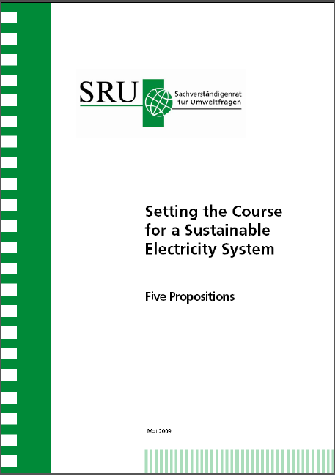
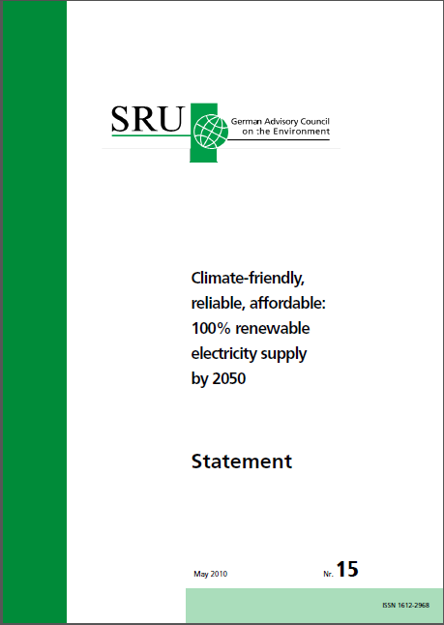
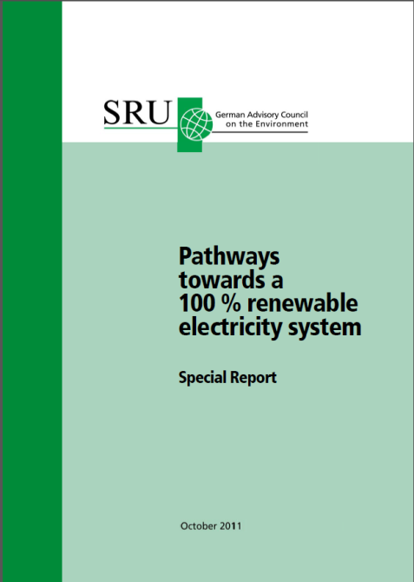
Contributions of SRU in the national debate
Position Paper:
May 2009
Statement:
May 2010
Special Report,
January 2011
Summary
for policy makers,
November 2013
Notes:
3

Slide 4
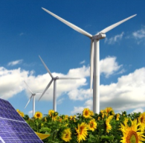
EU Climate and Energy Policies
Overview
Some Basic Characteristics of the EU
Agenda 2020
Agenda 2030
Notes:
4
4

Slide 5
Some Basic Characteristics of the EU
Different Socio-Economic Structures
Diverse Energy and Climate Policy Interests
Very Fragmented Institutional System
Process Control by the European Commission
First Mover and Leadership Advantages (EU as „agenda setting paradise)
A strong „green“ triangle: DG ENV/Environmental Council/ Environment Committee as institutional core
Consensus and solution-oriented political culture

Slide 6
Key Climate and Energy Policy Instruments
Emissions Trading System (Market Based)
Effort Sharing Decision (National Planning)
Renewable Energy Directive (National Planning)
Energy Efficiency Directive (National Planning)
Ecodesign Directive for Energy-related Products (Regulatory Law)

Slide 7
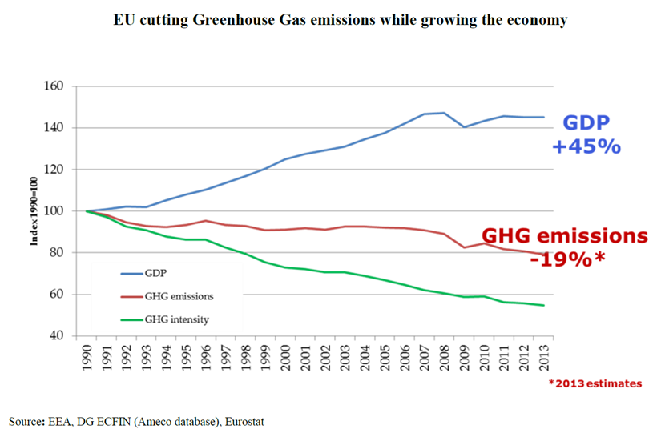
Agenda 2020: Climate targets achieved

Slide 8
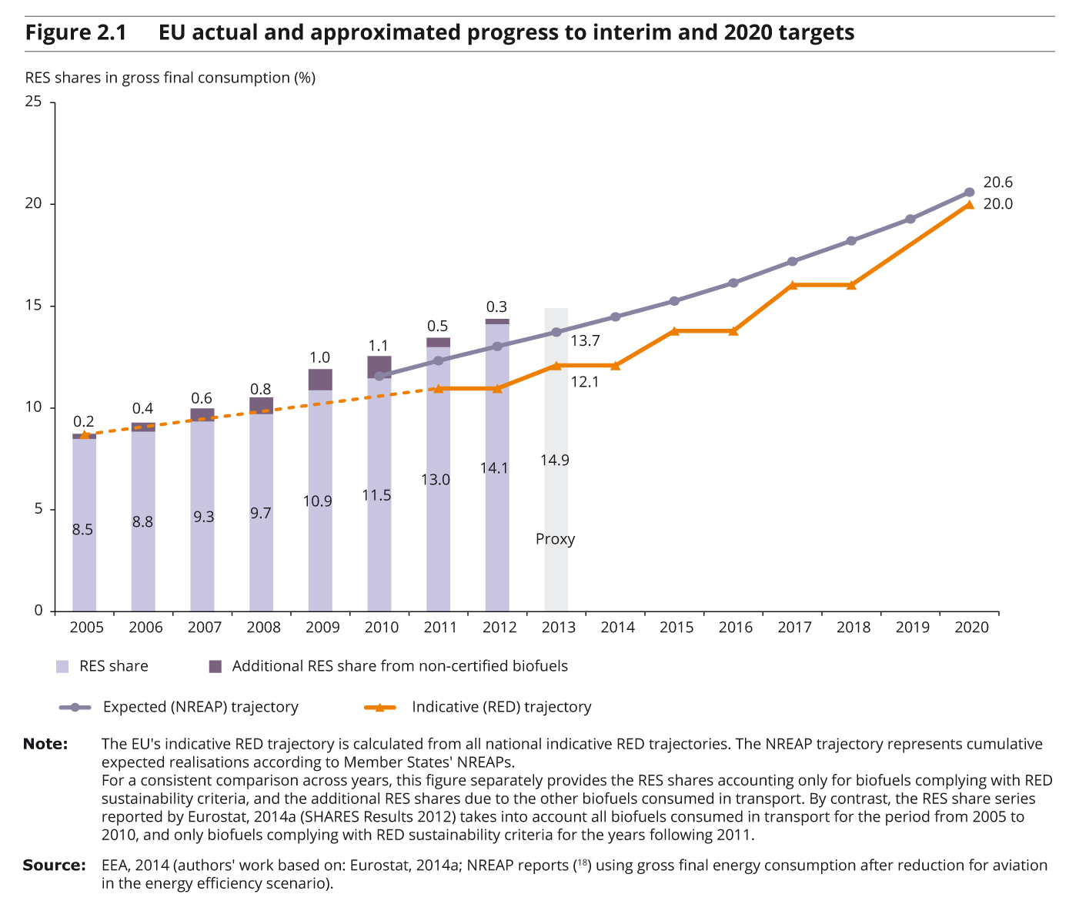
Agenda 2020: Renewables on Track

Slide 9
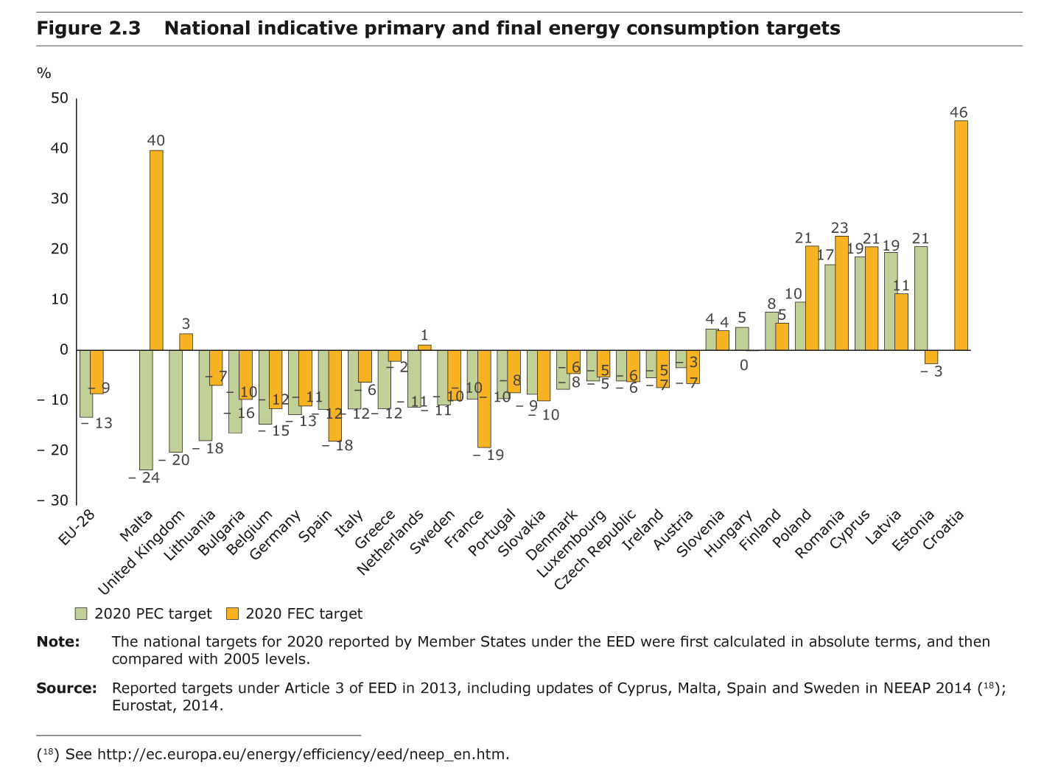
Efficiency Target: 20% by 2020
20% compared to trend = 13% less compared to 2005

Slide 10
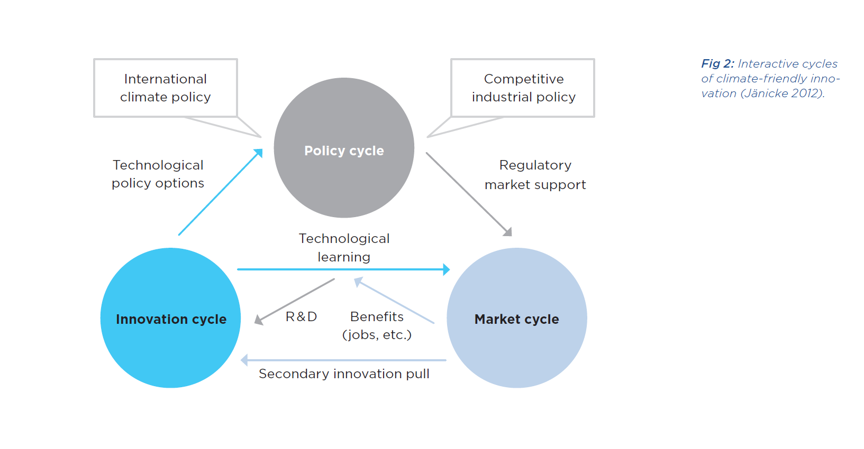
Drivers of Policy Acceleration

Slide 11
The Pre – 2008 Policy Cycle
Copenhagen Conference 2009: Demonstrate European Leadership and Credibility
The 2007 Stern Report: Reframing Climate as an Economic Concern
Extreme Weather Events: Heat Wave 2003, Catharina 2005: Early Warning Signals
The pre-crisis fuel price bubble
Industrial Policy: Renewables +Nuclear + CCS – as low carbon technology winners
A powerful pro Climate Coalition: UK, Fr, G, the Commission and the EP

Slide 12
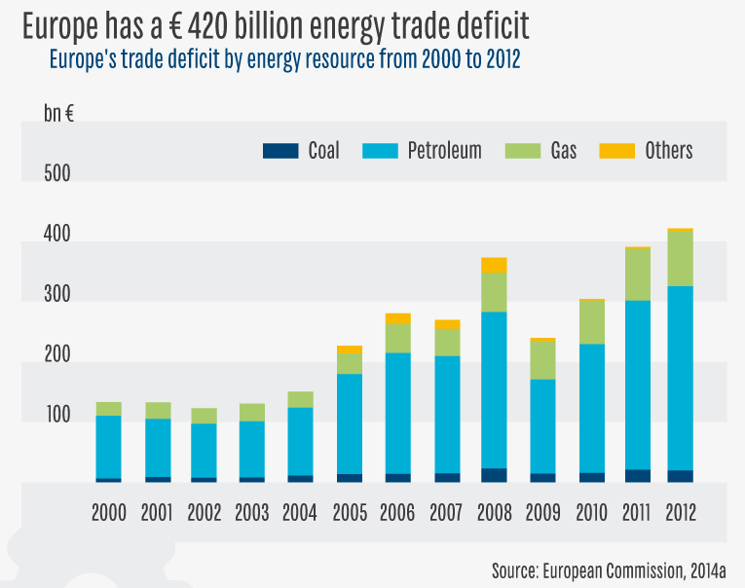
Market Conditions: Europe is Energy Poor

Slide 13
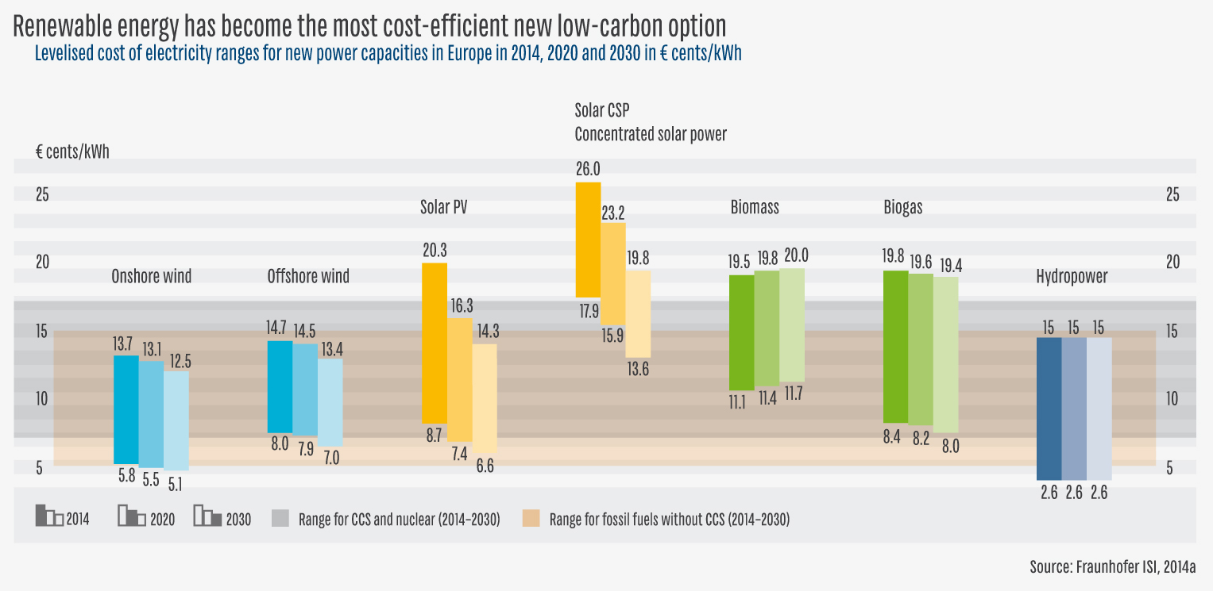
Market Conditions: Renewables are getting cheap

Slide 14
The Constellation 2014:
Economic Crisis – Competitiveness Concerns
Renewable Energy as threat to incumbents
Fuel Prices Declining
Fragile Alliance of Green Member States
New Market Oriented Agenda (Energy Union)

Slide 15
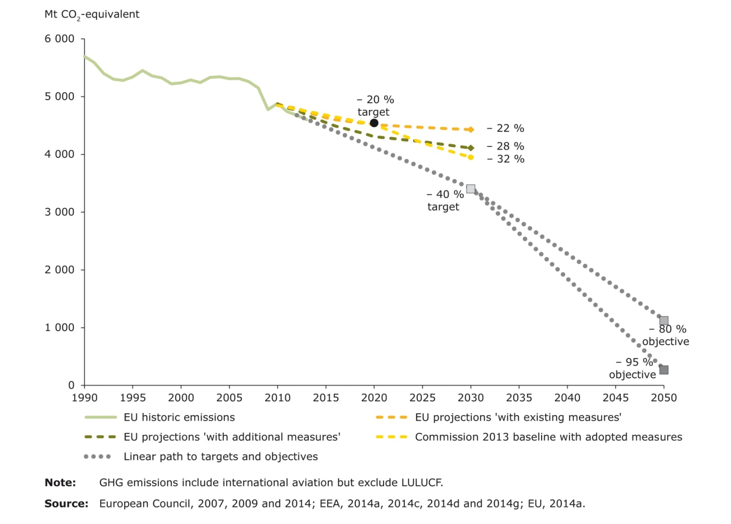
The agenda 2030: the Climate Target
40% by 2030 means more speed later
EEA, 2014, S. 61
Notes:
15

Slide 16
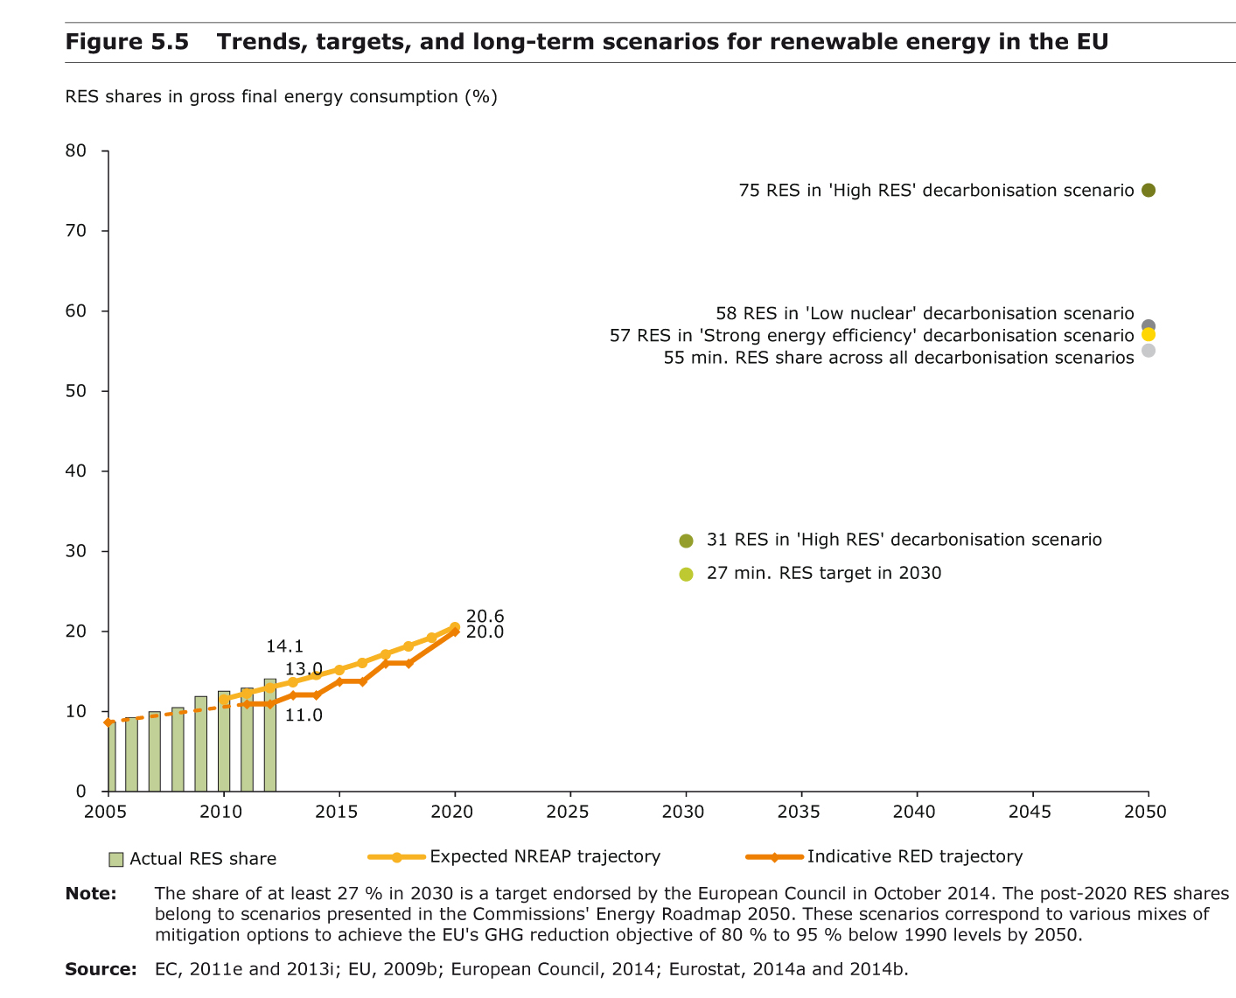
40-27-27:
Renewables Target: at the lower end
Notes:
16

Slide 17
Some Conclusions
Europe is in a difficult phase, but
EU still a credible and ambitious climate policy leader
EU has a rich portfolio of effective climate policy instruments
EU has potentially strong governance mechanisms
Energy Transition in Europe towards renewable energies was slowed down, but not stopped

Slide 18
Thank you for your attention
Dr. Christian Hey
German Advisory Council for the Environment, Berlin
www.umweltrat.de
www.eeac.eu
Notes:
Hope some food for thought!
Thank you very much for your attention

