Slide 1
The New Energy Union: Priorities and Conflicting Policy Objectives
Stephan Schott
Carleton University
School Public Policy and Admin

Slide 2
A roadmap of roadmaps
2011: Energy Roadmap 2050
2014: European Energy Security Strategy
2014: EU framework for climate and energy policies:
New GHG emission reduction targets
Reviving the Emission Trading System (ETS)
Ensure Competitiveness of EU and prevent carbon leakage
New targets on renewables and energy efficiency at EU not national level
Energy integration: building the Energy Union
Energy Security
Equity and balanced approach within the EU
New commitment to clean energy investments

Slide 3
The Energy Union
I want to reform and reorganise Europe’s energy policy
in a new European Energy Union. Jean-Claude Juncker (March 19th 2015)
“A Resilient Energy Union with a Forward-Looking Climate Change Policy”
European Commission Energy Union Priority:
A European Energy Union will ensure that Europe has secure, affordable and climate-friendly energy

Slide 4
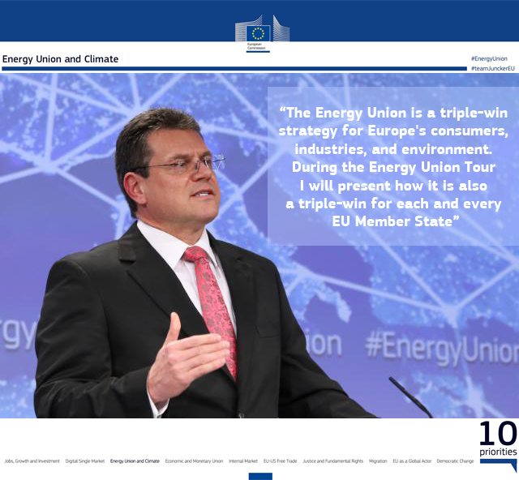
Notes:
Maros Sefcovic

Slide 5
Energy Challenges for EU countries
More than half of energy is imported (more than 90 % of oil and 66 % of natural gas)
Fragmented energy markets and systems
Energy prices much higher than elsewhere
Active climate change mitigation proponent
Energy largest emitting sector

Slide 8
EnU Priorities
Supply security Diversifying Europe's sources of energy and making better, more efficient use of energy produced within the EU.
A fully-integrated internal energy market Using interconnectors which enable energy to flow freely across the EU - without any technical or regulatory barriers. To enable increased competition and lower energy prices (affordability)
Energy efficiency Consuming less energy in order to reduce pollution, preserve domestic energy sources, and reduce the EU's need for energy imports (less strain on supply security).
Emissions reduction Rebuilding the European emissions trading scheme, pushing for a global deal for climate change in Paris in December 2015, and encouraging private investment in new infrastructure and technologies.
Research and innovation Supporting breakthroughs in low-carbon technologies by coordinating research and helping to finance projects in partnership with the private sector.

Slide 9
1. Supply Security
a new gas hub in Southern Europe
key infrastructure projects enhancing Finland's and the Baltic States' energy security
better use of regasification and storage capacity in the gas system
removing obstacles to LNG imports from the US and other LNG producers
advancing domestic production of oil and gas from unconventional sources such as shale gas (as long as public acceptance and environmental impacts are adequately addressed)
establishing strategic energy partnerships with important transit countries or regions such as Algeria, Turkey, Azerbaijan, Turkmenistan, the Middle East, Africa
strengthening partnerships with Norway
developing new partnerships with the United States and Canada

Slide 11
Challenges and Policy Conflicts
will require massive investments in LNG terminals and infrastructure; not specified how the financing will be secured
member states have very fragmented shale gas policies and do not agree on a common approach
tax incentives and subsidies for unconventional fossil fuels in conflict with creating a more integrated, smoother energy market and potentially with renewable energy targets
a suggested voluntary demand aggregation mechanism for collective purchasing of gas already rejected by a majority of member states: better to pursue antitrust proceedings against Gazprom

Slide 12
Cautious or opposed to shale gas
Germany is taking a cautious approach to shale gas development, in line with a recent report from the federal environment agency that specifies strict principles
Netherlands: Shale gas exploration in the Netherlands has been suspended, while a study (to be completed in 2015) on its environmental and social effects is carried out.
France the French government banned fracking in 2011 and cancelled exploration licences. In October 2013, France's constitutional court upheld the ban. President François Hollande has promised to maintain the fracking ban as long as he is in office.

Slide 13
Supportive of shale gas
Poland: domestic shale gas extraction will be tax-free until the end of 2020, and
taxes will not exceed 40% after that. The European Commission opened legal proceedings against Poland in June 2014, on the grounds that the new Geological and Mining Law infringes the environmental impact assessment (EIA) directive by allowing drilling at depths of up to 5 000 metres without having assessed the potential environmental impact.
UK: The current government is in favour of shale gas development, and has adopted regulations. Licences for shale gas exploration have been issued.
Spain: The Spanish government supports shale gas development. About 70 exploration permits have been issued, and a further 75 await authorisation
However; most shale gas reserves are located in the Basque-Cantabrian basin in the north of Spain. In 2013, the region of Cantabria banned fracking, but the Spanish constitutional court declared the ban unconstitutional in June 2014.

Slide 14
2. Fully-integrated internal energy market
Ramping up of energy connectivity between member states.
a minimum target of ten percent of existing electricity interconnections.
target of 15 percent by 2030.
Requires investment in new pipeline and grid infrastructure across EU borders: in the range of € 200 billion annually in the next decade. The private sector is supposed to bear the major share of this burden
develop new high-voltage supergrids (long distance connections) and new storage technologies.
The Commission will produce biennial reports on energy prices, analyse in depth the role of taxes, levies and subsidies and seek the phasing out of regulated prices below cost.

Slide 16
Challenges and Policy Conflicts
All of this will require major financial commitments by the member states and agreements on the magnitude, timing and location of investments.
Contentious issue as Portugal is advocating for 30% but France sees threat to its nuclear industry
Every member states has some kind of incentive or subsidy scheme for either renewables, shale gas or lignite reserve markets

Slide 17
3. Energy Efficiency
An indicative target at the EU level of at least 27% is set for improving energy efficiency in 2030
reviewed by 2020, having in mind an EU level of 30%
Commission will encourage member states to give energy efficiency primary consideration in their policies and through energy labeling and ecodesign legislation.
Commission will propose a strategy to facilitate investment in heating and cooling
Commission will review all relevant energy efficiency legislation and will propose revisions where needed

Slide 18
Challenges and Policy Conflicts
Many of the suggested policies are relatively soft and even the impacts of the European ecolabelling efforts are not clear.
Harder measures especially in the building and transport sector are necessary to achieve the relatively ambitious targets.
Binding at EU level?
Intrusion in domestic energy efficiency legislation

Slide 19
4.Emissions Reduction
EU commitment of an at least 40% domestic reduction in greenhouse gas emissions compared to 1990.
active European climate diplomacy that makes full use of trade and development instruments
stimulate the uptake of renewables and other low-carbon and energy-efficient technologies through the carbon price formation in the EU ETS

Slide 20
Challenges and Policy Conflicts
Some critics think the 27 % renewable target will continue to undermine the ETS mechanism and will deflate the carbon price contrary to EU view that it is compatible (Carlo Carraro (ICCG))
not clear if active climate diplomacy will involve import tariffs or cross border adjustments for certain goods
consistently low carbon price below € 10
EU having difficulties in agreeing on tighter emissions caps and a price floor of emission credits that would force a higher carbon price.
The renewable targets and the EU ETS price signals need to be more in tune, which requires
  a reformed market for emissions trading
  a market for renewable energy certificates
  short and long term bidding into the electricity system

Slide 21
5. Research and Innovation
Being the world leader in developing the next generation of renewable energy technologies
Smart grid and smart cities development
Efficient energy systems
More sustainable transport systems
a “forward-looking” approach to carbon capture and storage (CCS) and carbon capture and use (CCU) for the power and industrial sectors to reach the 2050 climate objectives in a cost effective way

Slide 22
Challenges and Policy Conflicts
Quite a reliance on not yet proven to be cost-effective technologies
This focus is in direct contrast to the ambitious and progressive development of alternative energy resources, and is more targeted to less developed areas of the EU that need to catch up to the rest of the EU
Still at quite a high policy level without explicit steps and recommendations

Slide 23
Conclusion
Change of focus on: supply security, affordability and competitiveness, infrastructure and technologies and solidarity between member states
Potentially contradicting objectives: energy integration, EU targets for renewables and energy efficiency but freedom to determine national energy mix
Fossil fuel subsidies (distributional and competitiveness objectives) and tax incentives for shale gas clash with carbon prices (investment and efficiency objectives) and other market signals (electricity and energy efficiency)
Still too much dependence on ETS sector until 2020 at least, not effectively dealing with transport, agriculture, forestry and other major carbon contributors

