Slide 1
An Open Educational Resource for Faculty Development to Develop and Teach Blended and Online Courses
cuOpen

Slide 2
Carleton’s Context
Certificate
The Provost’s Advisory Group on the Expansion of Online and Blended Learning
The CU Strategic Integrated Plan 2015-2018
OAVPTL Teaching & Learning Framework
Instructors’ & Departmental Increased Interest in online learning & ePedagogy communities

Slide 3
Project
Certificate in Blended and Online Teaching
Open Educational Resources
PowerPoint for face-to-face workshops
SCORM packages for online delivery
Teaching Tip sheets
Video vignettes
Creative Commons licensing
Notes:
Aims to address some of the most significant barriers to the systemic growth of online and blended course offerings in Ontario universities by addressing unfamiliarity and unpreparedness of course instructors to teach and facilitate learning experiences in blended and online environments.
Initially developed for the Carleton community, all materials developed for this project will be made available as open educational resources (OERs)
Over the past 5 months, a multidisciplinary team from Carleton (together with external consultants) has developed the following:
- PowerPoint presentations for face-to-face workshops.
- Teaching Tip sheets.
- SCORM-compliant modules for use in a learning management system.
- Video vignettes capturing comments from faculty and staff involved in online teaching from Universities across Ontario.

Slide 4
Community
Notes:
5 institutions
41 interviews
3M Award Winners
Faculty
Educational Developers and Educational Technology specialists
Instructors just starting to teach online + instructors who have taught DE courses for 15+ years + MOOC instructors + Instructors teaching blended + synchronous virtual classrooms

Slide 5
Certificate in Blended & Online Teaching
Ministry funding
Dev: Sept. 2013 – May 2014
Two cohorts have completed program
One in progress
http://carleton.ca/cuopen/

Slide 6
Process
External Project Manager (Dual Code)
External Media Production & Communication
(Kyle Mackie)
Internal CUOL Media Production
Internal – Four core developers

Slide 7
Topics
Benefits and Challenges of Online Education
Online Teaching Skills
Instructional Design Models and Theories of Learning
Online Course Development
Learning Outcomes as Blueprints for Design
Assessment in Online Environments
Communication Strategies in Online Environments
Synchronous and Asynchronous Tools
Online Learning Communities
Interaction, Engagement and Motivation
Gamification in Education

Slide 8
Structure 1
Certificate runs as a blended (35 hours) course.
Modules hosted in Carleton’s LMS
Positive feedback from first cohorts

Slide 9
Structure 2
11 modules (available http://carleton.ca/cuopen & www.ecarleton.ca )
Theoretical & practical skills
Focus on pedagogy

Slide 10
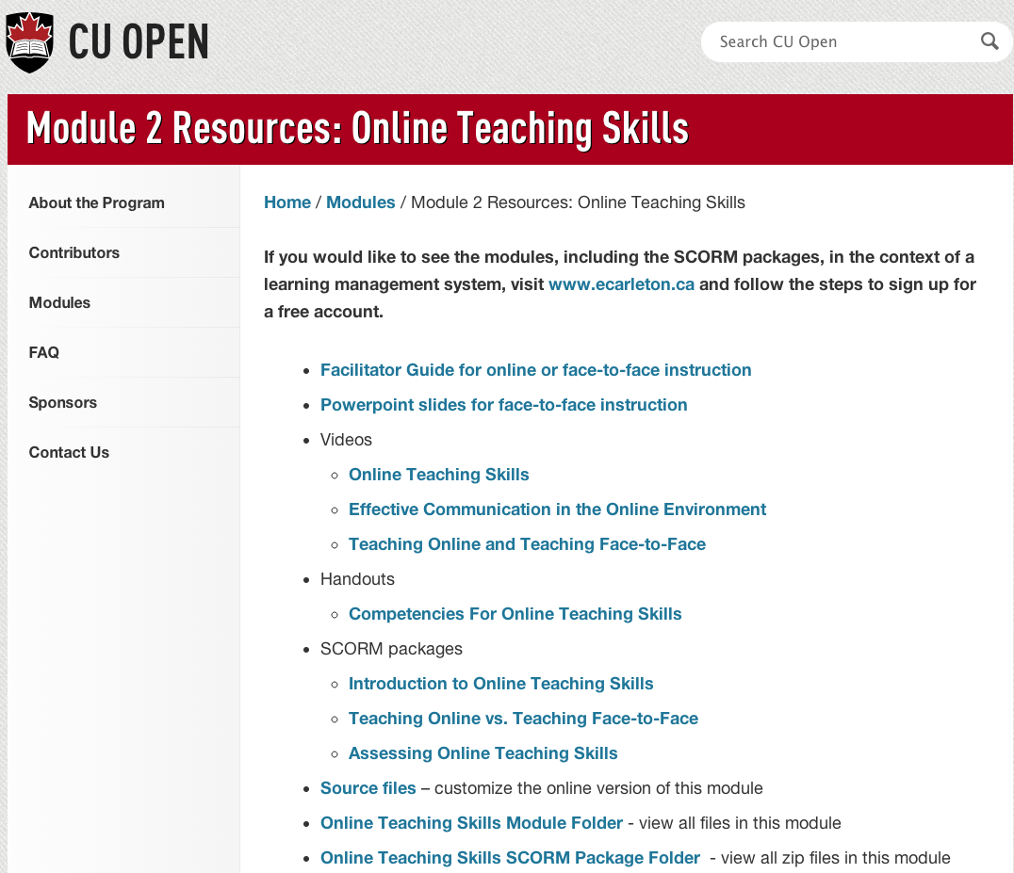
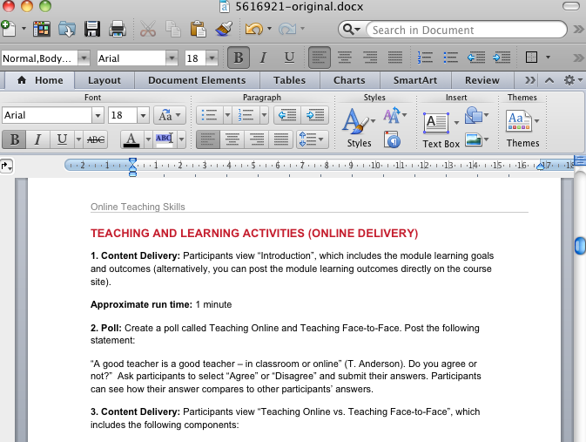
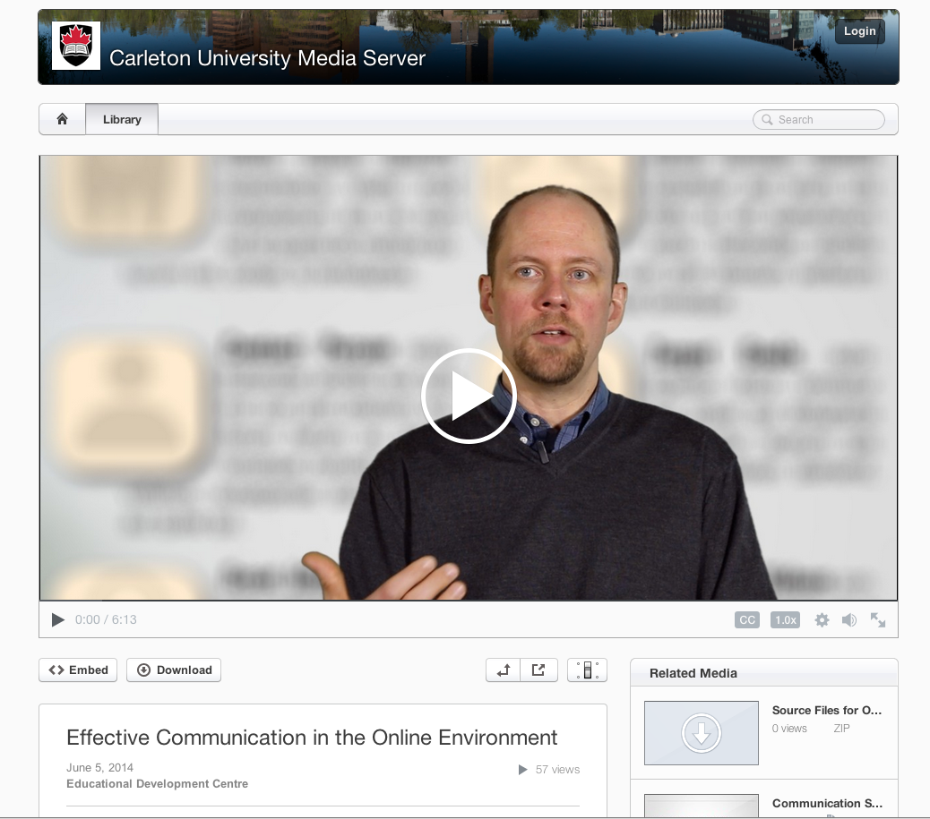
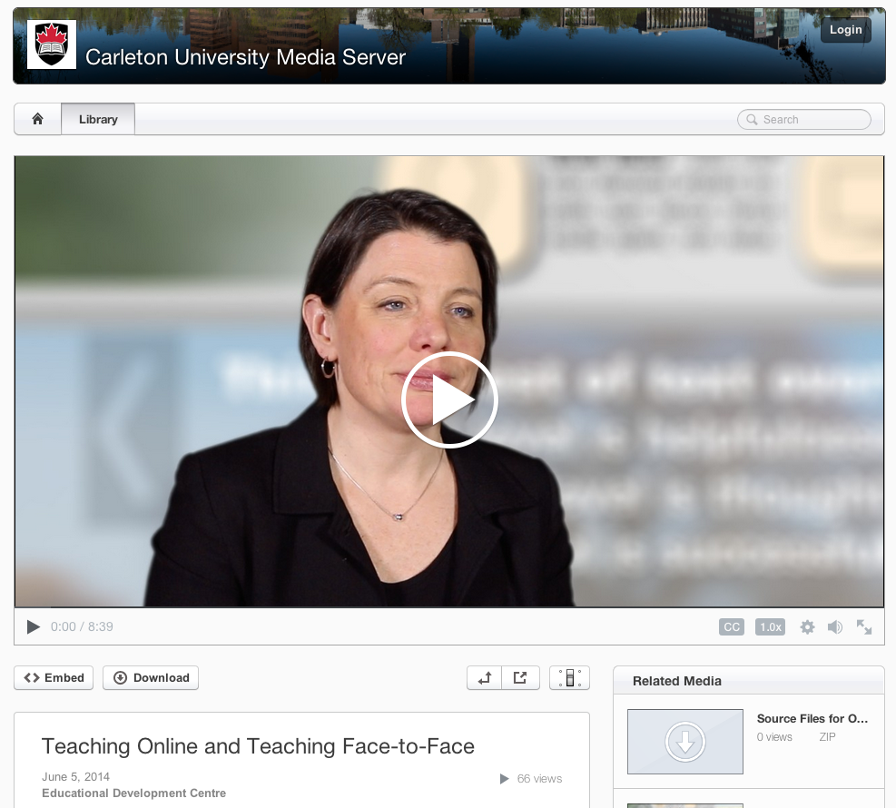
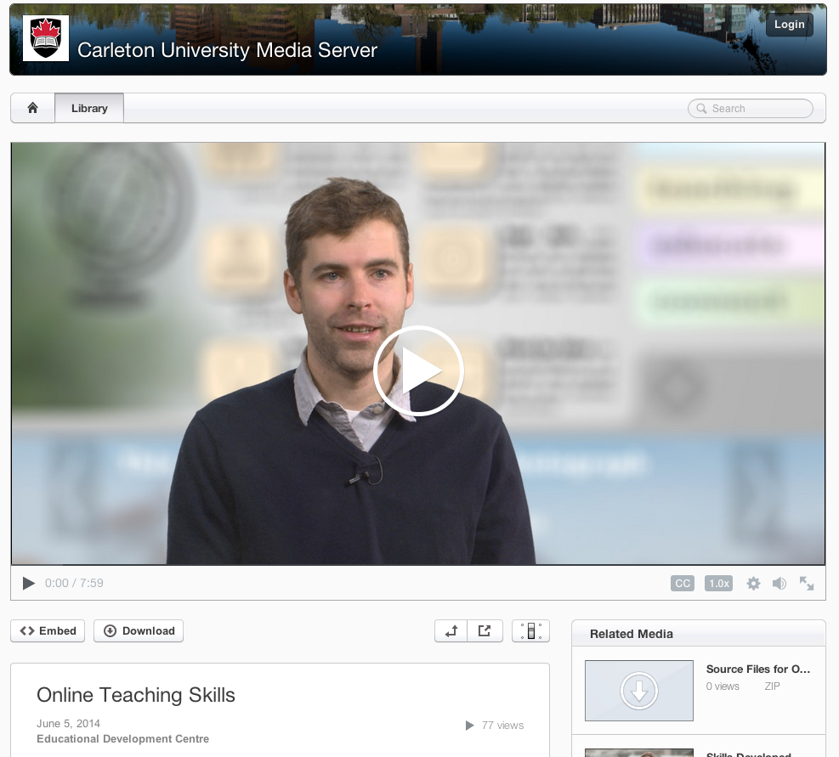
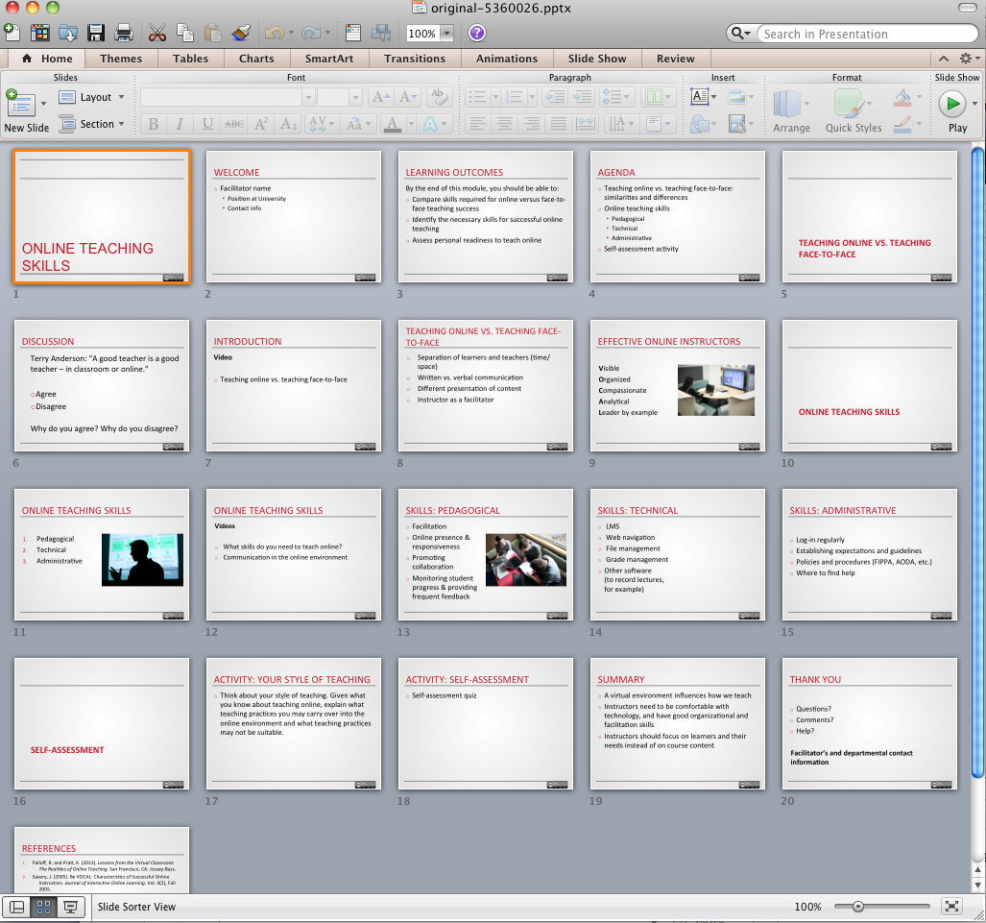
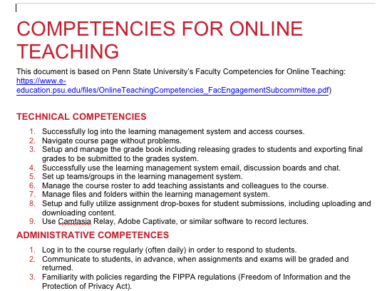

Slide 11
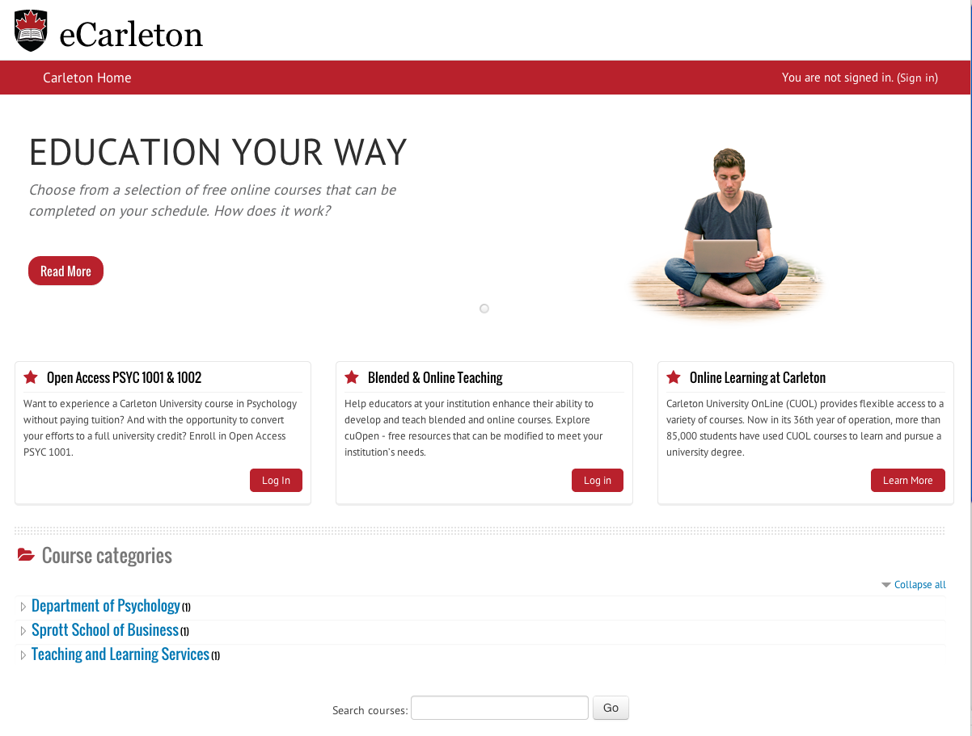

Slide 12
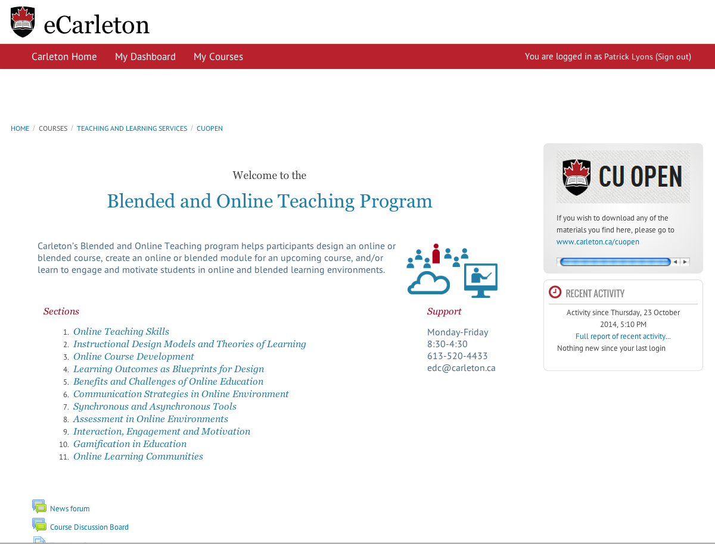

Slide 13
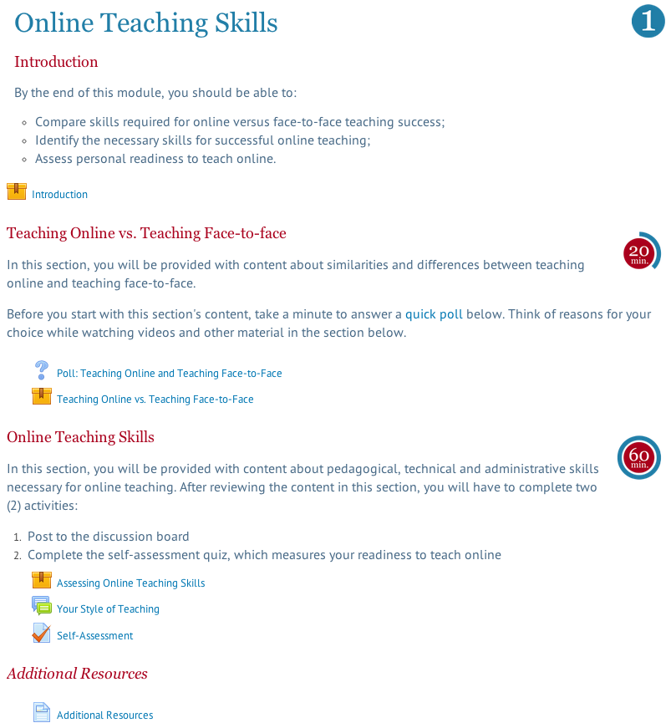
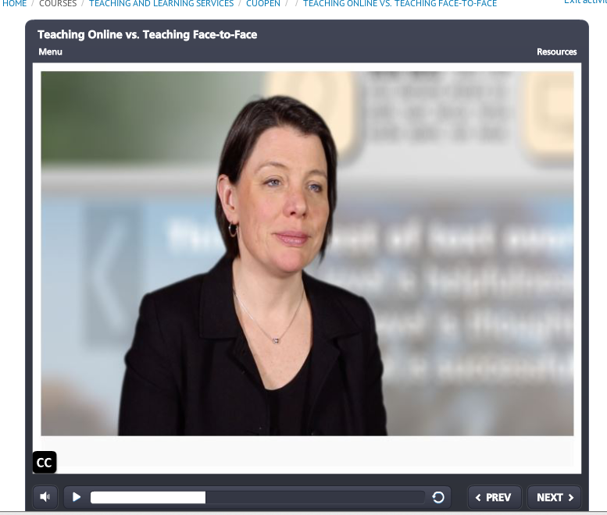
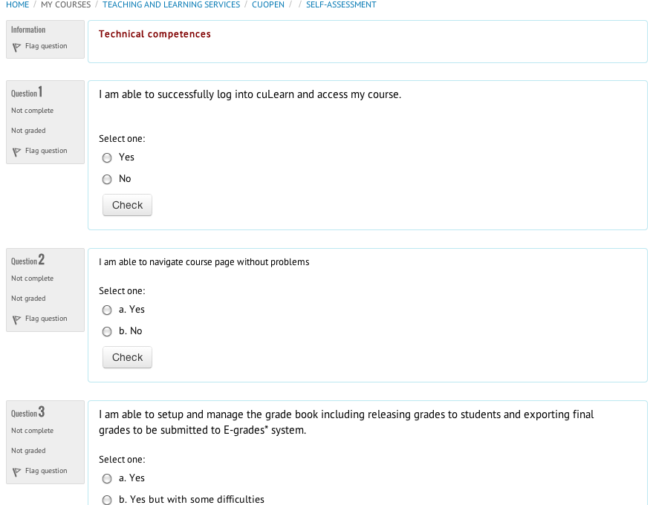
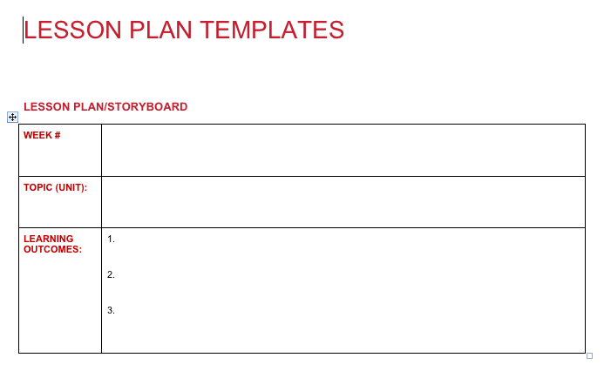

Slide 14
Challenges
Resources (time/staff)
Finding a fine balance between pedagogical and technological topics
Faculty expectations/different levels of background knowledge/motivation/prejudices towards online courses
Institutional adoption
Maintaining content relevancy

Slide 15
Next Steps
Collaboration (internally and externally)
Communicate
Enhance/Tweak

Slide 16
Take Away
IT’S FREE!
Freely available as open resources to any institution or person.
EVERYTHING: All materials online (video, slides, tips, facilitator guides, SCORM packages with source code)
UNBRANDED: Institutions can easily re-brand it and use it

Slide 17
Questions/Contact
www.carleton.ca/cuopen
Patrick_Lyons@carleton.ca

