Slide 1
30 YEARS IN 15 SLIDES
WHAT I LEARNED ASKING
CANADIANS ABOUT POLITICS

Slide 2
PEOPLE DON’T LOVE THE MEDIA
OR HATE POLITICIANS

Slide 3
IT ISN’T ALWAYS
ABOUT THE ECONOMY

Slide 4
OVER-HYPE…
& UNDER-WIN

Slide 6
“MAYBE” IS THE NEW “NO”
….& THE NEW “YES”

Slide 8
YOUR CORE VOTE …
IS LESS THAN THEY SAY IT IS

Slide 9
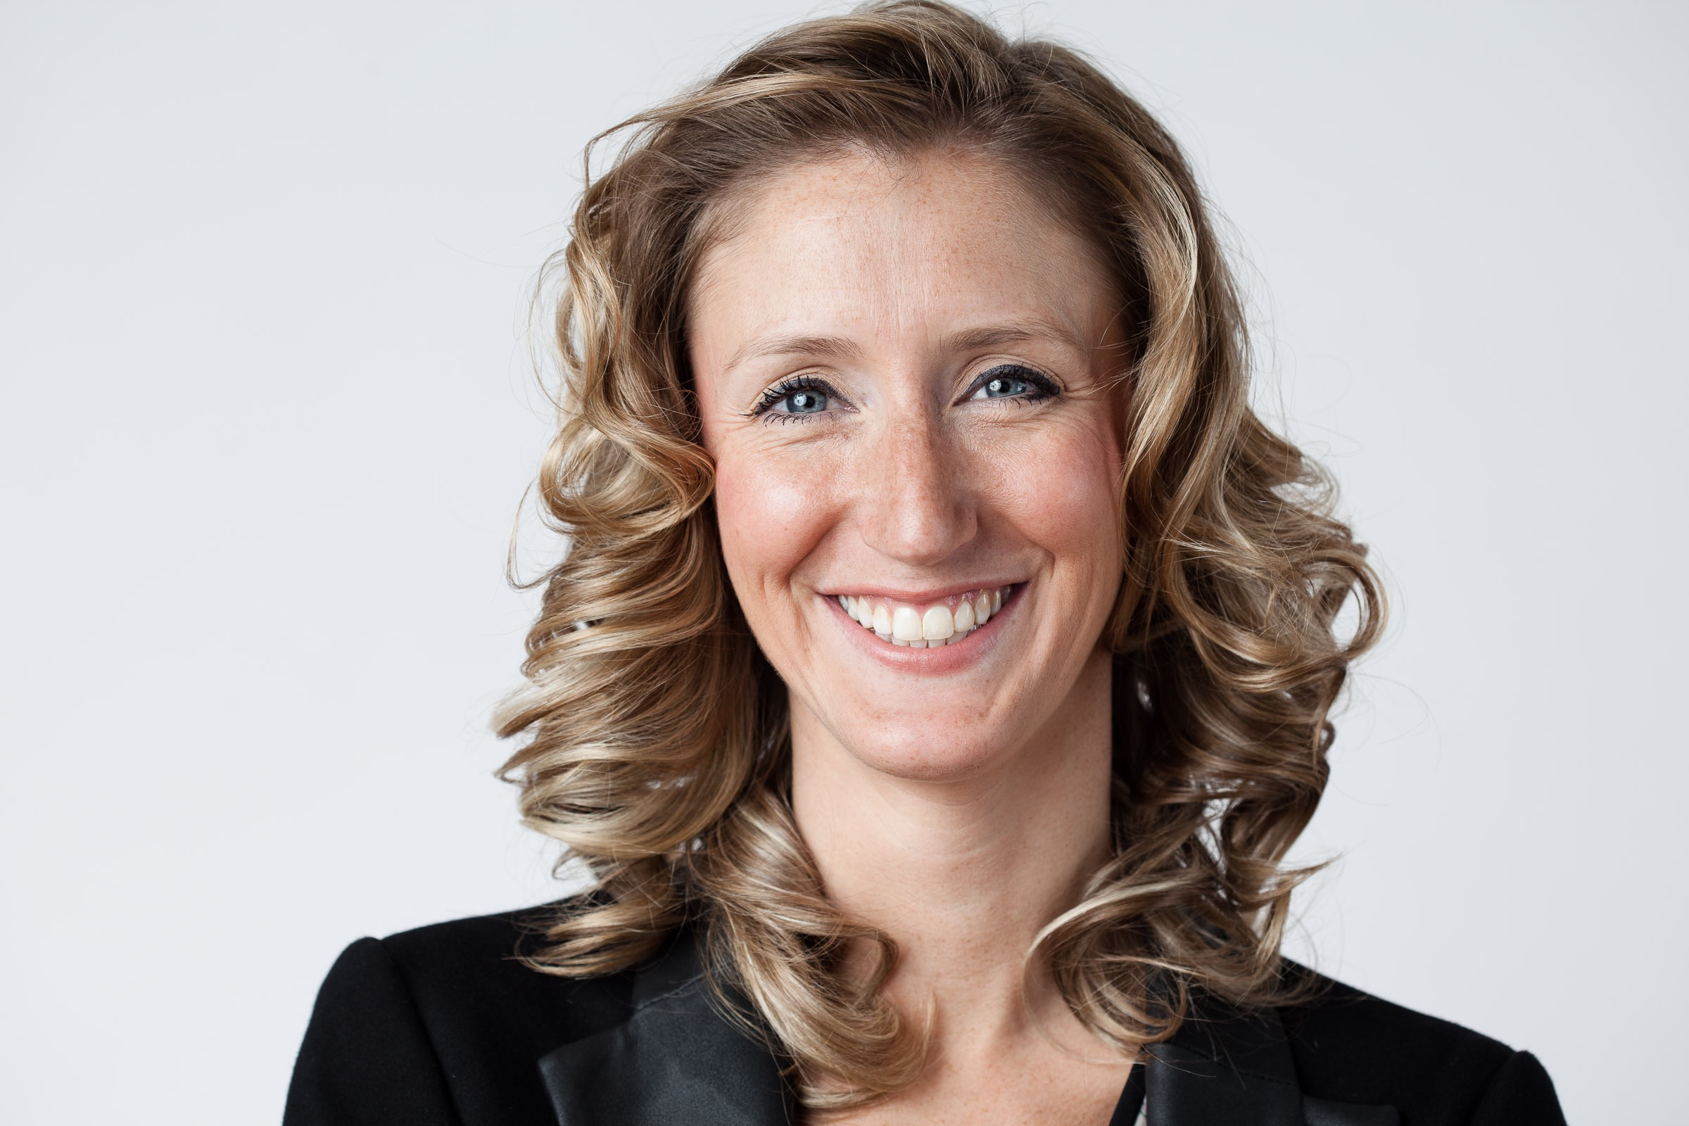

Slide 10


Slide 11
?
?

Slide 13
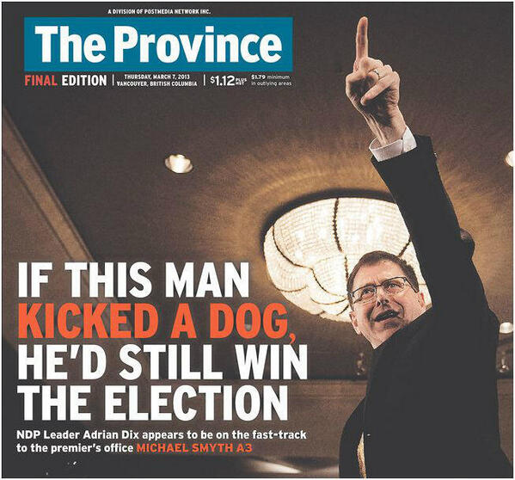

Slide 14
ASK A POLLSTER HOW…
NEVER ASK THEM WHAT

Slide 15
RUNNING ON YOUR RECORD….
IS ALWAYS A BAD IDEA

Slide 16
THANK YOU

