Slide 2
Lower oil prices and the energy outlook
May 2015
Ottawa, Canada
By
Adam Sieminski
U.S. Energy Information Administration

Slide 3
World crude oil price projection is lower in the AEO2015 Reference case than in AEO2014, particularly in the near term
Brent crude oil spot price
2013 dollars per barrel
History
Projections
2013
AEO2014
AEO2015
Source: EIA, Annual Energy Outlook 2015 Reference case and Annual Energy Outlook 2014 Reference case
Notes:
The North Sea Brent spot price of crude oil is considerably lower in AEO2015 than it was in AEO2014 as shown here, reflecting recent market trends. In the AEO2015 Reference case, the Brent price for crude oil falls from $109/bbl in 2013 to $56/bbl in 2015 and then increases to $76/bbl in 2018. After 2018, the Brent price increases, reaching $141/bbl in 2040 ($229/bbl in nominal dollars), as growing demand leads to the development of more costly resources.
In the AEO2014 Reference case, the projected Brent price in 2040 was $144/bbl.

Slide 4
For oil prices, the market-implied confidence band is very wide
WTI price
dollars per barrel
Source: EIA, Short-Term Energy Outlook, April 2015

Slide 5
Production growth in top crude producing regions (Permian, Bakken, Niobrara, and Eagle Ford) stops in early 2015
monthly percent change
three month rolling average
Source: EIA, DPR, April 2015

Slide 6
North American liquid fuels production slows
million barrels per day (MMbbl/d)
Source: EIA, Short-Term Energy Outlook, April 2015

Slide 7
World liquid fuels consumption picks up
million barrels per day (MMbbl/d)
Source: EIA, Short-Term Energy Outlook, April 2015

Slide 8
Oil supply and demand rebalance by late 2016
million barrels per day (MMbbl/d)
MMbbl/d
Source: EIA, Short-Term Energy Outlook, April 2015

Slide 9
Long-term considerations

Slide 10
All of the growth in liquid fuels consumption occurs in the emerging non-OECD (million barrels per day)
petroleum and other liquid fuels consumption, 1990-2040
million barrels per day
history
2010
projections
Non-OECD
OECD
Source: EIA, International Energy Outlook 2014

Slide 11
Most significant contributors to non-OPEC crude and lease condensate production: Canada, Brazil, U.S., Kazakhstan, Russia
non-OPEC crude and lease condensate production, Reference case
million barrels per day
Source: EIA, International Energy Outlook 2014
Notes:
The most significant non-OPEC contributors to production growth are Canada, the United States, Brazil, Russia, and Kazakhstan, which together account virtually all of the total net increase in non-OPEC crude and lease condensate supply.
Non-OPEC crude and lease condensate production in the Reference case grows by 15.3 MMbbl/d between 2010 and 2040, led by production gains in Canada (an increase of 3.0 MMbbl/d), Brazil (2.4 MMbbl/d), United States (2.2 MMbbl/d), Kazakhstan (1.6 MMbbl/d), and Russia (1.4 MMbbl/d).
In a shift from recent past IEOs, Mexico shows an increase over the projection in the IEO2014 Reference case of 0.8 MMbbl/d based on substantial near-term investment made by PEMEX and in the longer term, the impact of the changes in liberalizing Mexico’s energy laws, which we will talk about later in the presentation.

Slide 12
Reductions in energy intensity largely offset impact of GDP growth, leading to slow projected growth in energy use
U.S. primary energy consumption
quadrillion Btu
History
Projections
2013
2025
2040
Renewables (excluding liquid biofuels)
27%
29%
27%
Natural gas
8%
9%
10%
18%
19%
18%
Coal
8%
8%
8%
Nuclear
1%
1%
Liquid biofuels
1%
Petroleum and other liquids
36%
35%
33%
Source: EIA, Annual Energy Outlook 2015 Reference case
Notes:
Total U.S. primary energy consumption in the AEO2015 Reference case grows from 97 quadrillion Btu in 2013 to 106 quadrillion Btu in 2040. Most of the growth is in consumption of natural gas and renewable energy.
Total petroleum and other liquids consumption increases from 36.9 quadrillion Btu in 2013 to 37.1 quadrillion Btu in 2020, and then declines to 36.2 quadrillion Btu in 2040. The transportation sector continues to dominate demand for petroleum and other liquids, but there is a shift from motor gasoline to distillate.
Natural gas consumption in the AEO2015 Reference case increases from 26.9 quadrillion Btu in 2013 to 30.5 quadrillion Btu in 2040. The largest share of the growth is for electricity generation in the electric power sector, where demand for natural gas grows from 8.4 quadrillion Btu in 2013 to 9.6 quadrillion Btu in 2040, in part as a result of the retirement of 40 GW of coal-fired capacity between 2013 and 2025 (9 GW have been retired as of April 2015 with another 7 GW planned for retirement by the end of 2015 and 8 GW planned for retirement in 2016). Natural gas consumption in the industrial sector also increases, rapidly through 2016 and then more slowly through 2040, benefiting from the increase in shale gas production that is accompanied by slower growth of natural gas prices.
Coal use in the Reference case grows from 18.0 quadrillion Btu in 2013 to 19.0 quadrillion Btu in 2040. The Reference case and other AEO2015 cases do not include EPA’s proposed Clean Power Plan, which if implemented would likely have a significant effect on coal use.
Consumption of renewable energy increases by about 3.6 quadrillion Btu in the Reference case, from 9.0 quadrillion Btu in 2013 to 12.5 quadrillion Btu in 2040, with most of the growth in the electric power sector. Hydropower, the largest category of renewable electricity generation in 2013, contributes little to the increase in renewable fuel consumption. Wind-powered generation, the second-largest category of renewable electricity generation in 2013, becomes the largest contributor in 2038.
Nuclear generation remains close to the current level through most of the projections as the impact of new plant additions are offset by retirements.

Slide 13
In the transportation sector, motor gasoline use declines; diesel fuel, jet fuel, and natural gas use all grow
transportation energy consumption by fuel
quadrillion Btu
History
2013
Projections
2030
2040
24%
Diesel
31%
31%
10%
Other*
3%
Jet fuel
4%
13%
CNG/LNG
14%
1%
4%
3%
Ethanol
2%
5%
3%
48%
44%
58%
Motor gasoline
Source: EIA, Annual Energy Outlook 2015 Reference case
*Includes aviation gasoline, propane, residual fuel oil, lubricants, electricity, and liquid hydrogen
Notes:
13
13
Transportation total delivered energy consumption (excluding pipeline) declines from 27.0 quadrillion Btu in 2013 to 26.4 quadrillion Btu in 2040 in the AEO2015.
This trend differs markedly from history, which saw 1.3% average annual growth between 1973 and 2007 (the peak year for consumption).
Declining projected energy consumption is the result of a sharp drop in pure motor gasoline energy consumption, which falls 13% from 2013 to 2040.
Motor gasoline consumption falls due to rising light-duty vehicle fuel economy. Fuel economy improves due to GHG emissions and CAFE standards, which more than offset the increase in motor gasoline consumption from a modest growth in total VMT.
All other transportation fuels are projected to grow between 2013 and 2040, led by diesel fuel (+1.5 quadrillion Btu) and compressed and liquefied natural gas (+0.7 quadrillion Btu).
Rising diesel fuel consumption comes from strong growth in heavy-duty vehicle miles traveled, tempered only somewhat by rising GHG and fuel consumption standards.
Growing use of natural gas as a transportation fuel by the end of the projection occurs as increased numbers of heavy-duty vehicles, locomotives, and marine vessels switch away from diesel fuel due to fuel price dynamics.
Jet fuel consumption increases modestly as growth in personal air travel is tempered by increased energy efficiency.
In the big picture, the majority of energy consumed in the transportation sector by the end of the projection is still in the movement of people (mostly motor gasoline and jet fuel), although personal travel demand across modes grows more slowly than historically while energy efficiency improves at a greater rate than historically. Energy consumed in the movement of goods (mostly diesel and natural gas) grows relatively more due to robust travel demand and moderate efficiency gains.

Slide 14
U.S. crude oil production rises above previous historical highs before 2020 in all AEO2015 cases, with a range of longer-term outcomes
U.S. crude oil production
million barrels per day
History
2013
2013
2013
Reference
High Oil and Gas Resource
Low Oil Price
U.S. maximum production level of
9.6 million barrels per day in 1970
Tight oil
Lower 48 offshore
Other lower 48 onshore
Alaska
Source: EIA, Annual Energy Outlook 2015
Notes:
14
14
Reference case
In 2017, U.S. crude oil production is projected to surpass the 1970 oil production peak, and by 2020 hits a new peak 1 million barrels per day higher (10.6 million bbl/d).
Total U.S. oil production is expected to decline after 2020, due to the decline of onshore oil fields and the decline in tight oil production, which begins to dominate after 2021.
Other cases
The path of projected crude oil production varies significantly across the cases, with total U.S. crude oil production reaching high points of 16.6 million bbl/d in the High Oil and Gas Resource case (in 2039) and 10.0 million bbl/d in the Low Oil Price case (in 2020).
In the High Oil and Gas Resource, total U.S. crude oil production is higher than in the Reference case mainly as a result of growth in tight oil production, which rises at a substantially faster rate in the near term than in the Reference case.
In the High Oil and Gas Resource case, tight oil production grows in response to assumed higher estimated ultimate recovery (EUR) and technology improvements, closer well spacing, and development of new tight oil formations or additional layers within known tight oil formations.
Most of the difference in total crude oil production levels between the Reference and Low Oil Price cases reflects changes in production from tight oil formations. However, all sources of U.S. oil production are adversely affected by low oil prices. As crude oil prices fall and remain at or below $76/barrel (Brent) in the Low Oil Price case after 2014, poor investment returns lead to fewer wells being drilled in noncore areas of formations, which have smaller EURs than wells drilled in core areas. As a result, they have a more limited impact on total production growth in the near term.

Slide 15
U.S. crude oil supply and disposition change, 2025 v. 2013
thousand barrels per day
Source: U.S. Energy Information Administration, based on Turner, Mason and Company

Slide 16
Projected U.S. natural gas exports reflect the spread between domestic natural gas prices and world energy prices
U.S. natural gas imports and exports
trillion cubic feet
billion cubic feet per day
History
Projections
2013
2013
2013
Lower 48 states LNG exports
40
30
Alaska LNG exports
Pipeline exports to Mexico
20
10
0
Pipeline exports to Canada
Pipeline imports from Canada
-10
LNG imports
Reference
High Oil and Gas Resource
Low Oil Price
-20
Source: EIA, Annual Energy Outlook 2015
Notes:
16
16
Reference case
The United States remains both an importer and exporter of natural gas over the projection period, although natural gas imports into the United States fall by 41% from 2013 to 2040 and natural gas exports from the United States, both via pipeline and overseas via LNG, grow by nearly four-fold over the same time period.
Pipeline exports of U.S. natural gas to Mexico grow by 6% per year, from 0.7 Tcf in 2013 to 3.0 Tcf in 2040, and pipeline exports to Canada grow by 0.1% per year, from 0.9 Tcf in 2013 to 0.93 Tcf in 2040 (Canadian exports peak in 2027 at 1.28 Tcf).
U.S. exports of LNG increase to 3.4 Tcf in 2030 and remain at that level through 2040. Just over 2.5 Tcf of that volume originates from the lower 48, with the remainder from Alaska.
Natural gas pipeline net imports from Canada remain below 2013 levels through 2040 in all the AEO2015 cases, but these imports do increase in response to higher natural gas prices in the latter part of the projection period.
Other cases
In the High Oil and Gas Resource case, abundant U.S. dry natural gas production keeps domestic natural gas prices lower than international prices, supporting the growth of U.S. LNG exports, which total 10.3 Tcf in 2037 and account for 66% of total U.S. natural gas exports in 2040.
In the Low Oil Price case, with lower world oil prices, U.S. LNG exports are less competitive and grow more slowly, to a peak of 0.8 Tcf in 2018, and account for 13% of total U.S. natural gas exports in 2040. At the time that the modeling for AEO2015 was frozen, there was only one LNG project actively under construction (Sabine Pass with a capacity of 0.8 Tcf or 2.2 Bcf/d)
The United States continues to import small volumes of LNG, largely to help satisfy peak winter demand in the Northeast.
Projected exports are sensitive to assumptions regarding conditions in U.S. and global natural gas markets.

Slide 17
U.S. CO₂ emissions are sensitive to the influence of future economic growth and energy price trends on energy consumption
energy-related carbon dioxide emissions
million metric tons
History
Projections
2013
High Economic Growth
High Oil and Gas Resource
Reference
Low Economic Growth
Source: EIA, Annual Energy Outlook 2015
Notes:
Energy-related carbon dioxide emissions stabilize with improvements in energy and carbon intensity of electricity generation. Improved efficiency in the end-use sectors and a shift away from more carbon-intensive fuels help to stabilize U.S. energy-related CO2 emissions, which remain below the 2005 level through 2040.
U.S. energy-related CO2 emissions in 2013 totaled 5,405 million metric tons. In the AEO2015 Reference case, CO2 emissions increase by 144 million metric tons (2.7%) from 2013 to 2040, to 5,549 million metric tons—still 444 million metric tons below the 2005 level of 5,993 million metric tons.
As noted earlier, the AEO2015 cases do not assume implementation of EPA’s proposed Clean Power Plan or other actions beyond current policies to limit or reduce CO2 emissions.
Among the alternative cases, emissions show the greatest sensitivity to levels of economic growth, with 2040 totals varying from 5,979 million metric tons in the High Economic Growth case to 5,160 million metric tons in the Low Economic Growth case.

Slide 18
North American energy cooperation
Notes:
In the AEO2015 Reference case, the Brent spot oil price decreases from $___ per barrel (in 2013 dollars) in 2013 to $__ per barrel in ____. After ____, the Brent price increases, reaching $___ per barrel in 2040 (or about $235 per barrel in nominal dollars) as growing demand leads to the development of more costly resources (Figure E-1). This compares to $__ per barrel in 2040 in the AEO2014.
The key determinants of long-term petroleum and other liquids supply and prices can be summarized in four broad categories: the economics of non-OPEC petroleum liquids supply; OPEC investment and production decisions; the economics of other liquids supply; and world demand for petroleum and other liquids.
Among the key assumptions defining crude oil use in the AEO2015 Reference case over the projection period are average economic growth of ___% per year for major U.S. trading partners; average annual economic growth with other U.S. trading partners of ___%; and declining U.S. liquid fuels consumption per unit of GDP. This leads to a slight increase in liquids consumption by the Organization for Economic Cooperative Development (OECD) countries and annual growth of ___% in liquids consumption among non-OECD countries, with annual consumption growth in China and India of ___% or above. Production in AEO2015 from non-OPEC countries, particularly the United States, increases to levels above those in AEO2014. This results in a decline in the OPEC market share to less than __% in the near term, before increasing to a range of __% to __% after ____.
Major trading partners include Australia, Canada, Switzerland, United Kingdom, Japan, Sweden and the Eurozone.

Slide 19
Tri-lateral cooperation: Canada, Mexico, & United States memorandum of understanding signed 12/15/2014
1) Reconciliation of import and export information on energy flows. The working group would develop a cross reference for terminology and a table of conversion factors across the three countries. EIA would propose subcategories of+ crude oil, refined products, natural gas and electricity.
2) GIS mapping. The working group would establish a standard format, sourcing protocols and a mechanism for file/data sharing. Each party would provide its public map layers to each partner, while asking them to provide theirs. It would then be up to each party to decide if and how they want to display the information they receive from the other parties.
3) Outlooks for crossborder flows of fuels. EIA would propose that we begin by sharing information among the three partners regarding recent historical data and outlooks for cross border flows of oil, natural gas, and electricity. The information exchange would also provide some brief information on broader energy measures -- production and consumption of the energy commodities – as well as information on some of the key outlook drivers – economic and population growth.

Slide 20
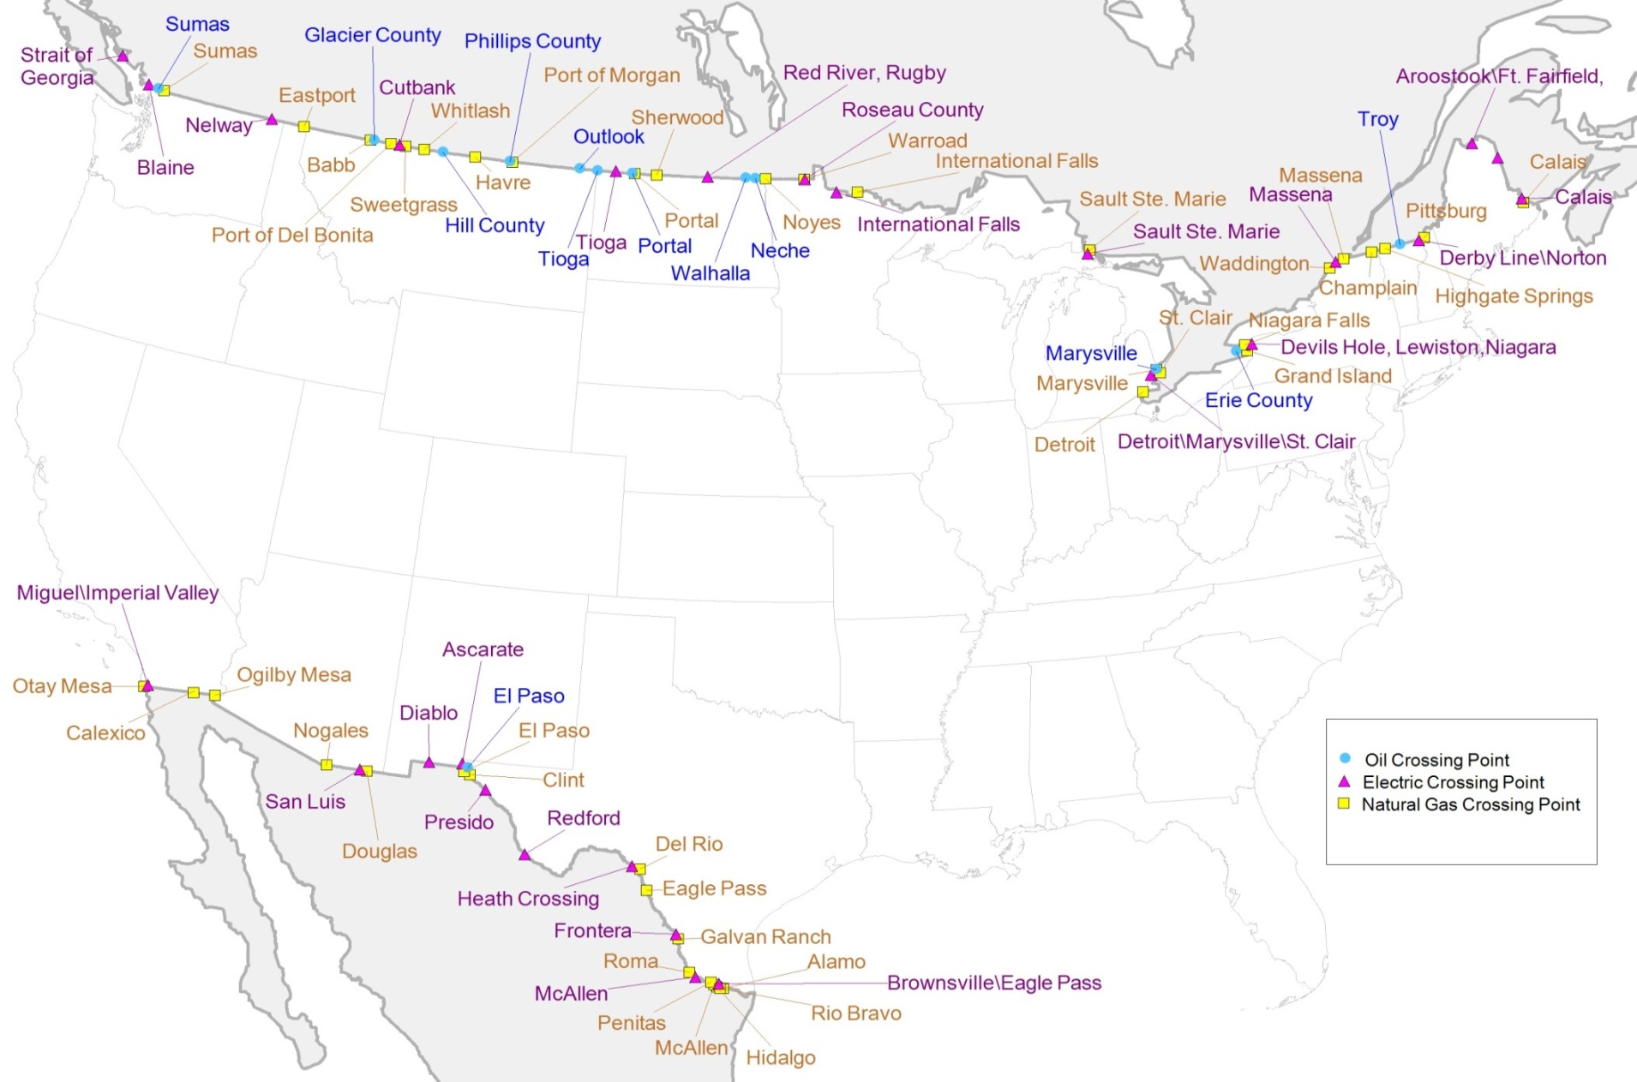
North American border crossing points for electricity and oil and natural gas pipelines

Slide 21
For more information
U.S. Energy Information Administration home page | www.eia.gov
Annual Energy Outlook | www.eia.gov/aeo
Short-Term Energy Outlook | www.eia.gov/steo
International Energy Outlook | www.eia.gov/ieo
Monthly Energy Review | www.eia.gov/mer
Today in Energy | www.eia.gov/todayinenergy
State Energy Profiles | http://www.eia.gov/state
Drilling Productivity Report | http://www.eia.gov/petroleum/drilling/

