Slide 1
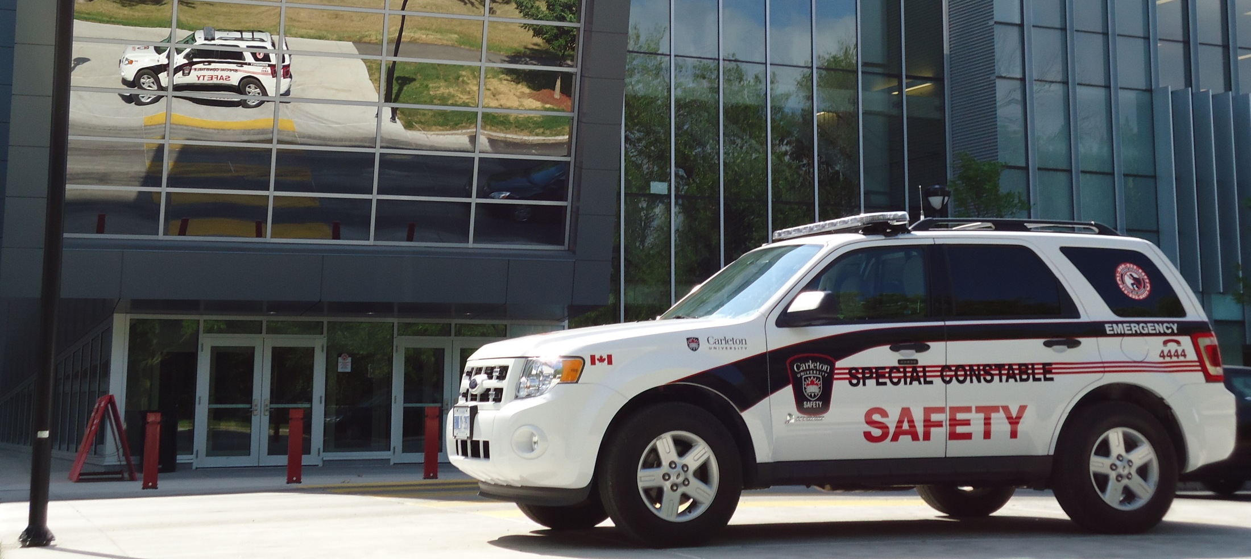
Department of University Safety S/Cst Mark Hargreaves Community Liaison Officer

Slide 2
Safety and EMCP Who we are? What to do if… How to contact us? Questions?

Slide 3
So… Who are we?
25 SPECIAL
CONSTABLES
30 STUDENT SECURITY STAFF
50+ CUSERT
RESPONDERS
PARKING
SERVICES
24/7 EMERGENCY
COMMUNICATION CENTRE

Slide 4
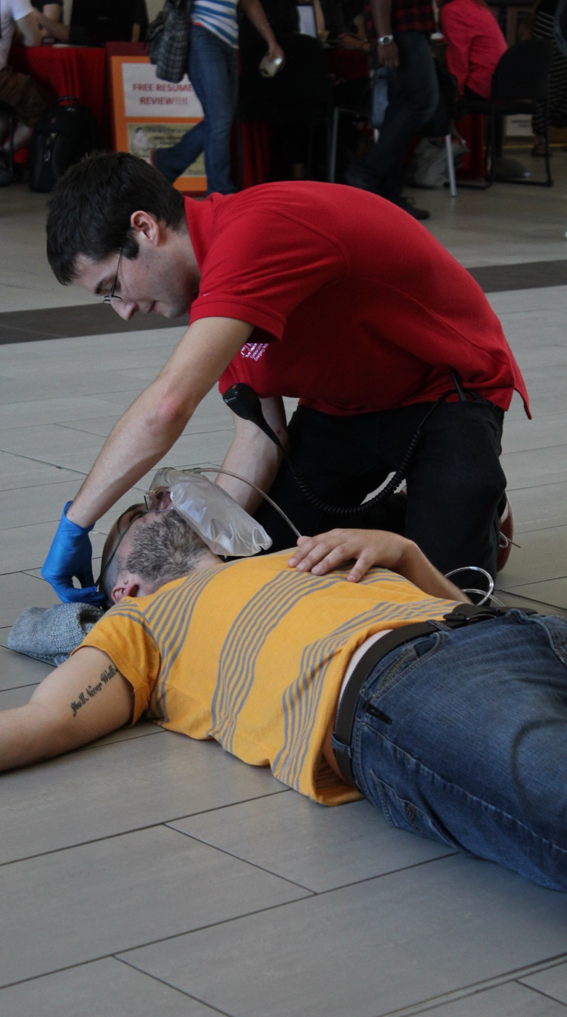
COMMON SITUATIONS
MEDICAL EMERGENCY
LOST STUDENT
THEFTS
PHYSICAL CONFRONTATIONS

Slide 5
HOW TO CONTACT US?
613-520-4444

Slide 6
THANK YOU
QUESTIONS?

