Slide 1
Understanding global refugee policy
James Milner
Carleton University
James.Milner@carleton.ca

Slide 2
Global refugee policy
Significant area of activity within the global refugee regime
Recent examples of global refugee policy:
UNHCR’s 2014 policy on alternative to camps
UNHCR’s 2011 policy on age, gender and diversity
UNHCR’s 2010 policy on statelessness
UNHCR’s 2009 policy on displacement and natural disasters
UNHCR’s 2009 urban refugee policy
ExCom’s 2009 Conclusion on protracted refugee situations
ExCom’s 2007 Conclusion on children at risk

Slide 3
Our understanding of global policy
Although Refugee and Forced Migration Studies has long been concerned with the elements and implications of policies refugees and other displaced persons, our understanding of the process that leads to these policies at the global level, and the factors affecting implementation at the local level, is surprisingly limited.
Contrast with our understanding of national and regional policies
Concerns about relations between research and policy and the independence of academic research (Bakewell 2008; Castles 2003)
Need for focused examination to add clarity to the concept and disaggregate the stages at which it can be understood and observed

Slide 4
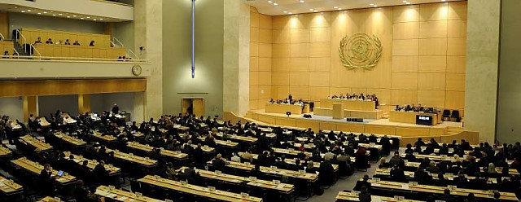
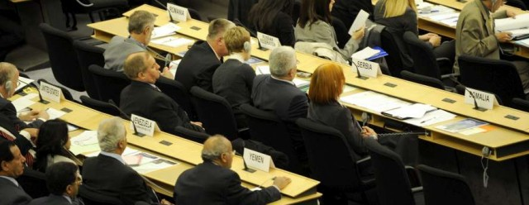
Why does this matter?
Time and energy dedicated by states, UNHCR and NGOs to the making and implementation of global refugee policy
Implicit moral claims relating to its legitimacy and ability to improve conditions for refugees and other ‘persons of concern’
A test for the functioning of the global refugee regime
Remains poorly understood despite its prevalence

Slide 5
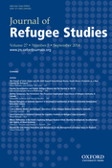
Understanding global refugee policy
Focus of 30th Anniversary Conference for the Refugee Studies Centre, University of Oxford, December 2012 and pre-conference workshop
Special issue of Journal of Refugee Studies, December 2014
Milner: Editorial introduction
Miller: Lessons from global public policy
Fresia: ExCom Conclusion on children at risk
Landau and Amit: Urban policy in South Africa
Milner: Protracted refugee situations in Tanzania
Gammeltoft-Hansen: Transnational policy networks
Kneebone: Global refugee policy and the Bali Process

Slide 6
What is global refugee policy?
‘Global refugee policy’ is a formal statement of, and proposed course of action in response to, a problem relating to protection, solutions or assistance for refugees or other populations of concern to the global refugee regime
Motivated by ‘policy problem’ affecting persons of concern to the global refugee regime (ie. not only refugees)
From decision-making bodies of the global refugee regime
Takes the form of either ‘regulations that define the limits of permissible behavior for national governments’ or ‘programs administered by international agencies’ (Soroos 1990)

Slide 7
GRP as product and process
Global refugee policy is both a product (the text of the policy document itself) and a process by which the policy is made, implemented and evaluated:
Agenda setting: How do certain issues make it on to the GRR’s agenda?
Policy formulation: Who presents different policy options?
Decision-making: Where and how are policies formalized?
Policy implementation: What factors condition variation in implementation?
Policy evaluation: How does evaluation inform revision?
Understanding the process will contribute to better uses of, and engagement with, global refugee policy

Slide 8
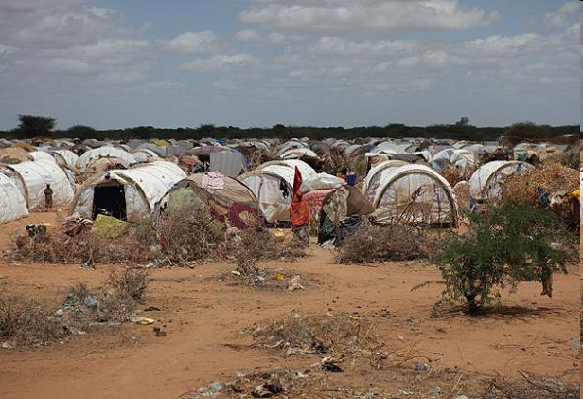
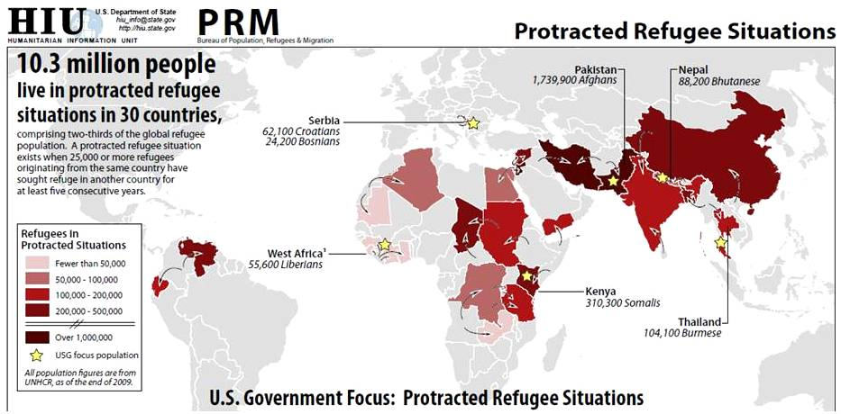
Case study: Protracted refugee situations
Some two-thirds of today’s refugees are trapped in protracted refugee situations (PRSs)
Average duration of refugee situations has risen from 9 years in 1993 to 18+ years today
Most PRSs are in some of the poorest and most unstable regions of the Global South

Slide 9

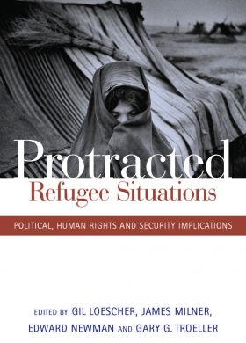
Making global policy on PRS
UNHCR evaluations from 1999 to 2003
Issue raised by UNHCR at June 2004 SCom
External research and advocacy campaigns
Canadian leadership (IDWG)
Culminated in three events:
High Commissioner’s Initiative on PRSs (June 2008)
High Commissioner’s Dialogue on PRSs (December 2008)
ExCom Conclusion on PRSs (December 2009)
Final text contains agreement on definition of the policy problem and steps to be taken by states and other actors to resolve the problem of protracted refugee situations

Slide 10
Negotiating the ExCom Conclusion
Lessons in the product and the process…
Failure to reach consensus by September 2009
Role of donor states in sustaining negotiations through to December 2009
Tensions between donor/resettlement countries (global North) and countries of first asylum (global South)
Definition of a protracted refugee situations (duration v. size)
Pathways to local integration and debates on self-reliance
Assertions of sovereignty and concerns of host states
Calls for case-specific and multi-sectoral responses
Indicative of the changing dynamics of ExCom itself?

Slide 11
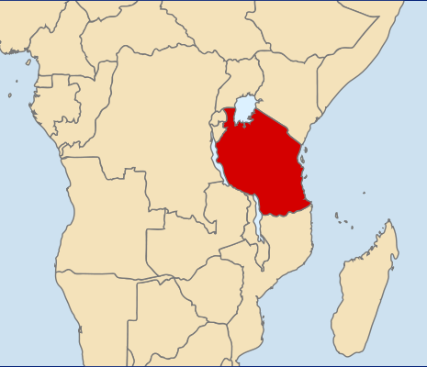
Implementing GRP on PRSs: Tanzania
2007: Tanzania announced its willingness to naturalize some of the 220,000 Burundian refugees who had been on its territory since 1972
Tanzania was one of five test cases for HC’s Initiative
February 2008 supplementary appeal: US$34 million
Program launched in March 2008
164,000 individuals apply for Tanzanian citizenship
June 2010: 98% of application accepted
Success?

Slide 12
Non-implementation of GRP on PRS
GoT required relocation from settlements to acquire citizenship
June 2010: Draft National Strategy for Community Integration Programme (NaSCIP) called for US$350 million to support relocation from the 3 settlements to 16 regions across Tanzania
US$103 million included in 2011-2015 UNDAP
US$55 million for relocation and integration
US$48 million to enhance ‘absorption capacity of receiving communities’
21 June 2011: ‘The government will consider another avenue that will please Tanzanians on this matter’ (Minister of Home Affairs)
August 2011: Relocation planning suspended

Slide 13
Explaining non-implementation
Declining public confidence in CCM and President Kikwete and tensions within the ruling party since October 2008
October 2010 election results
Kikwete returned with 62.8% of the vote (compared with 80.3% in 2005)
CCM wins 186 of the directly elected seats (compared with 206 in 2005)
Opposition parties gain in refugee-hosting and potential relocation areas
Rise in opposition to naturalization among CCM MPs post election:
Why is our country so generous? I see no reason why we should grant citizenship to these people even if they have applied for it. They should go home. We are not given such kind of treatment when we seek citizenship in other countries, why them? I think this matter should be re-considered.
(Azza Hamad, MP, 29 July 2011)

Slide 14
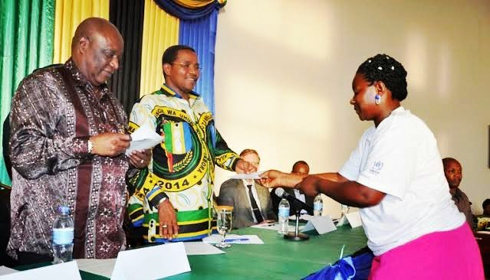
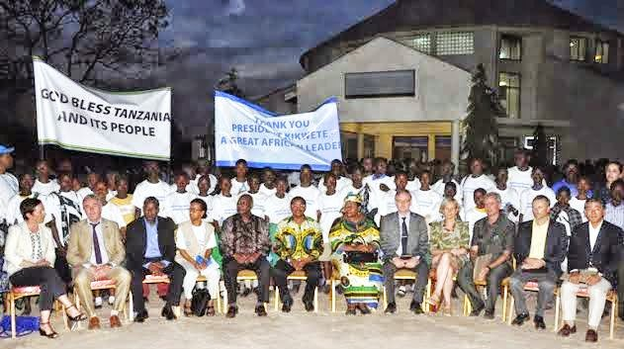
But then…
ExCom 2014: Tanzanian delegation announced that the naturalization process will proceed, without requiring relocation
14 October 2014: Citizenship granted to all approved applications, including dependents born after processing
Relocation no longer a requirement
Encouraging news, but how to explain the twists and turns?
http://issamichuzi.blogspot.ca/2014/10/rais-kikwete-awapa-uraia-wakimbizi-wa.html?showComment=1413343186882

Slide 15
Lessons from Tanzania
What role for global refugee policy?
Important in the early development of the policy, especially in rallying international support, but limited ability to alter domestic constraints
Need to consider the full policy cycle
Importance of recognizing and seizing policy opportunities
Need for on-going political analysis to understand the domestic context within which global refugee policy is implemented
What role for global policy actors?
Change in leadership in UNHCR Tanzania
Response of donor community to relocation planning and delays

Slide 16
Lessons for the study of global refugee policy
Soroos (1986): Mechanisms through which global policy actors affect national jurisdictions:
prioritizing particular policy problems
enforcement of regulations
financing specific programmes
Betts (2013): ‘If the processes that shapes implementation can be understood, they can be influenced’
What interests beyond the state? What role for sub-state (LGAs), non-state (private sector), bureaucratic and political actors?
How can a more rigorous understanding of the implementation of global refugee policy lead to more predictable results?

Slide 17
Next steps
Wednesday seminar series:
6 May: Jeff Crisp and MaryBeth Morand, “Better late than never? The evolution and implementation of UNHCR’s urban refugee policy”
13 May: Marion Fresia, “Ethnographic understandings of global refugee policy: Looking at policy in practice”
20 May: Guy Goodwin-Gill, “UNHCR’s protection guidelines: What role for external voices?”
27 May: Phil Orchard, “Global policy for IDPs: A parallel process?”
“Understanding power and influence in the global refugee regime”
1-2pm, 5 May 2015, Meeting Room A

Slide 18
Next steps
Global Refugee Policy Network (http://www.refugeeresearch.net/ms/grp)
Develop common approaches to studying the making and implementation of different examples of global refugee policy
Encourage comparative and collaborative research
Opportunities for sharing knowledge
Develop partnerships to examine global refugee policy
Building from CARE-Carleton-York MoU
Graduate students working with different policy partners examining the making of global refugee policy or the implementation of the same policy in different locations
Ability to draw common lessons from comparative research
Workshop at Carleton University, Ottawa, in September 2015
Video-linked with RSC (Oxford), CRS (York) and ISIM (Georgetown)

Slide 19
Thank you… I welcome your comments and suggestions!
James Milner
Carleton University
James.Milner@carleton.ca

