Slide 1

Certificate Program in Regulatory Leadership Regulatory Reflections April 12, 2016
Robert Slater, Carleton University
Michael Presley, University of Ottawa
A Critical Conversation™: Reflections on Regulatory Regimes – Present & Future

Slide 2
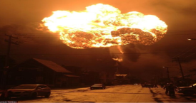


Outline
1. Management
2. Multiple Players
3. Social Licence

Slide 3
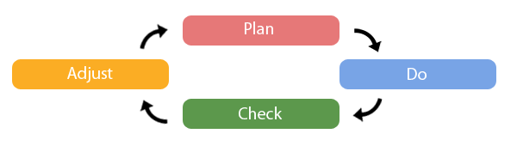
Management

Slide 4
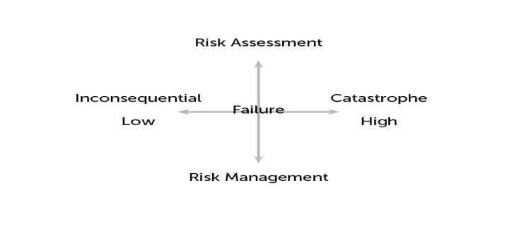
Management

Slide 5

Multiple Players
Government Inspection
International Alignment/outcomes
Private Sector Supply chain standards
Civil Society Monitoring/standards

Slide 6

Social Licence
“Divided We Stall”
3 Licences:
1. Financial
2. Regulatory
3. Social
Social: “till the ground”….confidence in government

Slide 7
Conclusions
Three Takeaways:
1. Improve management
2. Invest in people
3. Prize: Comparative national advantage

