Slide 1

The Volkswagen Scandal: Implications for the Regulatory Regime
Kassem El Saddik
PhD Public Policy
SPPA- Carleton University
A Critical Conversation™:Reflections on Regulatory Regimes – Present & Future

Slide 2
Volkswagen Story
The Scandal unfolds
The engineering of the scandal
The regulatory Aspect
Many violations setting a precedence
The implications of the scandal
  For Volkswagen
  Beyond Volkswagen
Features of the Future Regulatory Framework

Slide 3
The Volkswagen Story… large, ambitious, rapidly growing motor vehicle company…
Five Leading Vehicles Manufacturers by Global Sale (Million units) in 2014
It has been one of the leading carmakers in the world… aiming at holding the “No. 1” position in the industry by 2018…
“We want to have the most satisfied employees and customers in the world, sell more than 10 million cars a year and achieve a profit margin of more than 8 percent” Martin Winterkorn (VW CEO)
Source: Moving Progress, Facts and Figures - Navigator 2015, December 2014
Notes:
Let’s start by the story of a large, ambitious, rapidly growing motor vehicle company

Slide 4
The Volkswagen Story… large, ambitious, rapidly growing motor vehicle company…
Vehicle Sales (in thousands)- CAGR= 8.85%
Volkswagen’s workforce grew at an average rate of 10.64% (2010-2015) reaching 583 thousand employees.
Sales Revenues (in Million Euros)- CAGR=12.4%
The Group has set a sustainability strategy and reported taking forward steps in the Climate Change discourse.
Source: Moving Progress, Facts and Figures - Navigator 2015, December 2014
Notes:
In line with the strategic directions, the Group hit the 2018 target in 2014. In fact, it has increased the number of vehicles delivered to customers to 10.2 million from the 9.7 million in 2013, with a growth rate of 8.85% in vehicle sales since 2010 weighted average growth rate
Sale revenues reached 202.5 billion euros (2013: €197 billion), with a weighted average growth rate of 12.4% since 2011, as illustrated in figure 5. The 2014 profit amounted to €11.1 billion compared to €9.1 billion in 2013.
The Group expressed its support for the World Business Council for Sustainable Development “WBCSD Road to Paris” aiming at realizing the “2 degree” target at COP21 in Paris toward the end of 2015.
yet the scandal blew it away…

Slide 5
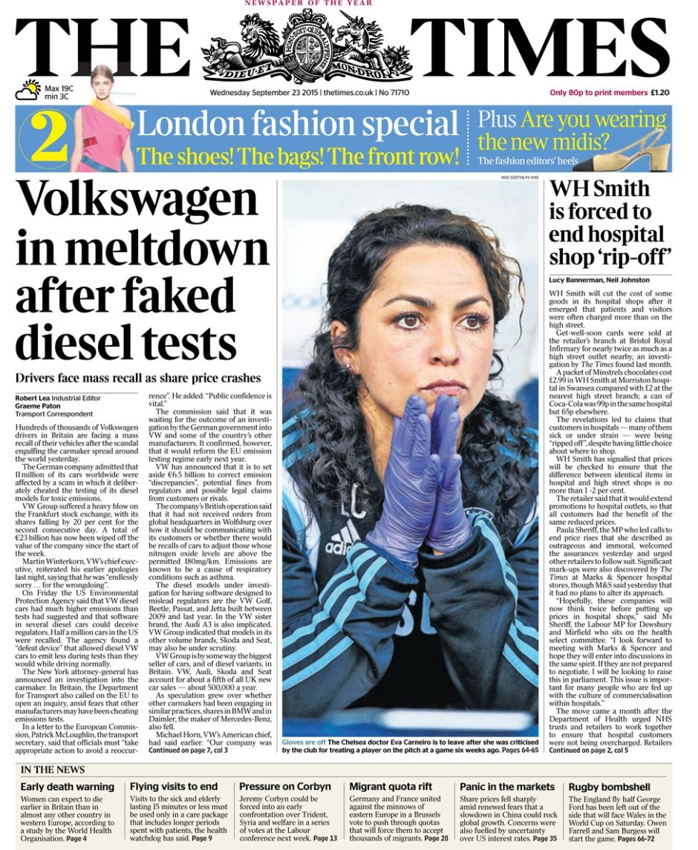
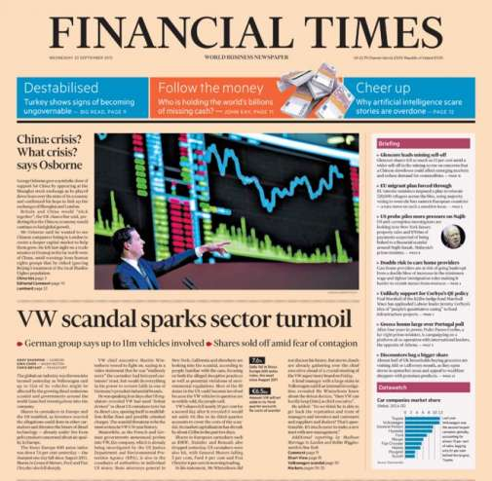


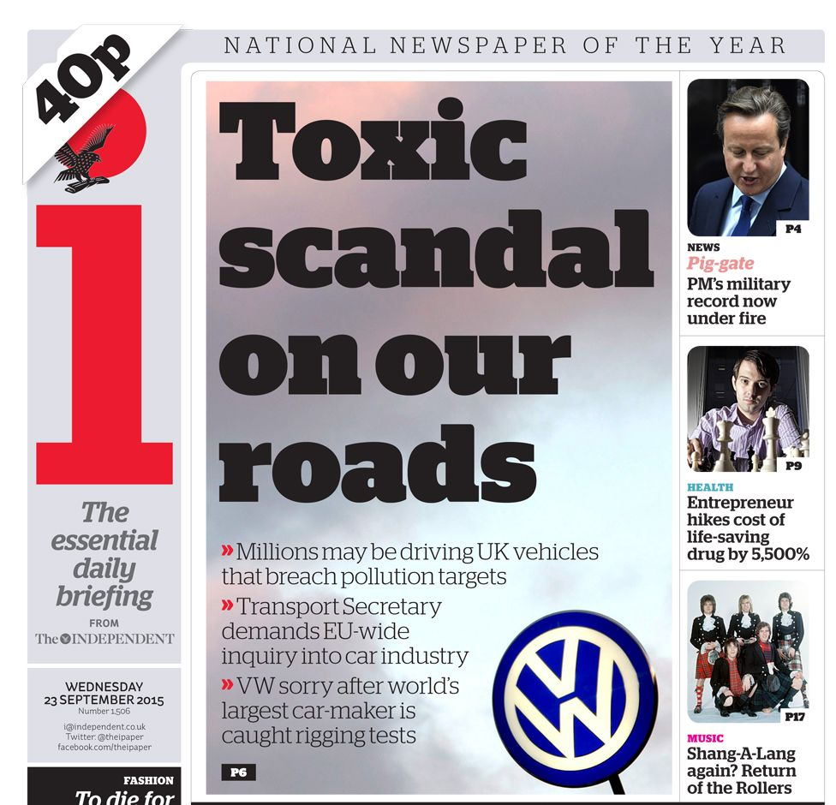
Notes:
However, in September 2015 VW occupied the headlines news… but this time the story was not about the success of the company but rather about its meltdown and suicide…
We have been all bombarded with news about the VW scandal…
No newspapers or magazine in September 2015 does not heave VW Scandal as the main news heading…

Slide 6
The scandal unfolded…
May
2014
3 Sept 2015
18 Sept 2015
2 Nov 2015
26 Jan 2016
ICCT notified CARB
EPA was Notified
1st NOV of CAA violation
(2.0 L vehicles)
2nd NOV Detailed violation
(3.0 L vehicles)
US Justice Dpt
($46 billion penalties - CAA)
Massive media exposure (Social media)
Once revealed, The VW Scandal received widespread media attention with headlines fronting news website…
Devastating Immediate implications for VW
Notes:
The issue emerged when the International Council on Clean Transportation (ICCT) - contracted the Center for Alternative Fuels Engines and Emissions at West Virginia University to test emissions from three light-duty diesel vehicles in 2014.
The aim was to run the tests under more “realistic” conditions than the ones in the laboratory context. To do so, the scientists fitted cars with a portable emissions measurement system.
The tests found that the levels of NOx emitted by:
1- Volkswagen Jetta vehicles were 15–35 times greater than the US standard (31 milligrams per km)
2- Volkswagen Passat were found to be 5–20 times greater.
The results were provided to the California Air resources Board in May 2014, and since then they became public.
1- On 3 September 2015, EPA threatened to withdraw its approval for all Volkswagen diesel vehicles approved for sale in the US.
2- On 18 September 2015, EPA issued a notice of violation (NOV) of the Clean Air Act to Volkswagen Group of America, Inc. alleging that model year 2009 – 2015 Volkswagen and Audi diesel cars equipped with 2.0 liter engines included software that circumvents EPA emissions standards for nitrogen oxides.
3- On 2 November 2015, EPA issued a second Notice of Violation (NOV) to Volkswagen Group (including Porsche) alleging that the Group has developed and installed a defeat device in certain light duty diesel vehicles equipped with 3.0 liter engines for model years 2014 through 2016 that increases emissions of nitrogen oxide up to nine times EPA’s standard

Slide 7
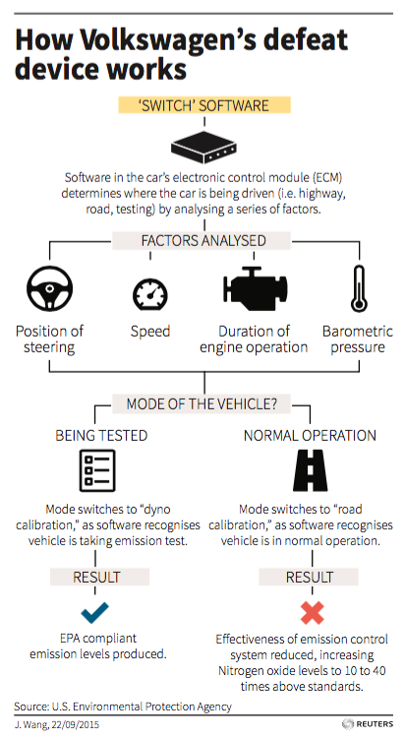
The engineering of the scandal…
The US EPA accused Volkswagen of violating key provisions in the CCA standard, particularly:
Noncompliance with CCA emissions
“bypassing, defeating, or rendering inoperative elements of the vehicle design related to compliance with CCA emission standard”.
2. Selling and introducing into the market vehicles that do not conform CCA standard.
Notes:
The software detects when the “Normal Mode” vehicle is not being tested. In such mode, tail pipe emissions of NOx are up to 9 times the permissible standard level.
It is a violation to the Clean Air Act…
Let’s have a look at the evolution of the emissions-related policy and regulatory regime

Slide 8
The regulatory Aspect…
The city of Pittsburgh
1890s, Chicago and Cincinnati issued ordinance to control smoke and shoot
“Motor Vehicle Air Pollution Control Act”
“Air Quality Act” in 1967 that set the “Criteria” pollutants
“Clean Air Act” (CCA)
Significant amendments to the CAA took place in 1966, 1970, 1977 and 1990-
1- New regulatory format
2- Tougher vehicle emissions standards
1990
1967
1965
1963
1860’s
Six Criteria Pollutants: (1) Carbon Monoxide (CO), (2) Sulfur Dioxide (SO2), (3) Nitrogen Oxides (NOx), (4) Ozone (O3), (5) Lead and (6) Particulate Matter (PM)
Notes:
Evolution of increasingly stringent standards for vehicle emission regulations
The first city order was passed in Pittsburgh city in the late 1860s prohibiting the use of bituminous coal or wood in locomotives.
In 1890s, Chicago and Cincinnati issued ordinance to control smoke and shoot from locomotives and factories
Cities turned to states to issue and enforce laws, while the states had to involve the federal state because of lack of data at local levels.
In 1955, the first air pollution law was enacted federally
In 1960, the Motor Vehicle Exhaust Study Act was enacted (to provide the study within 2 years
The “Clean Air Act” (CCA) was issued in 1963, followed by the “Motor Vehicle Air Pollution Control Act” in 1965, and the “Air Quality Act” in 1967
Significant amendments to the CAA took place in 1966, 1970, 1977 and 1990. but nothing since then.
The first legislated exhaust tailpipe emission standards were promulgated by the State of California for 1966 model year for cars sold in that state, followed by the United States as a whole in model year 1968.
In Canada: In 1971 under the Motor Vehicle Safety Act which was administered by Transport Canada.
in 1999, the Canadian Environmental Protection Act 1999 (CEPA 1999) was issued transferring the authority from from Transport Canada to Environment Canada and enacted the on-road vehicle emissions control .
“Criteria Pollutants” are set by the Federal law and necessitates the agencies to develop criteria for the states to use in controlling them.
Carbon Monoxide (CO)
Sulfur Dioxide (SO2)
Nitrogen Oxides (NOx)
Ozone (O3)
Lead
Particulate Matter (PM)

Slide 9
Yet, there has been a precedence for many violations …
1995
1998
2011
2014
2015/ 16
GM
$45 million
470 thousand vehicles
Honda
$267 million
1.6 million vehicles
EC JRC
On-road emissions of diesel vehicles exceed permissible level
ICCT
Portable emission measurement system revealed the discrepancy between Lab and “on-road” emissions
Volkswagen Scandal
$46 billion penalties - CAA
Ford Motor
$7.8 million
6 thousand vehicles
Massive media exposure (Social media)
Ironically, t took a couple of outliers (small research team) to uncover and make public what has been known within the industry for some time…
Notes:
Volkswagen diesel emission case is not the first violation in the vehicle industry. Nor has it been the first time automakers took advantage of their foreknowledge of the specific laboratory test conditions in order to bypass emissions controls during testing.There have been signs of violations looming prior to the scandal.
GM: for installing illegal devices in some 470,000 Cadillacs to defeat emissions controls, emitting 100,000 tons of CO.
Honda spent $267 million to correct the disabling of the misfire monitoring device on 1.6 million vehicles (1996 and 1997 model)
Ford Motor Company paid $7.8 million for programming 60,000 Ford Econoline vans (1997 model) to keep emissions low during the 20-minute EPA test routine, and then disabling the emissions controls during normal highway cruising.

Slide 10
The implications of the scandal…
USD 7.3 billion on rectifying the emissions issues
May
2014
3 Sept 2015
18 Sept 2015
2 Nov 2015
26 Jan 2016
ICCT notified CARB
EPA was Notified
1st NOV of CAA violation
(2.0 L vehicles)
2nd NOV Detailed violation
(3.0 L vehicles)
US Justice Dpt
($46 billion penalties - CAA)
VW Stock fell by a third (2nd week)
VW Stock fell by another 17%
VW Sale fell by 25 % (compared by Nov. 2014)
US Justice Dpt
($46 billion penalties - CAA)
more than 11 million vehicles were affected by the emission violation
2.8 million in Germany alone
Investors trust
Notes:
On all fronts, financial, liability, management and customer trust…
Before resigning, Martin Winterkorn expressed that: "I personally am deeply sorry that we have broken the trust of our customers and the public“.
The US EPA announced that should the allegations be proven, Volkswagen Group could face fines of up USD 18 billion (corresponding to US$37,500 per vehicle). Furthermore, the US Department of Justice Environment and the Natural Resources Division have embarked into conducting a criminal probe of Volkswagen AG's conduct. EPA decided to broaden its investigations, focusing on 28 diesel-powered models made by various manufacturers. On 4 January 2016, the US justice department, on behalf of the EPA, filed a lawsuit against VW in a federal court in Detroit, Michigan, seeking up to $46 billion in penalties for Clean Air Act violations. Besides, the states of West Virginia, New Mexico, Texas and Harris County, Texas have filed separate lawsuits seeking restitution from VW. The company also faces investigations by 48 U.S. state attorneys.

Slide 11
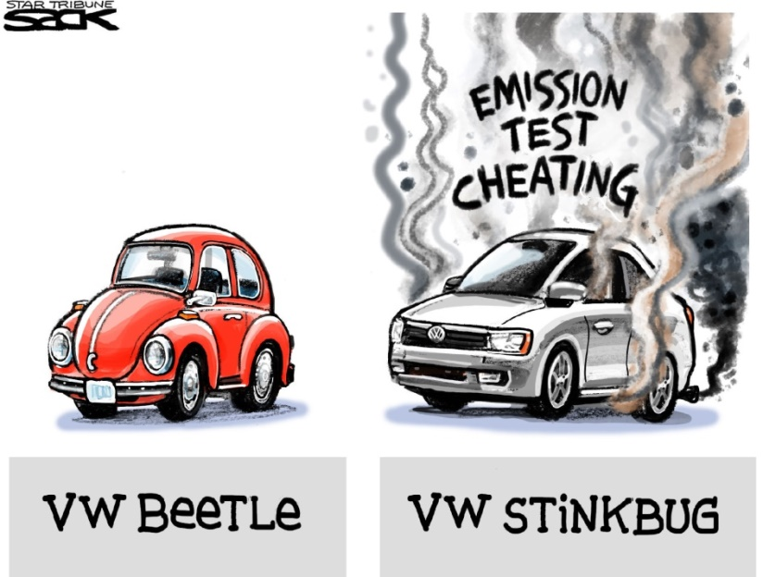
Implications beyond Volkswagen…
Car Industry
Massive scale press statements by the different car manufacturers aiming at distancing themselves from the scandal, reassuring public confidence, and reiterating their compliance with the set regulations.
Confidence in Diesel Vehicles
Rising demand for the new generation of vehicles – mainly the hybrid and electric ones
German Pride
Lawsuit tsunami affecting German competitiveness
Notes:
Volkswagen’s scandal has severely shaken the customers’ confidence not only in Volkswagen vehicles and technologies, but in the diesel vehicle technology in general
1- The scandal triggered massive scale press statements by the different car manufacturers aiming at alienating themselves from the scandal, reassuring the public confidence, and reiterating their compliance with the set regulations.
2- Emerging views suggest that the scandal is setting limits for the diesel-vehicle industry in particular and the conventionally-fueled vehicles in general, anticipating a rising demand and appreciation for the new generation of vehicles – mainly the hybrid and electric ones.
(3) Media (Reuters for instance) emphasized the unprecedented scale of the crisis that could jeopardize the whole German economy. This echoed the Deutsche Welle – Germany's main state broadcasters – qualifying the crisis as a "lawsuit tsunami" that might affect the German competitiveness and blow up the "Made in Germany" pride and branding.
(4) The scandal has raised public awareness and probably polarized the public vis a vis the diesel vehicle emissions. Most of the car manufacturers have become under public scrutiny. Many voices have criticized the inadequacy of the current regulations and their enforcement. They have called for a more “real-time” testing and enforcement to be implemented.

Slide 12
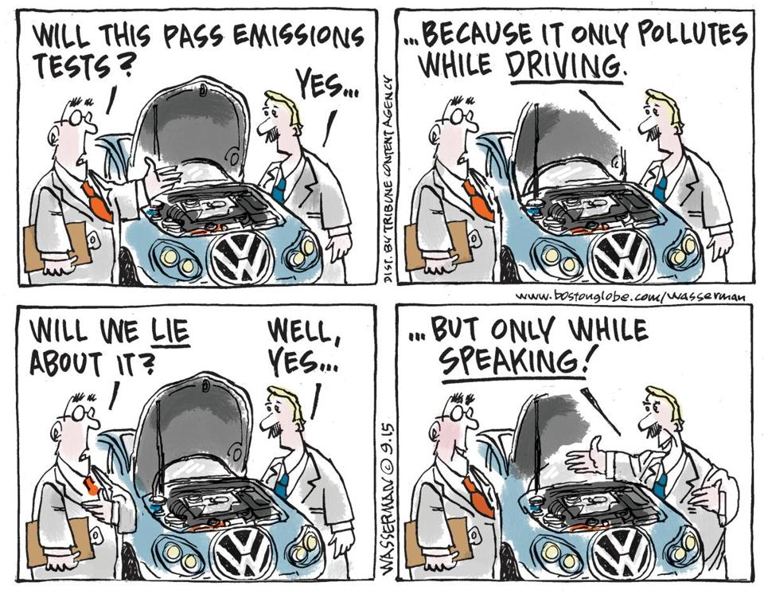
Implications beyond Volkswagen…
Regulatory Regime
Calling for more “real-time” testing and enforcement to be implemented.
Notes:
(4) The scandal has raised public awareness and probably polarized the public vis a vis the diesel vehicle emissions. Most of the car manufacturers have become under public scrutiny. Many voices have criticized the inadequacy of the current regulations and their enforcement. They have called for a more “real-time” testing and enforcement to be implemented.

Slide 13
Features of the future regulatory framework…
The flexibility of “Performance-based Regulation” is “both its principle advantage and challenge”, particularly in absence of the regulators’ oversight and audit. (Cary Coglianese)
Some key features of the future regulatory framework that should be taken into consideration :
Ensure public interest not just private interest
Meet statutory objectives
Have effective systems and processes of transparency and public accountability
Ensure and maintain a higher level of trust between the regulators and regulated on one hand, and the regulated and the general public on the other…
(Professor and Director of the Penn Program on Regulations at the University of Pennsylvania Law School)
Thank you
Notes:
Though the full range of impacts is unclear … The scandal is revealing serious concerns with regard to the overall regulatory regime governing the industry…
The Volkswagen case makes it clear that regulators opting to use performance-based regulation need to pay careful attention to how they monitor compliance once firms start to take advantage of the flexibility that performance standards offer. Though performance-based regulation might be theoretically superior, in reality, it is perceived that it only works when regulated firms’ performance can be assured.
”Flexibility gives firms room to find ways to comply with the letter of the law while still advancing their private goals – but sometimes they do so at the expense of public goals”

