Slide 1
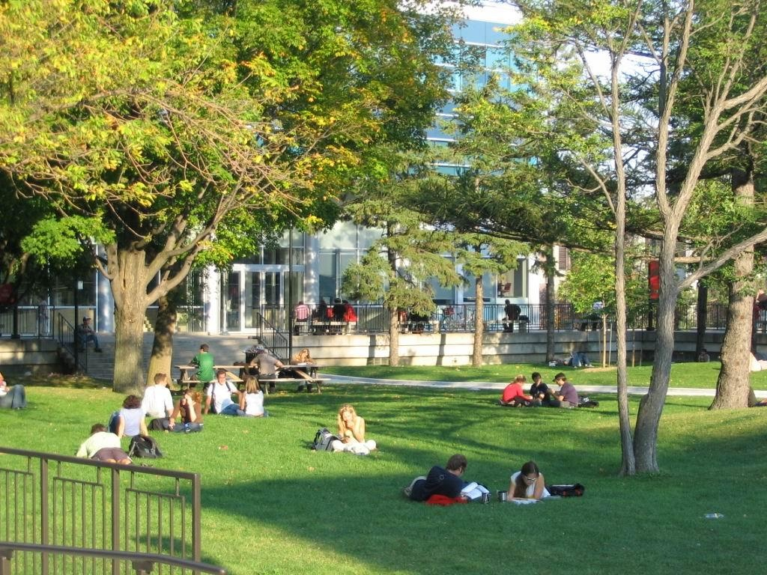
Achieving Emergency Management & Continuity of Operations for Carleton
Allan Burns, Project Director
Tony Lackey, Project Risk, Finance & Liaison Officer
Dr. Wayne Boone CD CBCP PCIP, Project Technical Advisor
Notes:
Support Briefing.

Slide 2
Outline of Briefing
Background
Project Aim and Rationale
Emergency Management / Continuity of Operations explained
Project Operations and Functional Approach
Expected Results
What The Team Needs From You And Your Staff
Benefits For You And Your Staff
Conclusion And Questions
Notes:
With existing resources, within RTO

Slide 3
Background
Table Top Exercise of Carleton’s Emergency Management (EM) capability (Nov 2010)
Covered only Emergency Response subset of EM
No business functions were resumed (recovery and restoration subsets of EM)
Uncertainty of Carleton’s ability to resume operations after a major interruption
EMCO Project initiated to enhance EM capability under sponsorship of VP Finance & Admin
Notes:
Director University Safety and CU Subject Matter Experts project proposal
Approved by VP Fin and Admin
Pres and VPs briefed and agree

Slide 4
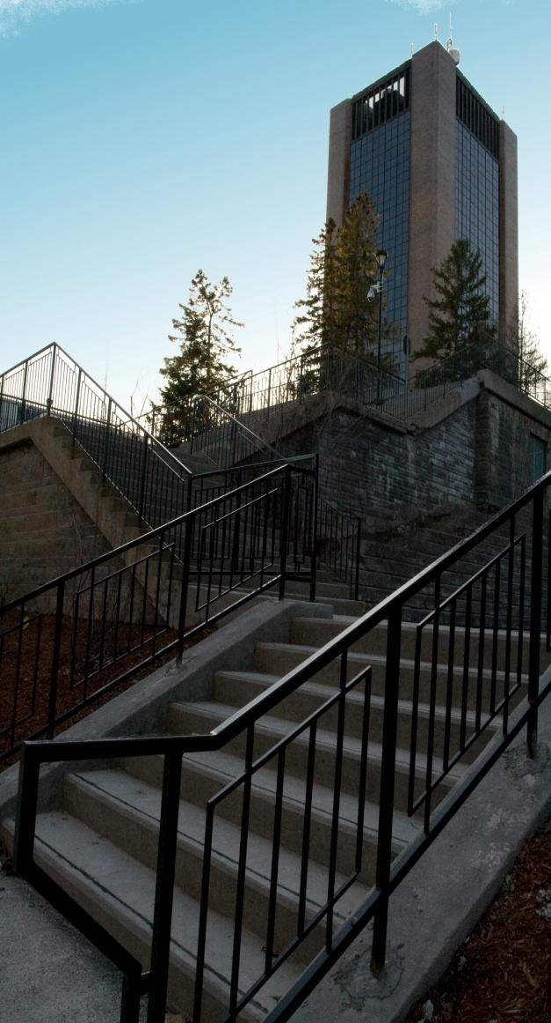
Project Aim
Assess current state of Emergency Management & Continuity of Operations (EMCO) capabilities at Carleton
Propose a way ahead to help Carleton address the current operational risk environment and to align with industry best practice in EMCO
Implement Carleton’s EMCO program
Notes:
Educate you on the conceptual breadth and depth of Emergency Management & Continuity of Operations (EMCO)
Capability requirements
Provide a status report on current EMCO capabilities at Carleton
Propose a way ahead to help Carleton address the current operational risk environment and to align with industry best practice in EMCO
Seek guidance to implement Carleton’s EMCO program
Which other committees should be briefed
Recommendation for next steps
Note replaced CU with Carleton throughout

Slide 5
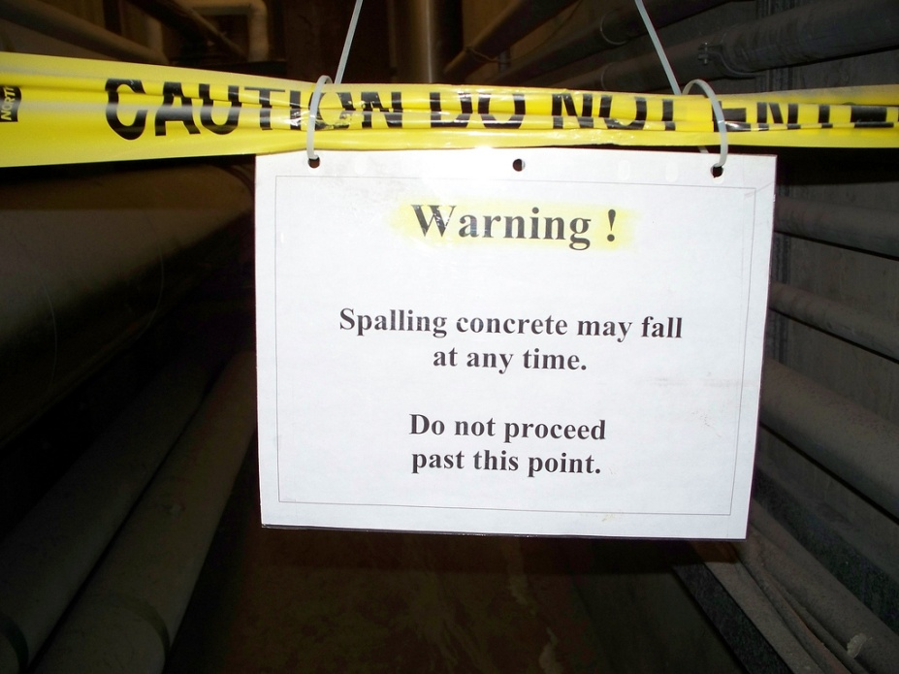
Why EMCO? – Rationale
Provide a safe environment
Mitigate impacts of a major interruption by minimizing:
Casualties
Asset destruction, data loss
Loss of services and business functions
Meet service mandates
Display due diligence
Protect reputation
Ensure business survival

Slide 6
Why EMCO? – Recent Statistics at Universities
3 major Laboratory fires - in past 3 years
University of British Columbia
University of Manitoba
University of Calgary
2 major Residence fires – past 4 years
McMaster University
Wilfrid Laurier University
Major failure of co-generation plant -2010
University of Calgary

Slide 7
EMCO Continuum
80%
20%
Diagram: Boone & Moore, 2011
Notes:
Definitions & concepts
EMCO comprises
ER
Contingency plans
BCP
DRP
EMCO exists to
reduce risks to …
People
Infrastructure
Ops
Reputation
Ensure business survival

Slide 8
Way Ahead -- Phases of EMCO Planning
Diagram: Boone & Moore, 2011

Slide 9
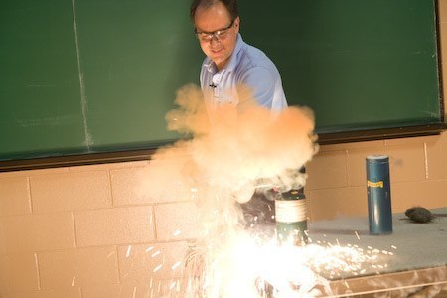
Project Operations
EMCO Team based on partnerships
Students
Volunteers (Specialists and Learners)
Faculty and Staff
Collaborative
Work with you
Iterative
Briefings/workshops
Questionnaires
Interviews
Verification and validation
Notes:
Make maximum use of in-house expertise
Faculty, staff and students (co-ops)
Part of degree and professional certificate programs
Collaborative, not consultative

Slide 10
Project Operations contd
Deliverables
Capabilities Inventory (ER, EM, Continuity, Disaster Recovery)
Gap Analyses
Functions and Resources Summary
Business Impact Assessment
EM and Continuity Strategies
Have a good understanding of process and level of effort from MacOdrum Library BCP project
Notes:
Similarly iterative and cumulative

Slide 11
Functional Approach to Assessment
University Operations
Teaching
Research
Support Functions (public facing)
Administrative Functions (internal)
Supporting activities and business functions
(focus of assessment)
Notes:
Teacher, Researcher, Support Services Provider, Administrative Services Provider all perform various support and business functions which contribute to these four functional business lines. For the purposes of assessment of current capability, identification of capability gaps, and recommendations for mitigative action, we must drill down to the individual functions and processes necessary to provide the services within these four business lines. The existing organizational structures will be used for validation and for coordination.

Slide 12
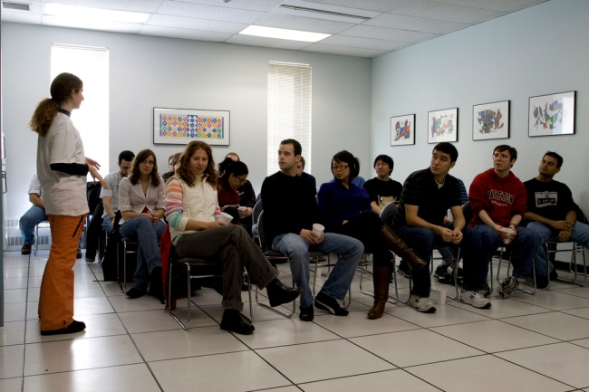
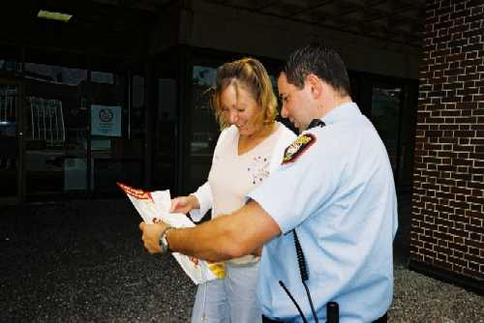
Major Activities Addressed
Address functions, irrespective of organizational reporting lines
Understand that a Faculty or Department may house activities related to teaching, research, admin and support functions
Like aligned with like
Notes:
Stop thinking organizationally, according to an org chart, e.g., teaching activities across faculties more closely related than teaching and admin functions within a faculty. Our aim is capture, collate and analyse the supporting activities and business functions as a packaged, trusted offering that can be provided after a major interruption

Slide 13
Expected Results
Increased capability for effective:
Emergency Response (Dir Campus Safety)
Continuity Planning and execution(BCP Coordinator)
Disaster Recovery (Computing/Communications Services)
Enterprise Risk Management (Mgr Risk and Insurance)
Continued viability of Carleton University (President and Senior Executive)
Planning and program development occurs in a concurrent and coordinated way
Notes:
Meet minimum requirements according to the expectations of our stakeholders, both internal and external.

Slide 14
What the Team Needs from You
Communicate to all staff about the project
Convey the importance and emphasize benefits
Encourage participation
Participate in verification and validation of iterative deliverables
Assist project team in development of Business Continuity Plans (BCPs)
Aid in transition to EMCO program
Notes:
Acknowledgement of the benefit of the project for Carleton’s reputation, operational viability, survival
Communication to all staff regarding the project and its importance
Participate in verification and validation of iterative deliverables such as Functions and Resource summaries, BIAs, gap analyses

Slide 15
How Your Staff Contributes
Review their activities and business functions within the four functional business lines
Consider the provided preparatory questions
No elaborate written responses required
Attend interviews/workshops as required
Verify teams’ findings as part of your validation
Notes:
Attend interviews/workshops (90/120 mins) as required

Slide 16
Benefits to You and Your Staff
After a major interruption, with minimal loss of time and resources, you will be able to
Resume teaching
Resume time-sensitive research with minimal data loss
Provide minimum support services to students and the public
Provide minimum administrative services to faculty and staff
Restore all remaining activities and business processes
Minimize chaos, panic and uncertainty
Have a much clearer appreciation of resources, interdependencies and priority of activities
Stimulates review and improvements to processes

Slide 17
Conclusions
An effective EMCO program is required for the survival of Carleton University as a viable academic institution
Collaborative and participative effort, project conducted for you, team working with you
Time invested now will reap rewards after a major interruption
Will also enhance your understanding of operations
We cannot afford not to have an EMCO program
Notes:
Ostrich tactic and hope are not effective EMCO strategies
An effective EMCO program will ensure the university is properly prepared to face a major incident thus mitigating risk and liability and protecting Carleton's valuable reputation as one of Canada's leading institutions of higher learning.
An effective EMCO program is required for the survival of Carleton University as a viable academic institution
Maintain reputation
Mitigate AP&S risks
Alleviate financial liability
A lower cost model for EMCO program development (utilizing existing resources and in-house support) will increase the time and effort required to develop and implement EMCO program
Significant project management, co-ordination by the BCP Coordinator, and senior management support is required
We cannot afford not to have an EMCO program

Slide 18
Points of Contact and Questions
Project questions
Allan Burns, Director University Safety (8535)
Administrative questions
Tony Lackey, Risk Management & Insurance (1473)
Technical questions
Wayne Boone, MIPIS Program (6672)
Discussion
Notes:
Ostrich tactic and hope are not effective EMCO strategies
An effective EMCO program will ensure the university is properly prepared to face a major incident thus mitigating risk and liability and protecting Carleton's valuable reputation as one of Canada's leading institutions of higher learning.
An effective EMCO program is required for the survival of Carleton University as a viable academic institution
Maintain reputation
Mitigate AP&S risks
Alleviate financial liability
A lower cost model for EMCO program development (utilizing existing resources and in-house support) will increase the time and effort required to develop and implement EMCO program
Significant project management, co-ordination by the BCP Coordinator, and senior management support is required
We cannot afford not to have an EMCO program

Slide 19
Preparatory Questions
What is your key (high-level) business function?
How quickly would that process need to be recovered in event of major disruption?
In what way is your function Administrative (staff/faculty) or Supporting (students)?
What quantity and type of resources do you require to provide your function?
People, Equipment, Information, Workstations...
19

Slide 20
Preparatory Questions
What documents support your department’s mandate?
Mission statements, Process documents, Pandemic plans, Regulations, MOUs, Emergency Plans
What “threats” might negatively impact your department’s ability to provide service?
What vulnerabilities exist in your department that could result in inability to provide service?
What single points of failure exist?
Infrastructure, Personnel, Information
20

Slide 21
Preparatory Questions
What time constraints do you face for service provision?
Regulations? Policy? Expectations?
How long can your department not provide service before serious consequence?
To your department? The University? Students?
What resources would it take to return your department to operational capacity?
21

Slide 22
Preparatory Questions
How much electronic data can you lose and still resume normal operations?
How critical is that data to recovery?
What other departments do you depend on and which departments depend on you?
If Campus were inaccessible for an extended time period, where else and how else could you continue providing service? What assistance would you require?
22

