Slide 1
Social
@ the Student Experience Office
Notes:
There is an official social media strategy
“social media is immediate, it is engaging and it builds relationships,” all facts that make it an important element in how the university operates and interacts with its stakeholders, including students, staff, faculty and the external community
CU’s goal: “To be the benchmark of excellence in the use and effectiveness of social media communications, with all of our communities, among Canadian universities.”
THEREFORE, we are taking steps to proactively evaluate and refine the ways in which we utilize digital tools to engage with our publics

Slide 2
The mission of the Student Experience Office:
transition support
engaging programming opportunities
Notes:
There is an official social media strategy
“social media is immediate, it is engaging and it builds relationships,” all facts that make it an important element in how the university operates and interacts with its stakeholders, including students, staff, faculty and the external community
CU’s goal: “To be the benchmark of excellence in the use and effectiveness of social media communications, with all of our communities, among Canadian universities.”
THEREFORE, we are taking steps to proactively evaluate and refine the ways in which we utilize digital tools to engage with our publics

Slide 3
Then
@CarletonSEO | 1,548
@CU_FallO | 1,488
@CU_CAB | 606
FB: Campus Activity Board | 680

Slide 4
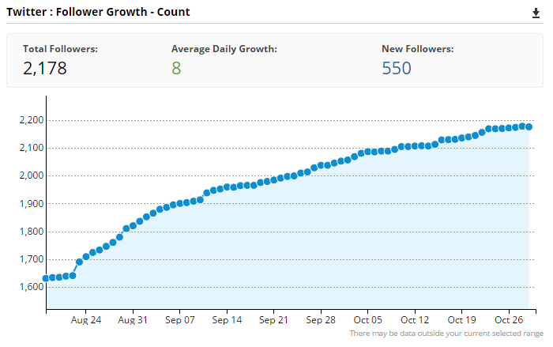
Hootsuite Report

Slide 5
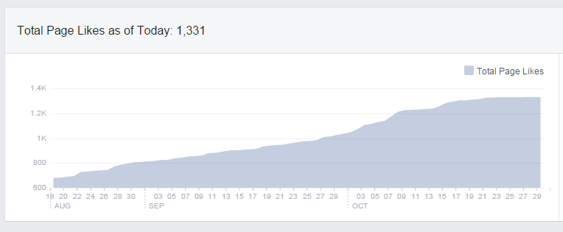
Facebook Page Likes

Slide 6
Now (70 days later)
@CarletonSEO | 1,548 → 2178 (40%+)
@CU_FallO | 1,488 (dormant)
@CU_CAB | 606 (removed)
FB: Carleton SEO | 680 → 1331 (96%+)

Slide 7
Pillars of Focus
awareness
involvement
commitment

Slide 8
awareness goals
Centralized, unique brand:
Remove program specific accounts
Grow social content production:
Establish internal process for sharing program and event info
Grow weekly foot traffic:
Establish monthly, social-media-driven retail style door-crashers
Grow social audience to 25% of undergraduate student body:
Leverage existing program/activities to grow online communities; use Facebook to grow our reach
Solicit student feedback and utilize ideas to improve outreach efforts:
Seek faculty collaboration; establish partnership with senior-level marketing and communications class
involvement goals commitment goals

Slide 9
Social Outside + In
Programs:
Actions and ideas to drive Awareness, Involvement, and Commitment
Infrastructure:
Policies, processes and tools that will enable us to carry out our Programs effectively.

Slide 10
Central Twitter Account
Awareness

Slide 11
Central FB Account
Awareness

Slide 12
#CUatSummerO
Awareness

Slide 13
#jointheconspiracy
Awareness

Slide 14
#CarletonSWAG
Awareness

Slide 15
#CUatRJ
Awareness

Slide 16
#CUatRJ Trending
Awareness

Slide 17
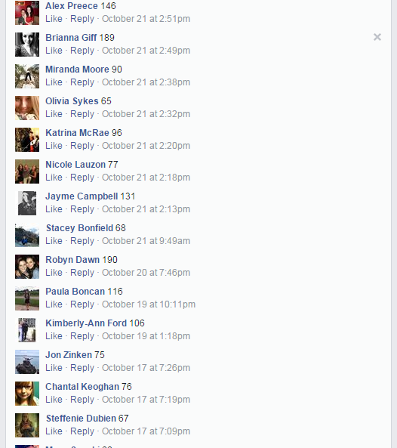
CCR Button Contest
Awareness

Slide 18
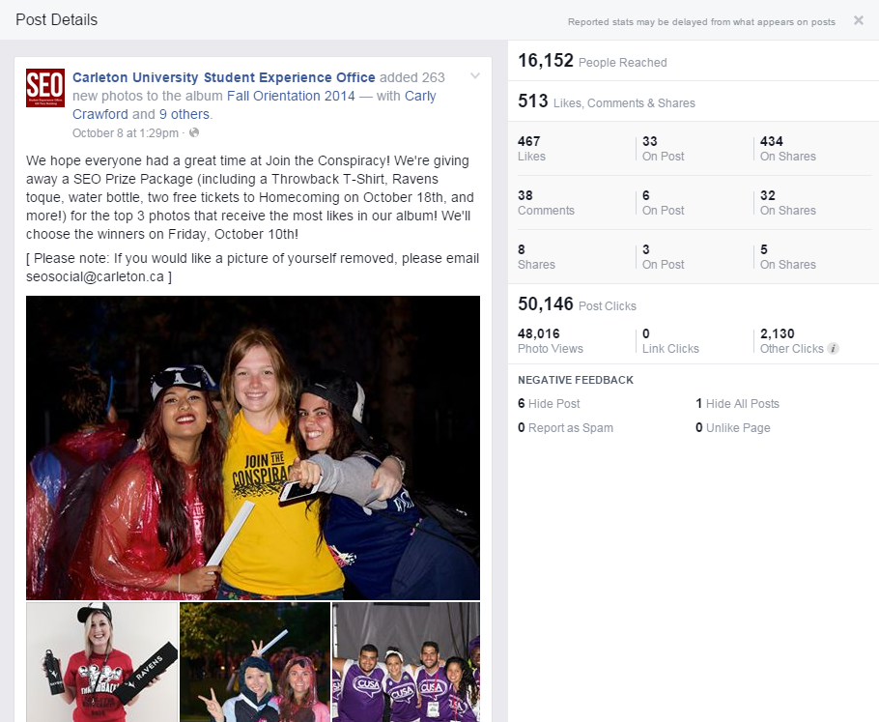
Photo Albums

Slide 19
Facebook Album Ads
Involvement

Slide 20
Involvement

Slide 21
Involvement

Slide 22
Carleton Serves is on Sept. 27 Register using the link below. Share this image to invite your friends.
Involvement

Slide 23
Shared Calendar
Awareness

Slide 24
Program Parameters for Social Content: Campus Activity Board
Awareness
Core About Sentence: CAB is a student-driven organization that plans and promotes on-campus activities and events.
Hashtag: #CarletonCAB
Key tagline: What are you doing tonight?
Location of pre-approved written or graphic content: :W/Departmentnal/PictureGallery/CampusActivityBoard

Slide 25
Micro-Campaign Form
Awareness
Example

Slide 26
evaluating our work: bi-weekly reporting
Hootsuite
Twitter
Facebook Insights
Twitter Analytics
Google Analytics
Offline KPIs

Slide 27
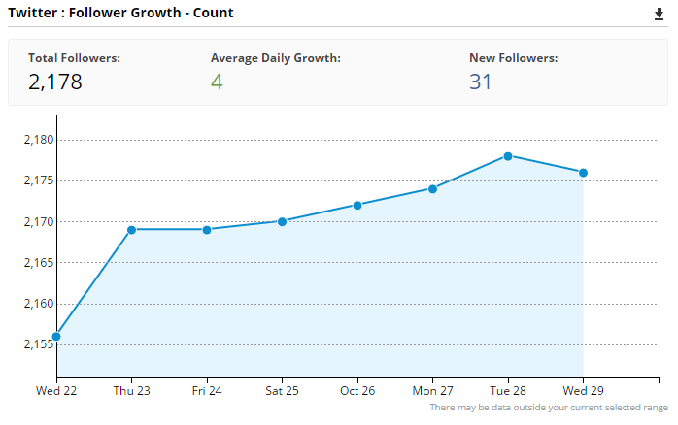
Hootsuite Weekly Report

Slide 28
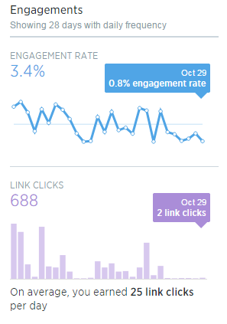
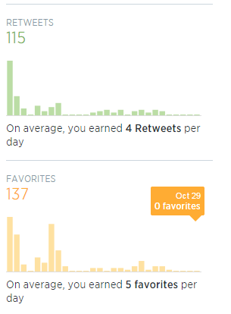
Twitter Analytics
Awareness

Slide 29
Successful Facebook Post Types

Slide 30
Funnel Stages | What does social look like?
Awareness | Outside (Social Media Programs) | Inside (Infrastructure)
Consideration | Website Engagement Twitter Facebook Blogs Video | Staff Training Evaluation Mechanisms Platforms Tools Program Parameters Policies
Intent
Involvement
Fulfillment
Commitment
Advocacy

Slide 31
Discussion
Notes:
There is an official social media strategy
“social media is immediate, it is engaging and it builds relationships,” all facts that make it an important element in how the university operates and interacts with its stakeholders, including students, staff, faculty and the external community
CU’s goal: “To be the benchmark of excellence in the use and effectiveness of social media communications, with all of our communities, among Canadian universities.”
THEREFORE, we are taking steps to proactively evaluate and refine the ways in which we utilize digital tools to engage with our publics

