Slide 1
OGS Workshops
Fall 2017
Leslie Main
Co-ordinator, Graduate Awards
Claire Samson
Associate Dean, Planning

Slide 2
Today’s Agenda
THE OGS PROGRAM
Overview
Application Process
Research / Program Statement
Reference Letters
Note: Some of this info may apply to other award programs.

Slide 3
OGS (Ontario Graduate Scholarship)
OGS is worth $5000 per term for 2 or 3 terms.
Must be registered full-time to receive the award, but may be registered part-time when making application
Carleton University has 181 awards to give out, 5 to international students
Students complete the application, Carleton deadline to the departments is November 15, 2017
Reference Deadline is December 1, 2017
If you have access to Carleton Central you complete the online application, otherwise you must complete the paper application
CC, Awards & Financial Aid, Online Graduate Award Applications
If you are applying to other institutions, please check procedures and deadlines at those institutions

Slide 4
Application Order (for Paper Application only)
Application Checklist
OGS Application Form – signed
Academic Assessment Report 1
Academic Assessment Report 2
All transcripts (Official transcripts only)
Proof of Citizenship - Permanent Resident
Proof of Citizenship – Student Visa
Proof of Citizenship – Protected Person
Research/Program Statement
Awards/Publication page (if applicable)

Slide 5
OGS Adjudication
Students complete applications and submit to department by November 15, 2017
References must submit their letters by December 1, 2017
Departments review applications and calculate GPA’s to determine eligibility
Departments forward eligible applications to faculty level committee
Committee reviews and meets to make decisions on applications
Applications are either, successful, reversion (waitlisted) or unsuccessful
Faculty forward successful and reversion applications to FGPA for vetting
FGPA informs students via email of the status of their OGS application by mid February 2017

Slide 6
How are applications adjudicated?
What are the criteria?
  50% on academic excellence
  (transcripts, awards, distinctions)
  30% research potential
  20% personal characteristics & interpersonal skills

Slide 7
GPA Calculations
All applicants must have a minimum GPA of 10.0 (A-) in each of their last two years of study, regardless of level of study

Slide 8
Research/Program Statement
Initial Considerations
Non-specialist evaluators
Demonstrate research potential
Highlight accomplishments (pubs, conferences, etc)

Slide 9
Statement of Interest or Program of Study
Follow the guidelines carefully (especially for page limit!)
Remember your essay may be evaluated by an interdisciplinary group. Write clearly and avoid jargon yet demonstrate that you know your field.
Get your referees to read over the statement!
In a short essay, organization is crucial:
  What is your research project? (Be specific!)
  How will you do it?
  Why are you doing it?
  Why are you well-equipped to do this project?

Slide 10
The One-Page Statement
What Not to Include:
Personal & background info
Revelations while “walking in the snow”

Slide 11
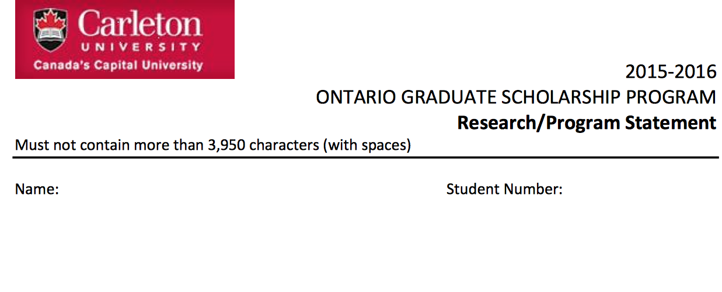
The One-Page Statement

Slide 12
The One-Page Statement
~ Considerations but Not a Template ~
Setting the context
  Scholarship
  Societal importance
Your research purpose
  Flow from the context
  Focus your attention

Slide 13
The One-Page Statement
(cont’d)
What will you do?
  Stage of program matters
  Demonstrate research potential
Why are you a strong candidate?
  Relevance of your experience
  Carleton as a suitable place
  Non-Carleton support

Slide 14
The Process
Reviews of draft proposals
  Other grad students in & beyond your program
  Friends
Engage your supervisor
  Request reviews
  Trust building exercise

Slide 15
References
Start early
Ensure references will:
  Be supportive
  Collectively cover (i) academic excellence, (ii) research potential (iii) communication, interpersonal, leadership & community skills

Slide 16
References cont’d
Up to one non-academic reference, preferably in related area
Current supervisor
  If you do not know her/him well???
  Share previous papers, meet regularly

Slide 17
Final Thoughts
Start early
Seek advice
All components are important
Final check is critical

Slide 18
Contact Info
leslie.main@carleton.ca
claire.samson@carleton.ca

