Slide 1
Putting Your Course
On the Map:
Designing Courses that Align with Your Program’s Learning Outcomes
Teaching and Learning Services &
The Office of the Vice-Provost and Associate Vice-President (Academic)

Slide 2
Introduction
Dr. Morgan Rooney
Educational Development Coordinator, TLS
Dr. Andy Thompson
Program Assessment Specialist, Office of Vice-Provost and Associate Vice-President (Academic)
country929.com
Notes:
Andy

Slide 3

Notes:
Andy – Land acknowledgement

Slide 4

Agenda
1:35 | Welcome and Introductions
1:45 | Learning Outcomes Review
2:00 | Situating Courses within Programs
2:30 | Discussion
2:45 | Review and Next Steps
villageofhudsonfalls.com

Slide 5
Learning Outcomes
By the end of this session, you will be able to:
  Differentiate between course and program level outcomes
  Discuss the relationship between your own course learning outcomes and the broader goals of your program
  Reflect on the implications of program level outcomes for your own course design procedures
blogg.hioa.no
Notes:
Define relationship between course and program level outcomes
Reflect on relationship between course outcomes and broader goals of the program
Plan for ways to enhance course assessments / make a plan for learning more

Slide 6
Welcome!
Tell us a little about yourself…

Slide 7
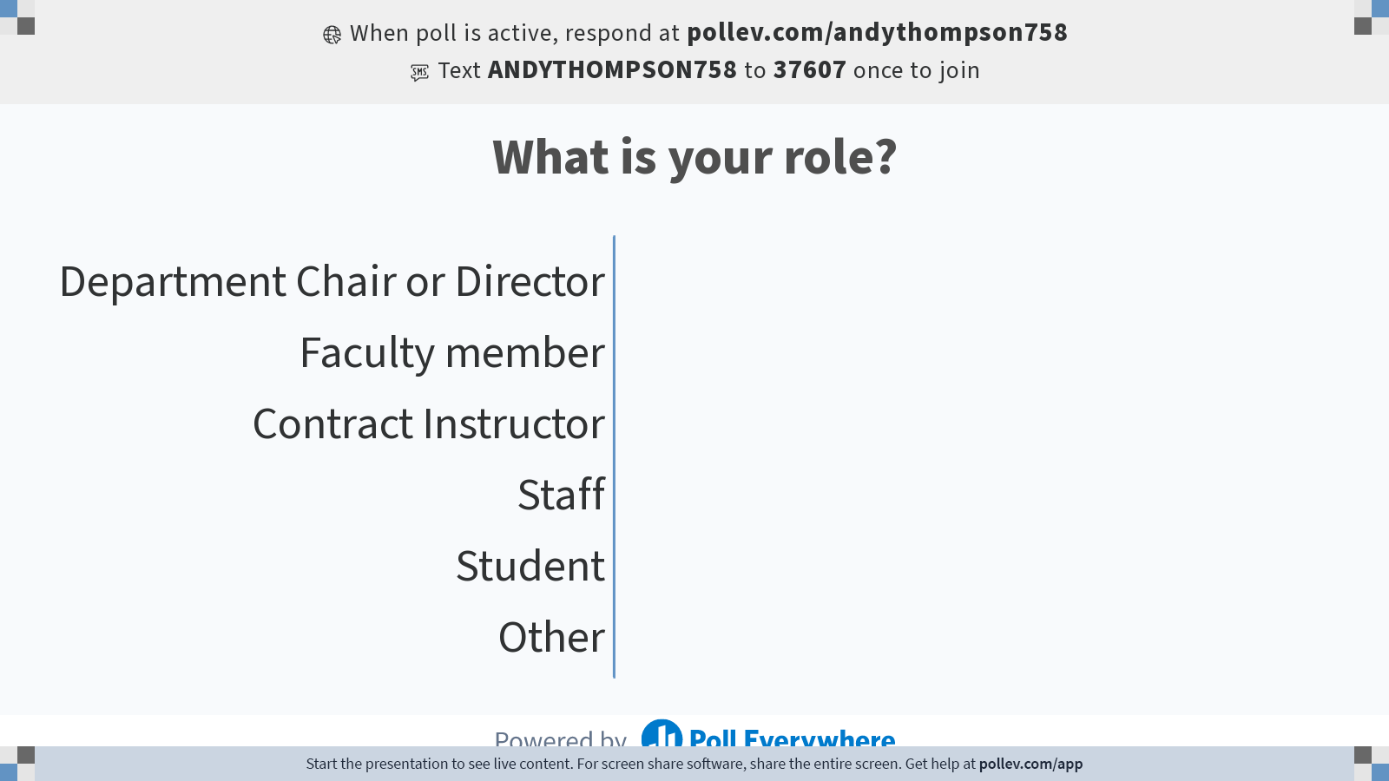
Notes:
Poll Title: Do not modify the notes in this section to avoid tampering with the Poll Everywhere activity.
More info at polleverywhere.com/support
What is your role?
https://www.polleverywhere.com/multiple_choice_polls/AmptXU4ACGwwT1YM0Jm39?flow=Default&onscreen=persist

Slide 8
Learning Outcomes Review
Part 1
Notes:
Morgan

Slide 9
Constructive Alignment
Learning Outcomes
Program
Course
Assess-ments
Theses, cuPorfolio
Essays, exams
Activities
Curricula
Course design
Also known as, backwards design
Supported by research (and common sense!)

Slide 10
Learning Outcomes
What students will be able to know, do, or value by the end of a period of instruction
    Discipline specific, observable, & attainable
    Written from the learners’ perspective (i.e., “By the end of this class, you will be able to…”)
solidwize.com

Slide 11
Learning Outcomes
Learning Outcomes are NOT…
  Checklists of content that the instructor has covered (e.g., “You will read four plays by Shakespeare”)
  Broad statements about the type of development the instructor expects of the student (e.g., “You will develop critical thinking skills”)
pi.tedcdn.com

Slide 12
Levels of Learning Outcomes
Institutional Learning Outcomes
Program Learning Outcomes
Course Learning Outcomes
Notes:
In Ontario, all university degrees must meet set of standards, known as Degree Level Expectations
Programs are free to address the DLEs in ways that make sense for their discipline
Expectations related to the DLEs are communicated through a program’s LOs
Program LOs are developed in individual courses and program requirements

Slide 13
Course vs. Program Outcomes
Course-level Outcomes | Program-Level Outcomes
Content-specific E.g., ability to read and analyze Chaucer in Middle English and Shakespeare in Early Modern English. | Discipline-specific E.g., read and analyze texts and their genres accurately, contextually, and critically
Mix of “nice-to-know” and “need-to-know” | All “need-to-know”
Independently created | Collaboratively created
Summative: “Was the goal achieved?” | Formative: “How are we doing?”

Slide 14
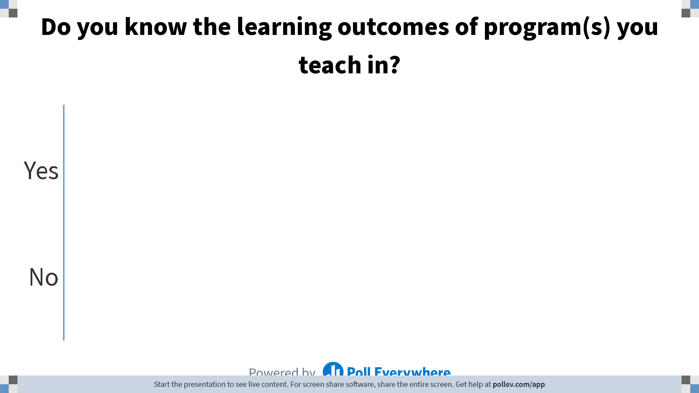
Notes:
Poll Title: Do not modify the notes in this section to avoid tampering with the Poll Everywhere activity.
More info at polleverywhere.com/support
Do you know the learning outcomes of program(s) you teach in?
https://www.polleverywhere.com/ranking_polls/WDdrqyWVEe4pBvIWKz0Gk

Slide 15
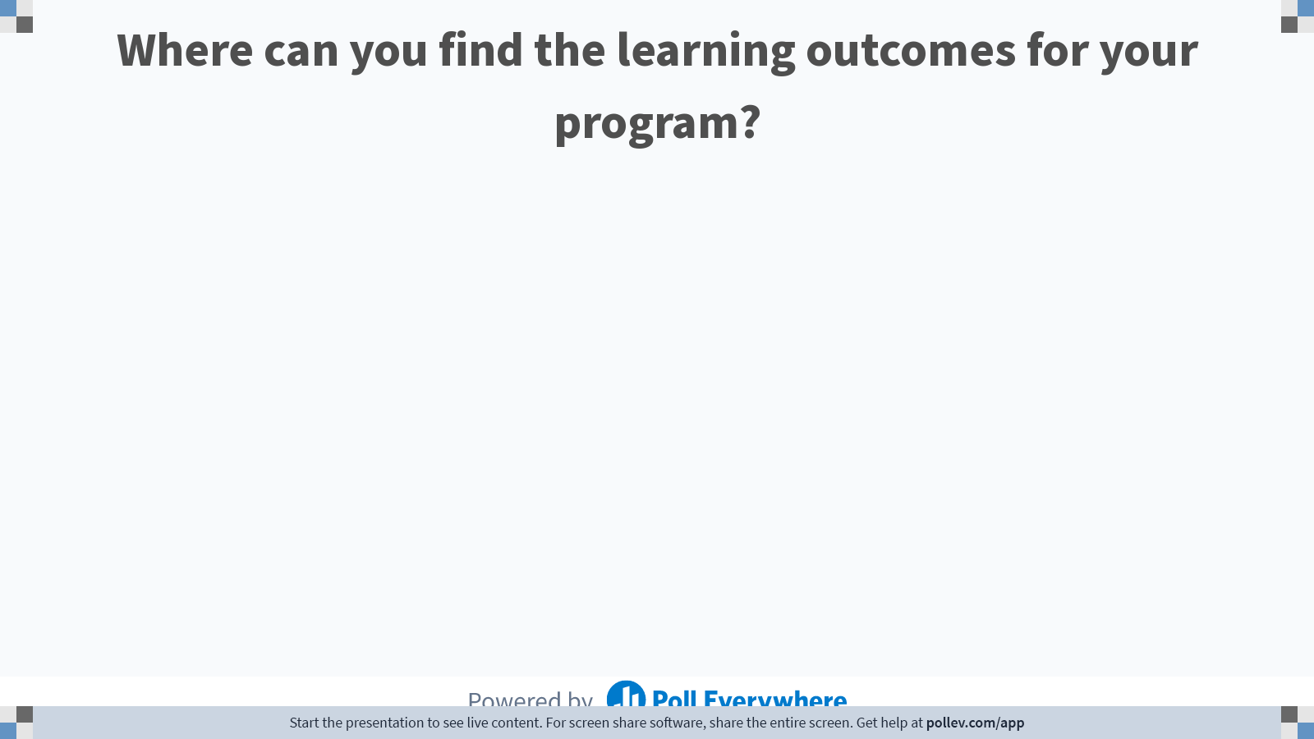
Notes:
Poll Title: Do not modify the notes in this section to avoid tampering with the Poll Everywhere activity.
More info at polleverywhere.com/support
Where can you find the learning outcomes for your program?
https://www.polleverywhere.com/free_text_polls/ybX887gwMtgrtwEtYqJmQ

Slide 16
Locating Program-Level Learning Outcomes
Departmental Curriculum or LOA Committee
Program Chair or Supervisors
Latest Cyclical Program Review Self-study
Institutional QA Office
commsbusiness.co.uk

Slide 17
Locating Your Course within the Program
Part 2

Slide 18

Course & Program: Part & Whole
Courses are the individual parts that contribute to the whole program
Developing course LOs without knowing the program LOs can be frustrating
Aligning course and program learning outcomes creates clarity for instructors AND students
runningonlove.org

Slide 19

Finding Your Place in the Curriculum
Learning outcomes tell only part of the story
Course-program alignment also requires situating courses within the curriculum of programs
Need to know what comes before and after your courses to ensure appropriate teaching and learning expectations
coloringpagewiki.com

Slide 20

Curriculum Mapping
Curriculum maps show where, when, and how the learning outcomes are developed though the program
Can be simplistic or highly detailed
NspireD2 - WordPress.com

Slide 21
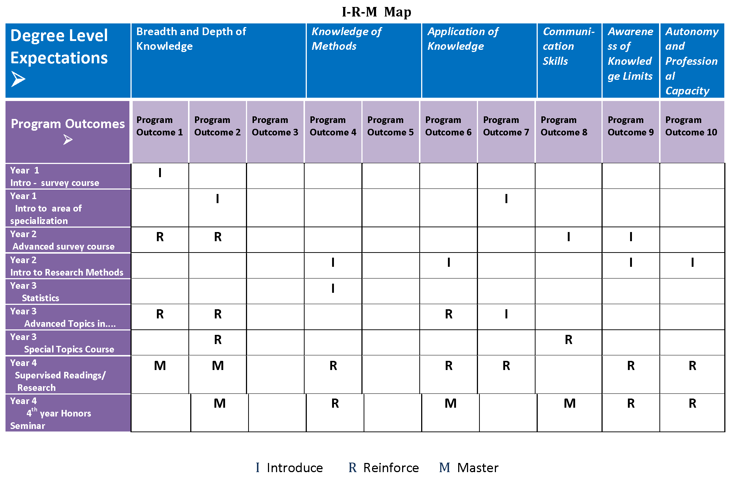

Slide 22
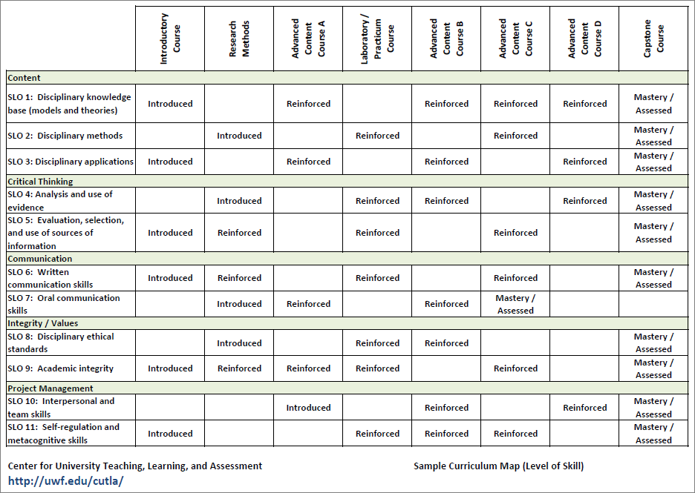

Slide 23
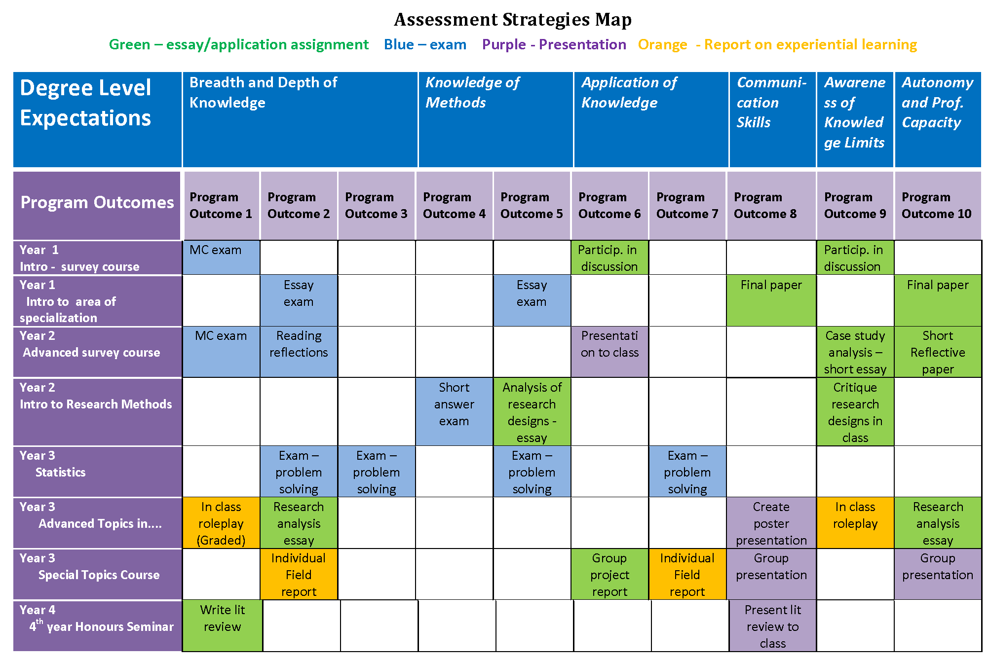

Slide 24
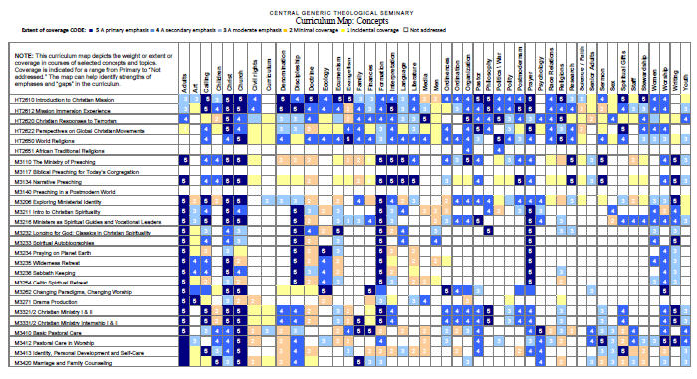

Slide 25

Curriculum Mapping
The curriculum map for each program tells you…
  Where each course fits in the curriculum
  Which learning outcomes should be addressed
  What your students have learned before
  What your students will learn after
clipartxtras.com

Slide 26

Aligning Course Assessments with Program Goals
All courses should…
    Reinforce previous knowledge and skills
    Introduce new knowledge and abilities
    Assess student abilities in defined areas

Slide 27
Addressing Gaps
A program gap occurs when there are too few opportunities for students to develop the learning outcomes of the program
Gaps can be addressed by modifying…
  The learning outcomes for the program
  Program structure and requirements
  Teaching and assessment activities
cdn.shopify.com
Notes:
Andy

Slide 28
Selecting Assessments
Skill or Ability | Appropriate Assessments
1. Demonstrating knowledge and understanding | Written or oral examination Essay or Report | Devise an encyclopedia entry Write an answer to a client’s question
2. Thinking critically and making judgments | Letter of advice Present a case for an interest group Briefing paper | Write a newspaper article for a foreign newspaper Article commentary
3. Solving problems and developing plans | Problem scenario or case study Group work | Work-based problem Draft a research bid to a realistic brief
4. Communicating | Written presentation (essay, report, reflective paper etc.) Oral presentation | Discussion/debate/role play Observation of real or simulated professional practice
Excerpted from Guide to Writing Learning Outcomes for Units of Study in Higher Education. Published by the University of Victoria University of Victoria, Melbourne, Australia.

Slide 29
Breakout Room Discussion
1. How might program-level outcomes and/or curriculum maps impact course design?
2. How might these tools impact student learning experience?

Slide 30
Review
Good course design = constructive alignment
Program-level learning outcomes communicate broad learning goals ALL graduates should achieve
Curriculum maps show where and when the learning outcomes are developed
google.ca
Notes:
Morgan

Slide 31
Review
Use program LOs and curriculum maps to identify previous and future learning
Consult with other instructors about what and how students are learning in their courses
Design assessments to reinforce and expand on student abilities
google.ca

Slide 32
Thanks!
Morgan Rooney, morgan.rooney@carleton.ca
Andy Thompson, andy.thompson@carleton.ca
chiefhro.files.wordpress.com

Slide 33
Please Provide Your Feedback
https://docs.google.com/forms/d/e/1FAIpQLSc7fe9Q8HYhR1dA--2MnSsUcsS61g2sRpH03_ihKDQ1ZZvSZg/viewform?usp=sf_link

