Slide 1
Train the Trainer: Engaging Faculty in Developing Program-Level Learning Outcomes
Andy Thompson, PhD and Eileen Harris, PhD
Office of the Vice-Provost and Associate Vice-President (Academic)
Carleton University
November 8, 2021

Slide 2
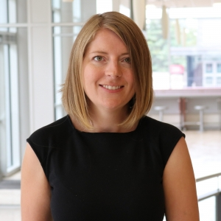
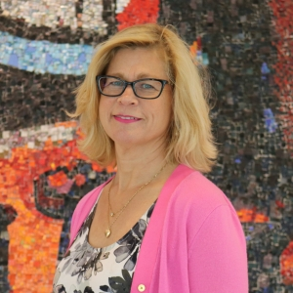
Welcome!
Andy Thompson
AndreaThompson@cunet.Carleton.ca
Eileen Harris
EileenHarris@cunet.Carleton.ca

Slide 3

Notes:
Andy – Land acknowledgement

Slide 4
Goals for this Session
Meet colleagues from other institutions
Share experiences and strategies
Learn something new!
  Identify obstacles and opportunities in the creation of program-level learning outcomes
  Explain one method of LO development that prioritizes faculty engagement and buy-in
Notes:
Andy

Slide 5
Tell Us About Yourself!
Notes:
Andy

Slide 6
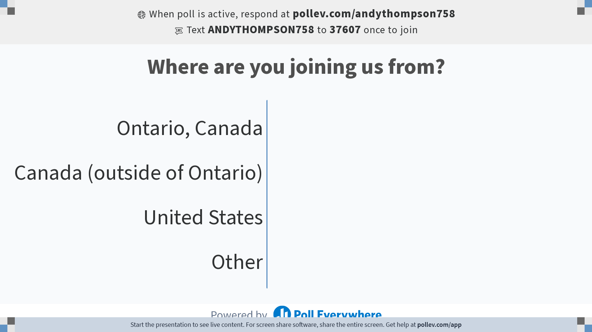
Notes:
Poll Title: Do not modify the notes in this section to avoid tampering with the Poll Everywhere activity.
More info at polleverywhere.com/support
Where are you joining us from?
https://www.polleverywhere.com/multiple_choice_polls/0ROdhnWq24IcXcTr4NG2t?flow=Default&onscreen=persist

Slide 7
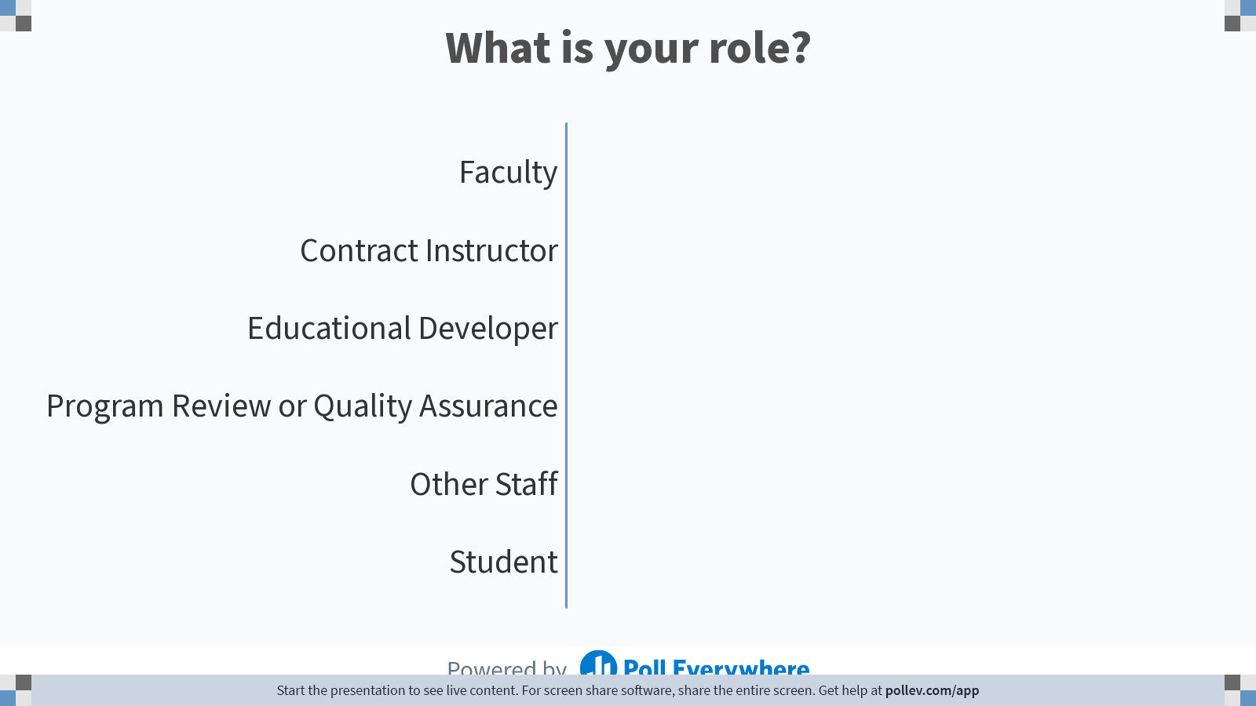
Notes:
Poll Title: Do not modify the notes in this section to avoid tampering with the Poll Everywhere activity.
More info at polleverywhere.com/support
What is your role?
https://www.polleverywhere.com/multiple_choice_polls/jf0co40FBgcL3StwNldIn?flow=Default&onscreen=persist

Slide 8
Where We Started...
Quality Assurance Framework 2011
  Mandated learning outcomes and assessment for every academic degree program in Ontario
Pilot Project
  One unit in each faculty
  Provided workshops, individualized support, goals and deadlines
Expectations were high!
  Develop learning outcomes, curriculum map, & assessments completed
  Direct assessment was prioritized

Slide 9
What Didn’t Work
Long, information heavy powerpoint workshops
High, deadline driven expectations
Emphasis on direct, quantitative assessment

Slide 10
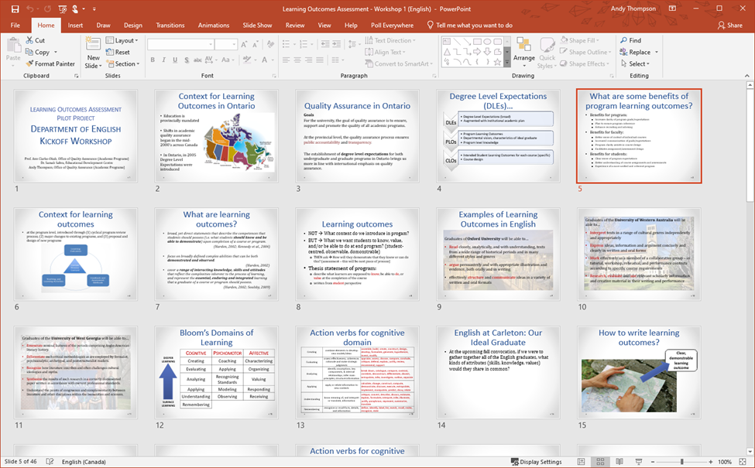

Slide 11
What Did Work…
Meet one-on-one to gauge readiness
Embrace the power of conversations
Changing the language used
Notes:
Andy

Slide 12
What Did Work…
Dispel myths
Share failures and successes
Minimize workload for faculty
Notes:
Eileen

Slide 13
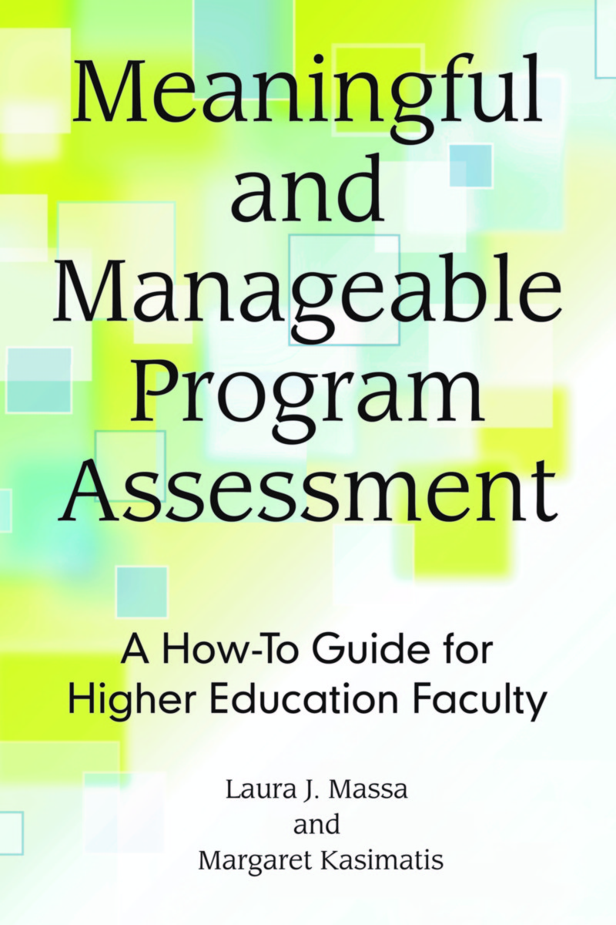
Guiding Principle
Learning outcomes assessment should be meaningful and manageable
Massa & Kasimatis (2017)
Notes:
Eileen

Slide 14
The Learning Outcomes Workshop
Typically situated within the Cyclical Program Review and New Program Proposal processes
Pre-meet with unit to identify key program stakeholders
  Faculty, students, admin staff
Focus on building relationships and trust
Notes:
Eileen

Slide 15
LO Workshop Step-by-Step
Welcome and introduction
Initial brainstorm session
Review and refine
Transcribe and analyze
Write and edit LO statements
Notes:
Eileen

Slide 16
Questions
What should IDEAL graduates be able to know, do and value?
What should ALL graduates be able to know, do and value?
What makes the program distinct or unique from other programs?
Notes:
Eileen

Slide 17
Notes:
Eileen

Slide 18
Small Group Discussion
What barriers have you encountered to LOA?
How have you promoted faculty engagement in LOA on your campus?
What are your going to try?
Notes:
10-minute breakout room

Slide 19
Things to Remember
Have confidence in the process
Signal faculty/unit ownership of LOs and LO process
Offer on-going support
LOA needs to be meaningful and manageable
Notes:
Eileen/Andy

Slide 20
Thank you for attending!
Please provide your feedback
https://docs.google.com/forms/d/e/1FAIpQLSdPSRUAZZ2M7PG6v9MdoDuF_zp5akmLB-fX1bDlCUpn5NH2Ng/viewform?usp=sf_link
Notes:
Andy & Eileen

