Slide 1
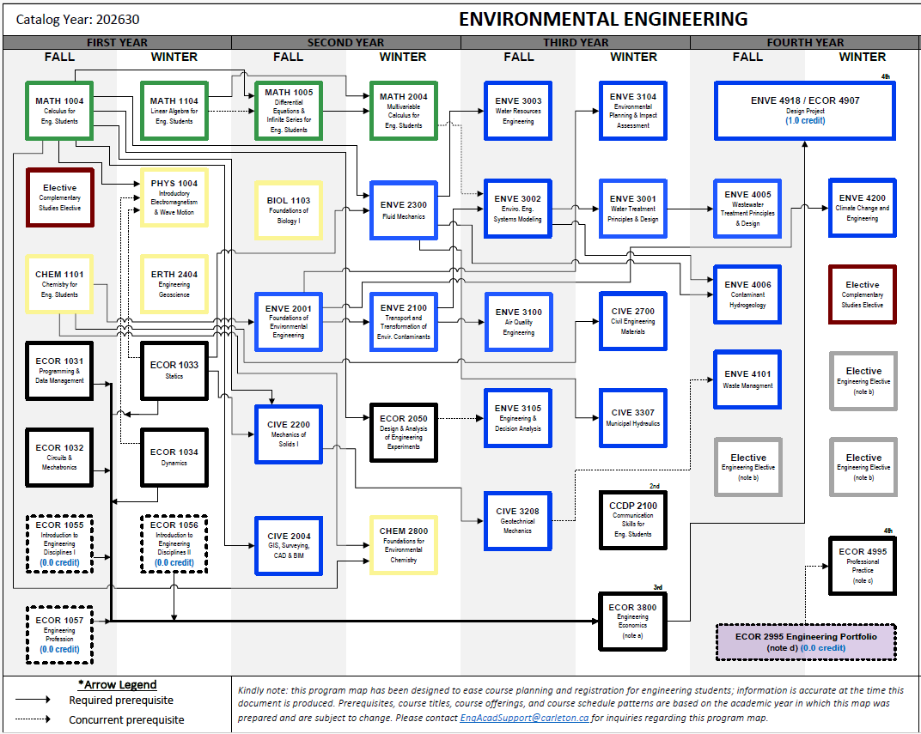
Updated on: enter date
Instructions:
Enter today’s date above
Copy/paste the boxes below and place them over the courses on the right. Make sure to replace 20xx with correct year (e.g., Winter 2027)
Make sure to include all courses that you passed and those you plan to take in the coming semesters
Passed!
Planned for Summer 20xx
Planned for Fall 20xx
Planned for Winter 20xx
Example:
ARCH 1000
Introduction to
Architecture
PHYS 1004
Introductory
Electromagnetism
& Wave Motion
Passed!
Planned for Winter 2027
Indicates courses that have been offered in recent years in different semesters. For example, MATH 1004 has been offered in FALL and WINTER.
Important notes: (1) This does NOT guarantee offering/availability or the absence if restrictions for specific majors, so please double-check on “Class Schedule “ in Carleton Central before planning your schedule. (2) It’s highly preferred that you follow the course progression tree as much as possible to avoid scheduling conflicts in the later years.

