Slide 1
Teachers’ Workshop
Teaching the EU
Teachers’ Workshop
February 18, 2011
EU Learning Project
Centre for European Studies,
Carleton University

Slide 2
EU Learning
Website Service
Teaching the EU
Teachers’ Workshop
February 18, 2011
EU Learning Project
Centre for European Studies,
Carleton University

Slide 3
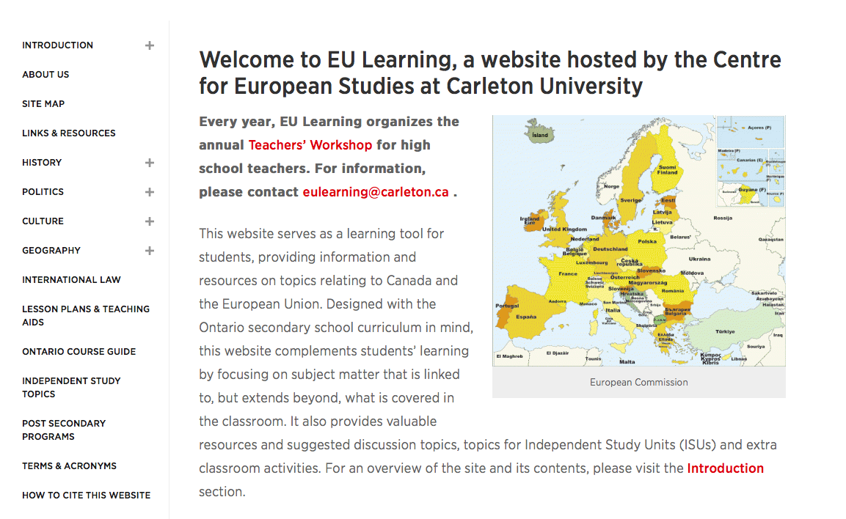
Welcome to the EU Learning Website
ww.Eulearning.ca contains:
An overview of the EU – history and institutions, politics, culture and geography,
Ontario Course Guide
Lesson Plans
Links and Resources
Post-Secondary information
EU learning activities for the
classroom
Event Information

Slide 4
Lesson Plans
Teaching the EU
Teachers’ Workshop
February 18, 2011
EU Learning Project
Centre for European Studies,
Carleton University

Slide 5
Lesson Plans
www6.carleton.ca/ces/eulearning/lesson-plans
Lesson Plan | Course Curriculum
EU Climate Change Policy | Grade 12 Canadian and World Politics (CPW4U), Grade 12 Analyzing – Economic Issues (CIA4U), Grade 12 Canadian and World Issues: A Geographic Analysis (CGW4U), Grade 12 Canadian and International Law (CLN4U)
European, Canadian and Russian Policy in the Arctic | Grade 12 Canadian and World Politics (CPW4U), Grade 12 Canadian and World Issues: A Geographic Analysis (CGW4U), Grade 12 Canadian and International Law (CLN4U)
Ukraine, Russia and the European Union | Grade 12 Canadian and World Politics (CPW4U), Grade 12 Analyzing Current Economic Issues (CIA4U), Grade 12 Canadian and World Issues: A Geographic Analysis (CGW4U), Grade 12 Canadian and International Law (CLN4U), Grade 11 World History since 1900: Global and Regional Interactions (CHT3O)
*Additional lesson plans available on the website

Slide 6
Teaching Resources
History
Europe After WWII
Moving Towards Integration
A European Community
Politics
The EU and Human Rights
Foreign Affairs and the EU
How Government Works in the EU
Culture
Travel to the EU
Geography
Canada and the European Union: An Overview
The Turbot War: Resolving International Disputes

Slide 7
Independent Study Topics
http://www.carleton.ca/ces/eulearning/independent-study-topics/
Subject | Corresponding Course Curriculum
EU Asylum Policy | Canadian and International Law (CLN4U) Canadian and World Issues (CGW4U)
EU and Energy Consumption | World Geography (CGU4U)
East-West Migration in Europe | Canadian and International Law (CLN4U)
EU, Canada, and GM Foods | Canadian and International Law (CLN4U)
EU and the Kyoto Protocol | The Environment and Resource Management (CGR4M) Canadian and International Law (CLN4U)
The Roma in Central and Eastern Europe | World Geography (CGU4U) Canadian and World Issues (CGW4U) Canadian and International Law (CLN4U)
Turkish Migrant Workers in Germany | World Geography (CGU4U) Canadian and World Issues (CGW4U)

Slide 8
EU Learning
at
Carleton University
Teaching the EU
Teachers’ Workshop
February 18, 2011
EU Learning Project
Centre for European Studies,
Carleton University

Slide 9
Institute of European, Russian and Eurasian Studies (EURUS) at Carleton University
http://www.carleton.ca/eurus/
Undergraduate BA Program
Exchange Programs in Europe and Russia
Required subjects:
Political Science
History
Literature and Culture
Economics
Elective subject course material:
Art history
Economics
Culture and Literature
History
Law
Music
Philosophy
Political Science
Combined Degrees with Law, Journalism, History and Political Science
Minor option
Co-op program option
EURUS Undergraduate Calendar
Bachelor of Global and International Studies (BGinS)
14 specializations including: Europe and Russia in the World
http://carleton.ca/bgins/europe-and-russia-in-the-world/

Slide 10
EU Online Bookshop
Teaching the EU
Teachers’ Workshop
February 18, 2011
EU Learning Project
Centre for European Studies,
Carleton University

Slide 11
EU Online Bookshop
bookshop.europa.eu
Publications on a variety of EU topics
Available free in PDF
First hard-copy free, let us help you get more!
Contact: Cathleen.Schmidt@Carleton.ca

Slide 12
New Initiatives

Slide 13
Recent Projects:
2017 EU Issues Conference
2017 Model European Union Simulation

Slide 14
The New Project: Studying the EU in Canadian High Schools
New activities under the project:
2018 (April): European Union Issues Conference
In-Class Presentations
Other Activities:
May 2018: Enhanced mini-courses (Carleton initiative): tp://carleton.ca/emcp/mini-courses/

