Slide 1
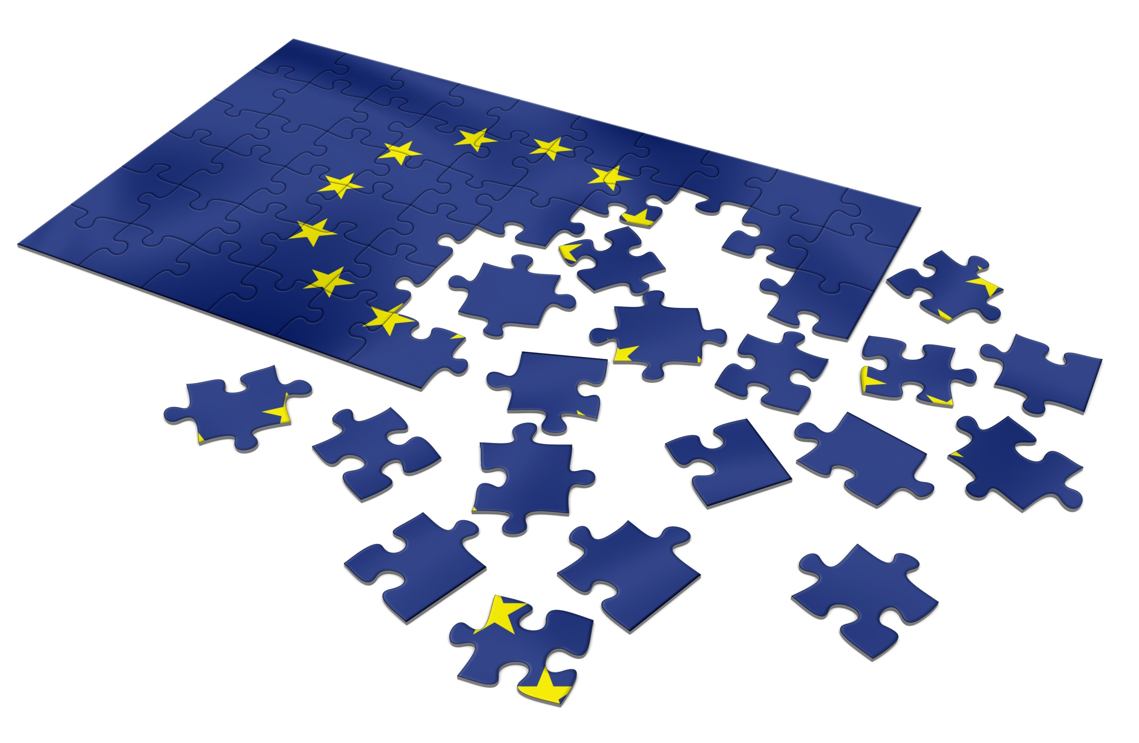
An Introduction to the European Union
Professor Achim Hurrelmann Institute of European, Russian and Eurasian Studies

Slide 2
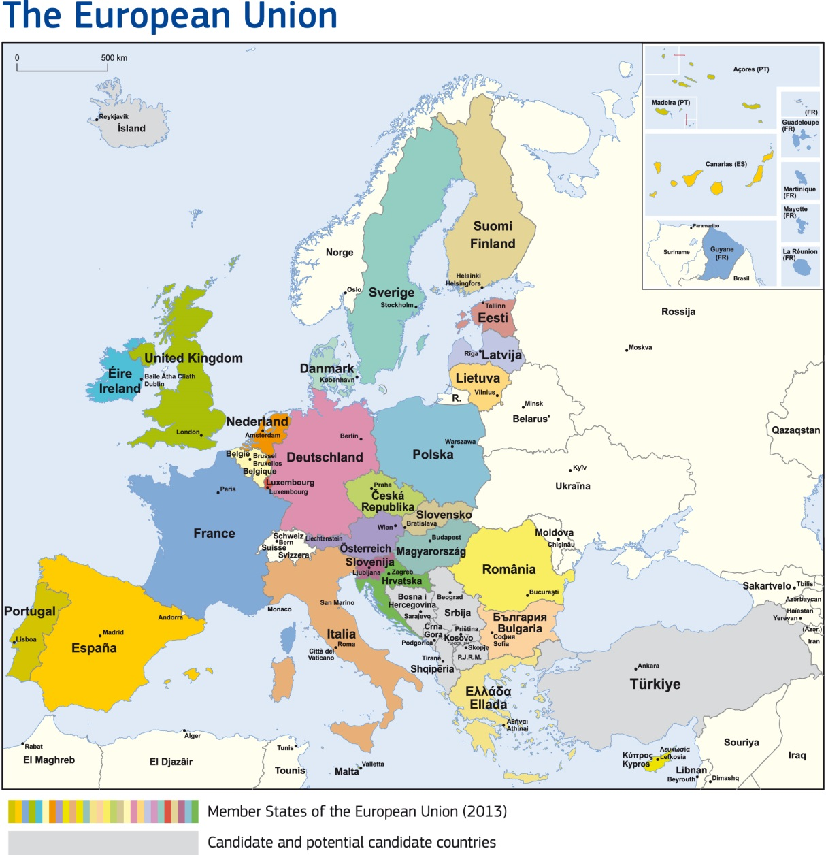
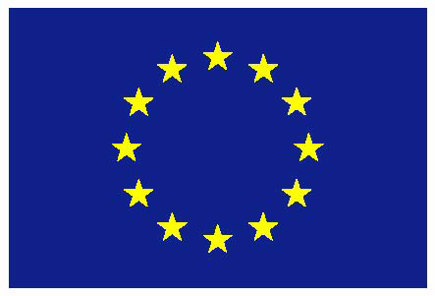
European Union: Member states and candidates for accession
Member States
(Potential) Candidate States

Slide 3
History of European integration
Origins of European integration: Integration initiatives launched in Western Europe in aftermath of World War II; period marked by political and economic reconstruction, beginning of Cold War
Institutional foundations of today‘s European Union: Three Communities created in 1950s: European Coal and Steel Community (ECSC), European Atomic Energy Community (Euratom) and European Economic Community (EEC), with six member states
Three trajectories of development: (1) Accession of more member states (“widening”); (2) transfer of more powers and decision-making autonomy to European institutions (“deepening”); (3) growing complexity of multiple, overlapping regional arrangements (“differentiated integration”)

Slide 4
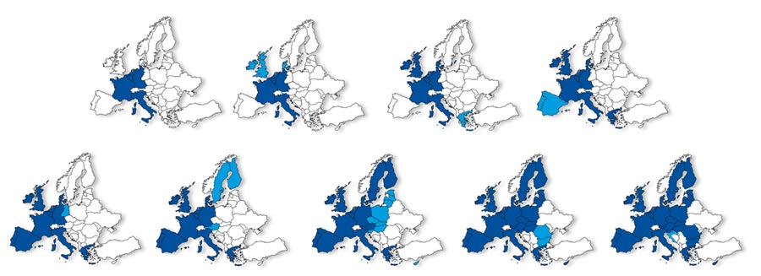
Widening integration
Original members: Germany, France, Italy, Belgium, Netherlands, Luxemburg
1973: UK, Ireland, Denmark
1981: Greece
1986: Portugal, Spain
1990: East Germany
1995: Austria, Sweden, Finland
2004: CEE countries, Cyprus, Malta
2007: Bulgaria, Romania
2013: Croatia

Slide 5
Deepening integration
1963/64: Court of Justice strengthens Community law against member states
1985: Single European Act abolishes member-state veto in many policy areas, strengthens European Parliament
1991: Maastricht Treaty creates European Union; lay groundwork for Euro; pushes integration beyond economics (foreign policy, home affairs)
1997/2000: Amsterdam and Nice Treaties reform EU institutions prior to enlargement; incorporate Schengen agreement into EU treaties
2007: Lisbon Treaty simplifies institutional structure, gives EU unified legal personality → in force since 2009
Since 2010: Succession of crises (Eurozone crisis, refugee crisis, Brexit) and rise of Euroscepticism

Slide 6
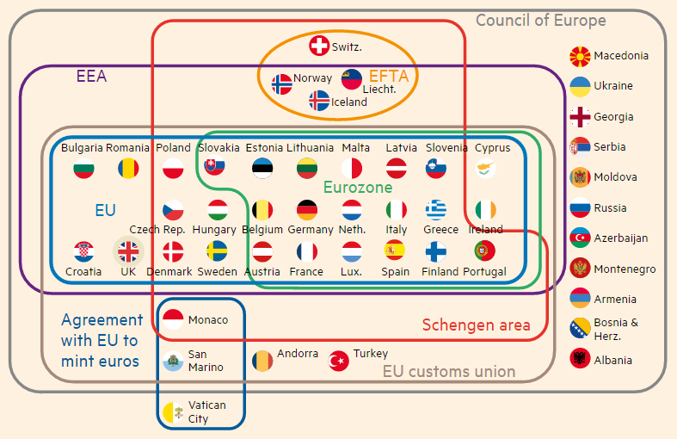
Differentiated integration
European Union

Slide 7
EU governance: Core characteristics
More than an international organization, less than a state:
EU is combination of intergovernmentalism (member-state control) and supranationalism (pan-European mandate)
Multilevel governance:
EU makes binding laws in wide range of areas, but mainly framework laws specified by member states; member states charged with policy implementation
Precarious legitimacy:
More democratic mechanisms than in any other international organizations, but limited citizen interest/participation and increasing Euroscepticism

Slide 8
Core EU institutions: A first overview
Institution | Composition | Governance role
European Council (Brussels) | Member state leaders (intergovernmental) | Defines legislative, executive objectives
European Commission (Brussels) | EU bureaucrats (supranational) | Executive, some legislative functions
Council of the European Union (Brussels) | Member state ministers (intergovernmental) | Legislative, some executive functions
European Parliament (Strasbourg, Brussels) | Elected MEPs (supranational) | Legislative
Court of Justice (Luxembourg) | EU judges (supranational) | Judiciary

Slide 9
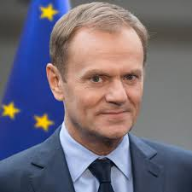
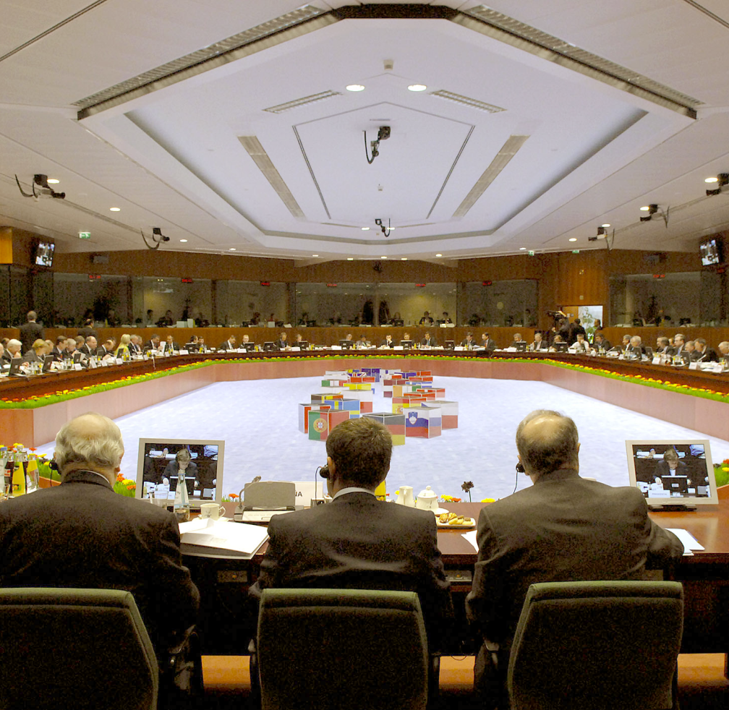
European Council
Summits of heads of state or government from all member states, permanent president (Donald Tusk)
Discusses pressing issues; defines policy objectives; decides on institutional reform and key personnel
Usually meets 5-10 times per year, makes decisions by consensus (few exceptions)

Slide 10
European Commission
One Commissioner per member state, responsible for specific portfolio, headed by president (Jean-Claude Juncker)
Monitors implementation of EU law; manages EU programs and finances; initiates EU legislation; some front-line regulatory functons
Seeks to speak with one voice (internal divisions usually not reported to the outside)

Slide 11
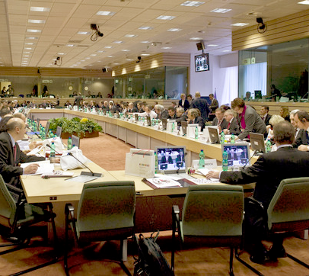
Council of the European Union
One minister per member state; composition varies by policy field; presidency rotates between member states every six months (currently: Estonia)
Must pass all binding EU laws; monitors Commission; executive role through national bureaucracies
Decides unanimously or per qualified majority (QMV)
Also called “Council of Ministers” or just “Council”

Slide 12
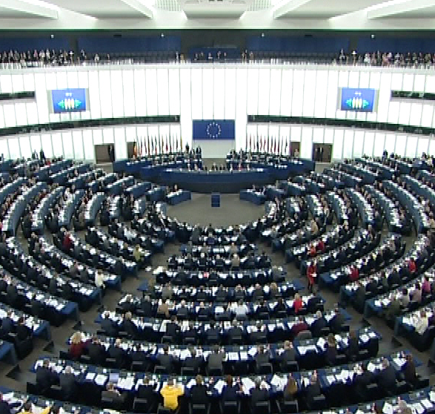
European Parliament
751 elected members, organized in trans-national party groups, chaired by president (Antonio Tajani)
Must pass EU laws in most policy areas (together with Council); scrutinizes of Commission
Usually decides by simple majority

Slide 13
Party Groups in the European Parliament
European People‘s Party (Christian Democrats) (EPP)
Progressive Alliance of Socialists and Democrats in the European Parliament (S&D)
European Conservatives and Reformists (ECR)
Alliance of Liberals and Democrats for Europe (ALDE)
European United Left – Nordic Green Left (GUE/NGL)
Greens / European Free Alliance (Greens/EFA)
Europe of Freedom and Direct Democracy (EFDD)
Europe of Nations and Freedom (ENF)

Slide 14
Composition of the European Parliament

Slide 15
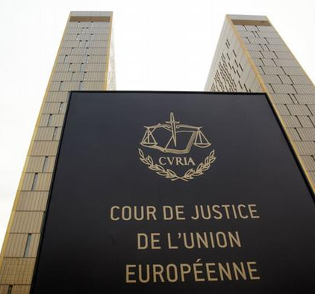
Court of Justice
28 judges, appointed by member states, chaired by president (Koen Lenaerts)
Makes decisions on interpretation of EU law; most cases brought by national courts, EU institutions, or companies directly affected by EU decisions
Most decisions made in chambers of 3 or 5 judges

Slide 16
Core EU institutions: Another look
Institution | Composition | Governance role
European Council (Brussels) | Member state leaders (intergovernmental) | Defines legislative, executive objectives
European Commission (Brussels) | EU bureaucrats (supranational) | Executive, some legislative functions
Council of the European Union (Brussels) | Member state ministers (intergovernmental) | Legislative, some executive functions
European Parliament (Strasbourg, Brussels) | Elected MEPs (supranational) | Legislative
Court of Justice (Luxembourg) | EU judges (supranational) | Judiciary

