Slide 1
Introduction to the European Union Professor Crina Viju-Miljusevic Institute of European, Russian and Eurasian Studies

Slide 2
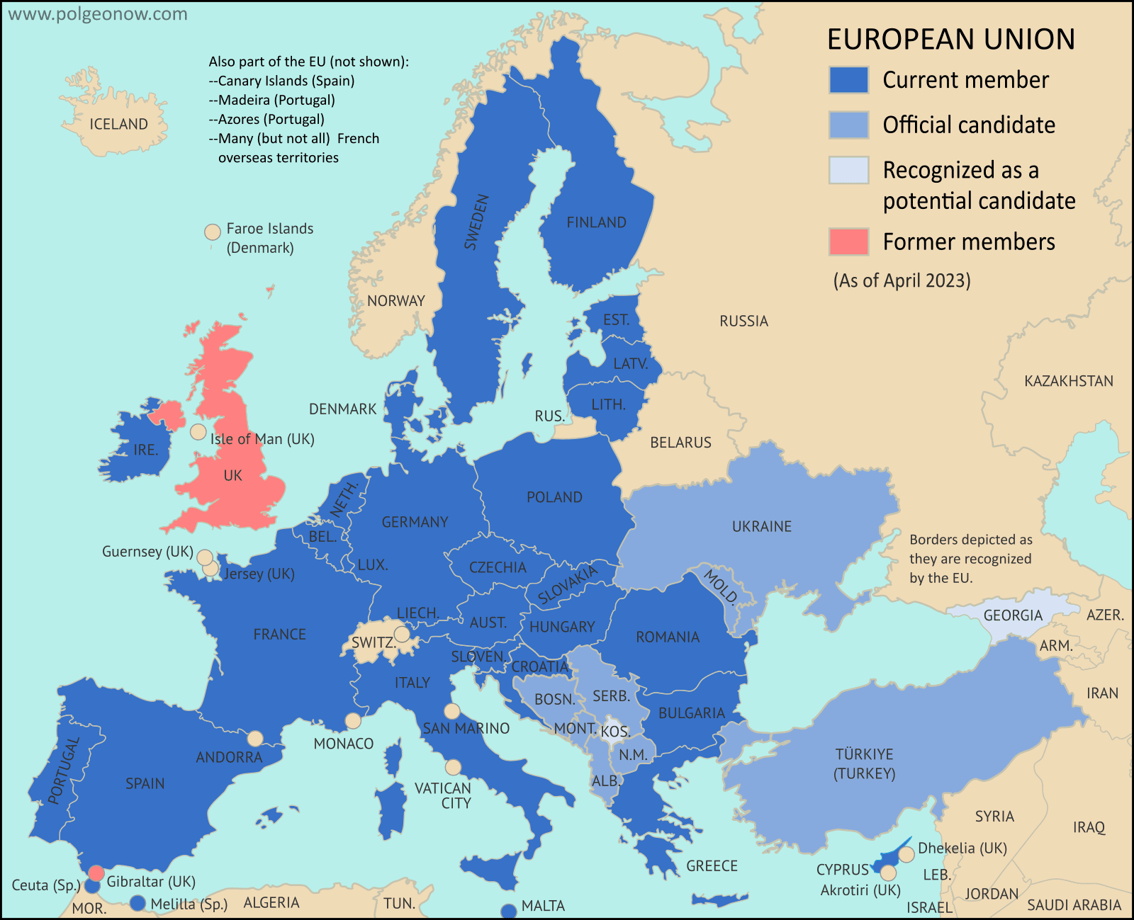
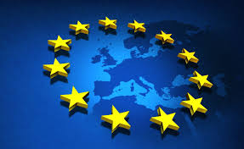
The European Union: 27 countries Member states, candidates and potential candidates for accession
https://www.polgeonow.com/2016/06/map-which-countries-are-in-the-eu.html

Slide 3
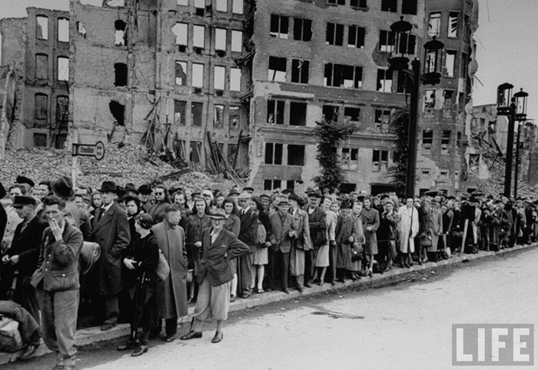
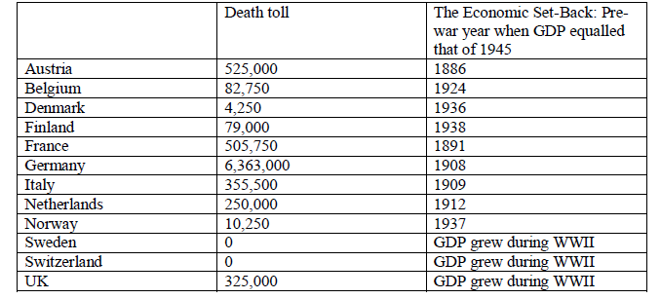
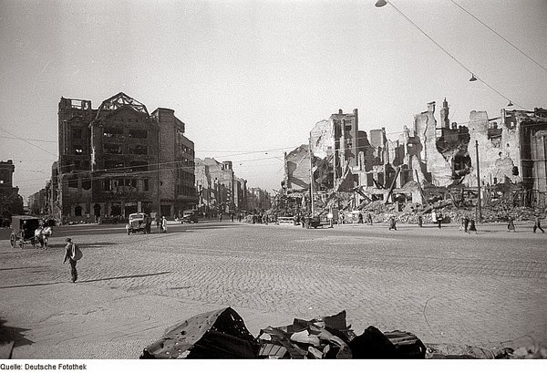
Why?
Peace in Europe (post-WW II)
Jean Monnet (1943):
“There will be no peace in Europe, if the states are reconstituted on the basis of national sovereignty with all that this implies by way of prestige politics and economic protectionism. If the countries of Europe once more protect themselves against each other, it will be once more be necessary to build up vast armies.”
“The European states must constitute themselves into a federation.”
Economic interdependence as key
Economic reconstruction
http://www.vintag.es/2013/08/old-photos-of-berlin-after-world-war-ii.html
https://historyshelf.blogspot.com/2011/04/facts-of-world-war-ii-in-europe.html

Slide 4
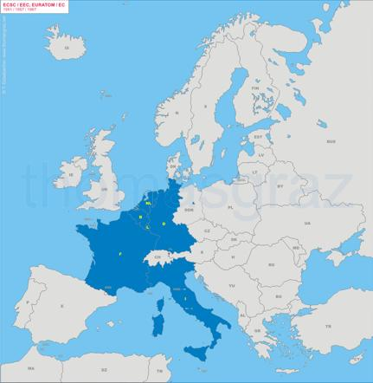
Institutional foundations
Three Communities created in 1950s:
European Coal and Steel Community (ECSC), 1951
making war in Europe not only ‘unthinkable, but materially impossible’
European Atomic Energy Community (Euratom), 1957
European Economic Community (EEC), 1957
Founders:
Germany, France, Italy, Belgium, Netherlands, Luxemburg
Different patterns of development:
Widening
Deepening
Differentiated and multi-speed integration

Slide 5
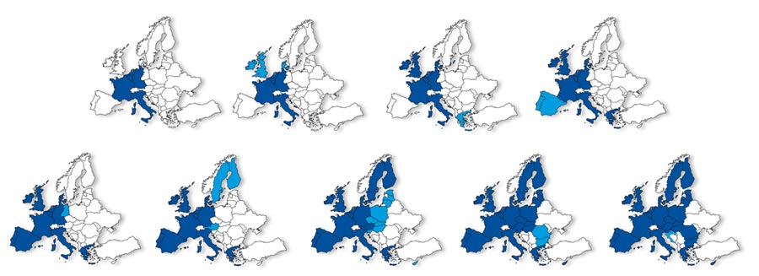
Widening: enlargement
Original members: Germany, France, Italy, Belgium, Netherlands, Luxemburg
1973: UK, Ireland, Denmark
1981: Greece
1986: Portugal, Spain
1990: East Germany
1995: Austria, Sweden, Finland
2004: CEE countries, Cyprus, Malta
2007: Bulgaria, Romania
2013: Croatia

Slide 6
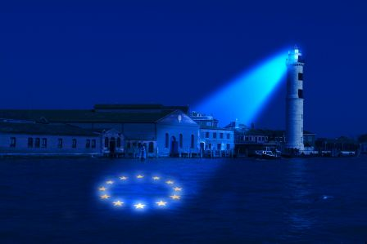
Deepening – more policy matters decided at EU level
Single European Act (1985): 4 freedoms of movement; strengthens European Parliament
Maastricht Treaty (1991): creates European Union; Euro; pushes integration beyond economics (foreign policy, home affairs)
Amsterdam (1997) and Nice (2000) Treaties: preparation for enlargement; incorporate Schengen agreement into EU treaties
Lisbon Treaty (2009): gives EU unified legal personality → in force since 2009

Slide 7
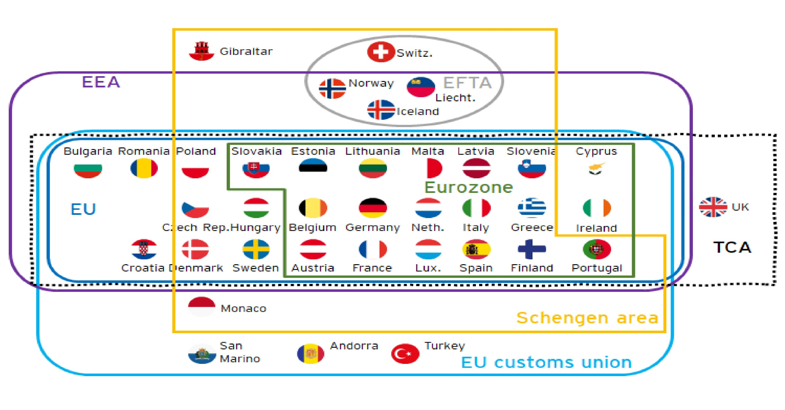
Differentiated integration
European Union

Slide 8
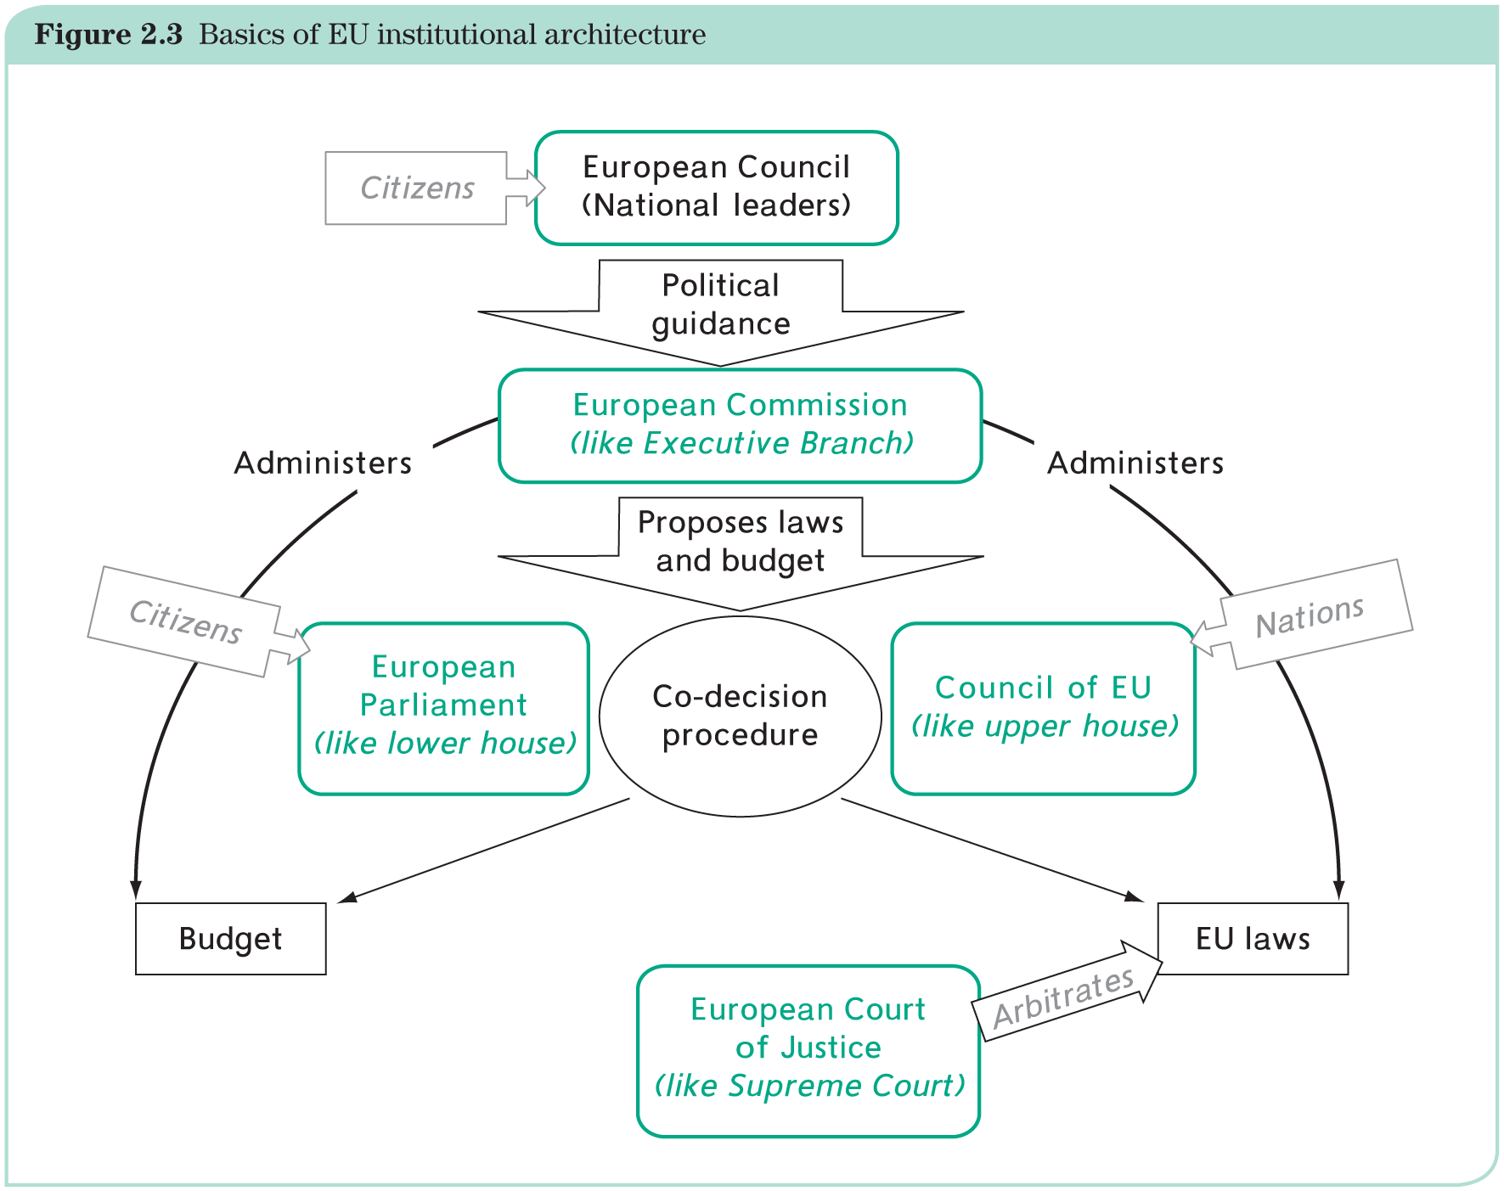
The ‘Big-5’ institutions

Slide 9
EU Institutions: a combination of a supranational principle (community matters) and an intergovernmental principle
Institution | Composition | Governance role
European Council (Brussels) | Member state leaders (intergovernmental) | Defines legislative, executive objectives
European Commission (Brussels) | EU bureaucrats (supranational) | Executive, some legislative functions
Council of the European Union (Brussels) | Member state ministers (intergovernmental) | Legislative, some executive functions
European Parliament (Strasbourg, Brussels) | Elected MEPs (supranational) | Legislative
Court of Justice (Luxembourg) | EU judges (supranational) | Judiciary
Hurrelmann, 2017

Slide 10
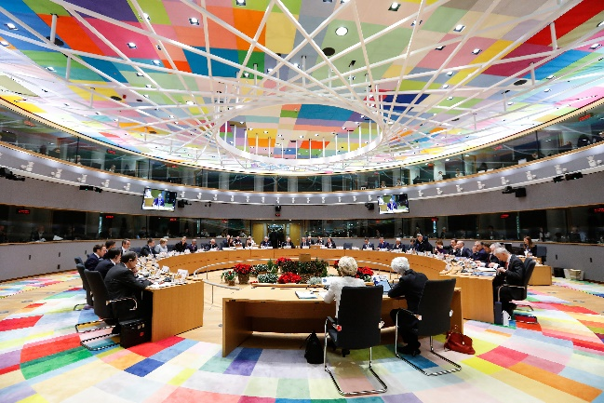
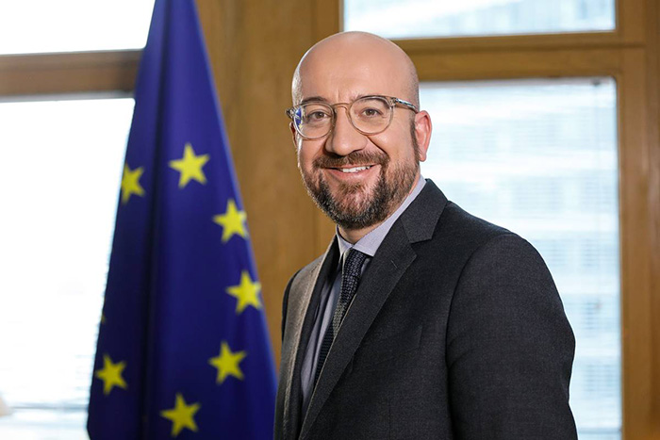
The European Council or Council of heads of state and of government (voice of the Member States) – president Charles Michel
Plays an important role:
in providing overall political direction to the Union,
defining goals and strategies
The European Council takes decisions on an intergovernmental basis, and implementation of the measures is left to the other EU institutions.
The Lisbon Treaty introduced a President of the European Council (Charles Michel since 2019) who holds office for 2.5 years, renewable for a following term (selected by qualified-majority voting in the European Council).

Slide 11
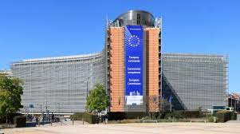
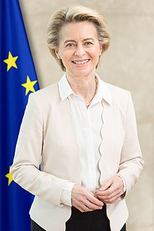
The European Commission (the voice of the EU) – president Ursula von der Leyen
The European Commission is the executive branch of the EU.
It enforces the Treaties and is driving forward European integration:
it proposes legislation to the Council and Parliament;
it administers and implements EU policies;
it provides surveillance and enforcement of EU law in coordination with the EU Court.
It represents the EU at some international negotiations (e.g., WTO). However, the Commission’s negotiating stances at such meetings are closely monitored by EU members.
The Commission is made up of one Commissioner from each EU member (including the President).
Commissioners are appointed all together and serve for five years.
Commissioners are not supposed to act as national representatives.

Slide 12
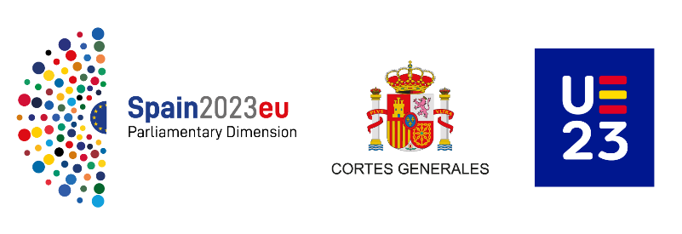
The Council of the European Union (the voice of the Member States); current Presidency: Spain
The Council is composed of representatives of each of the member states at the ministerial level plus a representative of the Commission; composition varies by policy field;
presidency rotates between member states every six months
Functions:
To pass EU laws – jointly with the EP in many policy areas;
To co-ordinate the broad economic policies of the member states;
To conclude international agreements between the EU and other countries or international organizations;
To approve the budget of the EU, jointly with the EP;
To develop the Common Foreign and Security Policy of the EU, based on guidelines set by the European Council and
To co-ordinate co-operation between the national courts and police forces in criminal matters.

Slide 13
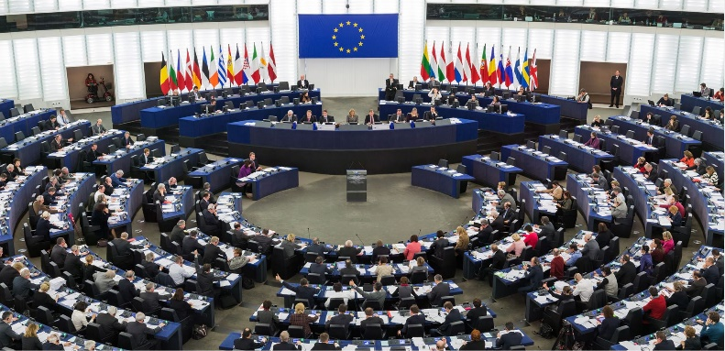
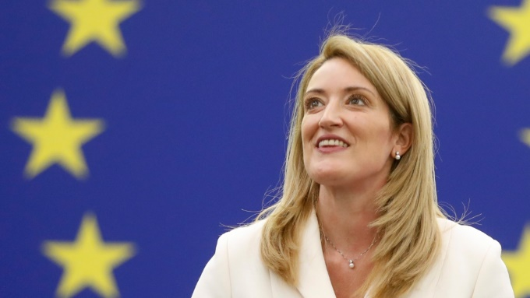
The European Parliament
Organization:
751 members (MEPs) directly elected; chaired by President (Roberta Metsola)
number per nation varies with population but is less than proportional;
MEPs physically sit left-to-right, not along national lines; organized in trans-national party groups.
The European Parliament adopts laws by a simple majority: the usual 50 per cent majority threshold with one vote per member of Parliament.
Main tasks:
sharing legislative powers with the Council of the EU and the Commission;
overseeing EU institutions, especially the Commission.

Slide 14
European Parliament (voice of the people)
Democratic Control:
Parliament is the primary democratic control over the EU’s activities;
MEPs are directly elected.

Slide 15
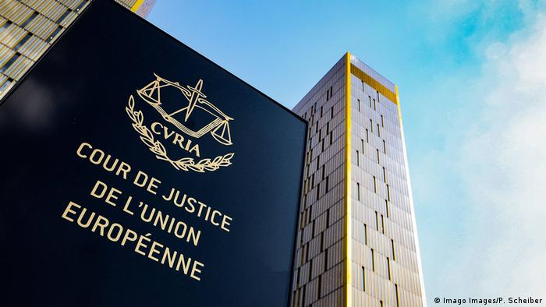
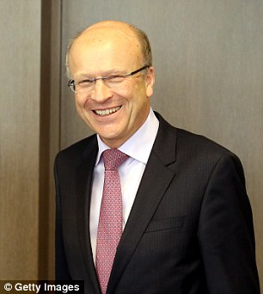
Court of Justice of the European Union
Organization:
one judge from each member appointed for six years; chaired by president (Koen Lenaerts)
Court reaches its decisions by majority voting.
EU laws and decisions are open to interpretation that may lead to disputes that cannot be settled by negotiation:
Court settles these disputes, especially disputes between Member States, between the EU and Member States, between EU institutions, and between individuals and the EU;
It has had a major impact on European integration via case-law.
Judges are appointed by common accord of the Member States’ governments.

Slide 16
Core EU institutions: Another look
Institution | Composition | Governance role
European Council (Brussels) | Member state leaders (intergovernmental) | Defines legislative, executive objectives
European Commission (Brussels) | EU bureaucrats (supranational) | Executive, some legislative functions
Council of the European Union (Brussels) | Member state ministers (intergovernmental) | Legislative, some executive functions
European Parliament (Strasbourg, Brussels) | Elected MEPs (supranational) | Legislative
Court of Justice (Luxembourg) | EU judges (supranational) | Judiciary

Slide 17
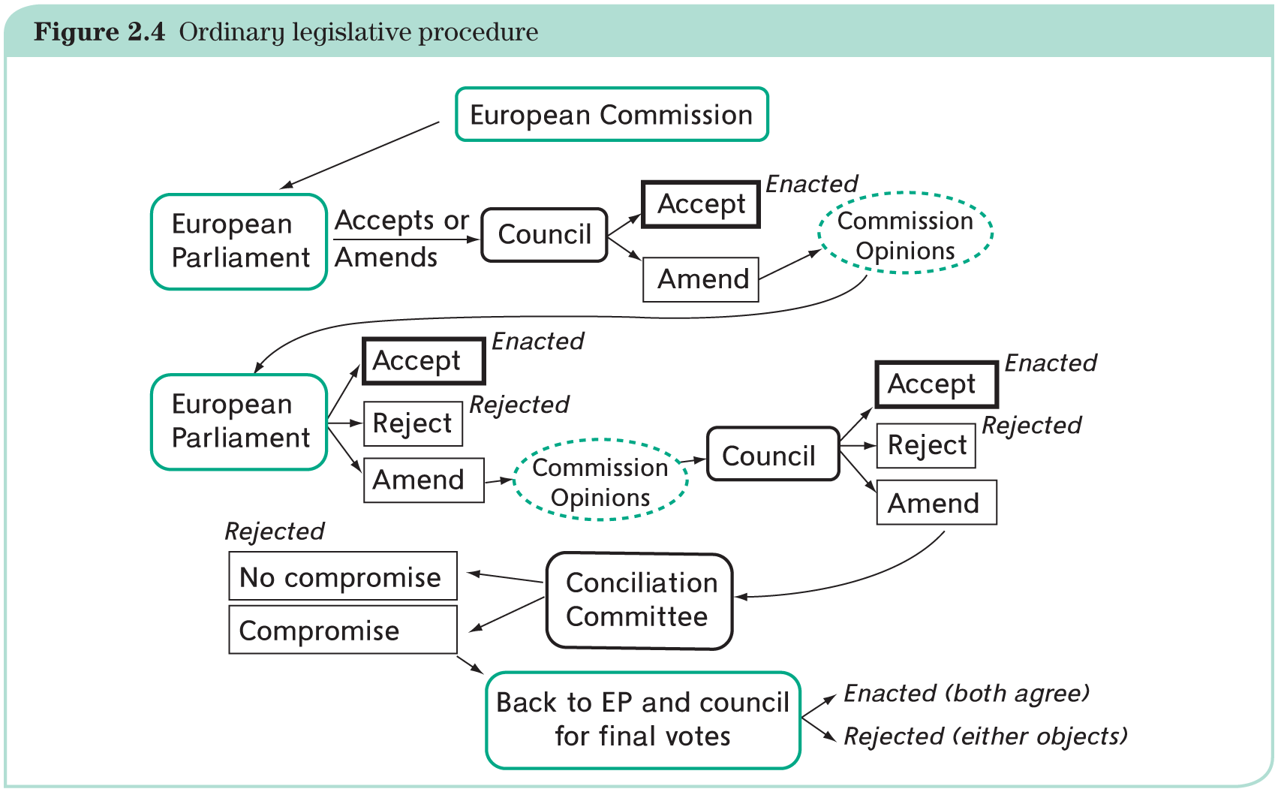
The ordinary legislative procedure

Slide 18
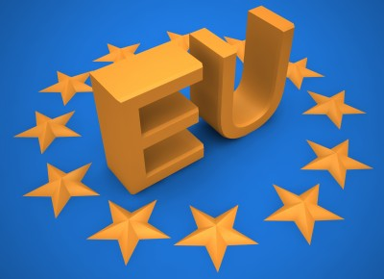
What is the EU?
More than an international organization, less than a state:
EU is a combination of intergovernmentalism (member-state control) and supranationalism (pan-European mandate)

Slide 19
Areas of success
Nobel peace prize in 2012
Spread of European norms and values (freedom, democracy, human and minority rights, rule of law) through various policies
Enlargement, trade, development
Largest single market of the world:
The EU is the third largest economy in the world.
The EU is the world's largest trading block.
The EU ranks first in both inbound and outbound international investments.
The EU is the top trading partner for 80 countries.
Global leader in environmental matters
Green Deal
The largest donor of the world

Slide 20
EU crises
Since 2010, succession of crises and rise of Euroscepticism:
Eurozone crisis
Refugee crisis
Brexit
Covid-19 pandemic
Russia’s war in Ukraine

