Slide 1
EU and NATO on a collision course with Russia?
Teachers’ Workshop, Nov. 30, 2023
Carleton University
Joan DeBardeleben

Slide 2
Structure of session
EU foreign policy: policy toward Ukraine and Russia as a case in point
Why should Canadians care about EU foreign policy?
Back drop to Russia’s war against Ukraine and EU reactions
Change in Post-Soviet Europe​
Russia's diminished power​
The EU's enlargement​
EU reliance on NATO for hard security
NATO's expansion​
EU-Russia relations​
Russia’s war in Ukraine and EU foreign policy
Where now?

Slide 3
EU foreign policy: decision-making
Member state (MS) retain most power
Common Foreign and Security Policy gives some special powers to the Union based on the intergovernmental principle (role of European Council), most of unanimously.
Coordinated MS actions, e.g, Permanent Structured Cooperation, activated in 2017; development of rapid response units (MS cooperation)
No European army, reliance on NATO for hard security
Debate about EU strategic autonomy
(In contrast, trade, customs, are EU competencies)

Slide 4
EU foreign policy : Actions Source: https://www.eeas.europa.eu/delegations/united-states-america/eu-assistance-ukraine-us-dollars_en?s=253#:~:text=Over%20%2429%20billion%20in%20military,basis%20by%20our%20Member%20States.
Generally, an emphasis on conflict resolution, crisis response, civilian actions
But, unprecedented and unanimous support for Ukraine
Progressive sanctions packages against Russia
$29 billion USD in military assistance to Ukraine from EU and MSs ($6 billion EU)
$43 billion financial/budgetary/ humanitarian/emergency assistance + training
Refugee assistance ($18 bill), 8 mill refugees

Slide 5
EU- Canada foreign policy cooperation: strategic partnership
Laid out in Strategic Partnership Agreement (2017) http://www.international.gc.ca/world-monde/international_relations-relations_internationales/can-eu_spa-aps_can-ue.aspx?lang=eng
Joint Ministerial Committee (annual)
Leaders’ summits (St. John’s Nov 23-24)
Canadian contributions to 12 EU civilian missions
Based on shared values
Also the CETA (Canada-EU Comprehensive Economic and Trade Agreement)

Slide 6
Russia’s sphere of influence diminished after 1991
USSR (source CIA from https://primarysourcenexus.org/2014/08/featured-source-republics-soviet-union/)
Russian Federation 1993 (source Washington DC, office of the Geographer, Library of Congress, public domain

Slide 7
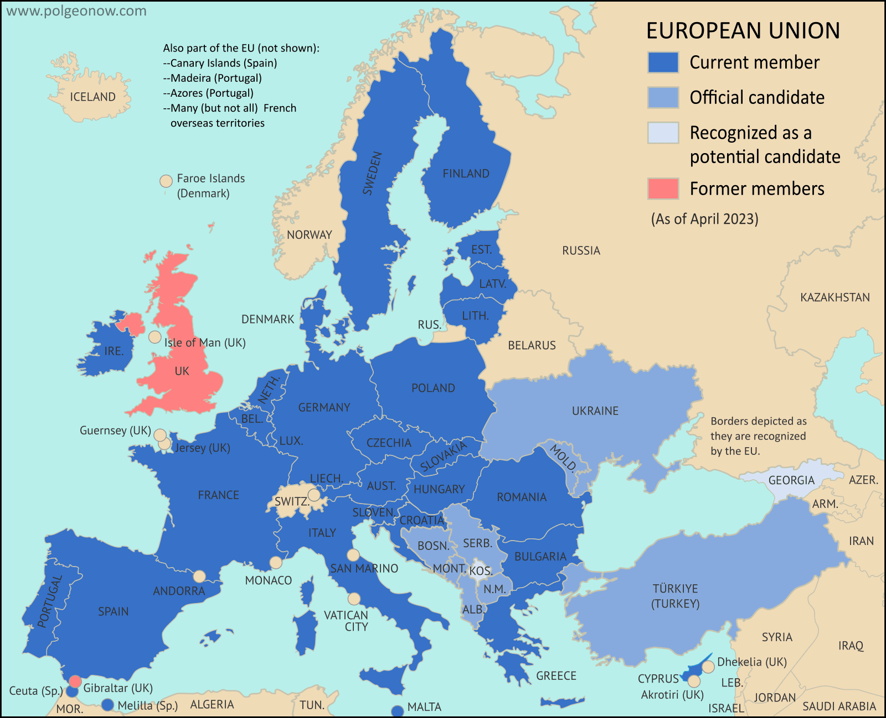
THE EU NOW (Source: Evan Centanni, from blank map by Ssolbergj. License: CC BY-SA, https://www.polgeonow.com/2016/06/map-which-countries-are-in-the-eu.html)

Slide 8
The next enlargements? (date of candidate status and of opening accession negotiations)
Candidate states
Türkiye (1999, negotiations 2005, stalled)
N. Macedonia (2005, negotiations 2020)
Montenegro (2010, negotiations 2012)
Serbia (2012, negotiations 2014)
Albania (2014, negotiations 2020)
Ukraine (since June 2022)
Moldova (since June 2022)
Bosnia & Herzegovina (since Dec 2022)
Potential candidate:
Kosovo
Membership perspective
Georgia (since June 2022)
Source: https://neighbourhood-enlargement.ec.europa.eu/countries_en
By CIA - Perry-Castañeda Library Map Collection, Public Domain, https://commons.wikimedia.org/w/index.php?curid=110271324

Slide 9
NATO - still needed in post-Cold war period?
Problems:
Original justification no longer valid
Irritant to Russia
Reason for maintenance of NATO in 1990s:
New security threats and tasks?
New mandates (e.g., conflict management)
‘Glue’ of the transatlantic political relationship
Organizational logic
NATO’s essential purpose is to safeguard the freedom and security of its members through political and military means” (inc. conflict prevention, promotion of democracy, crisis management)
http://www.nato.int/nato-welcome/

Slide 10
NATO MEMBERSHIP (31 countries)
1949: 12 countries (US, Canada, the UK, France, Italy, Belgium, Netherlands, Denmark, Portugal, Luxembourg, Norway, Iceland)
1952: Greece and Turkey
1955: Federal Republic of Germany (West)
1982: Spain
1999: Czechia, Hungary, Poland
2004: Bulgaria, Estonia, Latvia, Lithuania, Romania, Slovakia, Slovenia
2009: Albania, Croatia
2017: Montenegro
2020: Northern Macedonia
2023: Finland

Slide 11
NATO Enlargement (Source: https://en.wikipedia.org/wiki/Enlargement_of_NATO)

Slide 12
ARMS NEGOTIATIONS AND ARMS RACE: Things are not going well…..
Soviet period: strategic balance and nuclear deterrent
Arms race declined under Gorbachev and a number of agreements were put in place
Gradually undermined after 2000
Russian view: strategic balance at risk; Putin has warned of “a sense of the impending danger”
Western view: alarm at revisionism and brinkmanship of Russia in response

Slide 13
Major arms agreements
Anti-Ballistic Missile Treaty (US, USSR) | 1972 | US withdrawal 2002
Intermediate Nuclear Forces Agreement (US, USSR, then Russia, Belarus, Kazakh, Ukraine) | 1987 | Became contentious, due to missile defense and alleged Russ violations; US withdrawal 2019
Conventional Forces in Europe Treaty (NATO and Warsaw Pact members) | 1990, adapted 1999 | Russia suspends 2007,announce intention to withdraw 2015, finalizes withdrawal 2023; W. partners suspend participation
New START Treaty (US, Russia). (Russia withdrew from START 2 due to US ABM withdrawal 2003) (START 1, 1991) | In force 2011 | Extended by President Biden and Putin from 2021; Russia suspends participation in 2023

Slide 14
Principles underlying the EU’s approach to Russia before the war
Security through economic interdependence, but put under question in recent years in the energy sphere (Nordstream 2)
Attempt to encourage Russia’s market and democratic transformation (democratic peace theory) didn’t prevent Russia’s authoritarian drift
Differences between EU member states
E.g., countries bordering Russia (Estonia, Latvia, Lithuania, Poland ) more distrustful; strong German economic interests and send of historic responsibility ; France, prone to cooperation; UK more skeptical)

Slide 15
EU –Russia Relations: Tension and cooperation
An institutionally dense relationship (many bodies, dialogues, biannual summits)(Four Common spaces 2003, Roadmaps 2005, Partnership for Modernization 2010), Visa Dialogue
Dubbed a ‘strategic partnership’ (one of 10 for the EU) until the events of 2014
Periods:
1993-2004 Cooperation
2005-2013 Pragmatic competition
2014 - Confrontation (abrupt rift)
Flashpoints of tension
Chechnya wars (EU critique of Russia)1990s
Georgia conflict 2008
Ukraine conflict late 2014-

Slide 16
Russia’s geopolitical considerations
Security (loss of empire, NATO)
Status: demands for
regional primacy
recognition and equality
Western democracy promotion in EE seen as a threat

Slide 17
The EU’s Eastern Partnership Policy http://ec.europa.eu/environment/international_issues/eastneighbours_en.htm

Slide 18
Competing regionalisms in the shared neighbourhood
Eastern Partnership policy (launched 2009)
-Directed at 6 countries (inc. Ukraine)
-To encourage democratic and market reform, regulatory convergence
-Responding to European aspirations of countries like Ukraine, Georgia, Moldova, Armenia
-Became the trigger for 2014 events (Crimean annexation)
-Led to Association Agreements and deep trade agreements with Ukraine, Georgia, and Moldova
Eurasian Customs(2010) Union and Eurasian Economic Union (2015)
-3 founding members (Russia, Kazakhstan, Belarus)
-Expanded to include Armenia (2014) and Kyrgystan (2015)
-Heavy Russian pressure to bring Ukraine in – failed
-A tool for Russian to establish equal status with the EU
-Mimicked elements of the EU, but less deep integration
-Russian dominance, due to size and power
-Did not require reforms; bolstered authoritarian leaders
EU
Russia

Slide 19
Status of common neighbours
Ukraine: EU candidate and NATO aspirant
Moldova: EU candidate
Georgia: EU potential candidate and NATO aspirant
Azerbaijan: Two vector approach
Armenia: Eurasian Economic Union member; Comprehensive and Advanced Partnership Agreement with the EU (two vector)
Belarus: Eurasian Economic Union; aligned with Russia

Slide 20
The Current standoff (Ukraine war)
Scenarios:
Russian victory (unlikely)
Ukrainian victory (unlikely)
Persistent stalemate (continued warfare, clashes, or, eventually, frozen conflict)
Negotiated settlement
Determinants:
Continuing military capacity on both sides
Changes in the West: Durability of int’l support for Ukraine; political shifts (esp. US)
Changes in Russia: leadership change; economic costs
Overall shift in geopolitical configuration

Slide 21
Impacts of the war in Ukraine on the EU
Massive refugee influx
Major shift in energy policy
A return to enlargement as a foreign policy instrument
Amazing foreign policy unanimity, but ‘Ukraine fatigue’ may undermine it
Reduced attention to ‘strategic autonomy’ (strengthened US attention to Europe)
Uncertainty about long-term approach to Russia, questioning of peace through economic interdependence

Slide 22
Questions for discussion
Why is close cooperation with the EU in the foreign policy area important for Canada?
Why should Europe or Canada care about Ukraine?
What are long term prospects for relations with Russia, and how might this affect Canada?
Should the Canadian government be committing military resources to supporting Ukraine? Latvia? Why or why not?
What kind of diplomatic moves might break the security dilemma in Europe?

Slide 23
Why do relations with Russia and the situation in Ukraine matter to Canada?
Canadian values: Russia’s violations of principles of international law (territorial sovereignty) and human rights
Canada’s alliances and NATO commitment
Ukrainian diaspora in Canada
Common challenges: Is Russian cooperation needed to address them? (e.g. the Arctic, climate change, international security)

Slide 24
Canada’s aid to Ukraine
Since 2022
$2.4 billion in military aid
$9.7 billion in multifaceted aid
Continued training through UIFIER (to 2026)
Previously, since 2014
Previous loans ($400 mill repaid)
$890 mill in ‘multifaceted assistance’
Development assistance to promote democratic reform, social welfare, and gender equality
Peace and Stabilization Operations Program (conflict mediation, human rights monitoring, police training)
Canadian Police Arrangements (police reform, with EU) and military training missions UNIFER)
Also Canada-Ukraine Free Trade Agreement (2017), 'modernized version' up for renewal
https://www.canada.ca/en/department-national-defence/campaigns/canadian-military-support-to-ukraine.html; https://www.canada.ca/en/global-affairs/news/2023/10/minister-ng-introduces-modernized-canada-ukraine-free-trade-agreement-legislation-in-the-house-of-commons.html
https://www.international.gc.ca/trade-commerce/trade-agreements-accords-commerciaux/agr-acc/ukraine/modernized-canada-ukraine-moderniser.aspx?lang=eng
Photo credit: Cansdem

Slide 25
NATO and the Ukraine crisis: Canada’s role
Operation Reassurance:
April 2014: military measures to reinforce NATO’s collective defence and solidarity in the Baltics
Currently about 1000 Canadian Armed Forces member deployed)(Canada lead in Latvia; Germany in Lithuania; UK in Estonia; US in Poland)
Plans and preparation to lead a Forward Presence Brigade in Latvia by 2027 (up to 2200 personnel)
HMCA Montreal 6-month deployment (Jan. 18 2022 to Black Sea/ Mediterranean, training mission)

Slide 26
Operation Reassurance Source: https://lc.nato.int/operations/enhanced-forward-presence-efp

