Slide 1
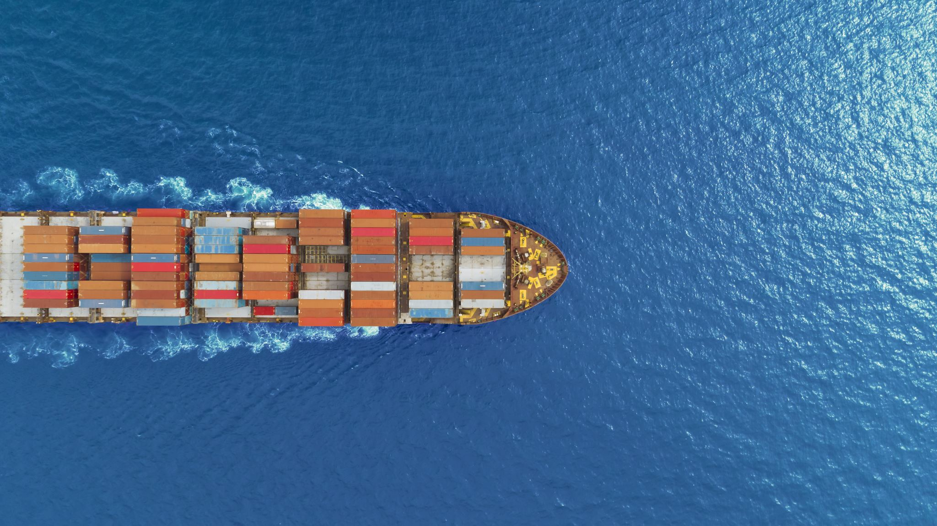
CANADA-EUROPE TRADE HISTORY
Carleton University

Slide 2
History of Canada-Europe Trade
Canada and Europe have had long-standing trade relations spanning centuries.
First established in the 1700s, the trade between the two is rooted in the Age of Discovery, when Europeans were exploring North America for its natural resources.
In the 18th century, the fur trade was a major area of commercial activity between the two continents and Canada became a key supplier for European markets.

Slide 3
History of Canada-Europe Trade
In the late 19th century, trade between Canada and Europe expanded to include manufactured goods, particularly from Britain. This increased further with the rise of trans-Atlantic steamships in the early 20th century, making it easier to transport goods from one continent to the other.
In recent years, economic relationships between Canada and Europe have significantly strengthened through the Canada-EU Comprehensive Economic and Trade Agreement, eliminating tariffs and increasing market access on both sides.

Slide 4
Timeline of Canada-Europe Trade
We will now look at a timeline of important events in the history of trade between Canada and Europe.
Using your timeline worksheet, note down the important events as we go through them.

Slide 5
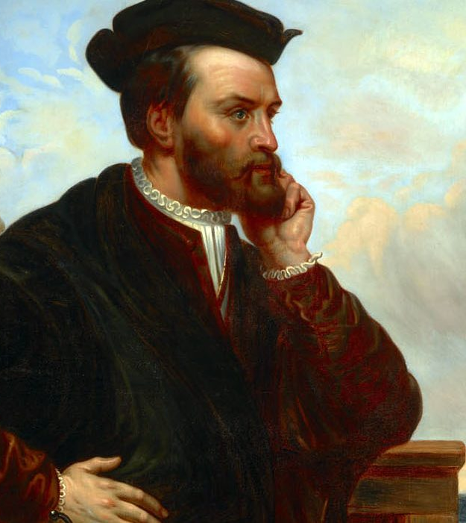
1530s
Jacques Cartier conducts the first fur trading between Europe and the First Nations.
This Photo by Unknown Author is licensed under CC BY-SA-NC

Slide 6
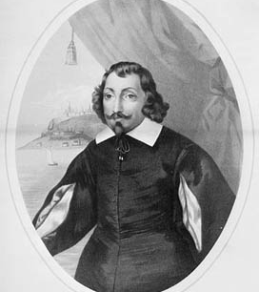
1604
Samuel de Champlain establishes the first Canadian trading post in Port Royal, Nova Scotia.

Slide 7
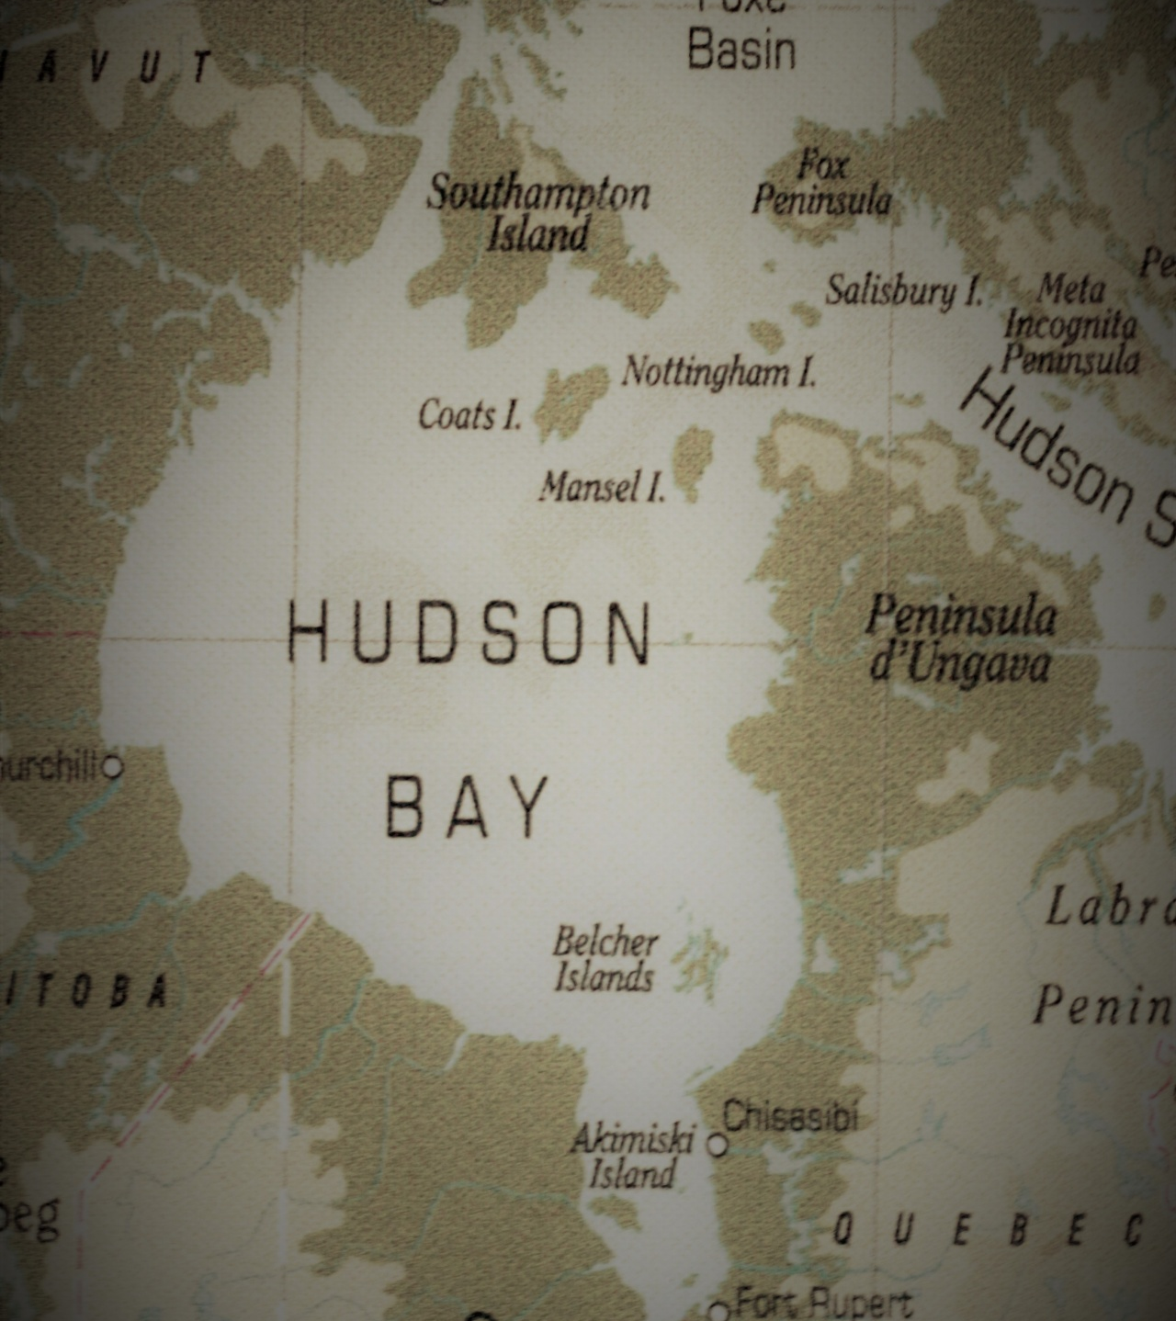
1670
The Hudson’s Bay Company is established, gaining a monopoly of trade in the Bay and ownership of all lands drained by rivers flowing into the Bay.

Slide 8
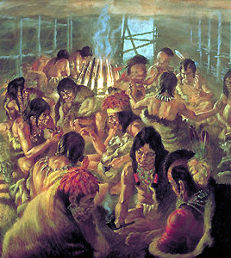
1701
The Great Peace of Montreal is signed between European settlers and the First Nations.

Slide 9
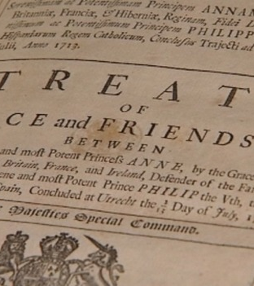
1713
The Treaty of Utrecht sees Britain gain control of New France (Canada) and the right to trade freely in its waters.
This Photo by Unknown Author is licensed under CC BY-NC-ND

Slide 10
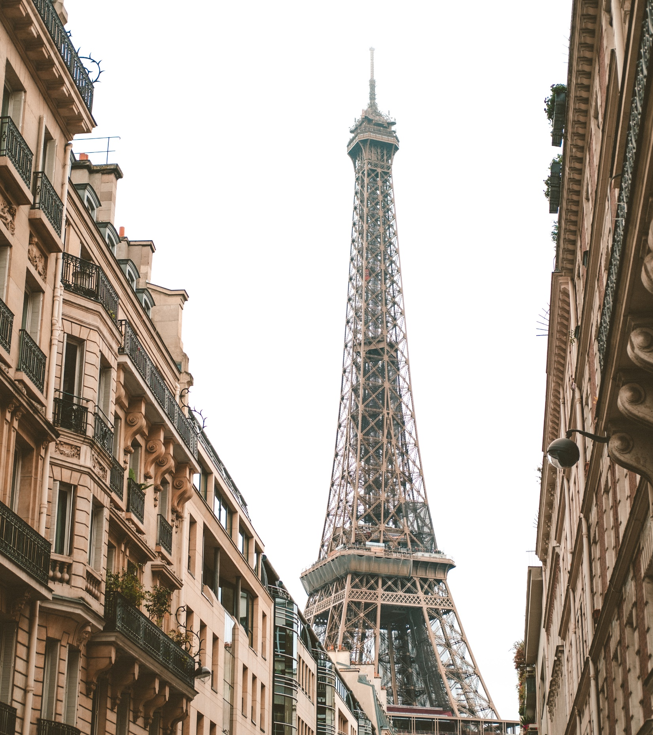
1763
The French cede their stake in New France to Britain in the Treaty of Paris and the fur trade is revitalised.

Slide 11
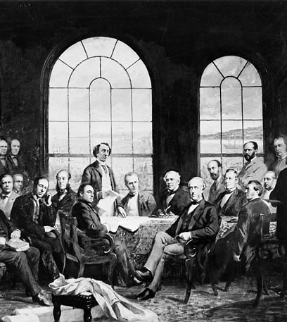
1867
Canada becomes a self-governing Dominion of the British Empire, allowing it to make its own trade agreements with other countries, including Europe.
This Photo by Unknown Author is licensed under CC BY-SA

Slide 12
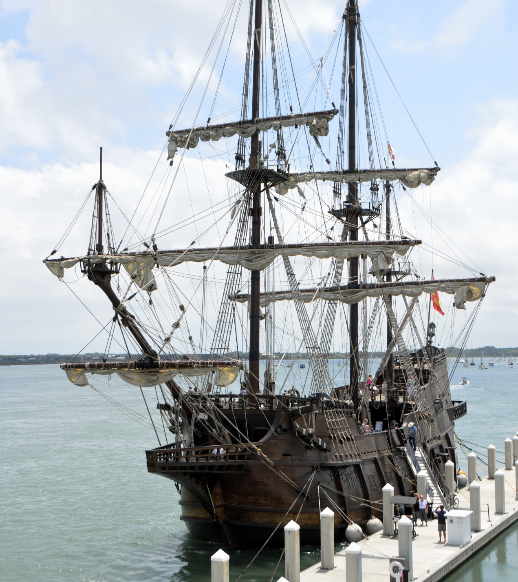
1871
The United Kingdom relaxes its protectionism, allowing Canadian products to be exported to Europe without tariffs.

Slide 13
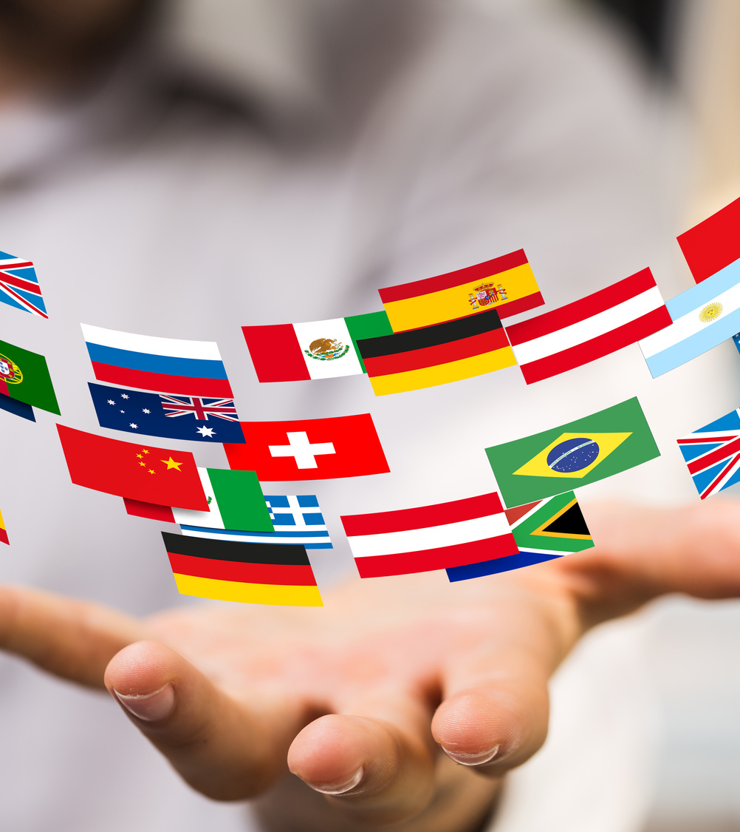
1947
Canada and European countries sign the General Agreement on Tariffs and Trade (GATT), which provides preferential access for goods moving between countries.
This Photo by Unknown Author is licensed under CC BY

Slide 14
1957
The European Economic Community (now the European Union) is established, leading to increased economic cooperation between Canada and Europe.
This Photo by Unknown Author is licensed under CC BY-NC

Slide 15
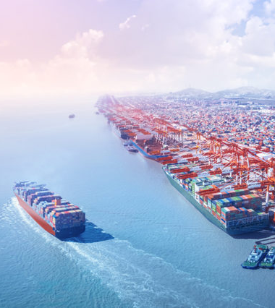
2004
Canada and the European Union (EU) begin negotiations on the Canada-EU Trade and Investment Enhancement Agreement (TIEA). This agreement was later superseded by CETA.
This Photo by Unknown Author is licensed under CC BY-SA

Slide 16
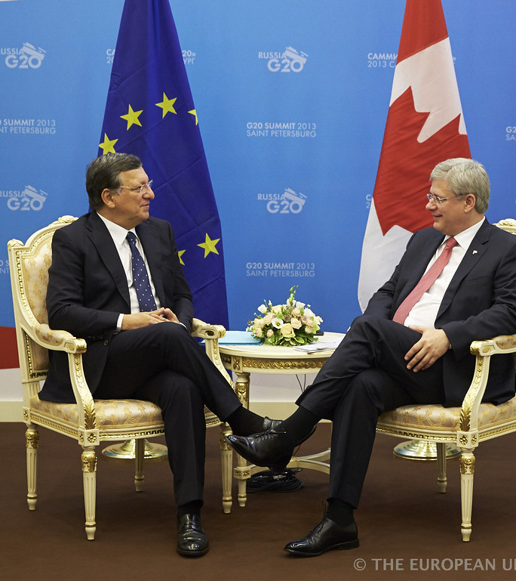
2007
Canadian and EU leaders agree to conduct joint study to examine costs and benefits of pursuing a closer economic partnership.
This Photo by Unknown Author is licensed under CC BY-NC-ND

Slide 17
2008
Canada signs the Canada-European Free Trade Association (EFTA) Free Trade Agreement with Iceland, Norway, Switzerland, and Liechtenstein.
This Photo by Unknown Author is licensed under CC BY

Slide 18
2013
The Canada–European Union Comprehensive Economic and Trade Agreement (CETA) is agreed in principle, which will provide Canada and the EU with increased access to each other's markets for goods, services, and investments.
This Photo by Unknown Author is licensed under CC BY-ND

Slide 19
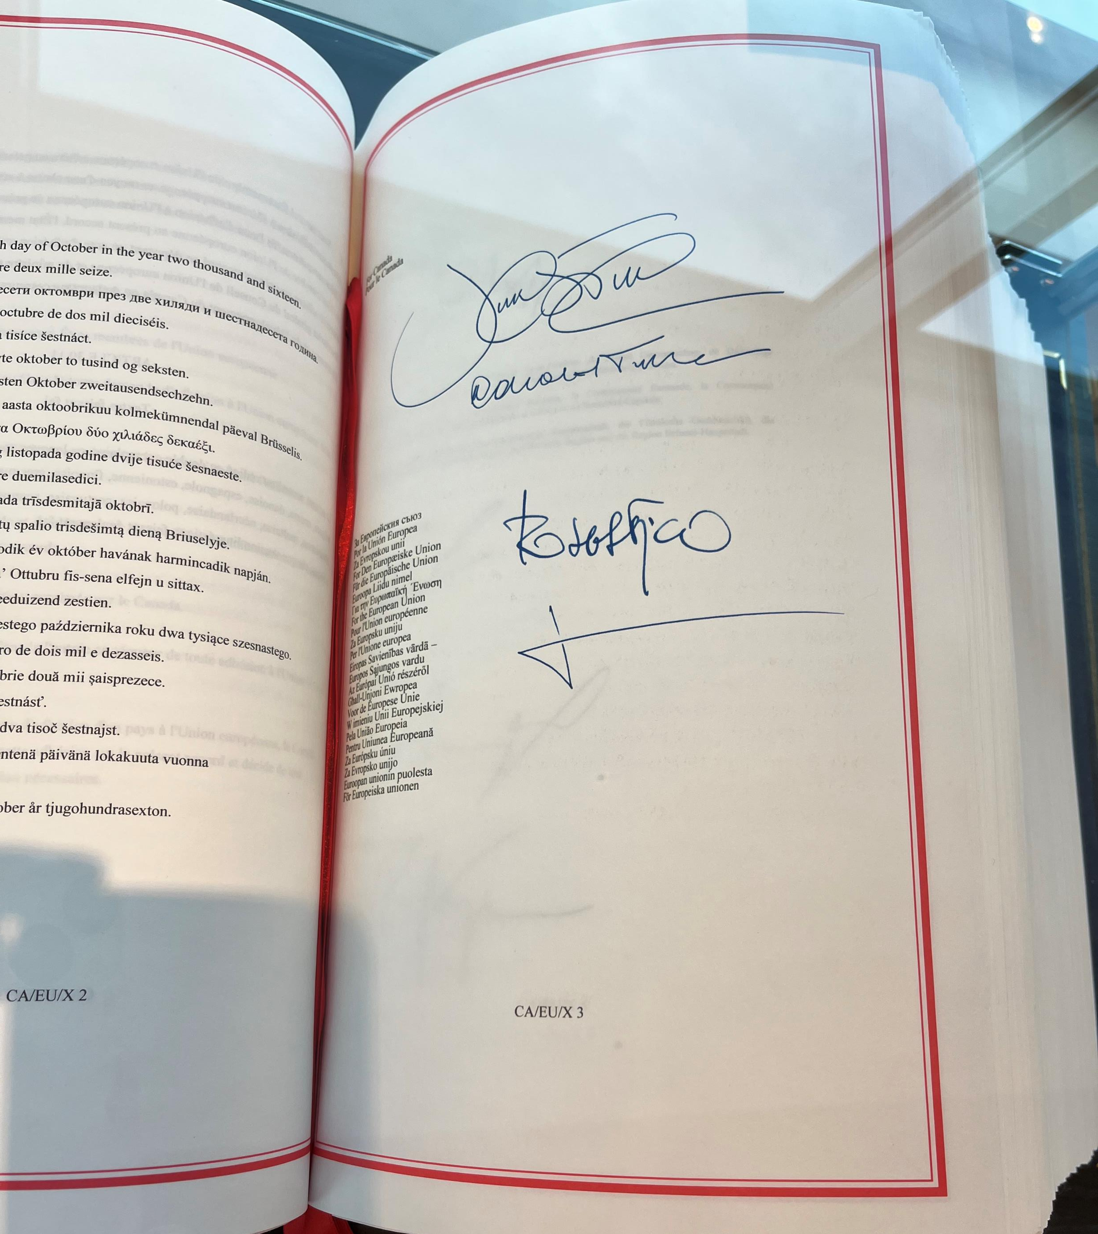
2016
Canada and EU sign historic trade agreement (CETA) during EU-Canada Summit.

Slide 20
2017
The Canada-European Union Comprehensive Economic and Trade Agreement (CETA) enters into force provisionally, awaiting ratification by all EU member states.
This Photo by Unknown Author is licensed under CC BY-ND

