Slide 1
War in Ukraine
Center for European Studies
Jean Monnet Center of Excellence
Supported by the Erasmus+ Programme
of the European Union and by Carleton University

Slide 2
Part 1:
Warm Up

Slide 3
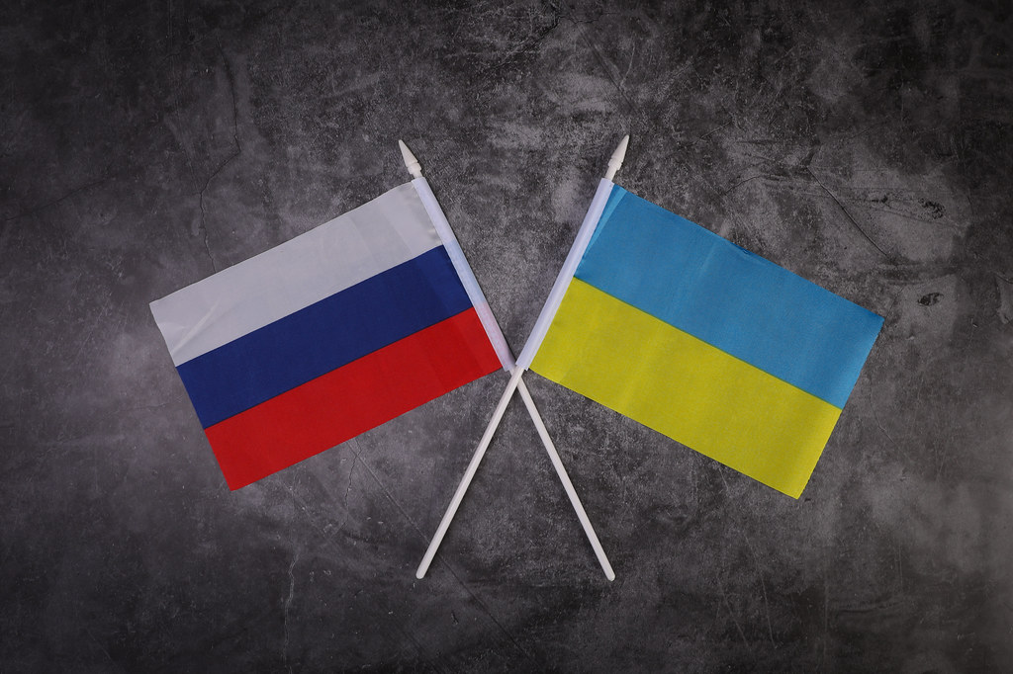
Introduction
What do you know about the war in Ukraine?
Why did Russia invade Ukraine in 2022? What are the origins of the conflict?
What has been the impact of the war on Canada and on the rest of the world?
Flags of Russia and Ukraine
(Source: Jernej Furman, Creative Commons)

Slide 4
Part 2:
Lesson

Slide 5
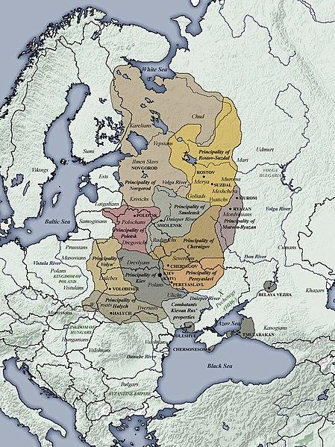
Ukraine-Russia Relations
Russia and Ukraine have a long, complicated history together as descendants from the Kievan Rus, the largest medieval state in Europe ¹
They share important political, linguistic and economic ties
Kyiv = Ukraine’s capital; also known as ‘Mother of all Russian cities’, and therefore central to Russian identity ²
Vladimir Putin, president of Russia, believes that Russians and Ukrainians are “one people” ³
August 1991: Ukraine voted to leave the Soviet Union; soon after, the Soviet Union dissolved in December 1991 ⁴
Since then, Ukrainian nationalism has been on the rise and Ukraine has made efforts to distance itself from Russia’s interference by seeking closer ties with the European Union and the North Atlantic Treaty Organization ⁵
11th Century Kievan Rus territories (Source: World History Encyclopedia, SeikoEn, Creative Commons)
Notes:
1. Masters, Jonathan, Ukraine: Conflict at the Crossroads of Europe and Russia (New York: Council on Foreign Relations, 2023), 3.
2. Ibid., 3.
3. Vladimir Putin, “On the Historical Unity of Russians and Ukrainians,” Presidential Executive Office, July 12, 2021, http://en.kremlin.ru/events/president/news/66181, (accessed October 10, 2023).
4. Masters, Jonathan, Ukraine: Conflict at the Crossroads of Europe and Russia (New York: Council on Foreign Relations, 2023), 2.
5. Jeffrey Mankoff, Russia’s War in Ukraine: Identity, History and Conflict (Washington: Center for Strategic and International Studies, 2022), 3, 10, 17-18.

Slide 6
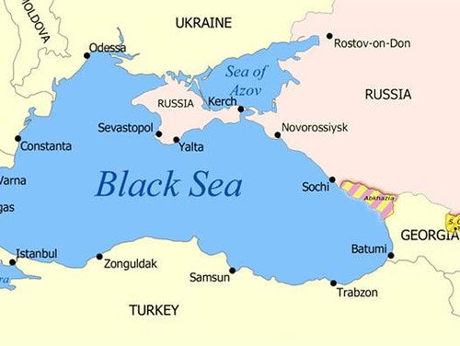
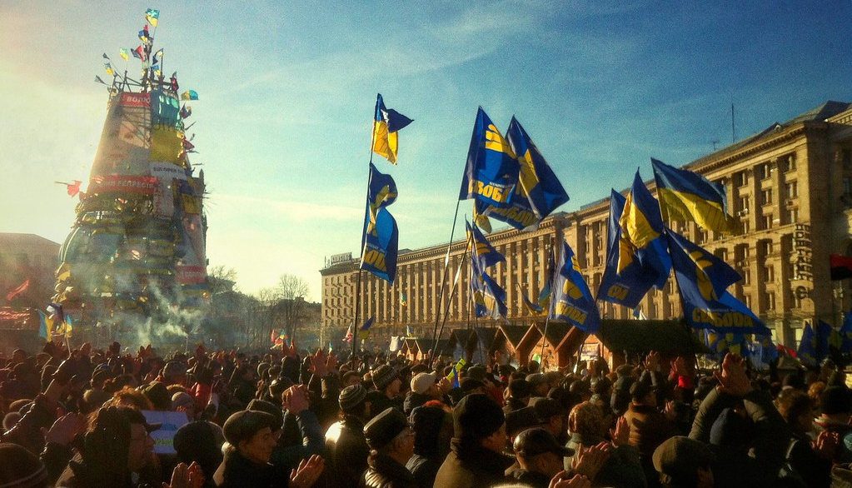
Annexation of Crimea
February, 1954: Nikita Khrushchev, leader of the Soviet Union, made the controversial decision to transfer Crimea to Ukraine to promote good relations between the two nations ¹
December 2013: Pro-EU Ukrainian President Yanukovych, under considerable Russian pressure, decided not to sign a trade agreement with the European Union, sparking Ukrainian ‘Euromaidan’ protests against their government’s perceived betrayal ²
February, 2014: Russia annexed the Crimean Peninsula to protect the Russian majority population in the area from Western influence, thereby taking control of the Black Sea ports and giving them strategic advantage over routes to the Mediterranean, Middle East and Balkans ³
Russian annexation of Crimea
(Source: Creative Commons)
Euromaidan Protests (Source: Mykhailo Liapin, Creative Commons)
Notes:
1. Masters, Jonathan, Ukraine: Conflict at the Crossroads of Europe and Russia (New York: Council on Foreign Relations, 2023), 4.
2. Jeffrey Mankoff, Russia’s War in Ukraine: Identity, History and Conflict (Washington: Center for Strategic and International Studies, 2022), 13.
3. Masters, Jonathan, Ukraine: Conflict at the Crossroads of Europe and Russia (New York: Council on Foreign Relations, 2023), 8.

Slide 7
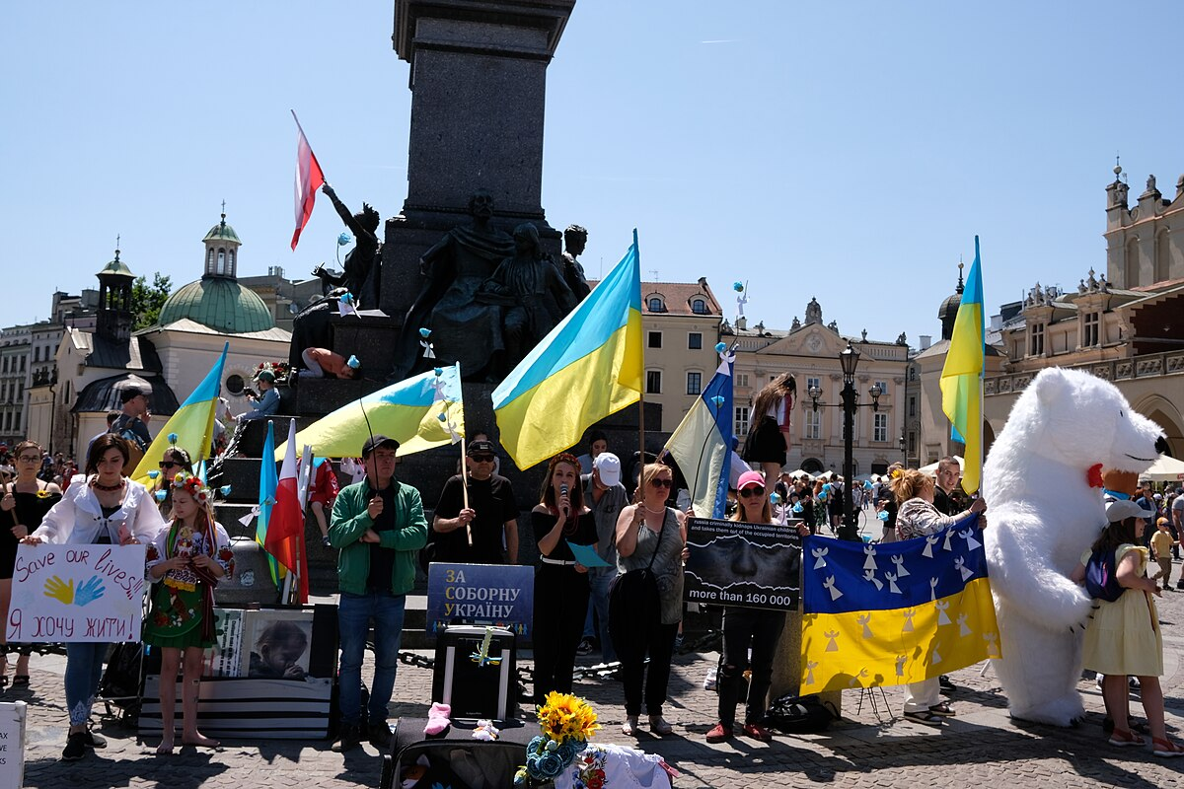
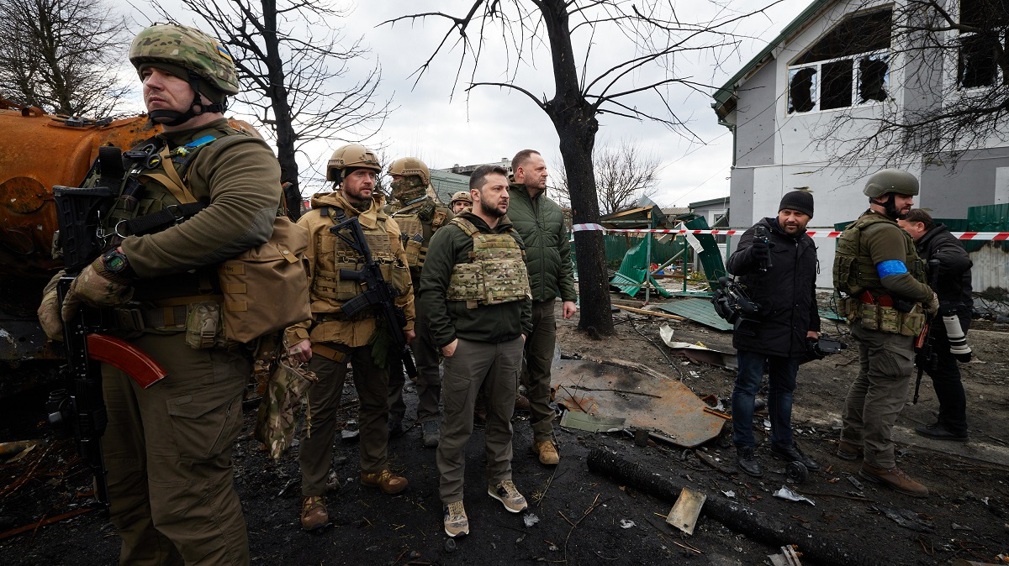
Invasion of Ukraine
September 2020: Ukraine, under President Volodymyr Zelensky, declared their intention to gain full NATO membership, which Putin perceived as a direct betrayal from NATO’s alleged agreement not to expand to the former Soviet Bloc ¹
February 24, 2022: Putin launched a ‘Special Military Operation’ for the purposes of ‘demilitarization’ and ‘denazification’ of Ukraine, thereby invading Ukraine with 190 000 troops and bombings in Kyiv, Kharkiv, Odessa and the Donbass area ²
Demonstrations and protests related to Russia’s invasion of Ukraine in Krakow, 2023 (Source: Creative Commons)
Zelensky’s visit after the Bucha Massacre on August 8, 2022, the site of 458 civilian deaths. (Source: Rawpixel, Public Domain)
Notes:
1. Masters, Jonathan, Ukraine: Conflict at the Crossroads of Europe and Russia (New York: Council on Foreign Relations, 2023), 6-7.
2. Ibid., 8-9.

Slide 8
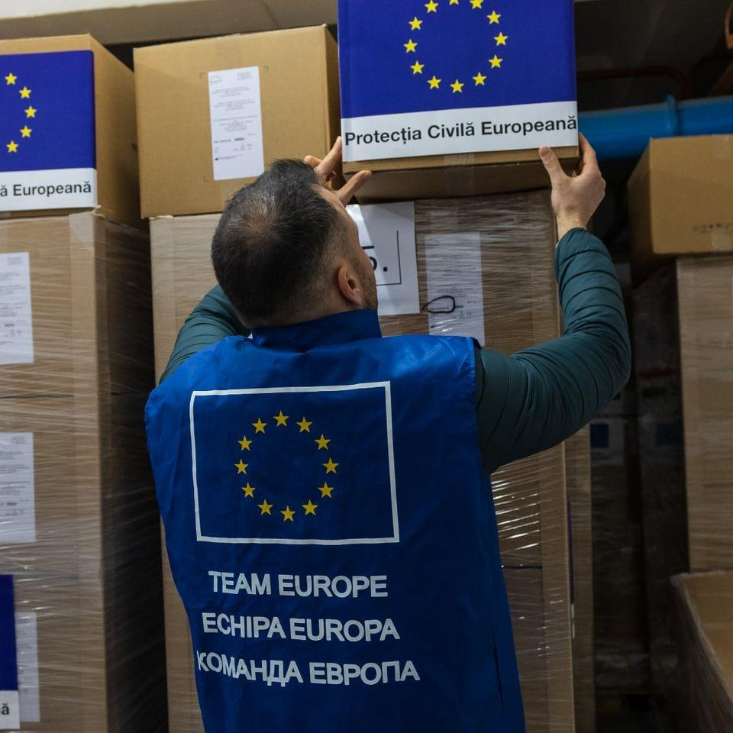
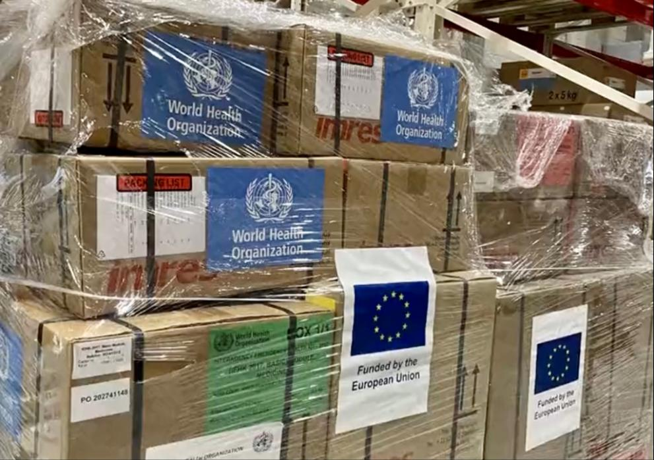
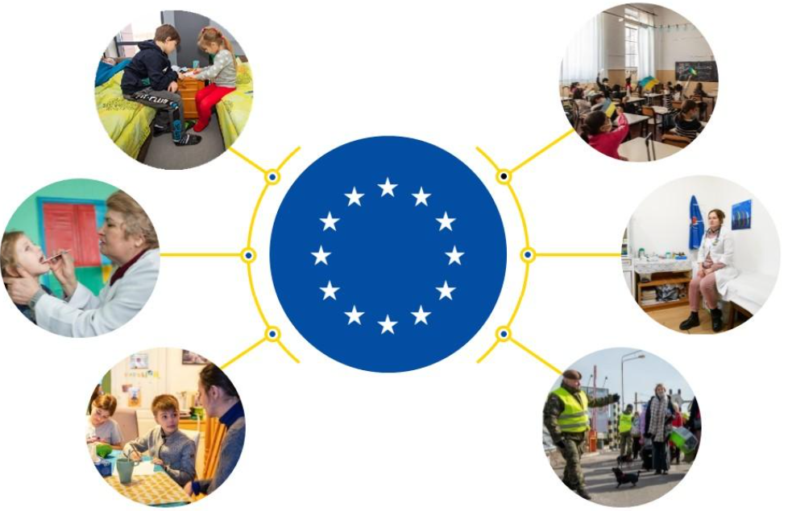
Reactions and Transformations
Since the invasion, Western powers such as the EU and NATO have joined together to support Ukraine in the war with Russia
EU Enlargement: Ukraine and Moldova became official candidates of the EU (June 2022) ¹
NATO Enlargement: Since the Russian invasion, Finland has joined NATO (April 2023) and Sweden is currently finalizing agreements to join ²
Defense: Traditionally seen as a ‘soft power’, the EU has made significant investments in military and defense since the war began, transforming it into a hard power to support Ukraine and defend its interests ³
Migration: Mass exodus of Ukrainians (5 million+) have fled from from the conflict ⁴
Supplies provided by the EU
Baby hygiene kits supplied by the EU to the St. Martin’s Hospital, Ukraine (Source: European Commission)
EU support for Ukrainian refugees in areas such as education, healthcare, accommodation and job search (Source: European Commission)
Notes:
1. House of Commons Canada, The Wake-Up Call: The World After February 24, 2022 – Report of the Standing Committee on Foreign Affairs and International Development. (Ottawa: House of Commons Canada, 2023), 15-16.
2. Ibid., 16.
3. Max Bergmann et al., A Continent Forged in Crisis: Assessing Europe One Year into the War, (Washington: Center for Strategic and International Studies, 2023), 18-19.
4. Jeffrey Mankoff, Russia’s War in Ukraine: Identity, History and Conflict (Washington: Center for Strategic and International Studies, 2022), 17.

Slide 9
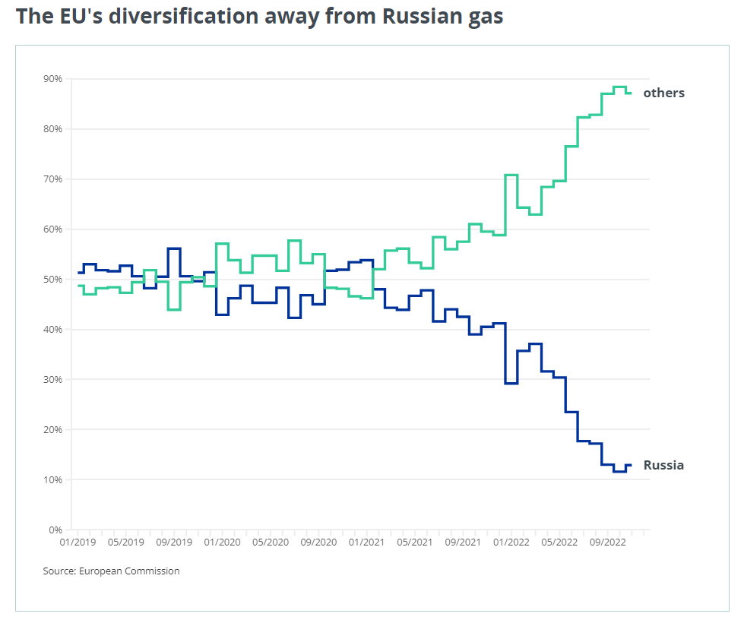
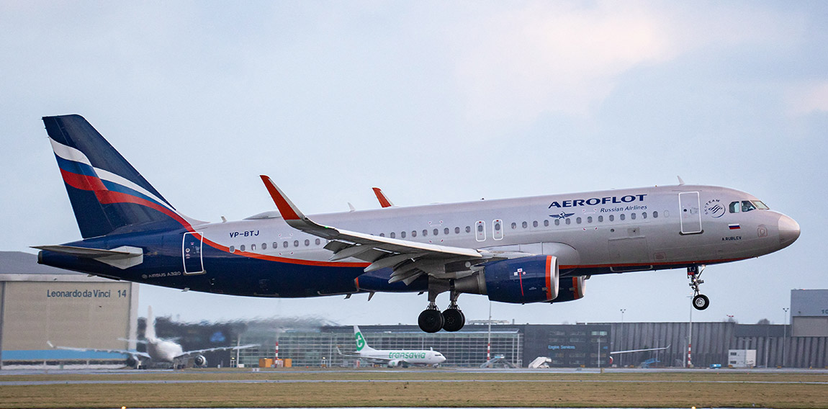
Impact: Economy and Energy
Sanctions: The EU has placed several restrictions on Russia, preventing its access to financial markets and international assets as well as exportation of oil, goods and technology ¹
Russia is currently the most sanctioned country in the world, with over 13000 sanctions from countries around the globe ²
Rising Gas Prices: Russia is a significant exporter of natural gas. To avoid Russian gas importation, the EU has employed a dual strategy of diversification of gas sourcing from other countries and exploration of renewable energy production (ex. Solar and wind power) ³
Soaring Food Prices: Ukraine, known as the ‘breadbasket’ of Europe, struggles to export its grain given that Russia has blocked the Black Sea ports. Therefore, Ukraine has been relying on alternate routes through Europe to export their products, necessitating the rise of food prices, global hunger, and market competition with other countries ⁴
Russia’s share of EU gas imports was 50% in January 2019 and declined to 12% in November 2022 (Source: European Commission)
All Russian aircrafts are banned from overflying EU airspace (Source: AFP, European Commission)
Notes:
1. European Council, “EU Sanctions against Russia Explained,” European Council, October 12, 2023. https://www.consilium.europa.eu/en/policies/sanctions/restrictive-measures-against-russia-over-ukraine/sanctions-against-russia-explained/. (accessed October 19, 2023).
2. Max Bergmann et al., A Continent Forged in Crisis: Assessing Europe One Year into the War, (Washington: Center for Strategic and International Studies, 2023), 7.
3. Stuart Coles et al. Seven Ways Russia’s War on Ukraine has Changed the World. (London: Chatham House, 2023).
4. European Council, “How the Russian Invasion of Ukraine has Further Aggravated the Global Food Crisis,” European Council, https://www.consilium.europa.eu/en/infographics/how-the-russian-invasion-of-ukraine-has-further-aggravated-the-global-food-crisis/ (accessed on October 19, 2023).

Slide 10
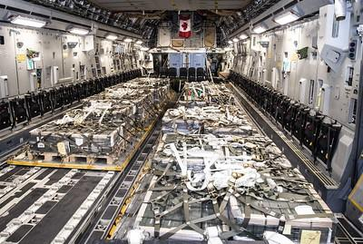
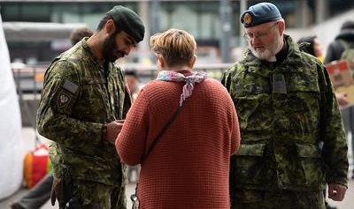
Impact: Canada
December 2, 1991: Canada becomes the first Western country to recognize Ukraine’s independence after the fall of the Soviet Union ¹
Now, Canada is home to over 1.4 million people in the Ukrainian-Canadian community, comprising the largest diaspora outside of Ukraine and Russia ²
Support for Ukraine
More than $8 billion to support Ukraine (ex. financial, humanitarian, economic, military, and emergency services, etc.) ³
Canadian sanctions have capped Russian oil and have banned many Russian imports and exports ⁴
Operation UNIFIER - Canadian Armed Forces has trained over 38 000 Ukrainian military and security personnel ⁵
Canada-Ukraine Authorization for Emergency Travel (CUAET): Canada has welcomed over 185 000 Ukrainian refugees through the CUAET program ⁶
Canada sends military equipment to Ukraine (Source: Canadian Armed Forces Photo)
Canadians assisting Ukrainian refugees in support of Operation REASSURANCE in Poland (Source: MCpl Genevieve Lapointe, Canadian Forces Combat Camera, Canadian Armed Forces Photo)
Notes:
1. Justin Trudeau and Volodymyr Zelensky, “Ukraine and Canada Joint Declaration. Prime Minister of Canada Justin Trudeau,” June 10, 2023, https://www.pm.gc.ca/en/news/statements/2023/06/10/president-ukraine-and-canada-joint-declaration (accessed on October 19, 2023).
2. Government of Canada, “Canada and the Russian Invasion of Ukraine,” Government of Canada, March 20, 2023 https://www.international.gc.ca/world-monde/issues_development-enjeux_developpement/response_conflict-reponse_conflits/crisis-crises/ukraine-situation.aspx?lang=eng (accessed on October 19, 2023)
3. Justin Trudeau and Volodymyr Zelensky, “Ukraine and Canada Joint Declaration. Prime Minister of Canada Justin Trudeau,” June 10, 2023, https://www.pm.gc.ca/en/news/statements/2023/06/10/president-ukraine-and-canada-joint-declaration (accessed on October 19, 2023).
4. Angus Reid Institute, “Russian Invasion, ” Angus Reid Institute, February 23, 2023, https://angusreid.org/russia-ukraine-canada-peace-military-lethal-humanitarian-aid-support/ (accessed October 19, 2023).
5. Government of Canada, “Canadian Donations and Military Support to Ukraine,” Government of Canada, October 11, 2023, https://www.canada.ca/en/department-national-defence/campaigns/canadian-military-support-to-ukraine.html (accessed October 19, 2023).
6. Government of Canada, “Canada-Ukraine Authorization for Emergency Travel: Key Figures,” Government of Canada, October 10, 2023, https://www.canada.ca/en/immigration-refugees-citizenship/services/immigrate-canada/ukraine-measures/key-figures.html (accessed October 19, 2023).

Slide 11
Conclusion
“If Russia stops fighting and leaves Ukraine,
the war ends.
If Ukraine stops fighting, Ukraine ends.”
– Antony Blinken, United States Secretary of State, during address to United Nations Security Council, February 24, 2023 ¹
The war in Ukraine has been perceived as not only fight for Ukraine’s sovereignty, but also a symbolic battle for international balance of power
Notes:
1. Karl-Peter Schwarz, War in Ukraine: Assessing the EU’s Response, (Liechtenstein: Geopolitical Intelligence Services, 2023), 2.

Slide 12
Bibliography
Angus Reid Institute. “Russian Invasion.” Angus Reid Institute. February 23, 2023.
https://angusreid.org/russia-ukraine-canada-peace-military-lethal-humanitarian-aid-support/ (accessed October 19, 2023).
Bergmann, Max et al. A Continent Forged in Crisis: Assessing Europe One Year into the War. Washington:
Center for Strategic and International Studies, February 16, 2023.
European Council, “How the Russian Invasion of Ukraine has Further Aggravated the Global Food Crisis,”
European Council, https://www.consilium.europa.eu/en/infographics/how-the-russian-invasion-of-ukraine-has-further-aggravated-the-global-food-crisis/ (accessed on October 19, 2023).
European Council. “EU Sanctions against Russia Explained.” European Council. October 12, 2023.
https://www.consilium.europa.eu/en/policies/sanctions/restrictive-measures-against-russia-over-ukraine/sanctions-against-russia-explained/ (accessed October 19, 2023).
Government of Canada. “Canada and the Russian Invasion of Ukraine.” Government of Canada. March 20,
2023.https://www.international.gc.ca/world-monde/issues_development-enjeux_developpement/response_conflict-reponse_conflits/crisis-crises/ukraine-situation.aspx?lang=eng (accessed on October 19, 2023).
Government of Canada. “Canadian Donations and Military Support to Ukraine.” Government of Canada.
October 11, 2023. https://www.canada.ca/en/department-national-defence/campaigns/canadian-military-support-to-ukraine.html (accessed October 19, 2023).

Slide 13
Bibliography
Government of Canada. “Canada-Ukraine Authorization for Emergency Travel: Key Figures.” Government
of Canada. October 10, 2023. https://www.canada.ca/en/immigration-refugees-citizenship/services/immigrate-canada/ukraine-measures/key-figures.html (accessed October 19, 2023).
House of Commons Canada. The Wake-Up Call: The World After February 24, 2022 – Report of the Standing
Committee on Foreign Affairs and International Development. Ottawa: House of Commons Canada, 2023.
Mankoff, Jeffrey. “Russia’s War in Ukraine: Identity, History and Conflict.” Center for Strategic and
International Studies. April 22, 2022. https://www.csis.org/analysis/russias-war-ukraine-identity-history-and-conflict. Accessed October 2, 2023.
Masters, Jonathan. Ukraine: Conflict at the Crossroads of Europe and Russia. New York: Council on Foreign
Relations, 2023.
Putin, Vladimir. “On the Historical Unity of Russians and Ukrainians.” Presidential Executive Office. July 12,
2021. http://en.kremlin.ru/events/president/news/66181 (accessed October 10, 2023).
Schwarz, Karl-Peter. War in Ukraine: Assessing the EU’s Response. Liechtenstein: Geopolitical Intelligence
Services, 2023.
Stuart Coles et al. Seven Ways Russia’s War on Ukraine has Changed the World. London: Chatham House, 2023.
Trudeau, Justin, and Volodymyr Zelensky. “Ukraine and Canada Joint Declaration. Prime Minister of
Canada Justin Trudeau.” June 10, 2023. https://www.pm.gc.ca/en/news/statements/2023/06/10/president-ukraine-and-canada-joint-declaration (accessed on October 19, 2023).

Slide 14
Part 3:
Station Activity

Slide 15
Stations
Instructions: Students will be divided into groups and assigned a station to learn more about the various aspects of the war in Ukraine. Each group will answer the questions that correspond to their topic and become an expert on their stations.
Here are the stations:
Station 1: Declaration of Military Intervention in Ukraine
Station 2: EU Sanctions against Russia
Station 3: Global Food Security
Station 4: Solving the Energy Crisis
Station 5: Migration

Slide 16
Part 4:
Presentation & Discussion

Slide 17
Discussion
Key Takeaways:
Why is the war in Ukraine important?
What are the global implications for the war in Ukraine? (ex. Economy, energy, food security, migration, etc.)
How do the station sources enhance your understanding of the conflict in Ukraine?
What predictions can we make of the future regarding Russia’s ambitions, Ukrainian nationalism, and the world’s response to the ongoing conflict?

