Slide 1
Telling Your Story with Data: Using CICP Dashboard Data
Community Education Centre
The Charity Insights Canada Project
Tara McWhinney, Postdoctoral Fellow
Kate Cornell, Senior Advisor, Strategic Communications

Slide 2
What this session will cover:
What is the Charity Insights Canada Project?
How to read our survey reports
Understanding Mean, Median, Standard Deviation and Margin of Error
Using CICP dashboards
Tips on assessing survey data
Using CICP data in grant writing

Slide 3
The Charity Insights Canada Project
Short weekly survey (≈40)
≈1000 charities each year
2023-present

Slide 4
Who is surveyed and how are they recruited?
Excludes hospitals, places of worship and educational institutions
Participants are Managers, Supervisors, CEOs and Executive Directors
Random selection of charities

Slide 5
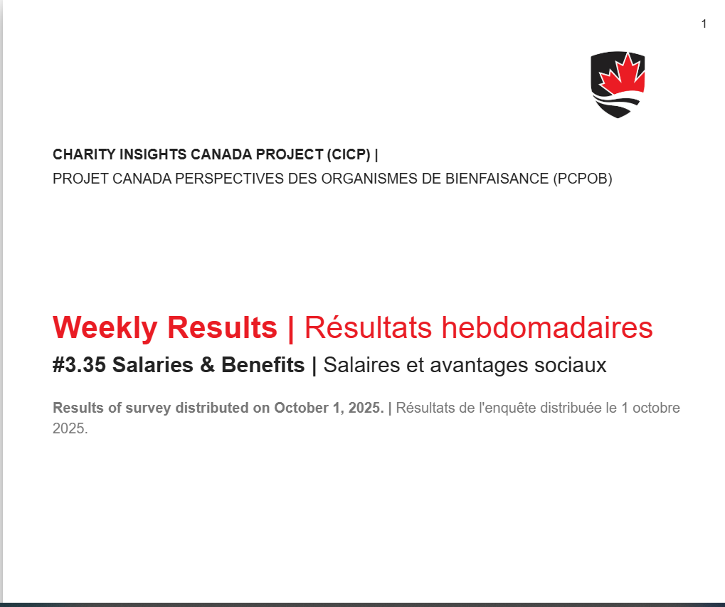
How to Read Survey Reports
https://carleton.ca/cicp-pcpob/all-reports-en/

Slide 6
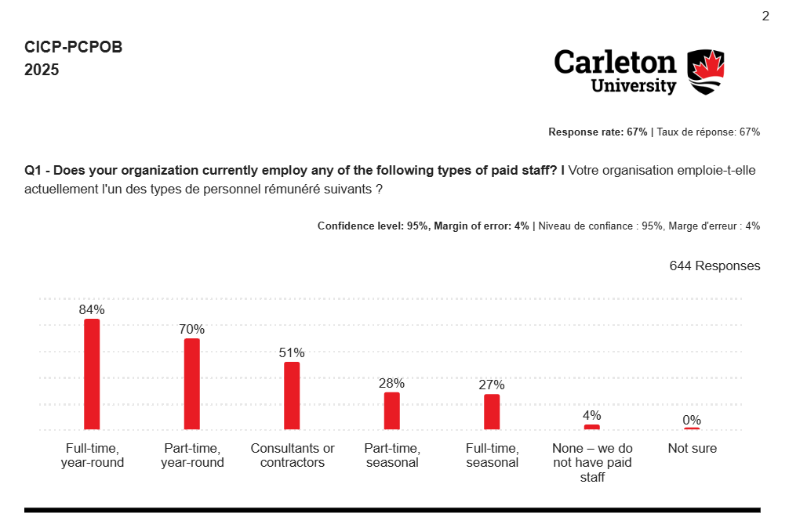
Response Rate and Margin of Error

Slide 7
The bigger the sample, the more confident you can be in the results
Margin of Error of 4% give us a confidence level interval of plus or minus 4%
A 95% confidence level means that if you repeat the study x amount of times, 95% of the time your findings will fall within the confidence intervals
For example, Full-time year-round staff % results would fall between 80%-88% most of the time

Slide 8
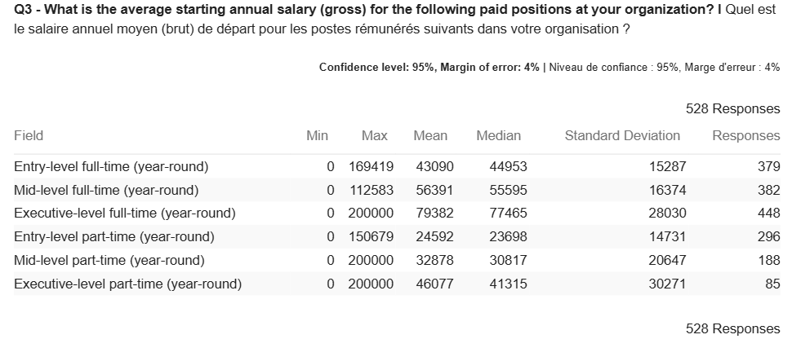
Quantitative Data: Mean, Median, and Standard Deviation

Slide 9
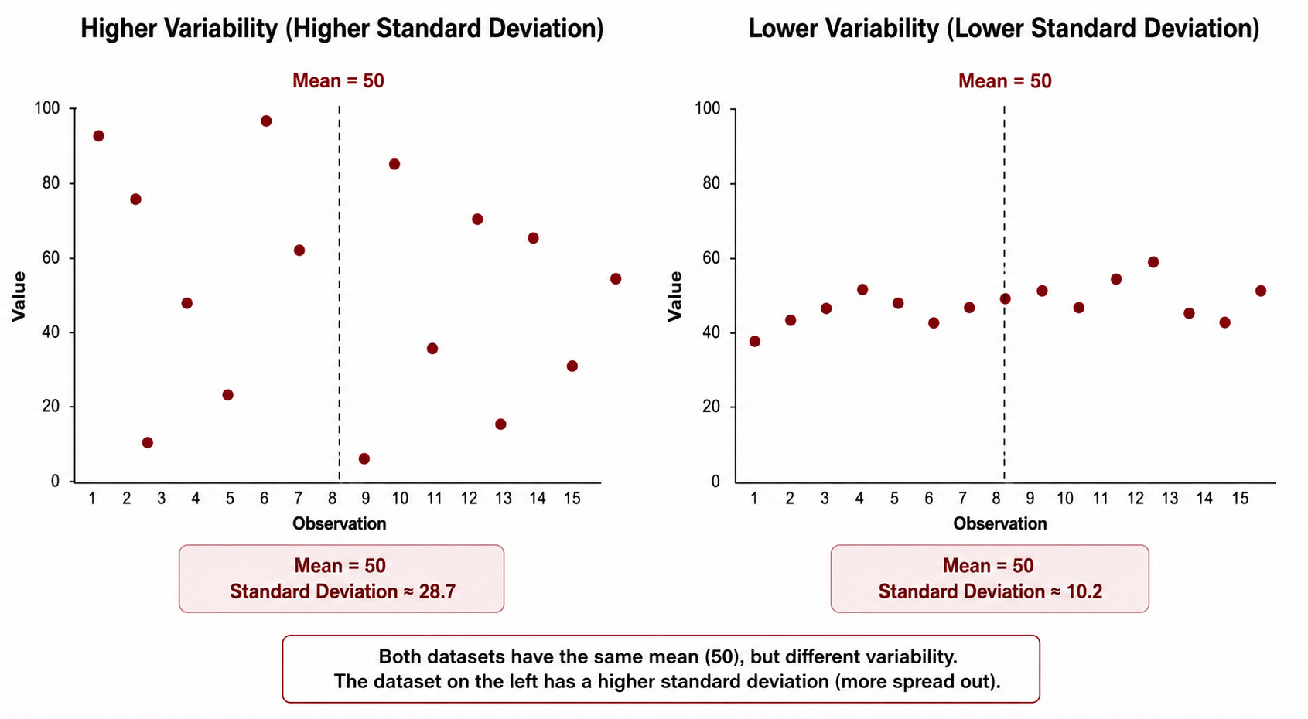

Slide 10
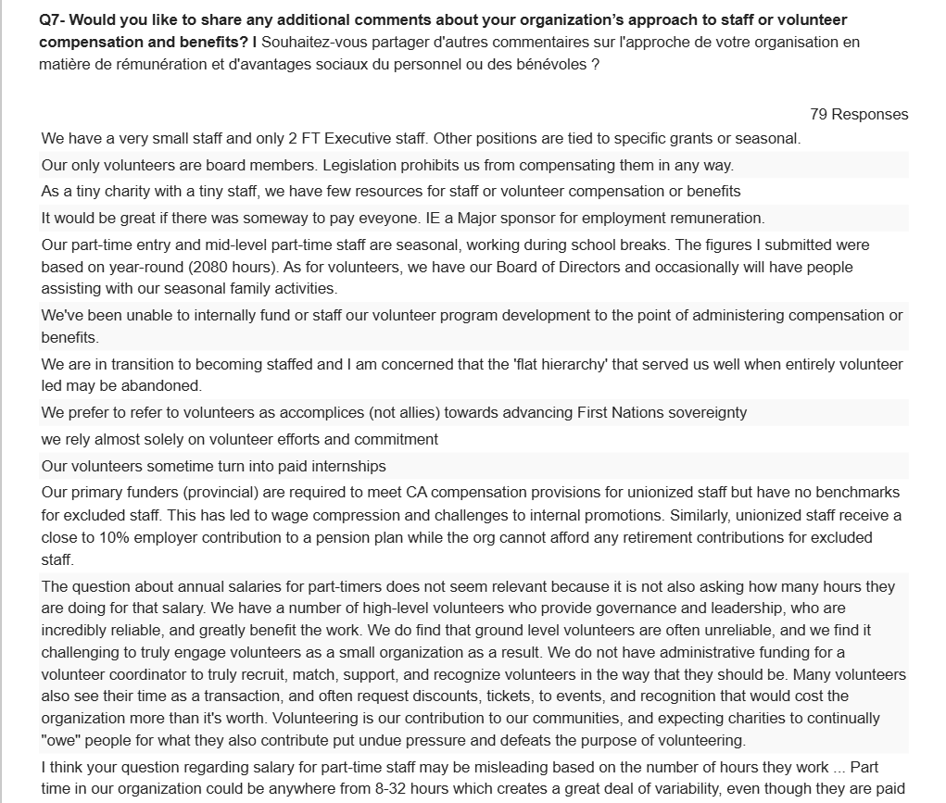
Most Surveys Include Qualitative Data

Slide 11
Using CICP Data Dashboards
2023 data on dashboards, 2024 Coming Soon!
https://carleton.ca/cicp-pcpob/cicp-survey-results-dashboard/
Dashboards visualize quantitative data

Slide 12
Wrap-Up
Assess survey research with a critical lens
Who conducted the survey?
When was the survey conducted?
Who was surveyed? Who may have been excluded?
How were the questions worded? What multiple-choice options were provided? What options may have been excluded?
Whenever possible, use multiple sources of evidence

Slide 13
Data Narrative for Funders and Donors
A data narrative refers to the practice of using data to tell a compelling and coherent story or message.
It involves the combination of quantitative data, such as statistics and measurements, with qualitative elements to convey information effectively.
In a grant application, a data story can demonstrate how your organization stands out

Slide 14
Three Steps to Stand out -
Using Data in your Funding Application
What is your objective?
How does the data make your organization stand out?
Locate the data source

Slide 15
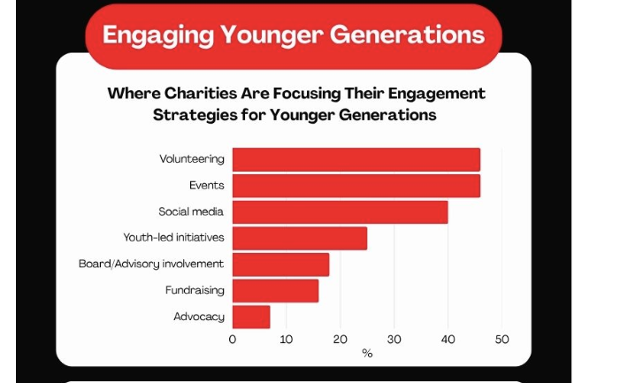
Let's build a data narrative together

Slide 16
Example:
Youth Engagement
Objective: Funding for Youth programs
What stands out?
Data source: CICP Infographic

Slide 17
Examples of Data Narrative
Example: My organization is part of a larger trend and our programming is high quality/unique so it warrants investment
Example: My organization is addressing a new issue that the majority of the sector has not recognized yet so it warrants seed funding

Slide 18
Questions

Slide 19
Thank you!

