Slide 1

Haiti
Policy Paper
By: Jessie-Ann Brouillette, Nyma Malik, Toby Dyson

Slide 2

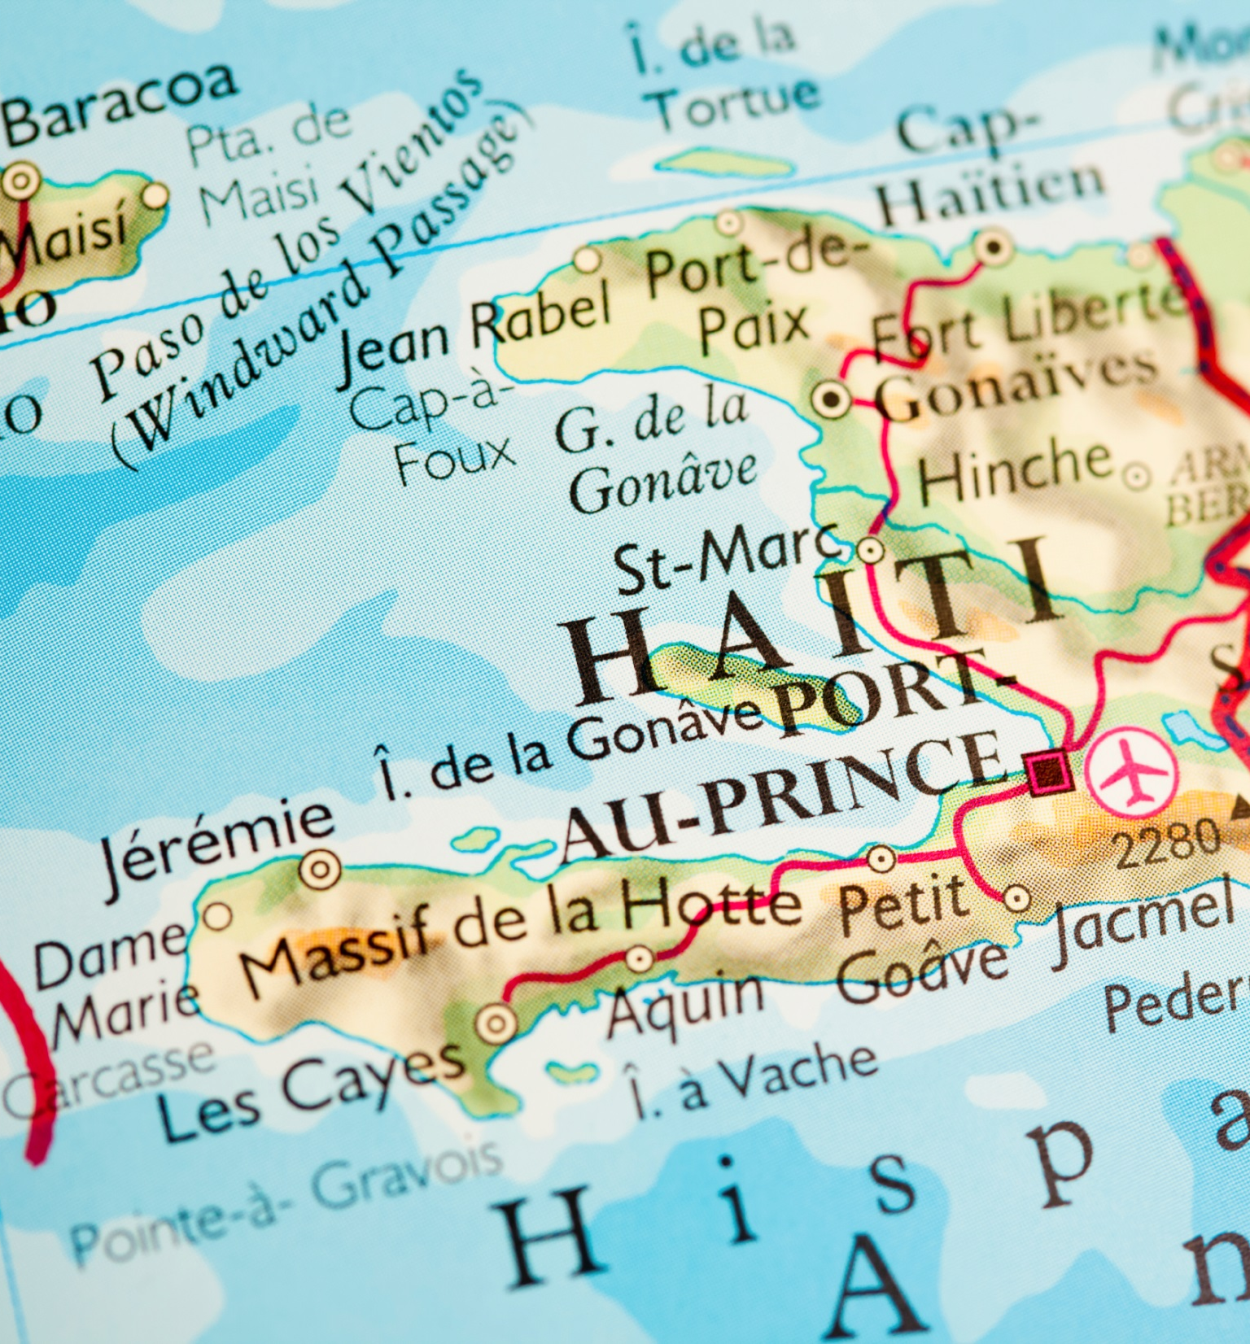
Overview
History of Fragility in Haiti
End User & Stakeholders
Primary Drivers of Fragility
Scenarios
Policy Options and Recommendation

Slide 3
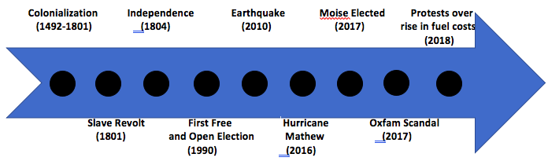
History of Fragility
Colonization

Slide 4

End Users:
Haiti Desk at Global Affairs Canada
&
Peace and Stabilization Operations Program
Stakeholders:
Internal
External

Slide 5

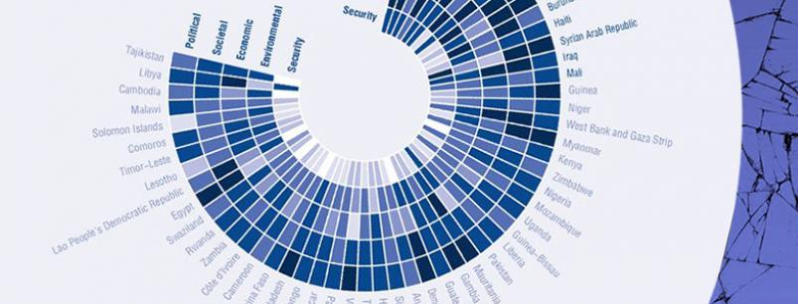
Primary Drivers of Fragility
Governance
Security and Crime
Human Development
Economic Development

Slide 6


Scenarios
Most Likely
Best Case
Worst Case
Wild Card (2)

Slide 7

Policy Options
Calls on the government of Canada to continue its current aid and development programs, specifically in the areas of Public Sector Policy, democratic participation and agricultural development.
The government of Canada should call for the extension of the MINUJUSTH mandate under guidance of the PSOP
Calls on The Government of Canada to increase investment in Haiti’s agricultural sector and environmental resiliency, through development projects overseen by the Haiti geographic desk, at Global Affairs Canada

Slide 8

Recommendation
The government of Canada should call for the extension of the MINUJUSTH mandate under guidance of the PSOP

