Slide 1
Committee Focus
Sustainability Operations
Carbon Neutral Campus
Travel and Scope 3 emissions
Divestment

Slide 2
Sustainable Operations - Updates
Sustainability Plans
AASHE Gold STARS
Carbon Savings
Divestment
UI Green Metric
Carbon Neutral

Slide 3
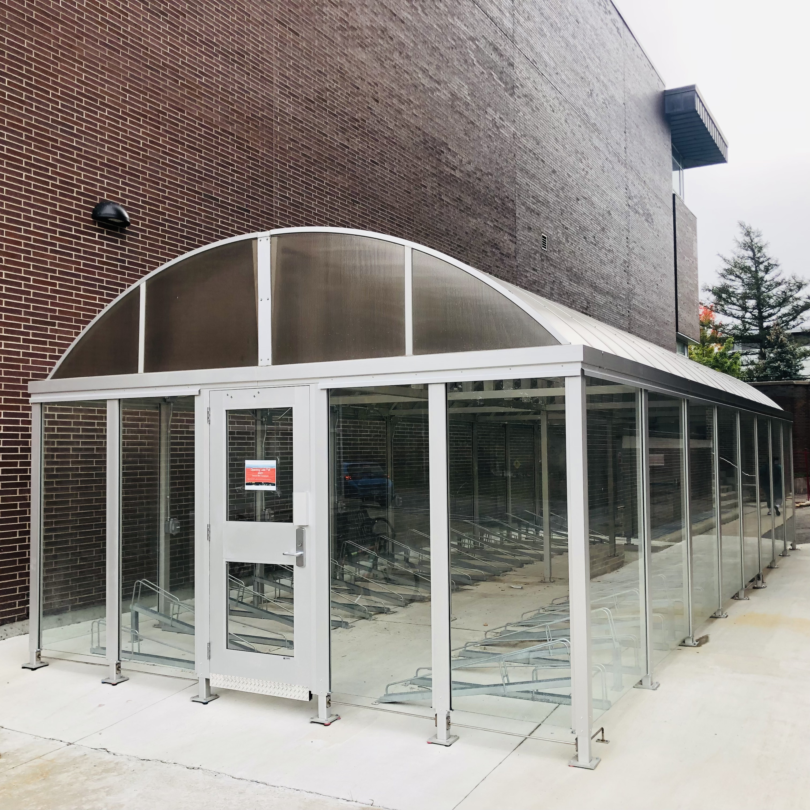
Travel
Cycling Promotions
Secure Parking
Electric Vehicle Charging
E-Scooters
Campus Connections
Scope 3 emissions

Slide 4
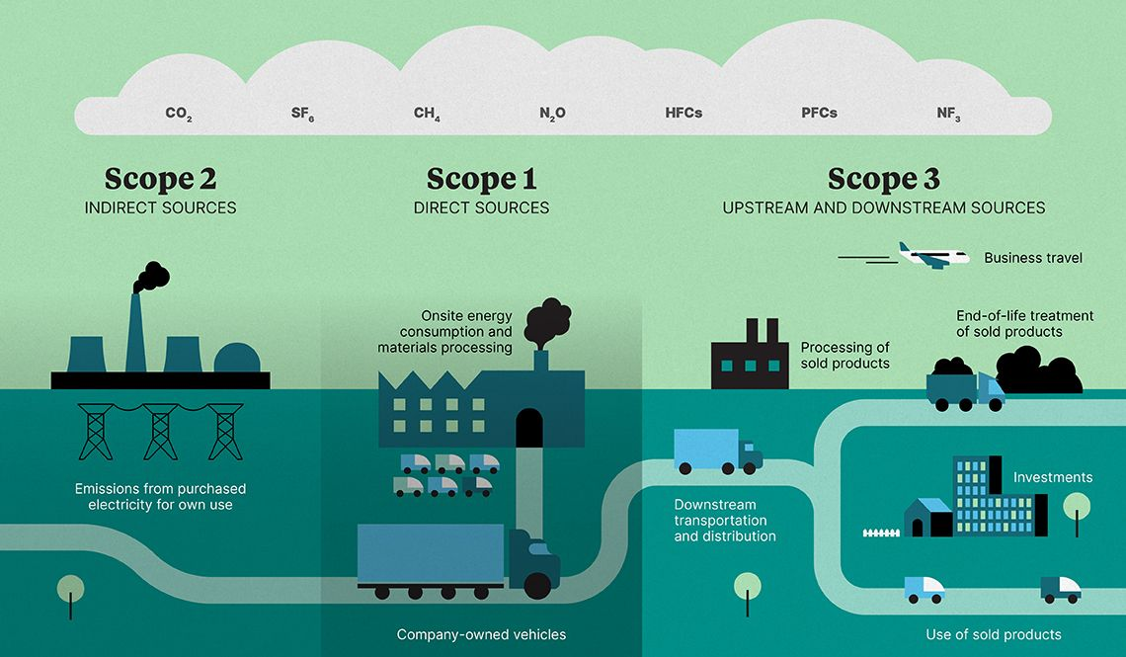
Scope 3 emissions

Slide 5
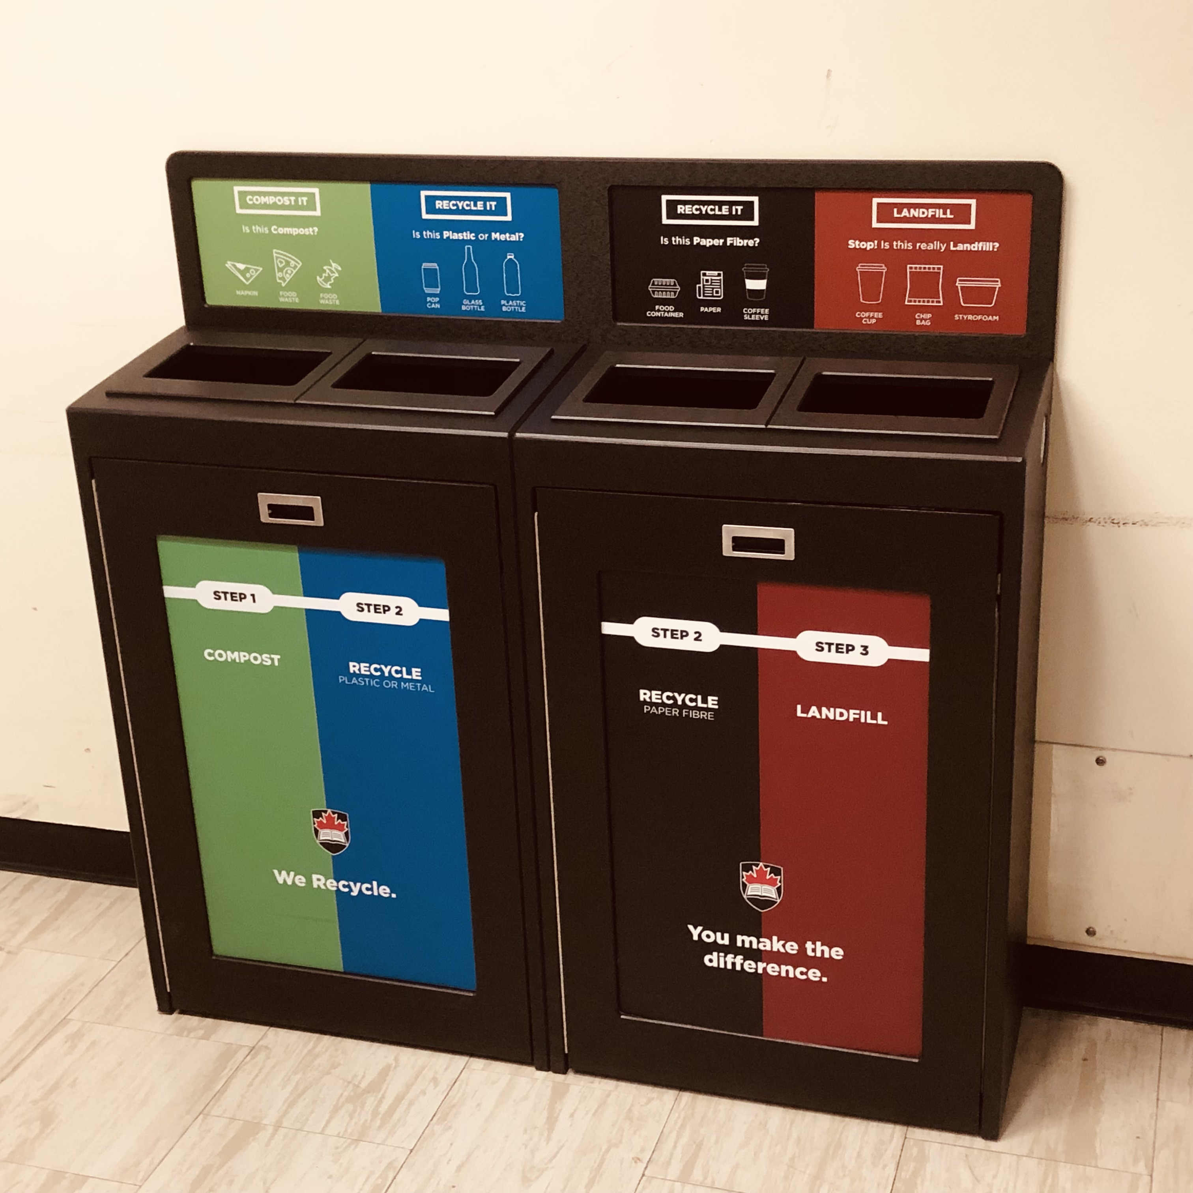
Waste
Recycling App
New Bins
New waste contract
Office bins
Waste packaging

Slide 6
Dining
Fairtrade Certification
Green Restaurant
Sustainable Fish
Meal Donations
Local Sourcing

Slide 7
Buildings
Green Globes
Passive House Design
Bird friendly
Green Space upgrades
Outdoor Space
Campus Master Plan

Slide 8
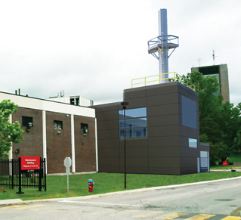
Energy
Carbon Neutral by 2050
Annual savings
Co-Generation Plant
LED Lighting
Electrical Infrastructure
PV and Battery Energy Storage

Slide 9
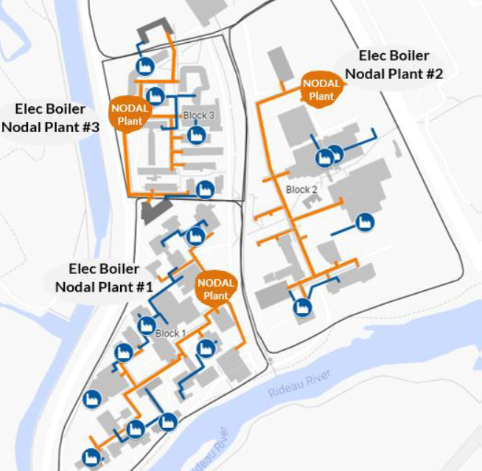
Thermal Heating
Nodal heating plants generate low temperature hot water, distributed for heating purposes.
Thermal Energy Storage (TES) tanks would reduce campus heating demand and provide energy cost savings.
Retrofit buildings to accept low temperature hot water.
Electrification reduces carbon emissions by 80%.

