Slide 1
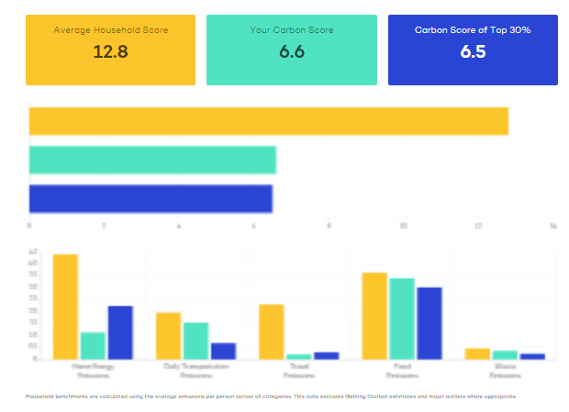
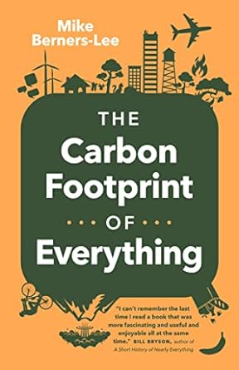
Carbon Literacy Challenge –
Your carbon footprint provides the best indicator of your impact on climate change. It is the result of choices you make and choices made by others who you depend on for energy, transportation, food and other stuff you need. The more you know about it – your carbon literacy - the more you will be able to make better choices and advocate for effective change.
The carbon footprint of an activity or a thing is the amount of greenhouse gases it adds to the atmosphere. Different gases are measured as the equivalent amount of carbon dioxide, because carbon dioxide is the main cause of climate change. Your carbon footprint includes the gases that you create directly, for example from burning natural gas to heat your house. It also includes emissions “embedded” in the services you use, the food you eat, and other stuff you buy.
The Carbon Literacy Challenge will help you understand how everyday choices affect your carbon footprint. First, you will estimate the total footprint for your household, using an online tool created for neighborhoods in Toronto. Second, you will explore the effect of day-to-day choices based on statistics from the book, The Carbon Footprint of Everything. The aim is help you to identify the most effective actions you can take to reduce your impact on climate change.

