Slide 1
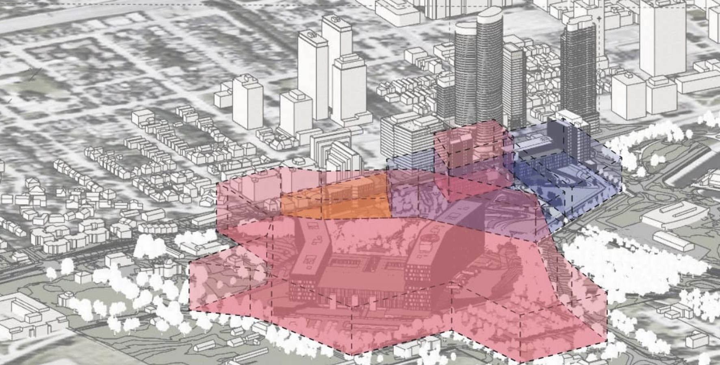
Action options

Slide 2
February 9: Open House re Civic at Farm Phases 3 & 4
Attend this public information session via zoom on February 9 at 6:30 p.m.
Critique the application and ask questions!
For more info on the application Register

Slide 3
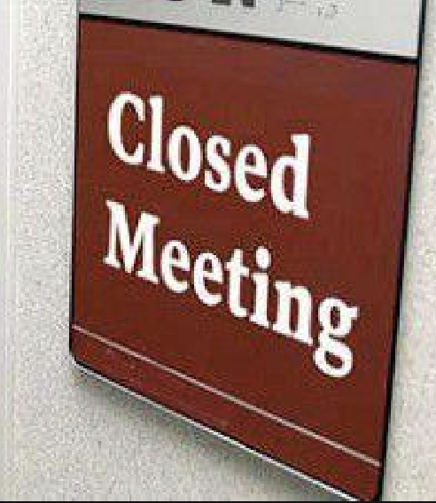
Questions to ask
1. No transparency on site selection
The site was selected during a closed door meeting in 2016. Why haven’t the minutes from this meeting been made public?
You’re holding a public meeting about another P3 development where the public is being kept in the dark. What’s to hide?

Slide 4
2. Why were the Algonquins of Pikwàkanagàn First Nation and Kitigan Zibi Anishinabeg not consulted about the site choice?
The proposed site at the Central Experimental Farm is on unceded Algonquin territory.

Slide 5
3. Did the hospital do the
Health Equity Impact Assessment recommended by the Ontario government and the World Health Organization? If one was done, where is it?

Slide 6
4. Why did the hospital choose a mega-Civic of over 1200 beds?
Studies clearly show much smaller community hospitals to be more efficient in cost and health outcomes.

Slide 7
5. Has the 2016 cost estimate of $2.8B been updated?
Some say the final bill will be at least double.
The province covers 75% of new hospital costs.
Will the hospital be responsible for 75% of the final cost?

Slide 8
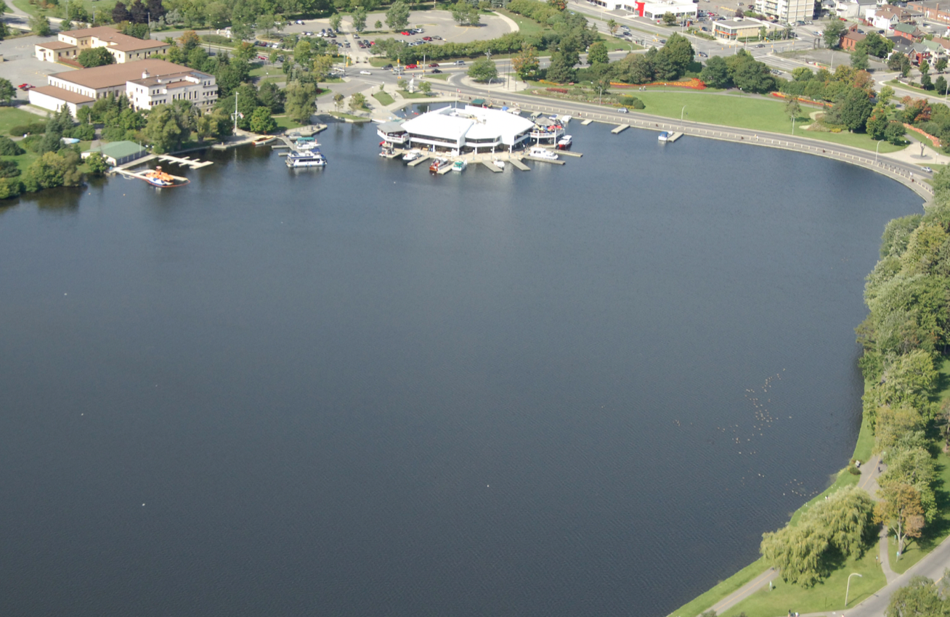
6. There is proof that toxic substances were leaking into Dow’s Lake from the site in the spring.
What is this from and what has been done?

Slide 9
7. Accessibility:The current hospital plan recommends ‘a moving walkway’ to transport hospital visitors up 4 1/2 football fields, up a 30 metre incline, to the hospital’s front door. Considering Ottawa is one of the coldest capitals in the world, and our experience with the LRT, can you guarantee this walkway will work?

Slide 10
Another Action Option
Give A Bang! Against Bills 23 & 39
Thursdays at 6:00 p.m.
Residents of Ottawa and communities across Ontario are banging pots and pans for just a few minutes every Thursday.
Keep the pressure on Queens Park to ditch these bills that choose development over environment and allow a one-third minority to pass motions at city councils.
Give A BANG! is supported by ReImagine Ottawa, Ecology Ottawa, Greenspace Alliance, Horizon Ottawa, Acorn, CAFES Ottawa and For Our Kids, with others across the province coming aboard daily. JOIN US!!

