Slide 1
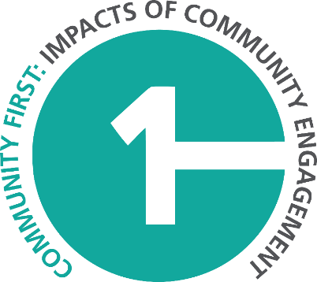
CFICE Webinar: Evaluating Impact in Community-Campus Engagement: Towards a Community-First Approach
What are some promising community-first practices related to institutionalizing and sustaining impactful CCE?
Magda Goemans
Research Assistant, Carleton University
CFICE Evaluation and Analysis Working Group

Slide 2
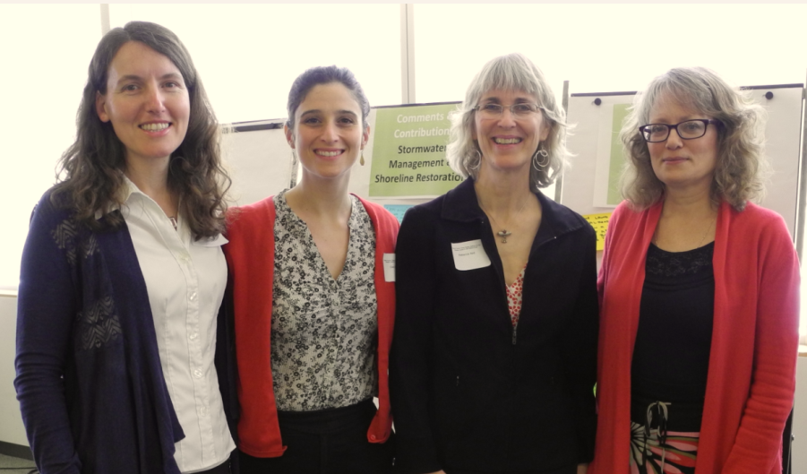
CFICE Webinar: Evaluating Impact in Community-Campus Engagement: Towards a Community-First Approach
Principles of good practice:
Foreground a community-first approach to understanding and communicating community impact

Slide 3
Principles of good practice: Foreground a community-first approach to understanding and communicating community impact
Consider community objectives for measuring impact
May vary widely among community-based organizations

Slide 4
Principles of good practice: Foreground a community-first approach to understanding and communicating community impact
Incorporate community perspectives and feedback into impact evaluation
Work with communities to establish criteria
Consider how standard metrics may diverge from community priorities
Recognize diverse ways in which impact is understood

Slide 5
Principles of good practice: Foreground a community-first approach to understanding and communicating community impact
Capture and communicate impacts in ways that recognize community expertise and further empowerment
Suggested metrics: community voice in CCE governance; reciprocity between community and academic partners; integration of community knowledge within academic research

Slide 6
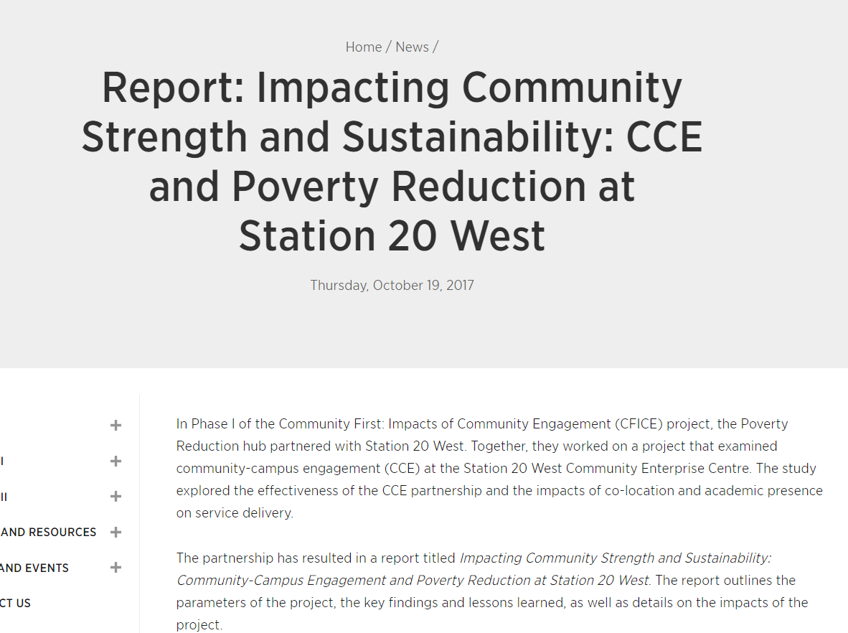
CFICE Webinar: Evaluating Impact in Community-Campus Engagement: Towards a Community-First Approach
Principles of good practice:
Employ a comprehensive approach to capturing impacts

Slide 7
Principles of good practice: Employ a comprehensive approach to capturing community impacts
Capture impacts of engagement beyond inputs:
What was accomplished for communities through hours devoted
How communities benefitted from funding

Slide 8
Principles of good practice: Employ a comprehensive approach to capturing community impacts
Assess impacts for communities during active engagement
How involvement in CCE may be influencing community perspectives
Recognizing relationships as ends in themselves

Slide 9
Principles of good practice: Employ a comprehensive approach to capturing community impacts
Capture impacts at varied scales
Short- and long-term; project and institution levels; cumulative ‘ripple’ effects
Employ a range of frames to capture and communicate impacts
Broad metrics, individual case studies and community storytelling

Slide 10
Principles of good practice
Challenges for institutions
Capturing impacts may be resource intensive
Institutions face pressures to demonstrate return on investment
Challenges in capturing intangible impacts
How to adequately define, measure and reward community engaged scholarship

Slide 11
CFICE Webinar: Evaluating Impact in Community-Campus Engagement: Towards a Community-First Approach
Promising practices…

Slide 12
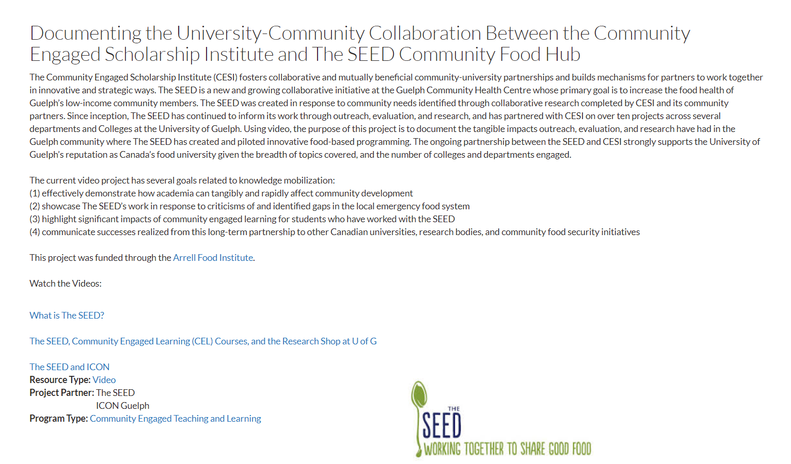
Promising Practices
University of Guelph, Community Engaged Scholarship Institute
Video storytelling

Slide 13
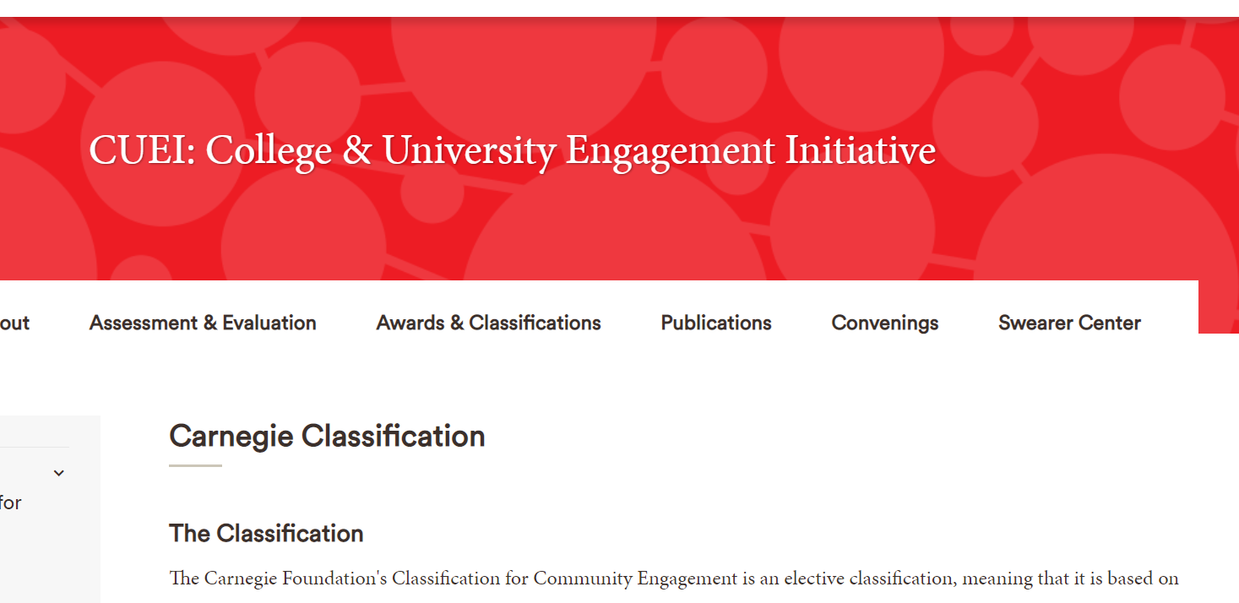
Promising Practices
Carnegie Classification Community Engagement Elective
Highlighting community voice and governance within assessments

