Slide 1
Social work & Social Change
Individual Agency,
Collective Responsibilities,
& Mutual Flourishing
Natalie Appleyard | natalie@cpj.ca
Citizens for Public Justice | cpj.ca

Slide 2


Learning goals
1. A deeper understanding of the interplay among individual agency and historic and contemporary systems in people’s experiences of poverty in Canada.
2. A deeper commitment to engaging in social work as an agent of social change.
3. A sense of belonging amongst social change movements for mutual flourishing.

Slide 3

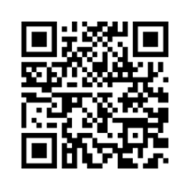
poverty in canada
Poverty Trends 2024:
Finding our Place in Systemic Change
  Measures & experiences of poverty
  Historic & contemporary factors
  Policy recommendations
  Opportunities to take action
cpj.ca/report/poverty-trends-2024/
Notes:
Link to Poverty Trends report: cpj.ca/report/poverty-trends-2024/

Slide 4
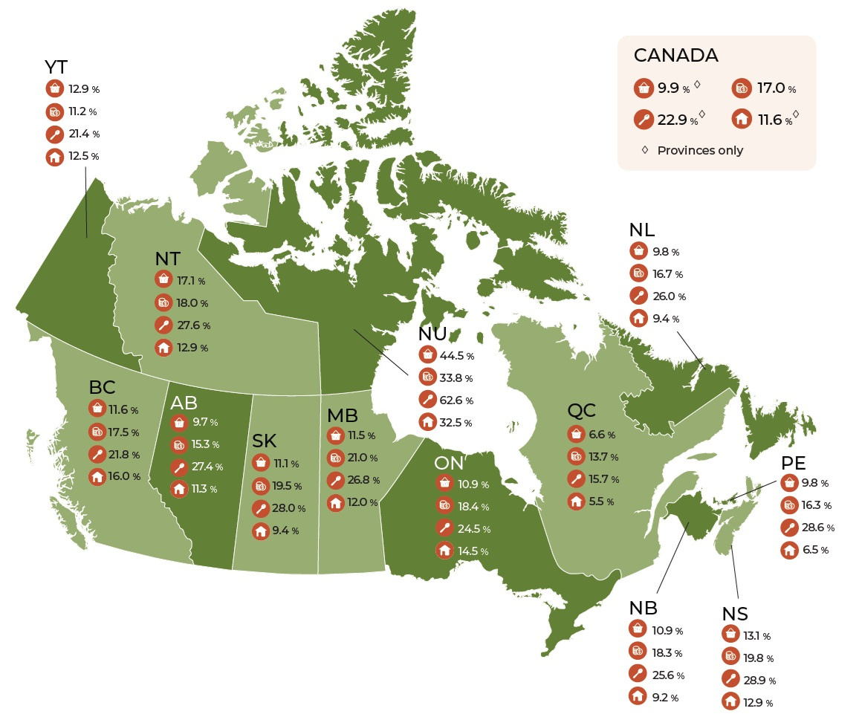
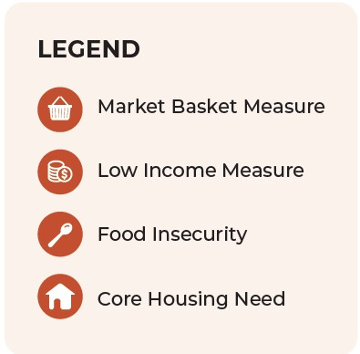

Slide 5
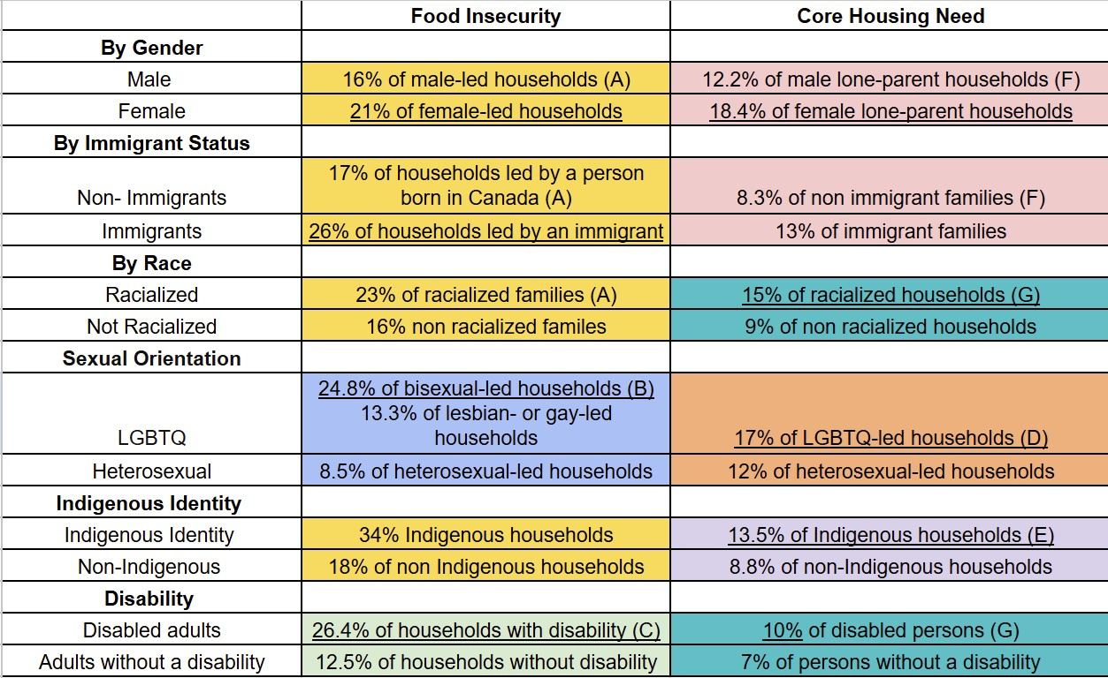
Notes:
Legend
(A) Food insecurity among Canadian families. 2021 Canadian Income Survey. https://www150.statcan.gc.ca/n1/pub/75-006-x/2023001/article/00013-eng.htm
(B) Statistics Canada, "Household food insecurity (moderate or severe) in previous 12 months, by sexual orientation, population aged 15 and older, 2015 to 2018," https://www150.statcan.gc.ca/n1/daily-quotidien/221004/cg-d001-eng.htm
(C) Statistics Canada, "Household food insecurity among persons with disabilities in Canada: Findings from the 2021 Canadian Income Survey," https://www150.statcan.gc.ca/n1/pub/82-003-x/2024008/article/00002-eng.htm
(D) Statistics Canada, "Housing experiences in Canada: LGBTQ2+ people in 2018," https://www150.statcan.gc.ca/n1/pub/46-28-0001/2021001/article/00004-eng.htm
(E) Statistics Canada, Indigenous Peoples Thematic Series, "Housing experiences and measures of health and well-being among First Nations people living off reserve, Métis and Inuit: findings from the 2018 Canadian Housing Survey," (2023), https://www150.statcan.gc.ca/n1/pub/41-20-0002/412000022023001-eng.htm
(F) Canadian Mortgage and Housing Corporation. Housing Market Information Portal, Core Housing Need, Full Report for Canada (2021), based on Census and National Housing Strategy data, https://www03.cmhc-schl.gc.ca/hmip-pimh/en#Profile/1/1/Canada
(G) Canadian Mortgage and Housing Corportation, "Core housing need data — by the numbers," https://www.cmhc-schl.gc.ca/professionals/housing-markets-data-and-research/housing-research/core-housing-need/core-housing-need-data-by-the-numbers

Slide 6
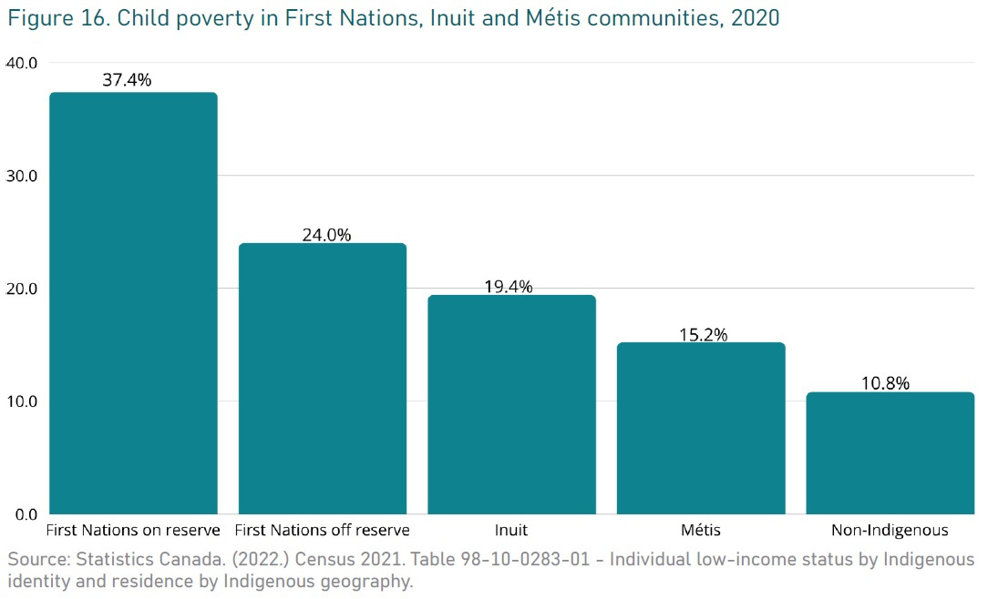
Ending Child Poverty: The Time is Now - 2024 Report Card on Child and Family Poverty in Canada
https://campaign2000.ca/report-cards/national/
Notes:
2024 National Report Card
Ending Child Poverty: The Time is Now by Campaign 2000
https://campaign2000.ca/report-cards/national/

Slide 7
Implications for social work
  Who are your clients and what are they dealing with?
  How are you, as a social worker, expected to respond?
  What are the impacts on our communities and on Canadian society as a whole?

Slide 8

How did we get here?
historical contexts
Contemporary Factors
Current Responses
Generational transfer of land, wealth, power, trauma; norms & attitudes
Polycrises; privatization & deregulation; systemic barriers & exploitation; polarization
Charity & surveillance vs rights-based approaches; have tools but need transformative change

Slide 9
Current responses & results
  Cash transfers
  Employment
  Housing
  Health care
  Education
  Child care
  Child welfare
  Criminal justice
  Taxation
  Immigration
What are we aiming for?
How are we measuring?
Who is benefitting?
Who decides?
Notes:
Human rights obligations
- max available resources
- without discrimination
- targeted where most needed
- targeted where most effective
- generation of needed revenue

Slide 10
a better way forward
vision
measures
Tools
Mutual flourishing of all people and all of creation; treaty and human rights upheld for all people
Equitable standards and outcomes designed and monitored by those most impacted
Legislative and policy levers; building shared understanding and collective capacity through a care economy; following best practices
Notes:
We don't have poverty in Canada because we don't know how to solve it or because we lack sufficient resources. We have tools that we know work and we have the resources. What we lack is the collective will and vision.
We need a better understanding of our history, our diverse current realities, and what is actually working here and elsewhere in the world.
We need to confront the reality that our current systems depend on the exploitation of many for the profit of a few, and we need to demand better for everyone. In inequitable societies, even those at the top suffer, though in very different ways and to very different degrees from those at the bottom.

Slide 11


Policy levers:
A rights-based social safety net
Treaty & Human Rights Obligations
Infrastructure & services
Income supports
  Individuals and communities are valued, supported, and can exercise agency.
  Our abundant resources and power are shared equitably and sustainably.
  We live in balance with nature.
Regulatory controls
Monitoring & accountability
Notes:
What could social work look like in this context?
- connection and care instead of surveillance
- feeling supported as a worker, and having supports available for your clients
- rehabilitation and healing instead of recidivism and relapse
- people will still need help dealing with crises, but supports will be there for them to live in dignity
- systems that help people heal instead of perpetuating harm
- less time filling out complicated paperwork to access income supports or programs??

Slide 12
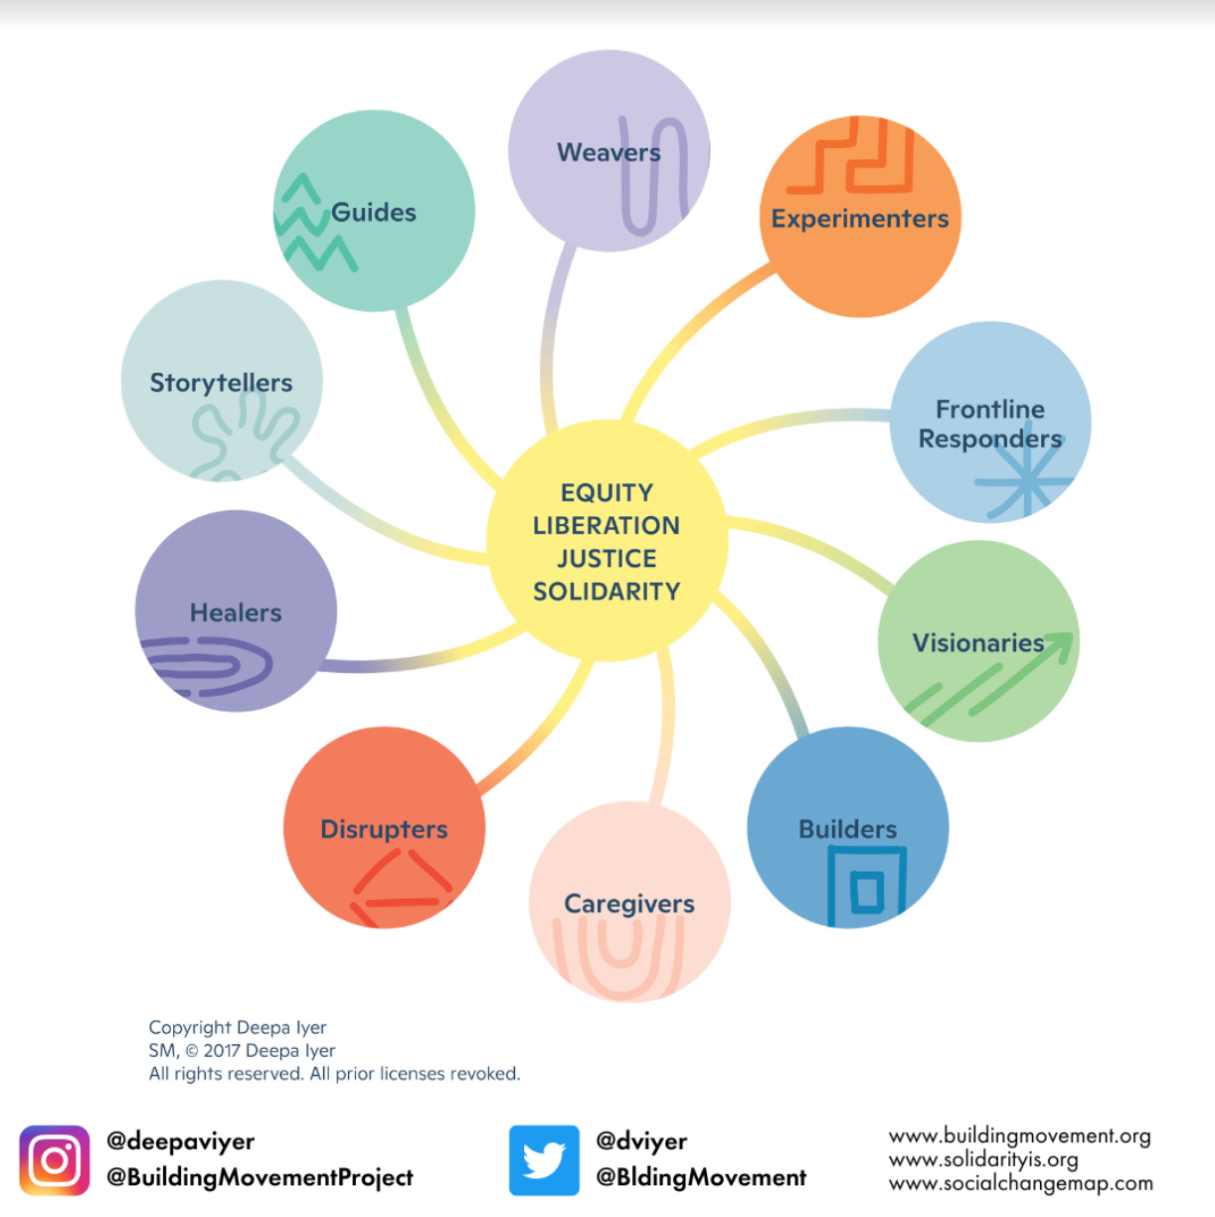

Climate Action Venn Diagram
Dr. Eyana Elisabeth Johnson
What needs doing?
Your
action
What brings you joy?
What are you good at?
Social Change Ecosystem Map
Deepa Iyer, Building Movement Project
Notes:
Climate Action Venn Diagram
https://www.ayanaelizabeth.com/climatevenn
Social Change Ecosystem Map
https://buildingmovement.org/our-work/movement-building/social-change-ecosystem-map/

Slide 13
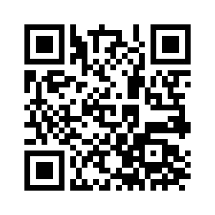


How are you leaving this webinar?
Please share your feedback and keep in touch!
https://forms.gle/9m5HnyVfSQdo6QpJ9
cpj.ca | natalie@cpj.ca

