Slide 1
Contingent capital and bail-in
Presentation for CUES
Walter Engert
Former Senior Director (Research), Office of the Superintendent of Financial Institutions (OSFI)
28 November 2017
walt.engert@gmail.com
Opinions expressed here are solely those of the author, and do not necessarily reflect the views of OSFI.

Slide 2
Lessons from the crisis (and elsewhere)
Major banks – “DSIBs” – are too big to fail.
Cannot be resolved with conventional resolution methods
Poor management of systemically important banks under stress generates large costs for other FIs and for economy
Bail-outs lead to moral hazard (encourages risk-taking), ruin government fiscal balance, and are not tolerated by the public
So we needed better tools to deal with failing large banks
  Non-viability contingent capital (NVCC) and bail-in debt (BID)

Slide 3
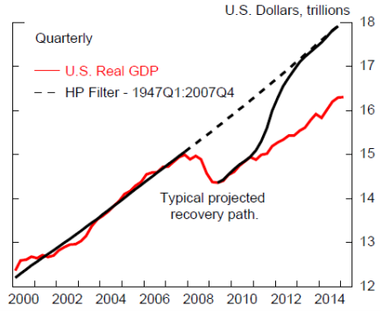
U.S. 2007–08 recession

Slide 4
Intuition for NVCC and Bail-in
Contingent capital and bail-in debt are financial instruments issued by Canadian DSIBs (six largest banks) that convert to common equity when a bank is under severe stress (not viable), at the discretion of government
Idea is to fully recapitalize a failing DSIB with private capital
  Private investors are the first port-of-call to support a failing DSIB, not the public sector
  Bail-in, not bail-out
Conversion terms are (largely) predetermined, and disclosed to investors/market
Pre-packaged bankruptcy plan, pre-funded by private capital

Slide 5
But not a silver bullet
Authorities would trigger conversion of NVCC and BID only if there is a high level of confidence that conversion plus additional measures would restore viability of the DSIB(s)
Would also include liquidity support from the public sector – Bank of Canada, CDIC
Associated environment still a nightmare

Slide 6
Two parts
  NVCC
  Bail-in
    How do they work?

Slide 7
What is “non-viability contingent capital” – NVCC?
Preferred stock and subordinated debt that convert to common equity (CE) at non-viability, at regulatory discretion
All preferred stock and sub debt issued by DSIBs must have this feature
  “Non-viability” based on OSFI judgement, input from FISC partners (Appendix 1, p. 19)
Structure of NVCC instruments influenced by OSFI regulations (see references)
Contractual NVCC terms have become standardized in the market – typical practice – and are fully transparent

Slide 8
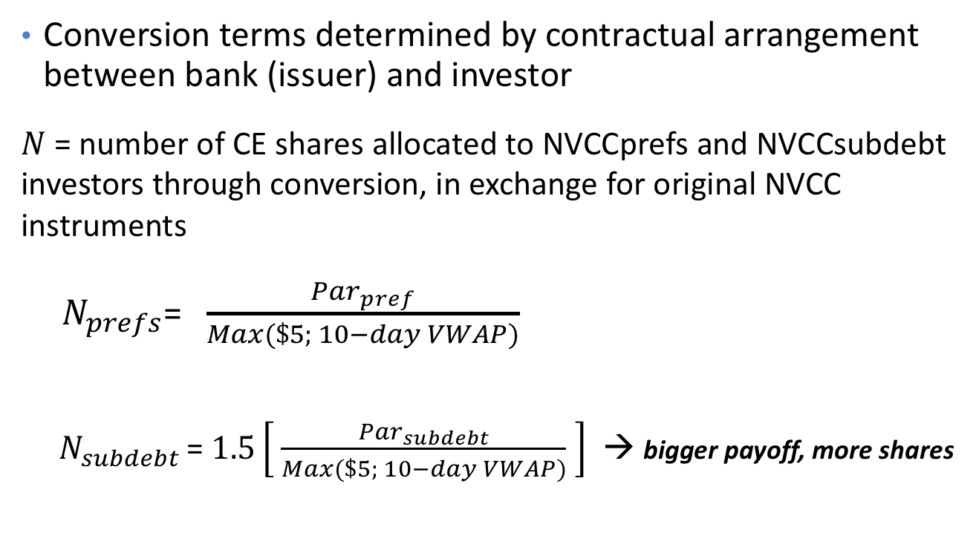
NVCC conversion to capital
Conversion terms determined by contractual arrangement between bank (issuer) and investor
$N$ = number of CE shares allocated to NVCCprefs and NVCCsubdebt investors through conversion, in exchange for original NVCC instruments
${ N}_{prefs}$= $\frac{{Par}_{pref}}{Max(\$5; 10−day VWAP)}$
  ${ N}_{subdebt }$= $1.5\left[ \frac{{Par}_{subdebt}}{Max(\$5; 10−day VWAP)} \right]$ → bigger payoff, more shares

Slide 9
What is “bail-in debt” – BID?
  Senior debt instruments – like bonds – that can be converted into common equity (CE) at non-viability, at regulatory discretion
  Bail-in is additional to prior conversion of all NVCC
    Other interventions would also apply, notably official liquidity support
  Features of eligible BID instruments are set out by OSFI regulations (more on this later)

Slide 10
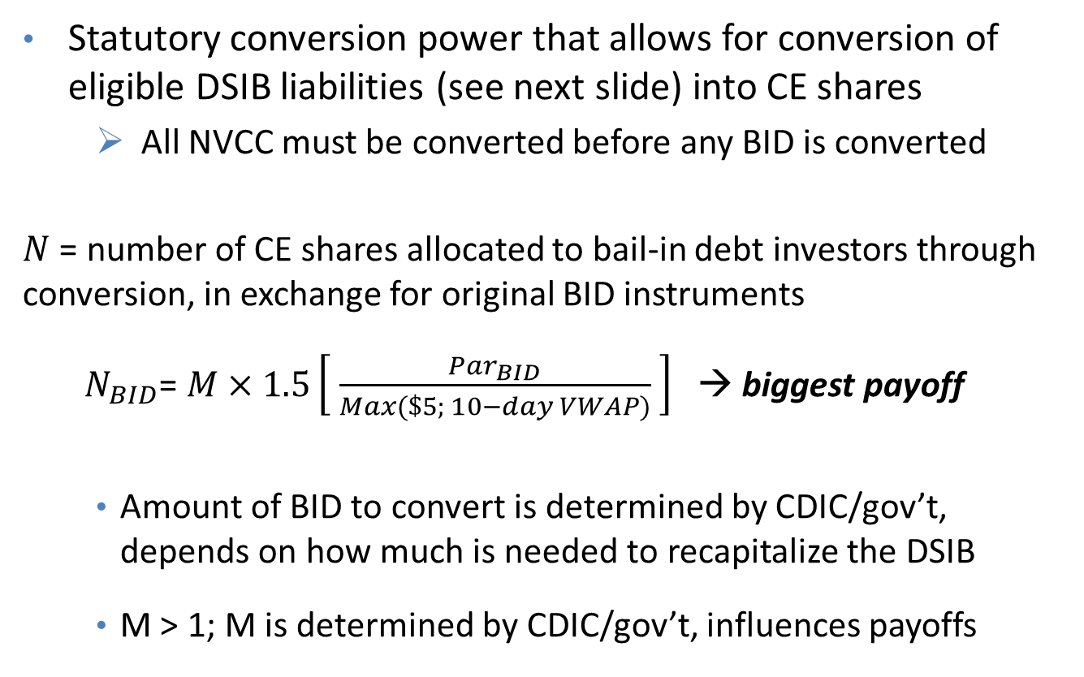
Bail-in conversion to capital
  Statutory conversion power that allows for conversion of eligible DSIB liabilities (see next slide) into CE shares
      All NVCC must be converted before any BID is converted
$N$ = number of CE shares allocated to bail-in debt investors through conversion, in exchange for original BID instruments
  $N_{BID}$= $M×1.5\left[ \frac{{Par}_{BID}}{Max(\$5; 10−day VWAP)} \right]$ → biggest payoff
    Amount of BID to convert is determined by CDIC/gov’t, depends on how much is needed to recapitalize the DSIB
    M > 1; M is determined by CDIC/gov’t, influences payoffs

Slide 11
What qualifies to be eligible as BID?
Scope of BID emphasizes operational feasibility, credibility and preserving access to (short-term) liquidity in stress
BID must be:
BID transparent to investors and market more generally
Excludes deposits, covered bonds, structured notes & derivatives
Issued after implementation date; no ex post application of BI
Tradable and transferable
Unsecured
Long term (original term>400 days)

Slide 12
Key features of the strategy
For DSIBs…
If the bank becomes “non-viable”…
On exiting control…
Comply with minimum “TLAC” requirement, set by OSFI
Temporary CDIC (resolution) control of DSIB
BID is converted, in whole or in part, into common shares on pro rata basis
Compensation for creditors and shareholders (paid by CDIC) if they are worse off than they would have been in liquidation (large deadweight losses)
All NVCC is converted into common shares

Slide 13
Total Loss-Absorbing Capacity (TLAC) requirement
TLAC = CE + NVCC + BID
Min TLAC calibrated so DSIBs can withstand very severe losses and emerge from resolution well-capitalized with the market’s confidence
OSFI sets the minimum TLAC requirement
  TLAC must be at least 21.5%RWA (risk-weighted assets)
  Excludes BID with remaining term-to-maturity less than 1 year (but still can be bailed in)
  DSIB compliance with minimum TLAC by November 2021

Slide 14
Notional DSIB TLAC – as % of RWA
Min TLAC = 21.5%RWA
2.5%
1.5%
11%
9%
Senior, unsecured debt –> Bail-in debt
Sub debt and prefs –> NVCC
TLAC = 24%RWA
Common Equity

Slide 15
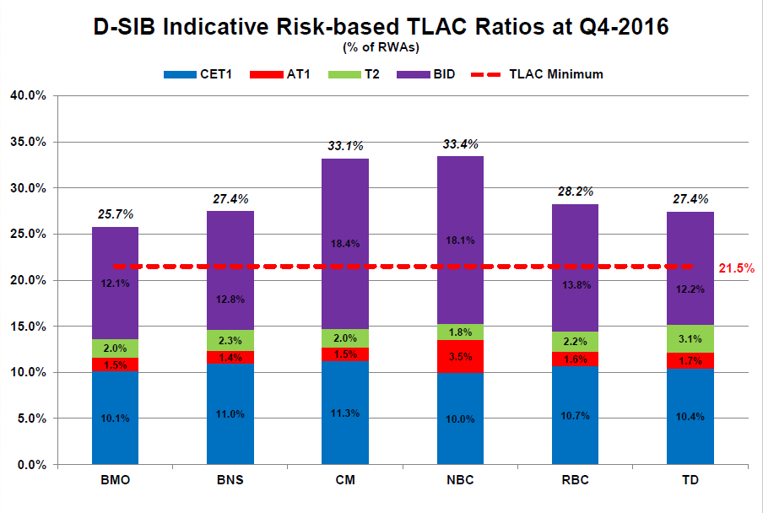
How do the DSIBs stack up?

Slide 16
Outcomes from bail-in resolution
DSIB stays open, aim for business as usual
Recapitalized quickly with limited taxpayer support and able to re-access markets
Recoveries consistent with relative hierarchy of claims, and Chapter 11/CCAA restructurings
  Significant dilution of original common shareholders through conversion of NVCC and BID
  Common shares issued to NVCC and BID according to their relative ranking
    Senior instruments get more stock, bigger “payoffs” —> bigger piece of the pie
    And smaller losses to most senior instruments
    Pricing in market should reflect relative risks –> marginal (other things equal)
Appendix 2 provides an illustration

Slide 17
Outcomes, continued
Increased volatility of DSIB stock price when under severe stress?
Arbitrage/spiral risk mitigated by: price floor and VWAP in instrument structures; discretionary conversion; limits on ability to borrow sufficient stock to run arbitrage
If such trades are not motivated by legitimate risk to DSIB, arbitrage and short-sales less likely to succeed —> market discipline
In response, DSIBs could target higher CE, avoid high-variance, fat-tail assets, improve transparency, act sooner to address problems, raise price floor/lengthen VWAP in structures

Slide 18

Questions?

Slide 19
Appendix 1: How is “non-viability” determined?
Seven indicative criteria in legislation and OSFI guidance
  Assets insufficient to cover liabilities
  FI has lost confidence of depositors, creditors or public – ie, prolonged difficulties raising short-term funding/runs
  FI has failed to, or will be unable to, pay liabilities as due
  Level of capital eroded materially
  FI fails to comply with an order to increase capital
  Any other state of affairs materially prejudicial to interests of depositors and creditors; eg, bankruptcy or insolvency proceedings in Canada or elsewhere related to the FI or affiliates
  FI cannot recapitalize on its own – no private or public investors willing to invest capital; parent unable or unwilling to support subsidiary
Not an exhaustive list and not all have to be met
Six of these based on criteria in legislation relating to Superintendent taking control of an FI or OSFI making a non-viability determination that is catalyst for other resolution tools

Slide 20
Appendix 2:
An illustration – “five-minute bail-in”…
Basic facts about the illustrative bank
  Roughly reflects features of a large Cdn DSIB (but bigger)
CE = 1bn shares x $60 = $60bn
CET1 ratio = 11%RWA
RWA = $545bn
Assets = $1,817bn (RWA/A = 0.30)

Slide 21
Bank funding stack –> “TLAC”
As on p. 14…
BID: 9%RWA = $49.1bn
NVCCsubdebt: 2.5%RWA = $13.6bn
NVCCprefs: 1.5%RWA = $8.2bn
CE: 11%RWA = $60bn
Total: 24%RWA = $130.9bn [min TLAC = 21.5%RWA]

Slide 22
Crisis
Suppose that significant macro and financial shocks lead to very large losses, liquidity pressures and collapse of bank stock price – and the DSIB is judged to be non-viable
  Move to resolution –> bail-in
In this example, assume that 10-day VWAP of stock price is $9 at non-viability – use this in the denominator of conversion formulas (p. 8, p. 10)
  This VWAP is 85% below pre-crisis stock price – consistent with stock price behaviour of failed/bailed-out major banks during financial crisis (in other countries…)

Slide 23
Conversion and distribution of shares
Convert all NVCC and BID (discrete decision)
Apply formulas on p. 8 and p. 10, with M set at 1.1 (discrete decision)
After reverse stock split (to restore original number of shares), bail-in is done, and we have the following distribution of shares:
N(BID): 682.9mn shares of common equity –> 68.3% of total
N(SubDebt): 172.2mn shares of common equity –> 17.2%
N(Prefs): 69.0mn shares of common equity –> 6.9%
N(Original CE): 75.9mn shares of common stock –> 7.6% (92% dilution)
Total: 1bn shares –> 100% of outstanding common stock

Slide 24
Projected loss absorption
Take conservative (maximum, upper bound) view of possible, expected losses to write off
Assume loss is 9%RWA
  Loss of 9%RWA is a conservative estimate relative to financial crisis experience (above the inter-quartile range)
CE after conversion: 24%RWA = $130.9bn
Projected maximum loss: 9%RWA = $49.1bn
Est CE after loss: 15%RWA = $81.8bn
After conversion and absorbing extreme losses, DSIB is still well-capitalized

Slide 25
Distribution of shareholder book value (BVe)
After conversion, reverse stock split and projected maximum loss absorption, what are the payoffs?
BVePS = $81.8bn/1bn shares = $81.8 per share
BVe(BID): 682.9mn shares x $81.8 = $55.9bn, vs 49.1bn; gain = 14%
BVe(SubDebt): 172.2mn shares x $81.8 = $14.1bn, vs $13.6bn; gain = 4%
BVe(Prefs): 69.0mn shares x $81.8 = $5.6bn, vs $8.2bn; loss = 32%
BVe(CE): 75.9mn shares x $81.8 = $6.2bn, vs $60bn; loss = 90%
BVe Total: 1bn shares x $81.8 $81.8bn
Book value gain relative to par for more senior debt provides buffer for market discount (next)
“no-creditor-worse-off” test

Slide 26
Distribution of shareholder market value (MVe)
Given high uncertainty and system stress, assume that after resolution the stock price would (initially) trade at a significant discount from BV, eg 40%, so that MVe = $49.09
MV(BID): 682.9mn shares x $49.08 = $33.5bn, vs $49.1bn; loss = 32%
MV(SubDebt): 172.2mn shares x $49.08 = $8.5bn, vs $13.6bn; loss = 38%
MV(Prefs): 69.0mn shares x $49.08 = $3.4bn, vs $8.2bn; loss = 59%
MV(CE): 75.9mn shares x $49.08 = $3.7bn, vs $60bn; loss = 94%
MV Total: 1bn shares x $49.08 = $49.1bn

Slide 27
Acronyms used
BID: Bail-in debt
CCAA: Companies’ Creditors Arrangements Act
CDIC: Canada Deposit Insurance Corporation
CET1: Common Equity Tier 1 capital ratio
DSIB: Domestic Systemically Important Bank
FI: Financial Institution
FISC: Financial Institutions Supervisory Committee
OSFI: Office of the Superintendent of Financial Institutions
NVCC: Non-Viability Contingent Capital
RWA: Risk-weighted assets
TLAC: Total Loss Absorbing Capacity
VWAP: Volume-Weighted Average Price of Common Stock

Slide 28
Selected references
December 2010 - Contingent Capital and Bail-in Debt: Tools for Bank Resolution
  http://www.bankofcanada.ca/wp-content/uploads/2011/12/fsr-1210-dsouza.pdf
March 2013 - Government of Canada, Economic Action Plan 2013 (pg. 144-45)
  http://www.budget.gc.ca/2013/doc/plan/budget2013-eng.pdf
August 2014 - Department of Finance – Consultation Paper on Bail-in Regime
  http://www.fin.gc.ca/n14/14-099-eng.asp
September 2014 - Applying contingent capital in Canada
  http://www.palgrave-journals.com/jbr/journal/v15/n3-4/index.html
December 2014 - OSFI Capital Adequacy Requirements Guideline, incl. NVCC rules
  http://www.osfi-bsif.gc.ca/Eng/fi-if/rg-ro/gdn-ort/gl-ld/Pages/CAR_chpt2.aspx
June 2017 – OSFI Consultation Paper on Total Loss Absorbing Capacity (TLAC) Guideline
  http://www.osfi-bsif.gc.ca/Eng/fi-if/rg-ro/gdn-ort/gl-ld/Pages/tlac_gias.aspx

