Slide 1
Ergonomic Office Equipment Purchasing Guide

Slide 2
Introduction
To help prevent musculoskeletal injuries in the workplace and meet regulatory standards, the EHS department has created this resource to support departments in choosing appropriate office furniture and equipment.
The purpose of this document is to share guidance and examples of items that are suitable for office use. CU does not promote or rate any particular equipment as being better than others, as individual needs and preferences can vary greatly. While some individuals may find specialized equipment helpful, others may not, as ergonomic requirements are highly personal. It is essential to evaluate factors such as a person’s height, workstation setup, and job tasks and to attempt adjustments using current equipment before investing in new items.
This resource is not intended to replace advice or recommendations provided by healthcare professionals.
Workstation assessment, and evaluation of ergonomic needs.
The steps below outline the process for requesting an ergonomics assessment from EHS. Take these steps before you make changes to your workstation or purchase any equipment or products:
Complete the Office ergonomic tutorial on Brightspace and Ergonomics Self-Assessment Checklist. These resources provide information on how to set up your workstation and recommendations for how to fix common deficiencies.
Speak to your supervisor. Advise your supervisor as soon as possible if you are experiencing discomfort or have concerns. Share with your supervisor the identified deficiencies in your office ergonomic equipment. Your supervisor may be able to discuss furniture or equipment options that are available within the department
Book ergonomic assessment. If you completed the above steps and your symptoms are persisting for more than 12 weeks book an in-person ergonomic assessment. please submit an Ergonomic Assessment Request and ensure the Ergonomic Pre-Assessment Report is completed and sent to ergo@carleton.ca prior to your assessment. For all other questions please email ergo@carleton.ca .
Before requesting an office ergonomics assessment from EHS, employees and supervisors are encouraged to review resource documents on the Ergonomics webpage and complete the Office Ergonomics training course.

Slide 3

Office ergonomics online workshop
The Environmental Health & Safety Office (EHS), has an Office Ergonomics Training intended to provide a practical introduction to office ergonomics and have you follow along with step-by-step instructions to properly set up your computer workstation. Although not mandatory, all employees are encouraged to take this course and adjust their workstations to reduce or eliminate musculoskeletal injuries before scheduling an ergonomic assessment.
This training can be accessed by following the steps below. 1. Visit Brightspace 2. Sign in using your MC1 credentials. 3. Search for the training using the term “EHS: Office Ergonomics” through the Discover link in the navigation bar and self-register by following the on-screen instructions.

Slide 4
Budget Considerations & Procurement
In our ongoing efforts to maintain fiscal responsibility and effective resource management, it is crucial to emphasize the necessity of budget considerations and obtaining departmental permission before making any product purchases. With supervisor approval, purchasing products can be conducted following your internal department protocols. Contact
your preferred Vendor for final quotes.
Here are the steps to follow before initiating any purchases:
Budget Evaluation: Before initiating a purchase, inquire into the available budget allocated to your department by contacting your administrator. Consider whether the proposed purchase aligns with the established budget.
Visit Carleton eShop: Before purchasing any furniture or equipment from external vendors, visit the Carleton eShop. Contact the procurement department for assistance and pricing options.
Special Approval Requirement: Any purchases that might exceed a department's allocated budget or fall outside regular operational expenses require special approval from the department head.
Approval Process: Submit the requisition and any necessary supporting documents to the supervisor or department head for approval. Approval should be obtained before making the purchase.
CUASA members have access to a separate fund as stated in their union collective agreement
Each department is responsible for funding the ergonomic equipment for their employees.
Employees who work from home are responsible for purchasing their own ergonomic equipment as per the flexible arrangement policy.

Slide 5
Office chair technical guideline
Individuals with unique anatomies including heights under 5’2’’ (157 cm) or over 6’1’’ (185 cm), or larger body sizes would require chairs with increased adjustability and are encouraged to email ergo@carleton.ca for more assistance.
Ergonomic chair features | Guidelines
Adjustable height | 15 to 22” including option for taller/shorter chairs. Allows for feet to be placed flat on the floor with knees and hips at the same height, or knees slightly lower. If the work surface height is too high, the chair raises high enough for elbows to be at the same height as the keyboard*. *A footrest is required if feet don’t rest firmly on the ground.
Adjustable armrest | Preferred if the distance between armrests can be adjusted between 15 and 20” or provide an option for a narrower seat pan. The chair should have a “360-degree armrest” that allows for adjustability in all directions. (i.e.; length, width, height) When shoulders are relaxed and elbows are bent to 90 degrees, armrests lower below elbow height.
Lumbar support | Height adjustable is required and sufficient support to hold various weights If the backrest is mesh fabric, ensure there is an additional mechanism for lumbar support Depth adjustable is preferred.
Backrest angle and height | Allows at least 15ᵒ reclined posture & locks in the upright position for full support. ≤17.7” support for shoulders. (may need a neck support option).
Seat pan depth and width | Seat width should be 19” with an option for narrower chairs or armrests that come in closer. Depth adjustability is preferred to allow the seat pan to slide forward/backward to fit the user’s upper legs for support. Seat pan depth is preferred to be 16 to 20” or option for smaller seat pan. Seat pan should accommodate a 2–3-inch space behind the knees.
Chair base and casters | 5-legged base with a minimum of 120 mm pneumatic lift. Other sizes are available upon request. Soft wheel casters for hard floor surfaces can be switched out for carpet casters if required.

Slide 6
Office chair recline mechanism
1. Center Tilt
The seat and backrest tilt together from a pivot point located at the center of the chair.
Pros:
Basic adjustability for simple ergonomic needs.
Affordable compared to more advanced mechanisms.
Cons:
Less natural movement alignment for legs.
Limited range of motion.
Best For: General office work or light desk tasks.
2. Knee Tilt
The pivot point is closer to the knees, allowing a more natural tilt motion.
Pros:
Supports a reclined posture without raising the thighs.
More comfortable for prolonged use.
Cons:
Often found in premium chairs, making it more expensive.
Best For: Executive seating or long hours of sitting.
3. Multi-Tilt Mechanism
Offers independent adjustability for the seat and backrest with multiple lockable tilt angles.
Pros:
Highly customizable for individual needs.
Supports a wide range of postures and activities.
Cons:
More complex to operate.
Higher cost than standard mechanisms.
Best For: Users with specific ergonomic requirements or health concerns.
4. Synchro-Tilt
The backrest and seat tilt simultaneously but at different ratios (e.g., 2:1 ratio for backrest to seat tilt).
Pros:
Encourages dynamic sitting and movement.
Better lumbar support during reclining.
Cons:
Requires a learning curve to adjust properly.
Higher price point.
Best For: Ergonomic-focused environments or users with varying posture needs.

Slide 7
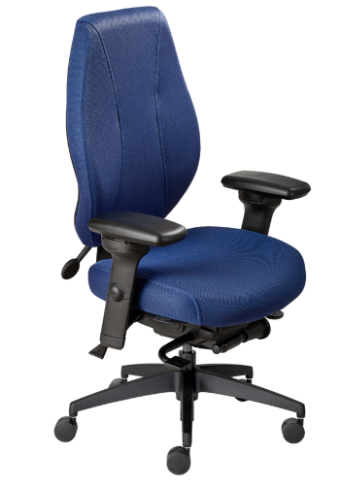
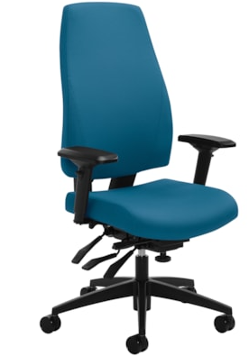
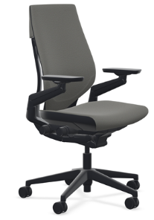
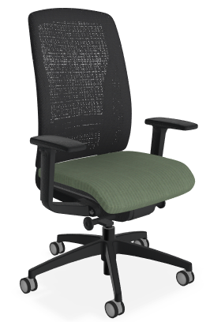
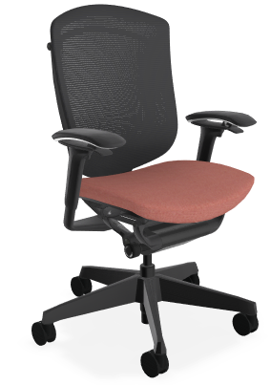
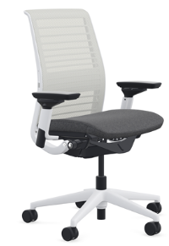

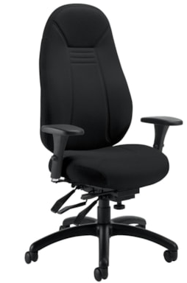
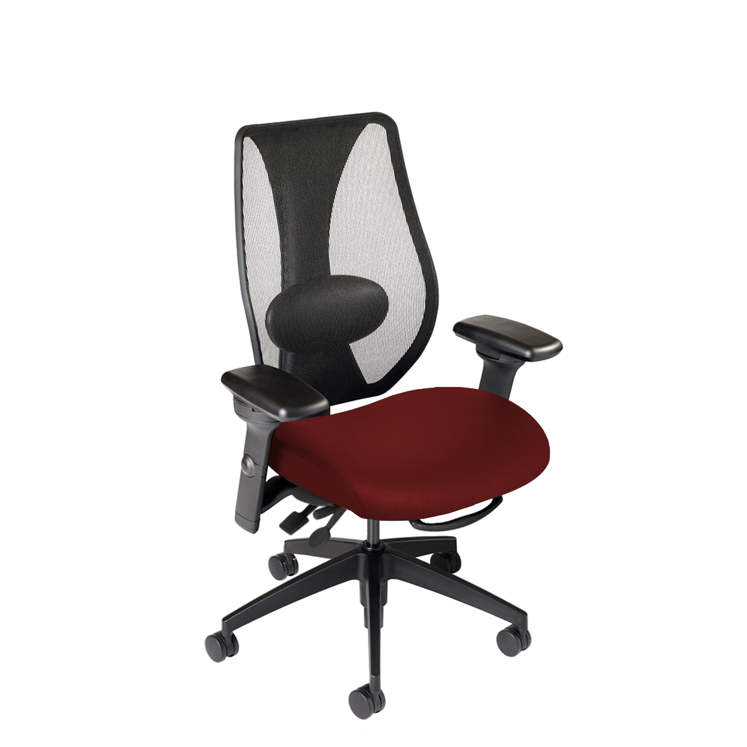
Examples of chairs that are appropriate for general office use
airCentric 2
Global G1 Ergo Select Multi-Tilter Chair
Steelcase Gesture
Teknion Around Task Chair
Teknion Nuova Contessa
Steelcase Think
Global ObusForme Comfort
ergoCentric tCenric hybrid
If you are purchasing a chair and unsure if it is suitable, feel free to contact the Ergonomics Program Manager to review
the chair. Large scale renovations that involve new furniture purchases should also consult EHS.

Slide 8
Sit/Stand desk technical guideline
Height adjustable desks are not a basic requirement; however, they can be helpful for people who require medical accommodation or users who face long hours of sedentary work as they can provide easy postural changes throughout the day. They are also useful for users who share a workspace.
For medical accommodations, please contact your supervisor.
Height-adjustable desks must fit the greatest number of people in both the sitting and standing positions.
The recommended height range for the desks is 22.6” to 48.7” which accommodates the 5th to 95th percentile. This recommendation is based on the CSA Z412-17 standard for office ergonomics and the BIFMA G1-2013 furniture guidelines.
Category | Guidelines
Office space | Measure the footprint of the area where the desk will be placed. Ensure you are able to easily move around your office and you are not blocking doors, drawers, cupboards, or foot traffic considering the dimensions of the new desk. Check the space above the desk. Does it allow for your monitor to raise to the appropriate height when standing. Measure standing eye height, this will be the approximate height of your monitor Consider electrical outlets and cord placement for automatic desks and equipment.
Desk surface | The preferred desk depth is 30’’, however, 24’’ is acceptable if using a keyboard tray. *Some height-adjustable desks will not allow tray installation
Height adjustment | Height adjustments for multiple users should accommodate 22.6’’ – 48’’

Slide 9
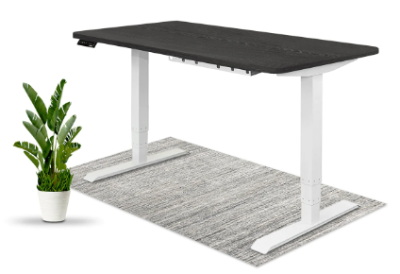
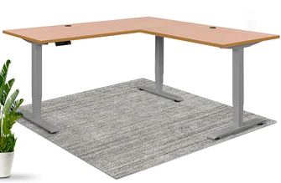
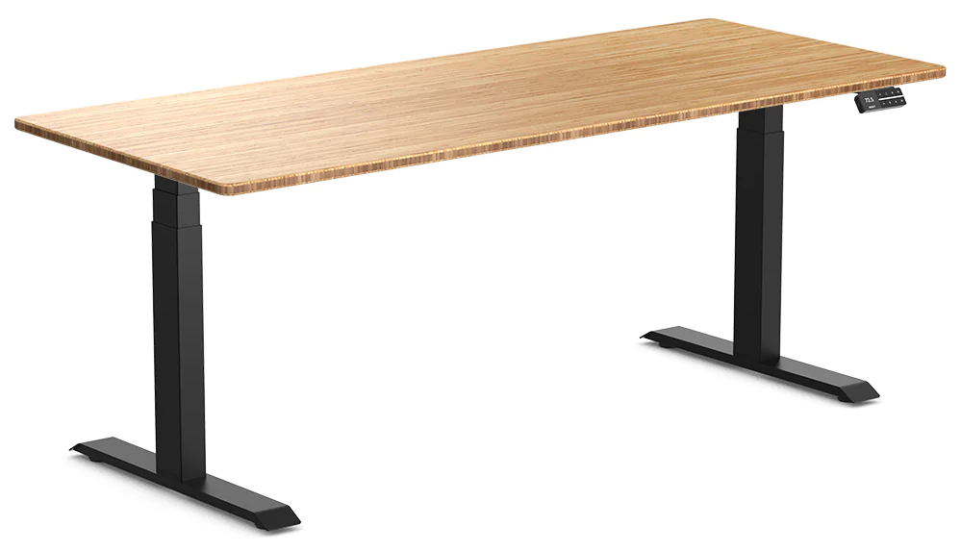
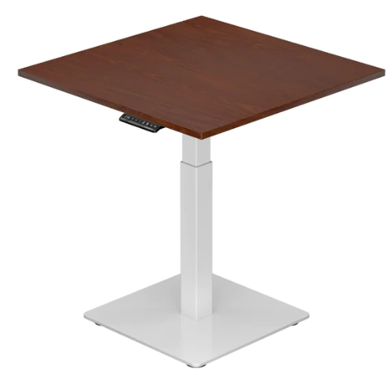
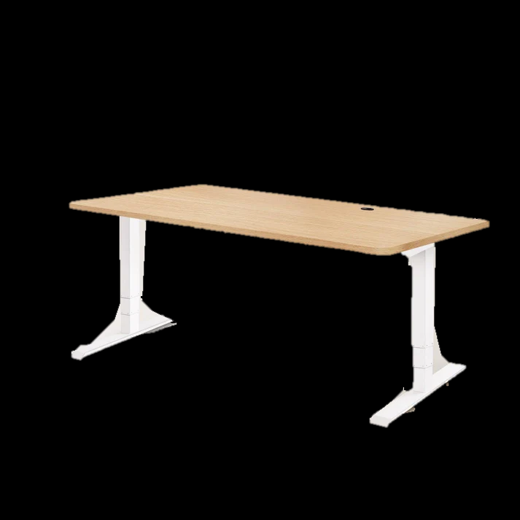
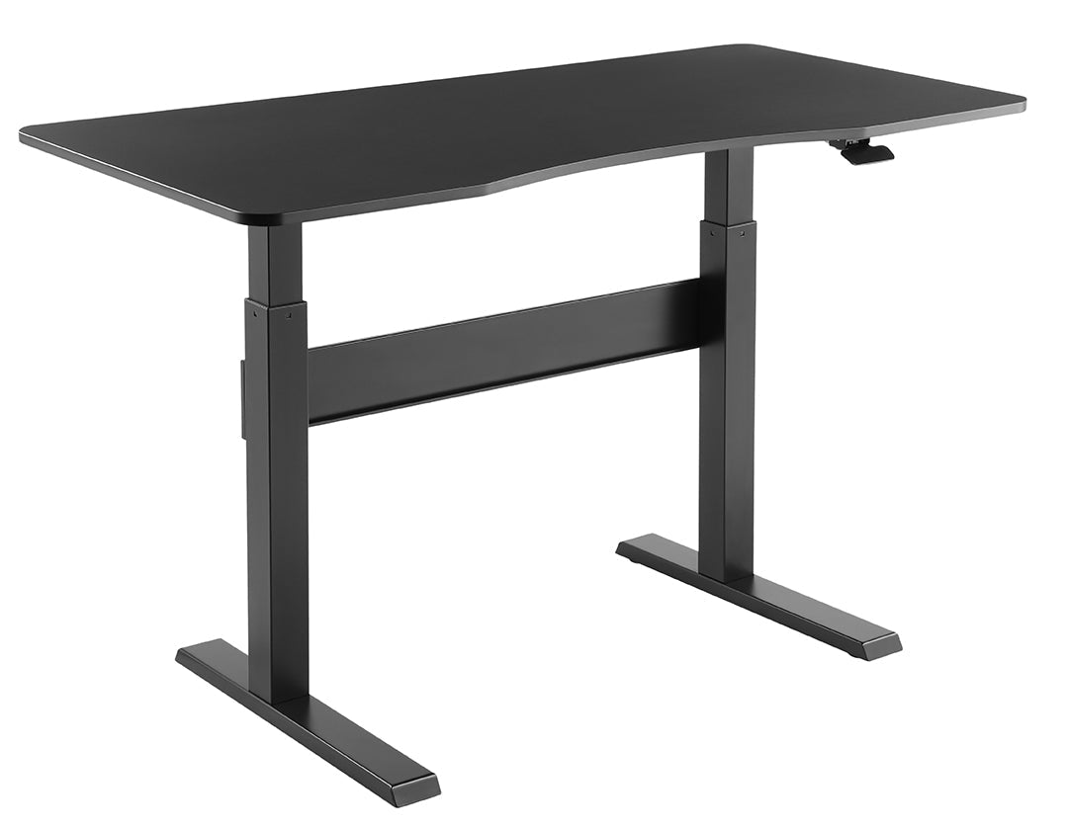
Sit/Stand desks examples for office use
Height-Adjustable Electric Standing Desk
 |  | Nimble Standing Desk
L-Shaped Height-Adjustable Corner Desk
Desky Dual Bamboo Sit Stand Desk
variable sizes
variable sizes
29.5” x 70.8”
Desky Air Lift Zero Sit Stand Desk
Mini Ryzer Standing Desk
28.7” x 57.1”
30” x 30”
The list above is not exhaustive. Departments can choose to work with a vendor of their choice as long as the desk depth and height ranges meets the recommended height range noted above.

Slide 10
Sit/Stand desk converter technical guidelines
Height-adjustable converters are adjustable devices that can sit on top of an existing desk and be raised to accommodate standing work. Functionally, height-adjustable desks are superior to using these platforms as they can reduce desk space and may have more limitations around height for shorter or taller people. Please take note of the height ranges when purchasing these platforms/units.
Things to consider | Guidelines
Type of converter | Determine the type of sit-stand converter that best suits your needs. Arm Adjustable Sit-Stand Desk Converter: Features an adjustable arm mechanism that allows you to raise or lower your computer setup. Typically mounted to the back of your existing desk, it provides vertical height adjustment for the entire workstation. Ideal for users who prefer a more dynamic and flexible adjustment range. Tabletop Adjustable Sit-Stand Desk Converter: Designed as a separate platform that sits on top of your existing desk. Users can manually adjust the height of the entire tabletop to switch between sitting and standing positions. Versatile and can be easily added to various desk setups. It can be heavy for some of the users. Not recommended for users with upper back issues. Pedestal Adjustable Sit-Stand Desk Converter: A pedestal-style converter is a self-contained unit with a sturdy base and a built-in lifting mechanism. The entire desk surface, including the keyboard and monitor platforms, moves up or down. Easy to lift with a keyboard tray that drops below the desk edge The price is comparable to buying a sit-to-stand desk
Work Space | Confirm that the converter provides enough space for your computer monitor, keyboard, and other essential accessories. Ensure the converter is compatible with your existing desk and office setup.
Adjustability | Ensure the sit-stand desk converter is easily adjustable to accommodate your specific height and preferences.
Weight capacity | Check the maximum weight capacity to ensure it can support your computer equipment and accessories.

Slide 11
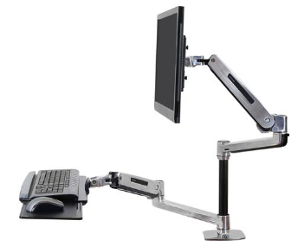
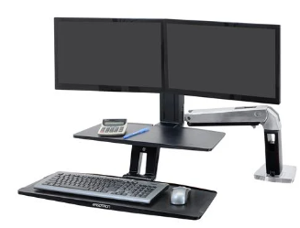
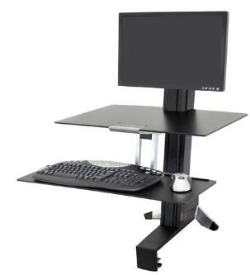
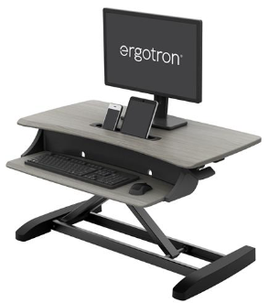
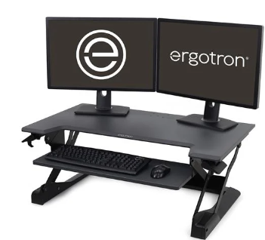
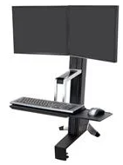
Examples of different types of sit/stand desk converters
WorkFit-LX, Standing Desk Mount System Arm
WorkFit-A, Dual Workstation with Suspended Keyboard
WorkFit-S, Single LD Workstation with Worksurface Pedestal
Arm-adjustable
Arm-adjustable
Pedestal-adjustable
WorkFit-Z Mini, Standing Desk Workstation
WorkFit-TL, Standing Desk Workstation
WorkFit-S, Dual Monitor Standing Desk Workstation
Tabletop-adjustable
Tabletop-adjustable
Pedestal-adjustable
contact vendors for pricing/availability

Slide 12
Computer mouse technical guidelines
Things to consider | Guidelines
Types of ergonomic mice | Vertical Mouse: Design that positions the hand in a handshake position, with the hand and forearm in a more natural and relaxed posture. This can reduce strain on the wrist and forearm, making it a popular choice for those experiencing discomfort from traditional mice. Trackball Mouse: Trackball mice have a stationary body and a ball on the top, which users can rotate to control the cursor. This design eliminates the need to move the entire mouse, which can be beneficial for those with limited desk space or mobility issues, also reducing arm and wrist movement. Thumb Trackball Mouse: Similar to a trackball mouse, but the trackball is positioned for thumb control. This design can be comfortable for users who prefer thumb movement over finger movement for cursor control. Contoured or Shaped Mouse: These mice have a contoured shape that conforms to the natural curves of the hand. They provide a comfortable grip and reduce strain on the wrist and fingers. Contoured mice often come in various shapes to accommodate different hand sizes and grip styles. Hybrid Mouse: Hybrid mice combine features from different ergonomic designs to provide a versatile option. For example, a mouse might combine elements of a vertical mouse with those of a traditional contoured mouse.
Mouse size | Using the proper sized computer mouse is an important step in preventing injuries. The correct mouse size will help to reduce awkward postures and contact stress on the hand and wrist. Visit the online Computer Mouse Size Calculator
Ergonomic features | Check for features like a contoured shape, textured grips, and customizable buttons to enhance comfort and usability.
Wired/wireless | Wireless mice typically require battery replacement and a small USB. Wired mice require space for extra USB ports and cords.
Adjustability | Check for features like a contoured shape, textured grips, and customizable buttons to enhance comfort and usability.

Slide 13
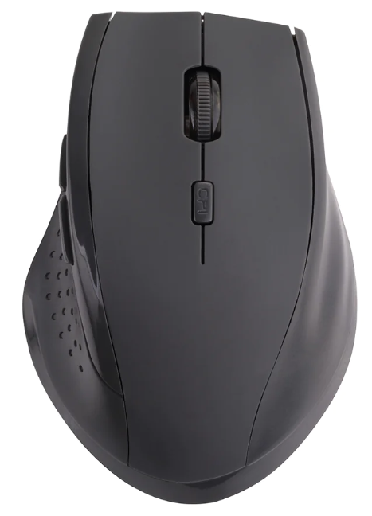
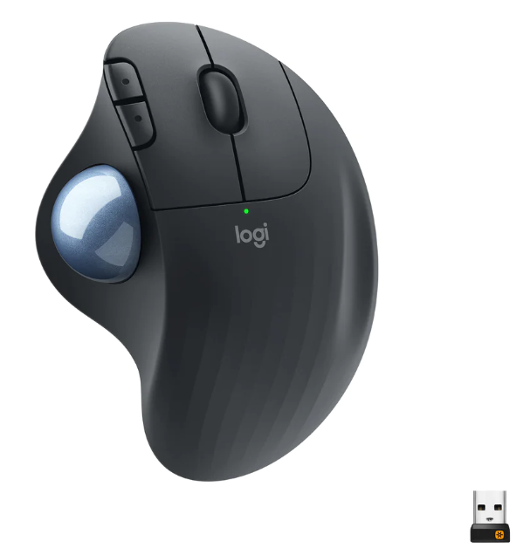
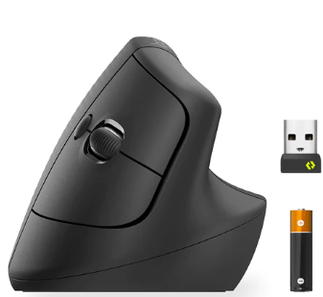
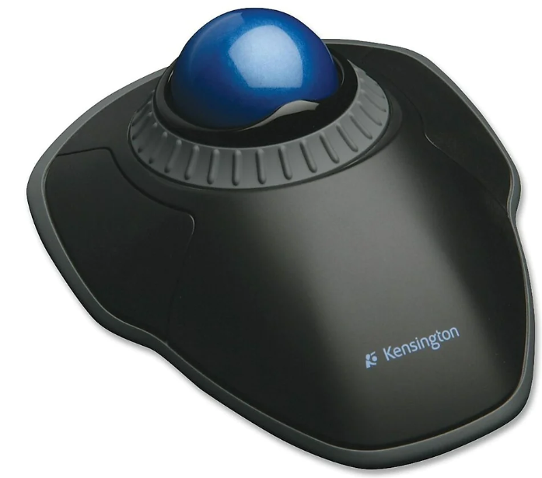
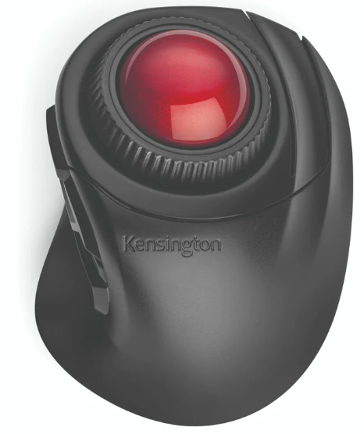
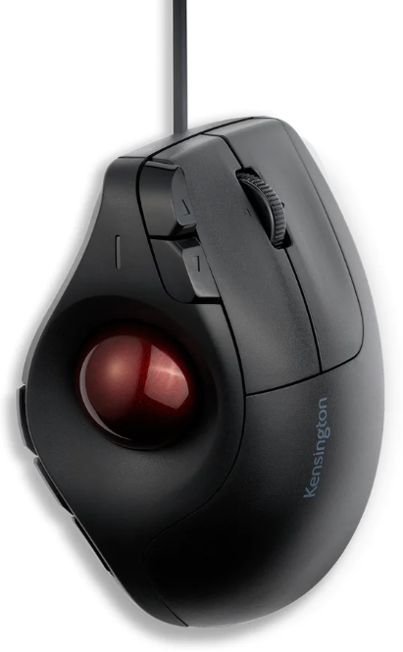
Examples of ergonomic computer mice
Logitech Lift Vertical Ergonomic Mouse
Staples Wireless Ergo 2.4GHZ Mouse
Logitech Ergo M575 Wireless Optical Trackball Mouse
Kensington Orbit Scroll Ring Trackball
Kensington Orbit Fusion Wireless Trackball
Kensington Pro Fit Ergo Vertical Wired Trackball

Slide 14
Keyboard Purchasing Guide
Many new types of keyboards are available, including split and angled keyboards with alternative key arrangements. Benefits of ergonomic keyboards include reduced risk of repetitive strain injuries, improved posture, and enhanced comfort during extended typing sessions.
Things to consider | Guidelines
Wired/wireless | Wireless keyboards typically require battery replacement and a small USB. Wired keyboards require space for extra USB ports and cords.
Size | Compact keyboards fit most keyboard trays. Their small size decreases reaching distance to the mouse, however if you have wide shoulders, compact keyboards are not recommended. Measure the worksurface to ensure the keyboard size allows for comfortable mouse use and placement. Consider your use of a number pad. Some keyboards have detached number pads, left hand number pads or retractable pads to assist with decreased reaching when using a mouse.
Type | Sculpted keyboards allow for a more neutral forearm position. Some sculpted keyboards are too wide or too large. If shopping in-person, try various keyboards, using a proper wrist and elbow position. If you do not require a specialized keyboard, you can purchase standard equipment for low cost.
Ergonomic features | Consider split keyboards, contoured keyboards, and compact keyboards, which are examples of ergonomic keyboards that accommodate a natural hand and wrist position. They are recommended for users with carpal tunnel and other work-related upper extremity disorders. Split keyboards are designed to split in the middle to promote a more natural hand and wrist position Contoured keyboards have a curved layout to match the natural alignment of fingers. Compact ergonomic keyboards are smaller in size, minimizing reaching and strain.

Slide 15
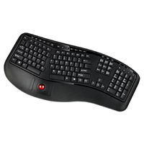
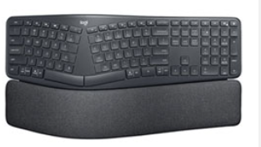
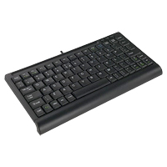
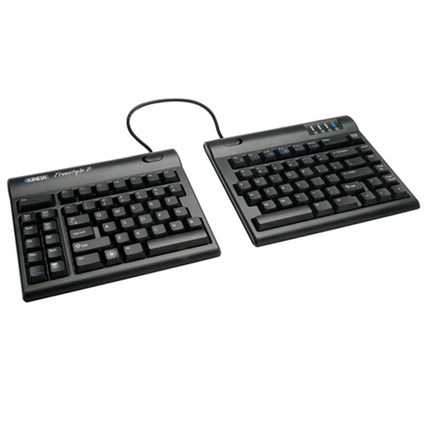
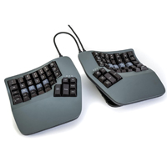
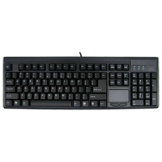
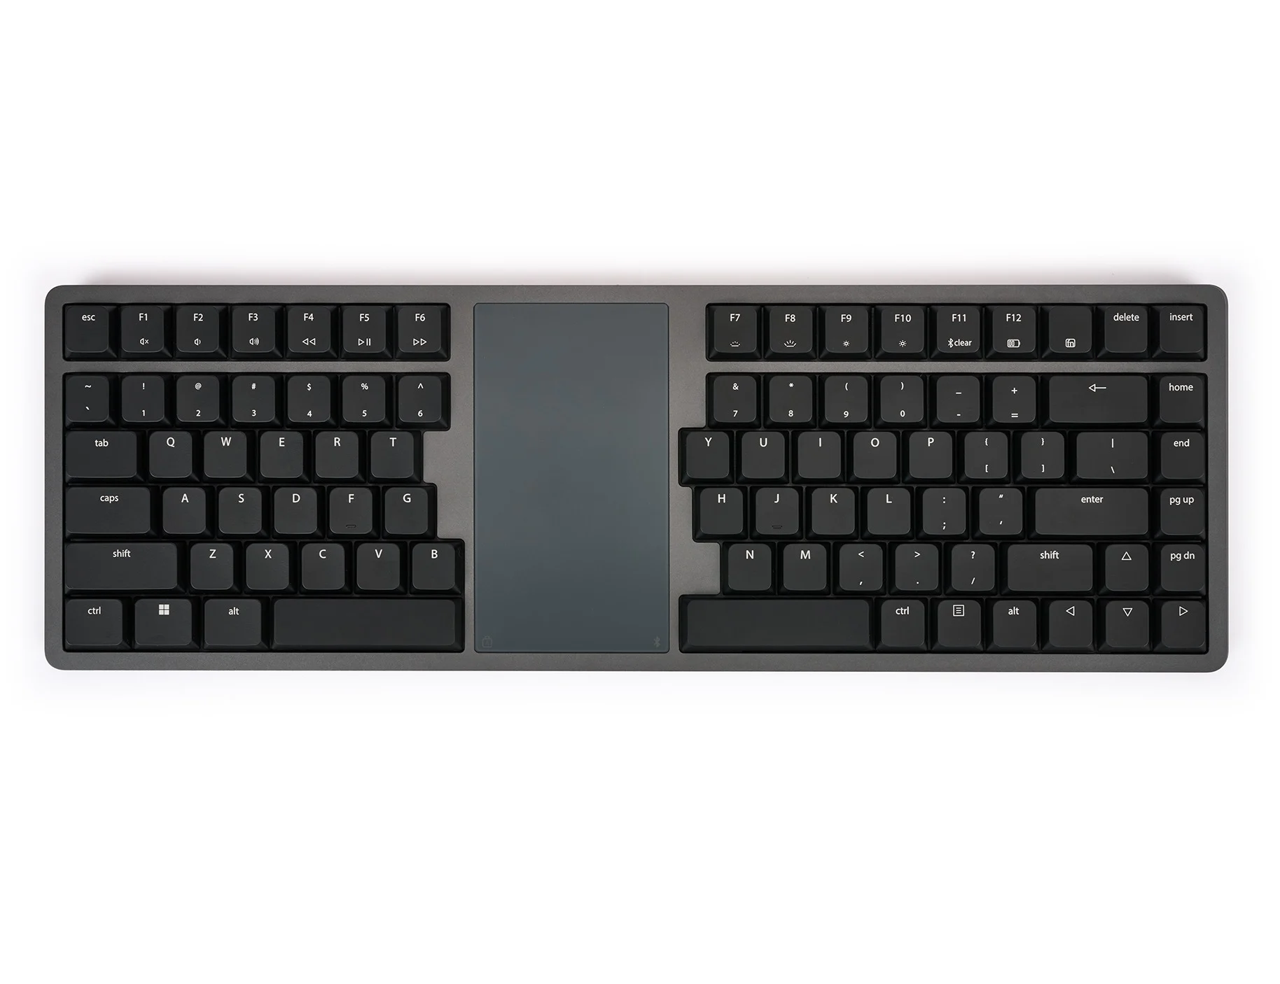
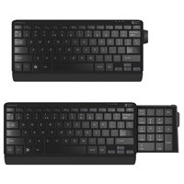
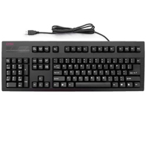
Examples of ergonomic keyboards
 |  | SolidTek Super compact mini keyboard
Kinesis Advantage 360 contoured keyboard | SoildTek full-size keyboard with a built-in touchpad | Kinesis split keyboard
Kinesis Form – split keyboard with a touchpad | Posturite number slide compact keyboard | DSI Left-handed mechanical keyboard
Logitech ERGO Bluetooth ergonomic keyboard
Adesso trackball keyboard

Slide 16
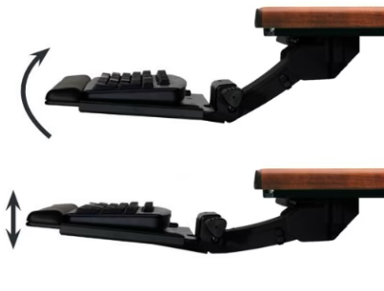
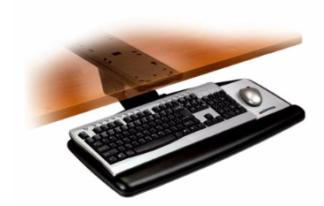
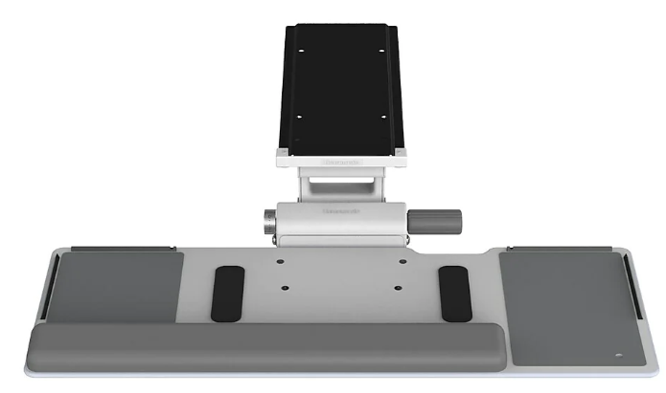
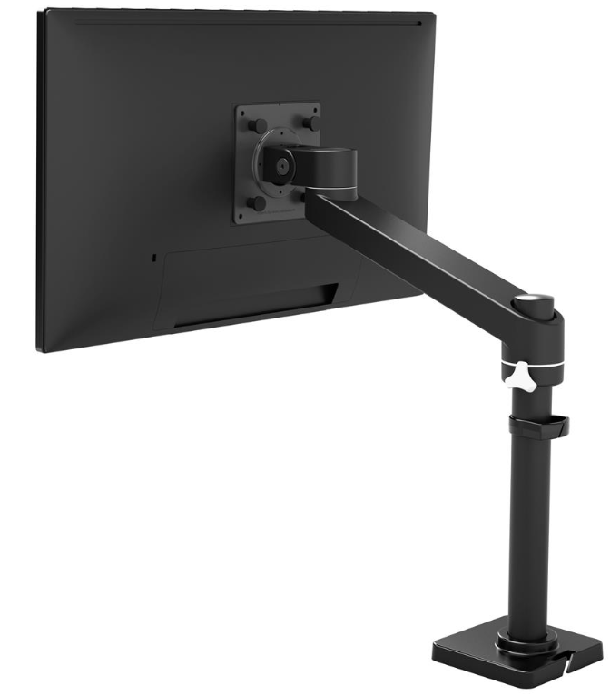
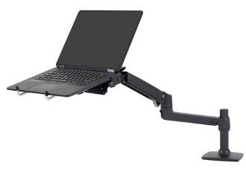
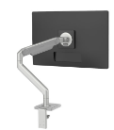
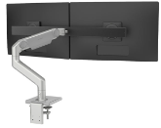
Keyboard trays examples
Before purchasing keyboard trays, ensure that keyboard and tray are size-compatible. Desk depth and thickness must also accommodate the selected keyboard tray tracks and mounting screws. If any incompatibilities arise, look into clamp-on trays or those with shorter tracks.
Desk depth and thickness must also be reviewed for compatibility with the platform system of monitor arms and respective mounting screws.
Humanscale 6G500 Big Board Keyboard Tray System
3M Adjustable Keyboard Tray
Humanscale 6F Keyboard System
Ergotron NX Monitor Arm
Ergotron LX Desk Laptop Arm
Humanscale Monitor Arms

Slide 17
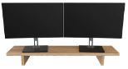
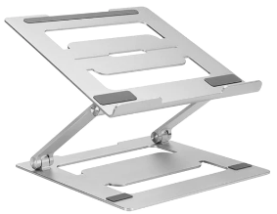
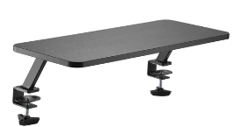
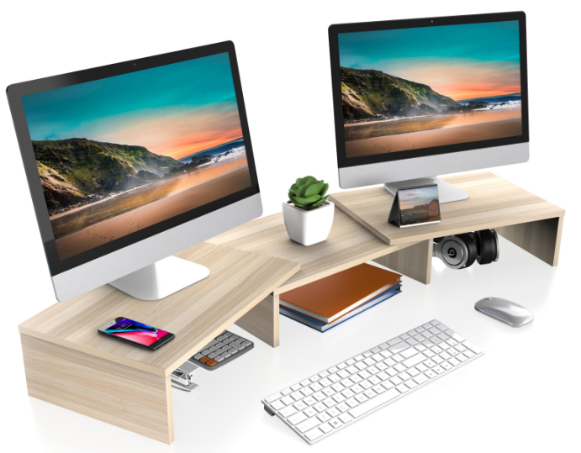
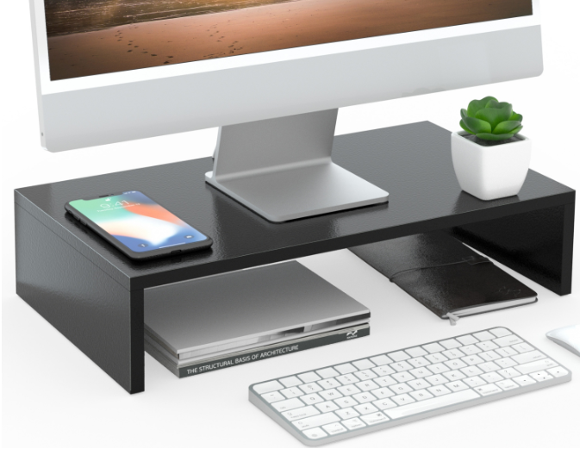
Monitor riser examples
Risers are used to lift the top of a monitor or laptop to eye level, the optimal ergonomic position. They are used if table and chair height adjustments aren’t sufficient in reaching that position.
When using 2 or more monitors, dual-monitor setups should be made of the same size monitor. All monitors should be angle adjustable whether or not they are height-adjustable.
Desky Monitor Stand
Desky Adjustable Laptop Stand Riser
Desky Clamp-on Monitor Riser
FITUEYES Dual Monitor Stand
FITUEYES Monitor Stand

Slide 18
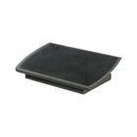
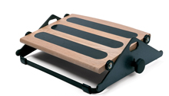
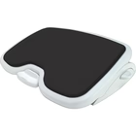

Footrests examples
A footrest can be a necessary support when the chair is raised for a user to reach the work surface and feet are unsupported. It also can increase comfort by allowing adjustable angles between the legs and feet, and provide a means to create variations in the work postures.
When looking for a footrest, it’s important to consider some necessary features, such as; non skidding surface, a sufficient size to allow freedom of movement and adjustable to allow the foot to move 90 degrees to ankle.
 | 3M Adjustable footrest | Kensington SoleMate Comfort with Memory Foam
Humanscale Foot Machine 300
BOOTES Heavy Duty Footrest

Slide 19








Additional Accessories
Fellowes Plush Touch Wrist Rest - Black
Fellowes Professional Series Keyboard Palm Support
ObusForme Gel Seat
ObusForme LowBack Backrest Support
Safco Movable Anti-Fatigue Mat
ErgoCentric Anti-Fatigue Mat
Fellowes Professional Series In-Line Document Holder
Screen Protectors & Privacy/Glare Filters
Note: Anti-fatigue mats can be a useful tool to reduce discomfort while standing for long periods, however, for several health and ergonomic benefits, it's essential to combine their use with a variety of work positions and regular movement.

Slide 20



Additional Resources
Computer Ergonomics
How to prevent health problems such as musculoskeletal disorders when using computers or mobile technology.
Ergonomics in the workplace: understanding the law
Occupational health and safety laws related to ergonomics and ways to address hazards due to poor ergonomics.
Stretching at the workstation
Why is stretching important?
What can be done to minimize strain?
What are some stretches for the hands and forearms ?
What are some stretches for the neck and shoulders?
What are some stretches for the back, side and legs?
MSD Prevention Guideline for Ontario
Basic Guideline to Prevent MSD
Fact sheet introducing the MSD Prevention Guideline for Ontario website
Read success stories and case studies about preventing MSD.
Office Ergonomics Fact Sheets
Personal or Individual risk factors
Keyboard selection and use
Eye discomfort in the office
Monitor positioning & display colours
Eequipment adjustment tutorials …. and more

