Slide 1
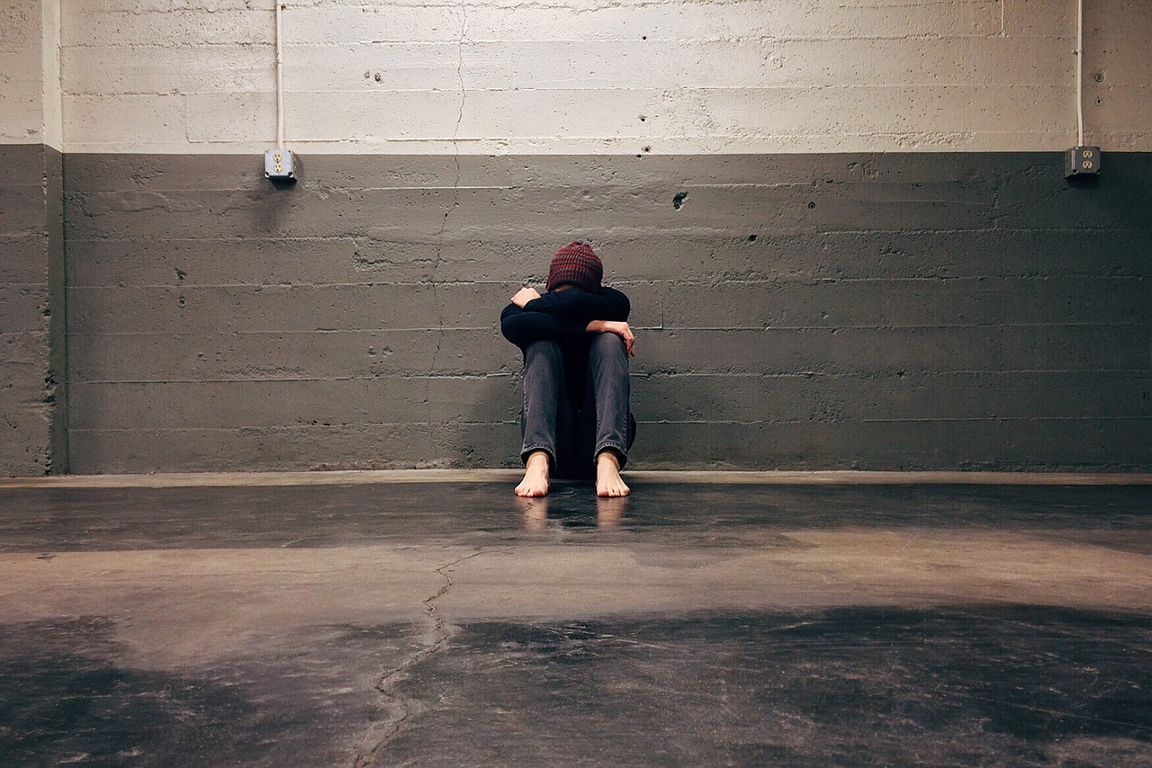
Evaluating the Implicit Successes and Failures of Schools in the Presence of Youth Homelessness
By Charlotte Smith
“I’m trying to survive this right now. Like, I’m trying to survive, it takes all my strength just to stand up and not just collapse into nothing. So it’s like, school, it was a joke”

