Slide 1
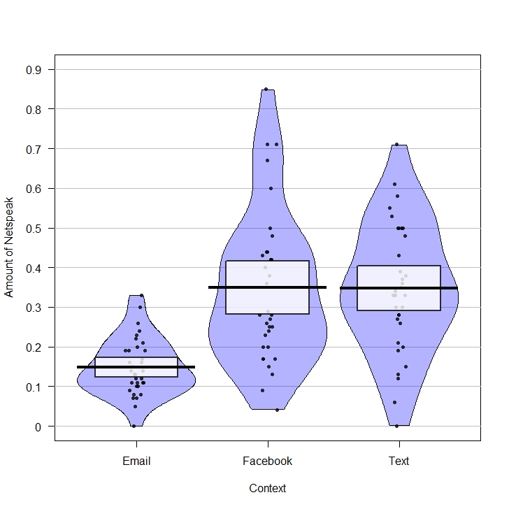
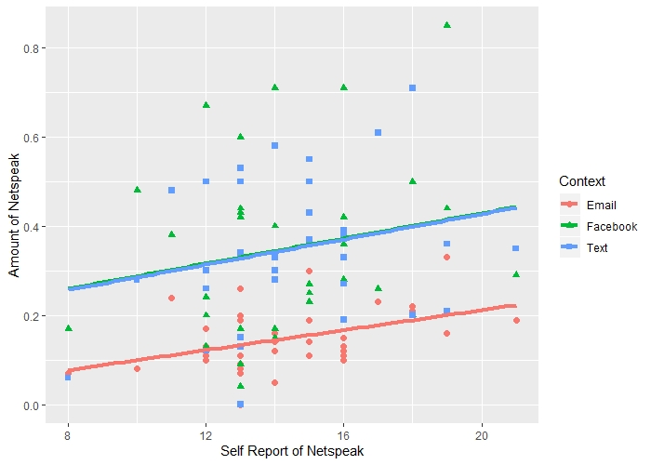
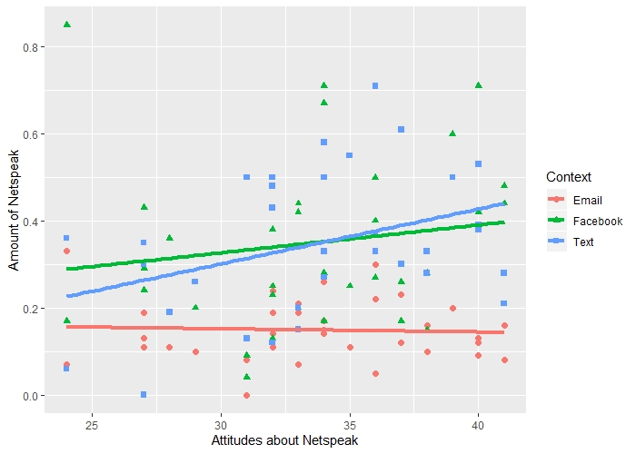
Netspeak and the internet: A contextual Analysis Emma Bornheimer Supervisor: Tamara Sorenson Duncan School of Linguistics and Language Studies Question: Does Netspeak use vary depending on context?
Figure 1: Amount of netspeak per context
Figure 2: Recorded netspeak vs reported netspeak
Figure 3: Netspeak attitude and netspeak score by context
Findings:
1.Netspeak use was significantly lower in email than in Facebook posts and texts
2. Those who reported using netspeak more tended to use more in all three contexts.
3. Attitudes about Netspeak impacted the amount of netspeak in the texting condition.

