Slide 1
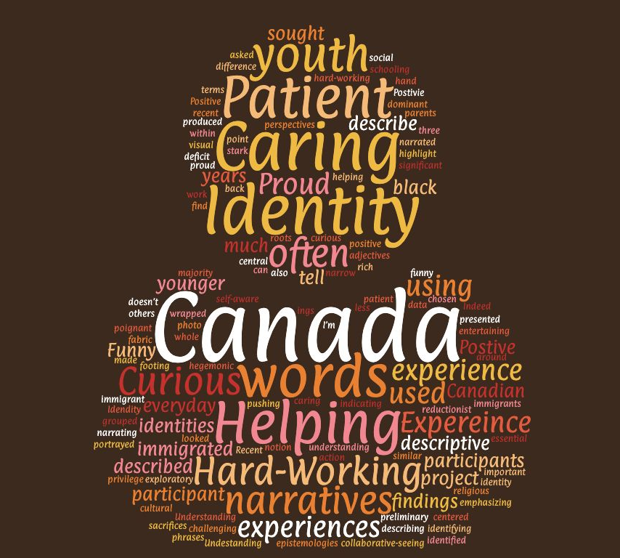
Narrating Identity in Canada: Exploring the experiences of first-generation Black youth from East Africa
Research Lead: Hikmet Mawi
Supervisor: Alexandra Arraiz Matute
Childhood and Youth Studies
Faculty of Arts and Social Sciences
Carleton University, September 2020

