Slide 1
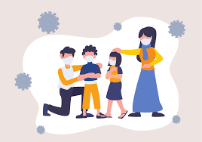
The Impacts of School Disruptions on Families of Carleton University Faculty and Staff during COVID-19

Slide 3
The Impacts of School Disruptions on Families of Carleton University Faculty and Staff during COVID-19

