Slide 1
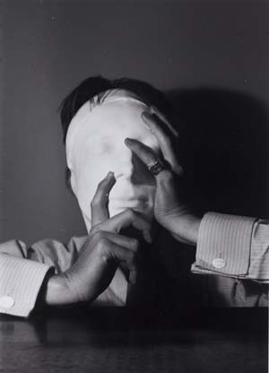
COMPLICATED RELATIONSHIPS
James Merrill,
Elizabeth Bishop,
and the New Criticism

