Slide 1
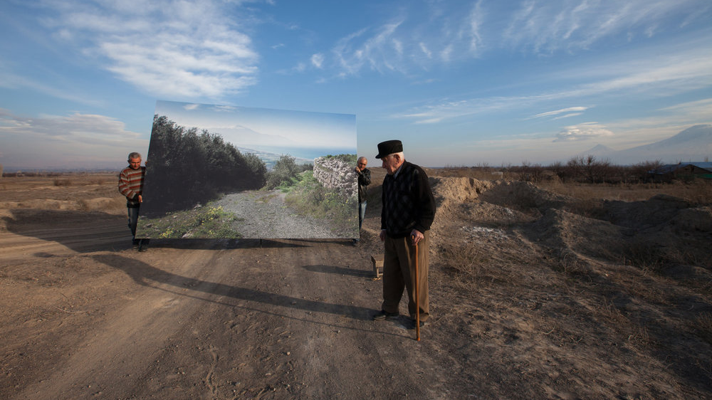
Diana Markosian’s Multi-Media Series 1915 And Photography’s Unique Capacity To Contribute To A Multi-Perspectival Global Art History
Rebecca Korn – Art History – Supervised by Birgit Hopfener
Photograph by Diana Markosian, Movses and musa-ler from the Series 1915, (2015)

