Slide 1
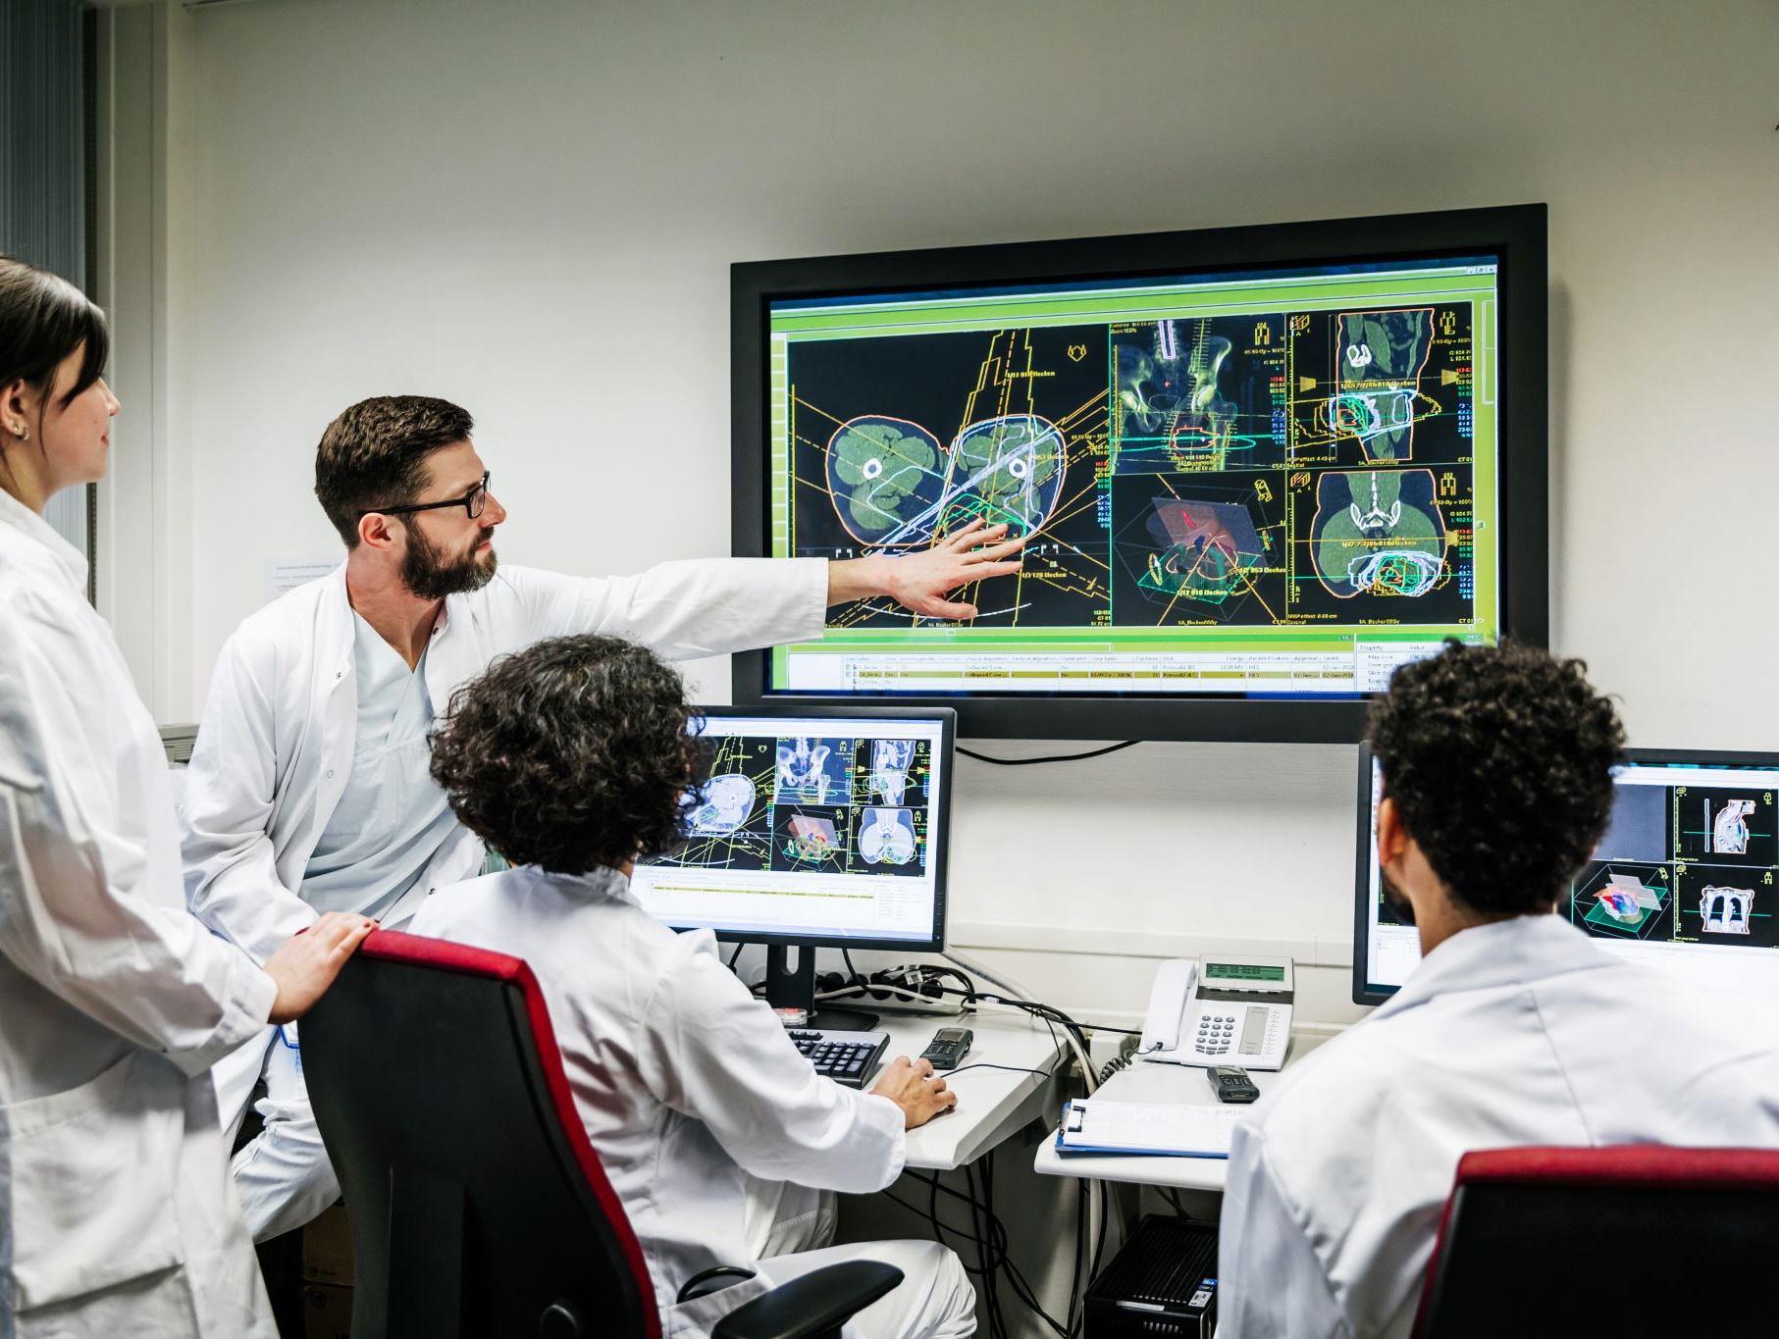
Inside a System of Abuse
The experiences of women with invisible, rare, physical chronic illnesses within Canada’s healthcare system
“They look at any young woman who believes she has a rare disorder as an attention seeking hypochondriac who hopped on google one day and decided she wanted to play sick” (Eve, 22)
“Negative. Frustrating. There was a lot of gaslighting and minimization of my experience. I was told flat out that my symptoms didn’t make sense and couldn’t be real. Every time I had an appointment, I would go in hopeful and come out confused, disappointed, and utterly hopeless.” (Victoria, 31)
“If my daughter had not been in the appointment with me, I still maintain to this day that I would have walked into traffic and ended it all right then and there. It was one of the most demeaning and humiliating experiences of my life.” (Julia, 55)
By Sarah Szumlanski; Supervised by Dr. Kelly Fritsch

