Slide 1
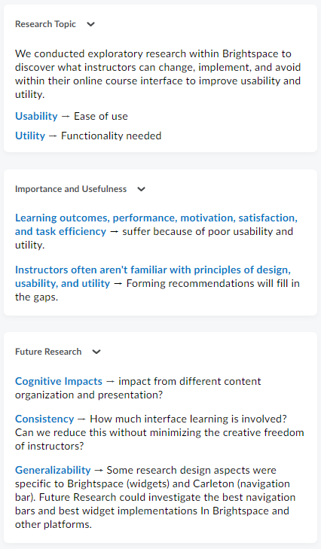
Kyle Grant, supervised by Nadiya Slobodenyuk

