Slide 1
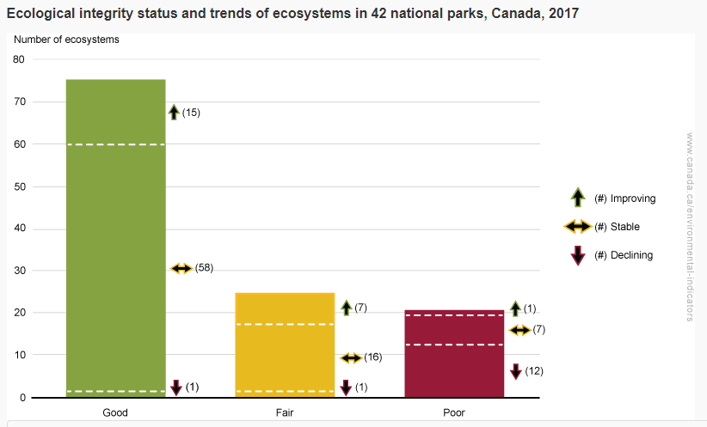
Was the 2017 Discovery Pass a good environmental policy?
Stephanie Lonz Professor John Milton
Department of Geography and Environmental Studies, Carleton University
Background
As part of the Canada 150th celebrations, the federal government waived the entrance fee for all national parks in 2017 with the Discovery Pass.
In the 2016 ecological report on National Parks, one third of assessed ecosystems were in declining health
In the last decade, we have seen increasing levels of development in many of our national parks, which some organizations have suggested comes at a cost to their ecological integrity (CPAWS, 2016)
In the 2012 budget, funding for conservation work resulted in a 31 percent reduction of conservation and science staff yet staffing in the visitor experience program grew by 9 percent (CPAWS, 2016).
Purpose
The purpose of this research was to determine whether free access to our national parks is a good environmental policy. Given the state of our national parks, does increased levels of visitation, due to waived entrance fees, lead to adverse ecological impacts.
Methods
A trend analysis of visitation levels among national parks was performed to determine if the Discovery Pass lead to an increase in visitation
A statistical analysis of number of incidents 2017 was done to determine if there was a correlation between visitation levels and number of incidents
An analysis of the type of incidents recorded in 2016 and 2017 was done to determine if there was a disproportionate amount of specific types of enforcement in Banff, Jasper and Yoho National Park
A rank comparison was done between the most visited parks, the most fragile parks and the parks with the largest number of incidents to determine if there were any visible patterns
Conclusions
The results of this project suggest there is no clear answer in determining whether the 2017 Discovery Pass was a good environmental policy. Even though our national parks did show an increase in visitation and enforcement rates, confounding factors such as increased prudence in giving out warnings during the 2017 season, climate change, wildlife fires and other variables could impact the data. While incidents increased, many are contained within campsite limits and may have minimal ecological impacts. What is seen in this research is that many of our most visited national parks have declining ecosystems which may be a result of increasing levels of tourism, and subsequently, development. It is important that scientific monitoring be given the resources needed to ensure our parks are being used sustainably so that future Canadians can continue to enjoy these important spaces.
Results
Visitation
The 2017 Discovery Pass lead to an increase in visitation in national parks
The mountain parks accounted for 55 percent of national park visits annually. Banff and Jasper National Parks saw some of the largest increases in absolute numbers, though not all mountain parks followed this trend
The largest percent increase in visitation and increase in absolute numbers from 2016 was mostly observed in the mid-sized parks which see 100,000 to 5000,000 visits annually
Enforcement Action/Incidents
Overall, there was a 17 percent increase in incidents from 2016 to 2017
Of three most recorded incidents in Banff, Jasper and Yoho National Park only camping regulations saw an increase in 2017 from 2016.
Wildlife regulation incidents saw a 38 percent increase from 2016 in Banff, Jasper, Yoho National Park
Ecological Fragility, Visitation and Incidents
There was no clear relationship between the number of visitors or incidents and the ecological fragility of a national park
In mountain parks, however, the 2017 ecological integrity report shows an increased in the number of poor and declining ecosystems from the 2016 report.
References
1. Canadian Parks and Wilderness Society (2016). Protecting Canada’s National Parks: A call for renewed commitment to nature conservation. CPAWS 2016 Parks Reports. Retrieved from https://cpaws.org/uploads/CPAWS-Parks-Report-2016.pdf

