Slide 1


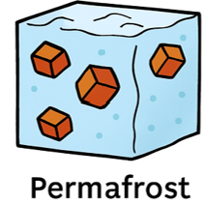
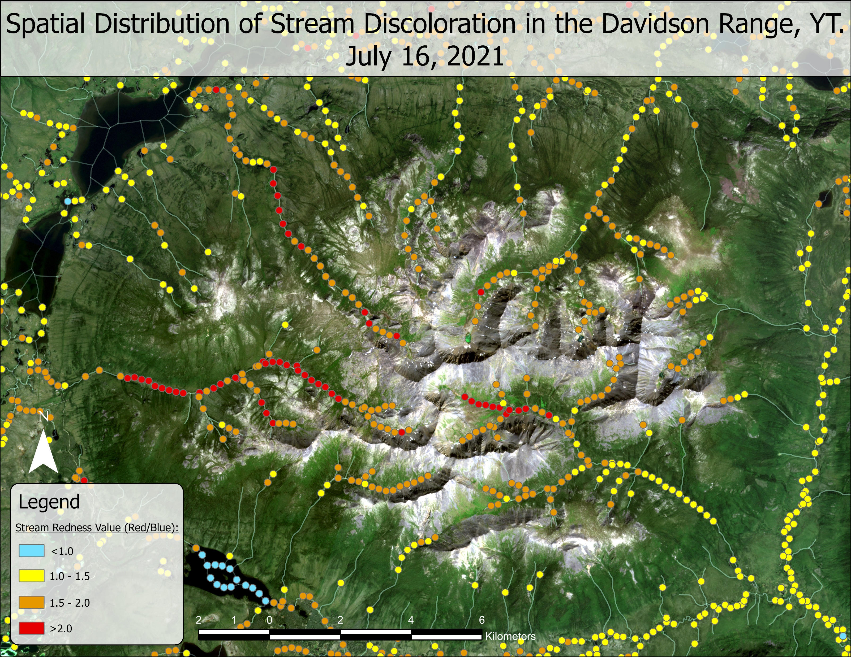
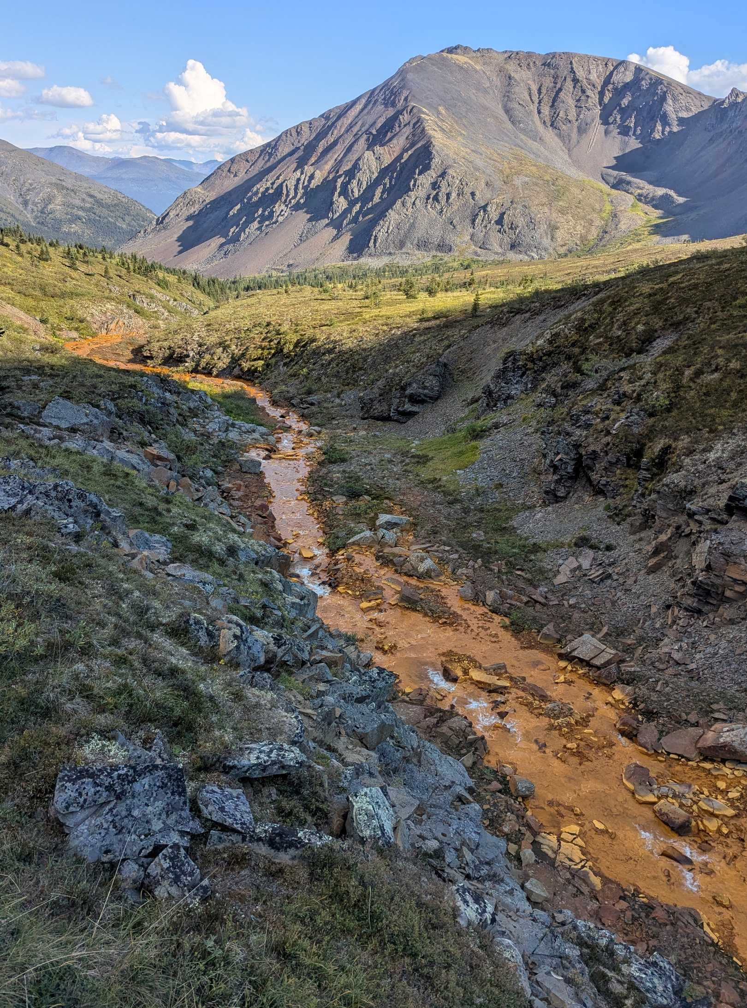
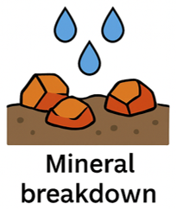
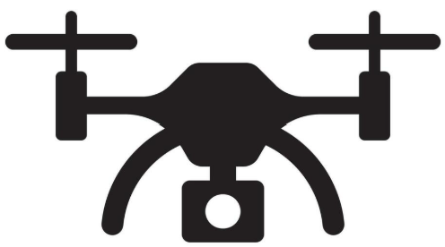
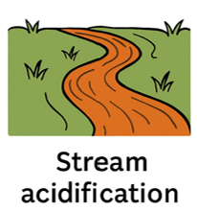
Remote Sensing Techniques for Identifying Acid Rock Drainage
Ben Schellenberg
Supervised by:
Dr. Murray Richardson
Dr. Elliott Skierszkhan
Dr. Koreen Millard
Thaw
Mobilization

