Slide 1

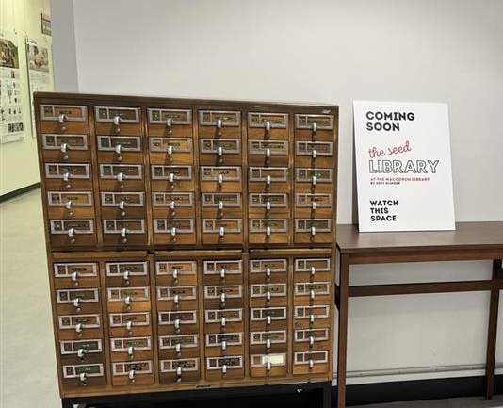

Researching the Implementation of an Academic Seed Library at Carleton University
Interview topics: success factors, constraints and challenges, costs and resources, circulation and return policies, social, ecological, and educational impacts, engagement with equity-deserving groups, and future research needs
Seed library impacts: more food sovereignty, healthy living, and community building.
Healthy relationship with the environment
Joey Slinger, Bachelor of Arts in Environmental Studies
Supervised by Professor Patricia Ballamingie

