Slide 1
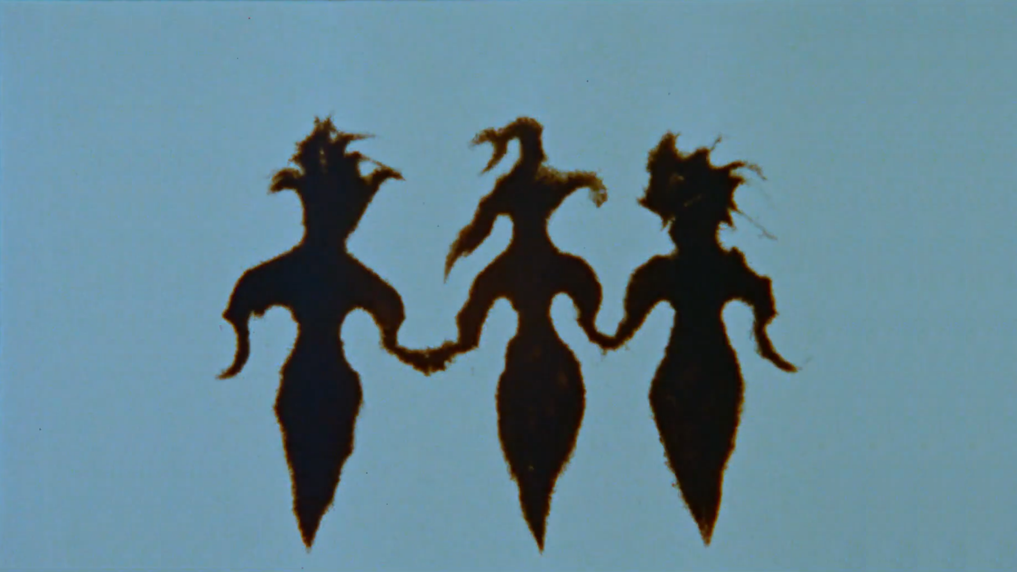
Indigenous Visual Sovereignty and the Right to be Unbodied
Proposition, Dissolution, Revision

