Slide 1

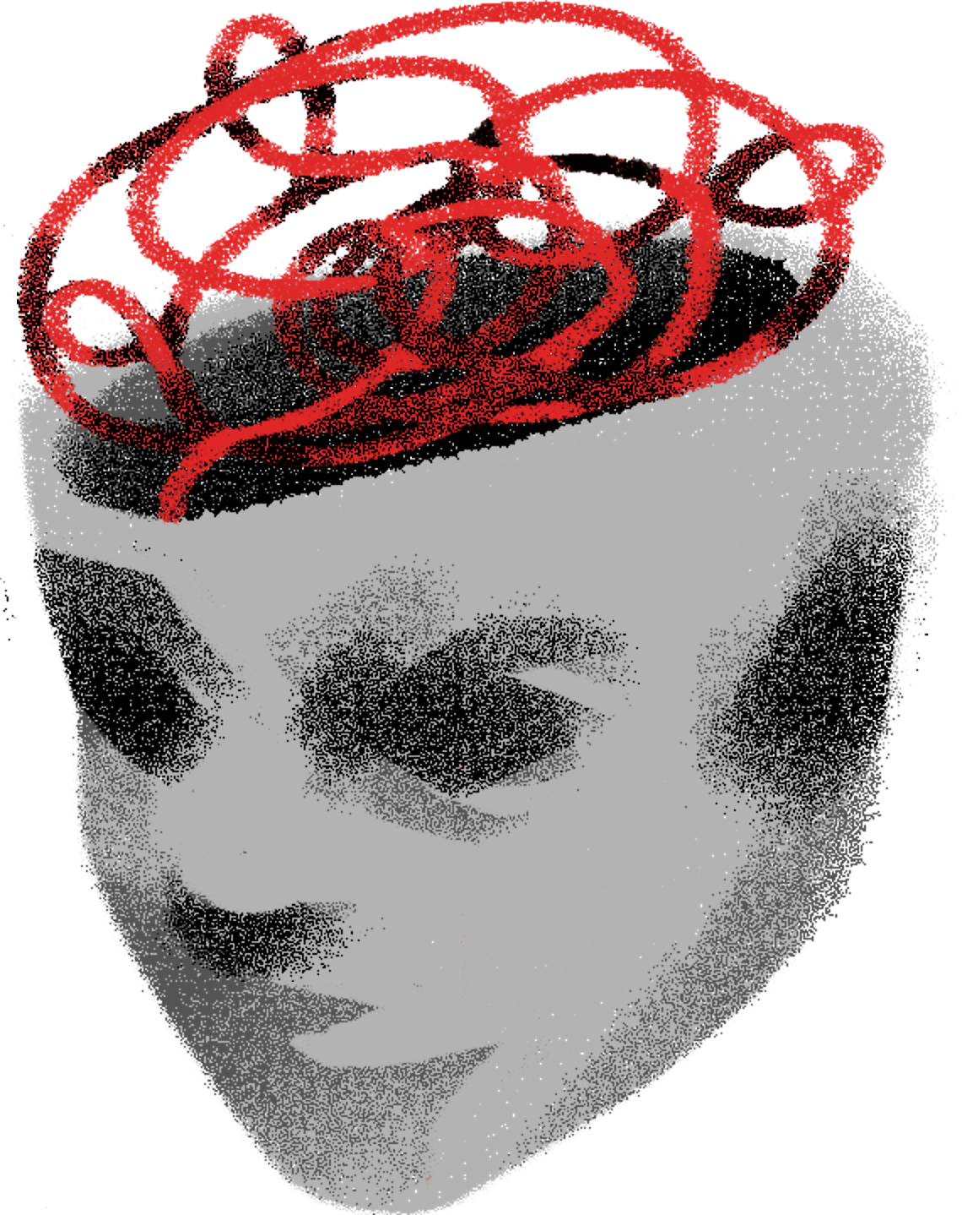
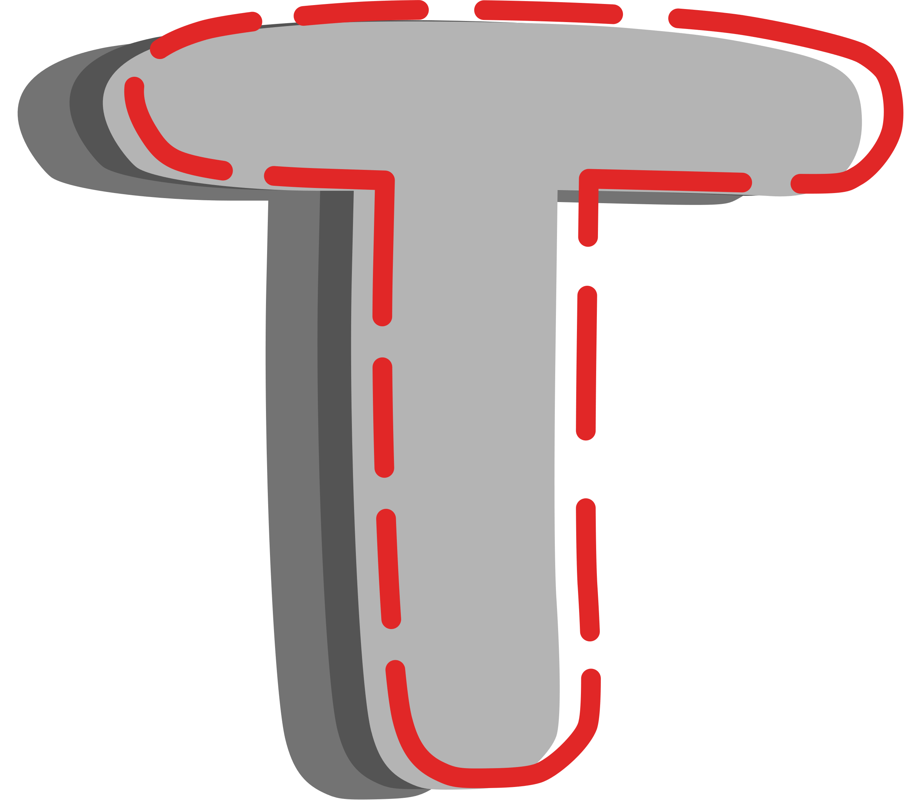
Hormonal Influences on Violent Attitudes:
The Role of Testosterone
Anastasia Weir, supervised by Dr. Kevin Nunes
↑Dominance
↓Self-control
↑Independence
Personality
Testosterone
Violent Attitudes

