Slide 1
Graduate Awards
September 2026

Slide 2
This presentation is meant as a general overview.
Applicants should always refer to the criteria and instructions on the specific award websites. Material on these websites takes precedence over any details discussed in these slides as information can change
year-to-year.
A list of resources will be available at the end of the presentation.

Slide 3
Presentation Overview
Internal Awards
External Awards
• Ontario Graduate Scholarship (OGS)
• Canada Graduate Research Scholarship Programs: CIHR, NSERC, SSHRC
1. Master’s program
2. Doctoral program

Slide 4
Internal Awards
Donor Funded Scholarships:
1. Competitive Donor Funded Awards
2. Department Specific Donor Funded Awards
Criteria:
- Academic merit
- Financial need
- Specific research areas
- Other criteria set by award terms
3. Graduate Research Travel Bursary

Slide 5
Internal Awards
Value: Ranges from a few hundred dollars up to $20,000
Eligibility: Registered full-time in the award term; not eligible if on program extension.
How to Apply to Competitive Donor Funded Awards & the Graduate Research Travel Bursary:
Carleton Central >> Student Services tab >> Awards and Financial Assistance >> Graduate Online Application Forms
*Competitive donor funded award applications are now available online, deadline to apply: October 7, 2026*
How to Apply to Department Specific Awards: Departments will advise, as applicable.

Slide 6
External Awards
Ontario Graduate Scholarship (OGS)
Tri-Council Funding: Canada Graduate Research Scholarship (CGRS), Master’s and Doctoral Programs
1. Social Sciences and Humanities Research Council (SSHRC)
2. Natural Sciences and Engineering Research Council (NSERC)
3. Canadian Institutes of Health Research (CIHR)
→ Please read each agencies’ mandate very carefully to determine which agency you should be applying to. If you are unsure, ask your research supervisor or email Graduate.Awards@carleton.ca

Slide 7
External Awards: General Application Assessment Categories
OGS | CGRS-Master’s | CGRS-Doctoral
Academic excellence (GPA) 40% | Academic excellence (GPA) 50% | Research potential 50%
Academic Excellence (other criteria) 20% | Research potential 30% | Relevant experience and achievements obtained Within and beyond academia 50%
Referee’s reports 10% | Personal Characteristics and Interpersonal Skills 20%
Research proposal and potential 30%

Slide 8
External Awards: Application Adjudication Process
Departments: Applications are first reviewed and ranked by departmental committees before moving forward to the University level committees.
>> University Level: University committees review departmental rankings and prepare both the recommended and alternate (reversion) lists to forward to Graduate Studies.
>> Graduate Studies: Graduate Studies conducts the final review and communicates the results to the funding agency.
All adjudication committee members complete EDI training and are advised to consider special circumstances and apply EDI principles throughout the evaluation process..

Slide 9
Ontario Graduate Scholarship (OGS)
Funding: Province (⅔) + Carleton (⅓)
Value: Up to $15,000 per year
→ distributed at $5,000 per term
Duration: Minimum 2 consecutive terms, (maximum 3 terms)
Availability: Quotas set by Ministry (domestic & international)
Applications: Submit separately to each institution
Note: Master’s students can hold an OGS twice, PhD students can hold an OGS four times; All students cannot exceed a lifetime maximum of six years of government funded awards.

Slide 10
Ontario Graduate Scholarship: Eligibility
Who can apply:
- Canadian citizens, permanent residents, or protected persons
- International students with a valid Ontario study permit (limited awards)
Academic: Minimum 10.0 GPA (A-) in each of the last 2 years (full-time equivalent)
Enrolment: Must be full-time in a graduate program (2027–28)
Other:
- Cannot be in default on Canadian government-sponsored loans
- Cannot be in or going into an extension term
- Cannot hold another external award in the same term as an OGS scholarship

Slide 11
Ontario Graduate Scholarship: How to Apply
Apply Online
- Carleton Central >> Student Services>>Awards & Financial Assistance >>
Graduate Application Forms (only use “Term” filter)
- Undergraduate students can also access
Deadlines
- Student Application: November 16, 2026 by 11:59 PM
- Reference: December 2, 2026
Applicants Notified: April 2026

Slide 12
Canada Graduate Research Scholarship – Master’s Program (CGRS-M)
Offered through all three federal granting agencies:
1. Social Sciences and Humanities Research Council (SSHRC)
2. Natural Sciences and Engineering Research Council (NSERC)
3. Canadian Institutes of Health Research (CIHR)
Value: $27,000
Duration: 12 months
Application Deadline: December 1, 2026, 8:00 PM EST
How to Apply: Via the Research Portal used for all three granting agencies
Results: By April 30, 2026
Other: Up-to-date official transcripts of all undergraduate and graduate studies required; two reference assessments are required

Slide 13
CGRS – Master’s Program
Eligibility overview:
Canadian citizen, permanent resident of Canada, or Protected person.
Must be enrolled in, have applied for or will apply for full-time admission to a graduate program at a Canadian institution with a CGRS-M allocation
- Program must be primarily research-based and require the completion of a thesis, major research project, dissertation, scholarly publication, performance, recital, and/or exhibit that is evaluated through a merit review process; if admission to the research stream occurs after entry to the program, acceptance into that stream must be confirmed before the award can be held.
At Carleton, must have achieved a first-class average, (10.0 GPA (A-)), in each of the last two years of study (full-time equivalent).
Cannot have previously held a CGRS-M scholarship from any of the granting agencies

Slide 14
CGRS-M Eligibility: Months of Study
By December 31, 2026 (year of application):
0–12 months full-time study in:
- Master’s
- Direct-entry PhD (from Bachelor’s)
- Combined Master’s/PhD
- Fast-track Master’s → PhD (no master’s degree conferred)
- Master's program transitioning to an eligible doctoral program before the award ends
OR
4 -12 months of full-time study in an eligible master's program where degree requirements will be completed before award activation, allowing the award to be held during the first 12 months of the subsequent doctoral program.

Slide 15
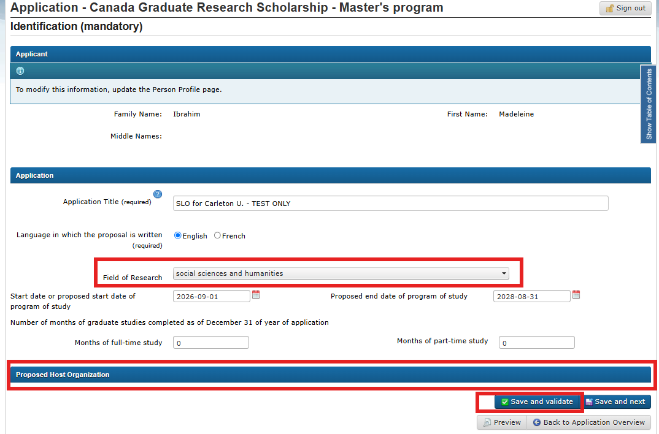
CGRS-Masters Application: Research Portal

Slide 16
Canada Graduate Research Scholarship – Doctoral Program (CGRS-D)
Offered through all three federal granting agencies:
1. Social Sciences and Humanities Research Council (SSHRC)
2. Natural Sciences and Engineering Research Council (NSERC)
3. Canadian Institutes of Health Research (CIHR)
Value: $40,000 per year, up to 36 months
Application Deadline:
SSHRC and CIHR: October 5, 2026 by 11:59 PM EST
NSERC: Sept. 28, 2026 by 11:59 EST
How to Apply: Via each agencies’ application system
Results: By April 30, 2027
Other: Up-to-date official transcripts of all undergraduate and graduate studies required; two reference assessments are required

Slide 17
CGRS - Doctoral Program: Eligibility
Who can apply:
- Canadian citizens, permanent residents, or protected persons
- New: International students that are registered by the application deadline
Months of study:
- Completed no more than 36 months of full-time equivalent study by
December 31,2026, in:
1. Doctoral program
2. PhD portion of a joint professional/PhD program (e.g., MD/PhD, JD/PhD, DVM/PhD)
3. Joint master’s–PhD program (e.g., MA/PhD, MSc/PhD, MBA/PhD.

Slide 18
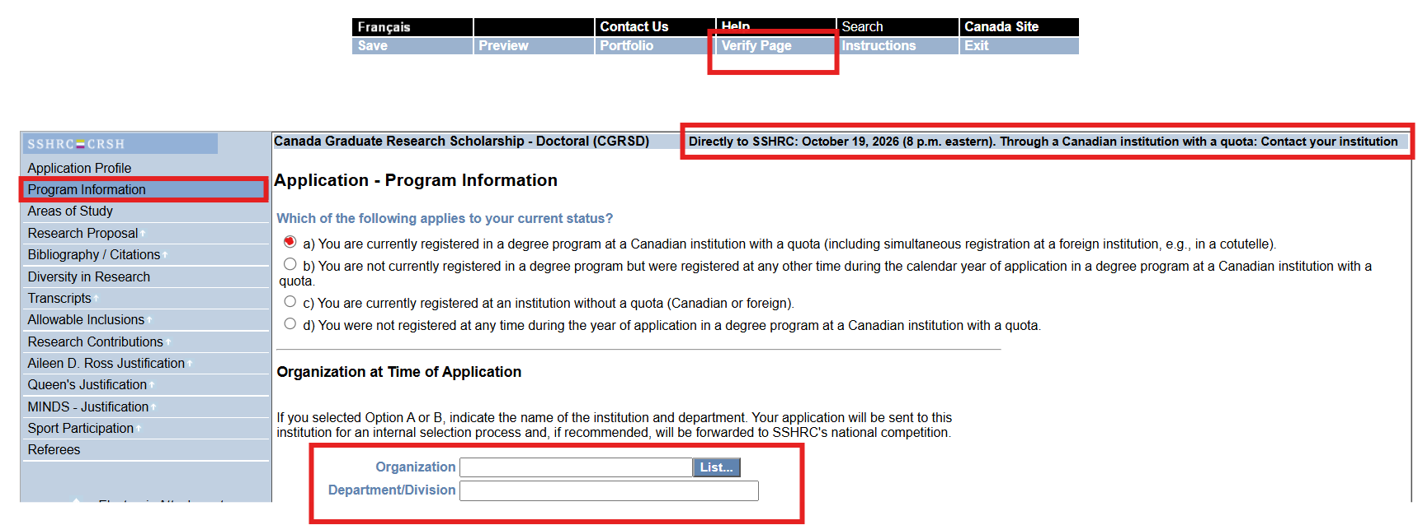
SSHRC CGRS-Doctoral Application Portal View:
CU Deadline: October 5, 2026 (8:00p.m. eastern)

Slide 19
Resources
Name | Link
Ontario Graduate Scholarship (OGS) | https://gradstudents.carleton.ca/ogs/
Canada Graduate Research Scholarship – Masters Program (CGRS-M) Literature Application Instructions | https://nserc-crsng.canada.ca/en/funding-opportunity/canada-graduate-research-scholarship-masters-program https://nserc-crsng.canada.ca/en/canada-graduate-research-scholarship-masters-program-instructions-completing-application
Canada Graduate Research Scholarship – Doctoral Program (CGRS-D) Literature SSHRC Portal SSHRC Application Instructions | https://nserc-crsng.canada.ca/en/funding-opportunity/canada-graduate-research-scholarship-doctoral-program https://webapps.nserc.ca/SSHRC/faces/logon.jsp?lang=en_CA https://sshrc-crsh.canada.ca/en/funding/opportunities/canada-graduate-research-scholarships/doctoral-program/2026/competition/instructions/applicant.aspx
Graduate Awards and Funding | https://gradstudents.carleton.ca/awards-and-funding/
Carleton Central | https://central.carleton.ca/
Contact for Graduate Award Questions | Graduate.Awards@Carleton.ca

Slide 20
Questions?

