Slide 1
Water Allocation and Water Markets in Southern Alberta
Anteneh Belayneh
Carleton School of Public Policy & Administration
March 20, 2018

Slide 2
Outline
Hydrological and Policy context
Water Market
Institutional Analysis
Optimization Model

Slide 3
Hydrological Context
Alberta has only 2.2% of Canada’s renewable freshwater
Southern Alberta receives 500mm in annual precipitation
80% of Alberta’s renewable freshwater is in Northern Alberta
80% of Alberta’s population resides in Southern Alberta
Notes:
Canada has a relative abundance of water, yet southern Alberta is one of the few regions where water scarcity is a enduring and recurring concern
To put the level of precipitation in context, Cape Town, which is running out of water averages 788mm of precipitation/year
One of the few semi-arid climates in Canada with a highly variable climate which contributes to recurring water scaricty

Slide 4
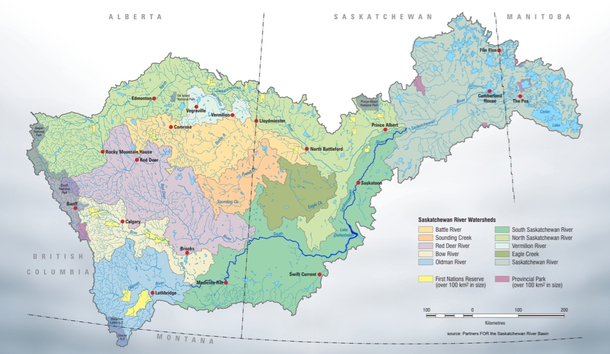
South Saskatchewan River Basin (SSRB)
Irrigation responsible for 75% of consumptive water use and for 75% of water allocations
SSRB accounts for 65% of Canada’s irrigation
13 irrigation districts account for 80% of irrigation water use
Notes:
When talking about southern Alberta, one is inevitably talking about the SSRB.
4 sub-basins: the Bow, Oldman, Red Deer and south Saskatchewan
Climate is variable: drought in 2000, 2001, 2015, maybe 2017
Wet years: 2005, 2013 (Calgary floods)
In three of the four sub-basins there are too many water access rights or water licenses relative to the volume of water flow normally available
Moratorium on new licenses in 3 out of 4 sub-basins

Slide 6
The Policy Context
In drought years there is not enough water in the basin to satisfy all water users
How can water be allocated in the face of increased scarcity and demand?
  Climate change
  New emerging water uses
  Environmental concern
  Developing municipalities
Notes:
A limited resource is allocated on the basis of a priority system
Priority system was designed to address concerns pertaining to settlement in the late 19th century
Concerns that multi-year droughts will make water scarcity acute

Slide 7
Water Allocation in SSRB

Slide 8
The Water Rights Regime
  Prior allocation system – a prior allocation system is a government–controlled system where water rights are issued to users for specific volumes and purposes. Priority among users is also based on first in time, first in right (FITFIR), with priority based on the date of application.
Influenced by legislative developments in Australia and the American West
Development no longer restricted to areas abutting a water source
Notes:
In Alberta, water is allocated using a prior allocation regime
There was a moratoria on the issuance of new license in 2006 due to water being overallocated
This system of water allocation was introduced in 1894 through the NIA
Allowed development away from water sources
Called for the construction of an extensive network of dams, canals and water storage reservoirs
Shifted paradigm of water supply. Land used to determine water use but shifted to where water supply could be brought

Slide 9
Priority System
First in Right, First in Time
Government licensing system
Northwest Irrigation Act (1894)
Appurtenant to land
This allocation regime had the potential to leave junior license holders without water in dry years but also provided an incentive for irrigators to stake their claim early, thereby encouraging rapid development of irrigation
Notes:
The older the license, the higher that user is on the priority list
First licenses are issued to access the full amount of water before newer licenses have access regardless of use

Slide 10
Irrigation development
Water allocation regime was designed to facilitate irrigation
Irrigation was thought to be key to intensive agriculture and settlement
Encourage irrigators to stake claim early
Regime unable to accommodate emerging water uses
Notes:
Encouraged irrigators to stake their claim early
Government objective to develop and settle southern Alberta

Slide 11
Water Allocation over time
1872 – Dominions Lands Act
1894– North-West Irrigation Act
  Eradication of riparian rights and establishment of prior allocation rights where all users had to apply for a license to validate their water use
1931 – Water Resources Act
  Alberta assumes control for water resources
1991 – cap on licensed allocations to irrigation
1999 – Alberta Water Act
  Removal of Appurtenancy
  Water trading introduced for current license holders
2001-2002 – Drought
  Moratorium on the issuing of new licensed allocation in tributaries of Oldman River
2003 – Water for Life Strategy
  Goal of 30% improvement in water use efficiency
2005 – “Over-allocation” of SSRB and no new licenses granted except in Red Deer sub-basin
  Total water license allocations exceeded water flow in the basin

Slide 12
Water Market
203 license transfers as of May 2017
Provincial government can impose a 10% holdback on each transfer for conservation purposes
Lack of secure/defined property rights for water users

Slide 13
Institutional Development & Context

Slide 14
Supply Side Solutions
The establishment of prior allocation encouraged the diversion of water to wherever it could be put to use
Increased the amount of water that could be used and the infrastructure needed to use it.
Location no longer determined water use

Slide 15
Agricultural Coalition and Entrenchment
Irrigation districts, agriculturalists, water managers, engineers and the policy elites
01
Believed that water resources must be harnessed for development purposes
02
By the 1970s the province paid for 86% of irrigation infrastructure
03
From 1970 to 1979, the area of assessed irrigable land in the SSRB grew by 50 per cent, from 279,877 hectares to 419,730 hectares.
04
Notes:
, underpinned large scale water projects and large scale inter-basin transfer proposals, and reinforced the regulatory framework of the Water Resources Act.

Slide 16
Political Context
Irrigation development was regionally concentrated
From 1975-2012 irrigation belt returned PC MLA’s to provincial legislature
Considerable influence of the agricultural coalition
Notes:
A major reason was the political power of irrigators and their supporters in southern Alberta. Irrigators and irrigation dependent communities are concentrated in southern Alberta. This fact has given this coalition considerable electoral influence in the single-member plural electoral system in Alberta. From 1975 to 2012, the irrigation belt consistently returned PC MLAs to the Alberta legislature, giving them strong representation in the party that governed the province continuously from 1971 to 2015
Since irrigation was regionally concentrated, a lack of support or failure to maintain the status quo with respect to water policy would have a disproportionate impact on one part of the province

Slide 17
Institutional Stasis
Institutional structures were change resistant
Backed by powerful coalition with political capital
Continuous expansion of water infrastructure and irrigation

